Slide 1
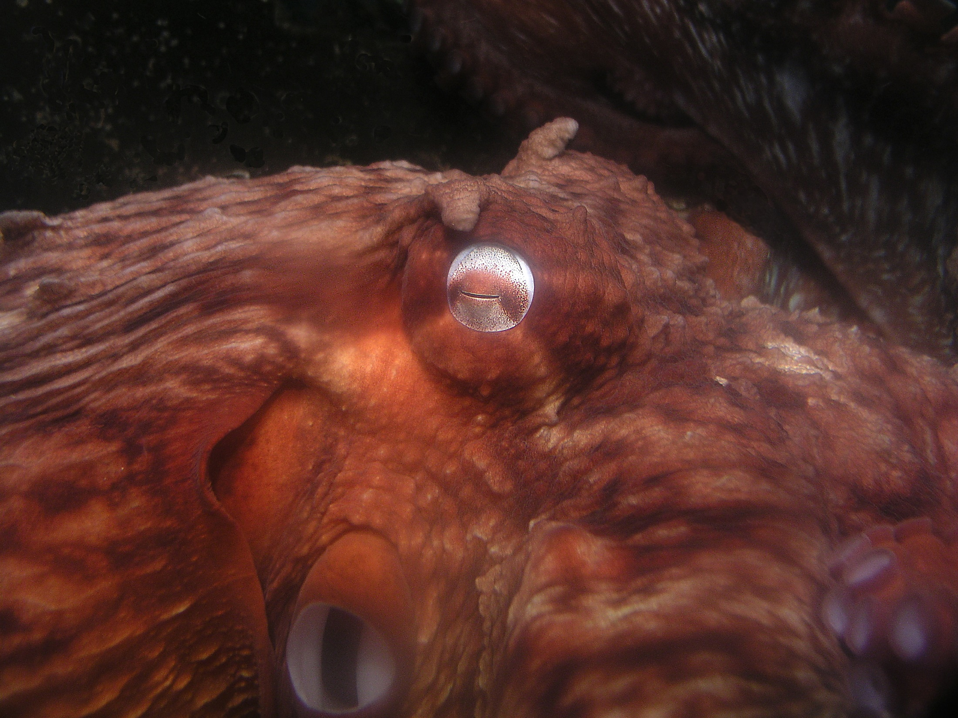

Evolution of Cephalopod Intelligence: a dead end?
Jennifer Mather
Professor of Psychology
University of Lethbridge

Slide 2
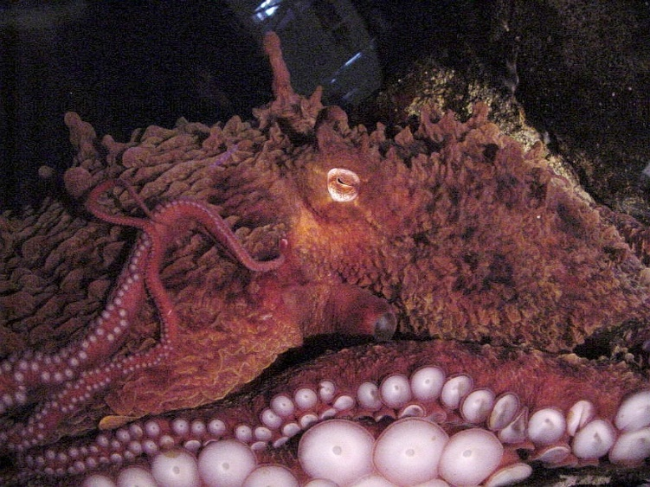
In Support of their Intelligence:
Large centralized brain
But 3/5 of neurons in arms
Excellent Manipulative Capacity
  But much local control in arms

Slide 3
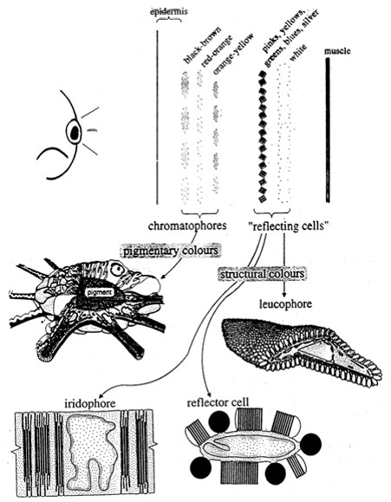
Skin Display System:
LANGUAGE?

Slide 4
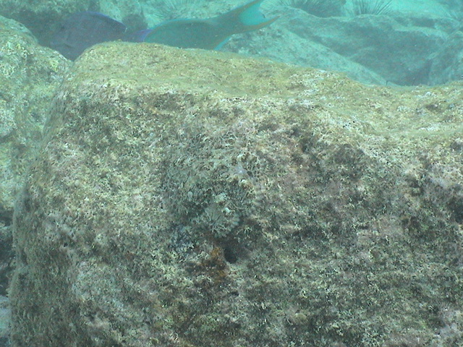
But Used Mainly For Camouflage

Slide 5
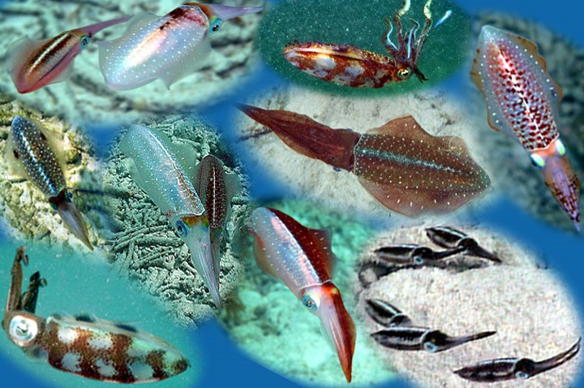
And Sexual signals
Limited
repertoire
Distinct
displays

Slide 6
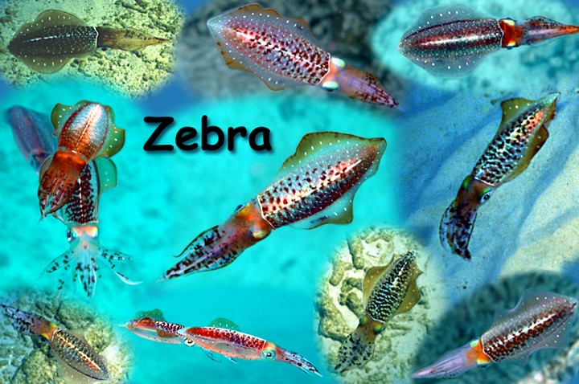
Squid agonistic zebra display
Quantitative by skin area
Directional
Formal contest

Slide 7
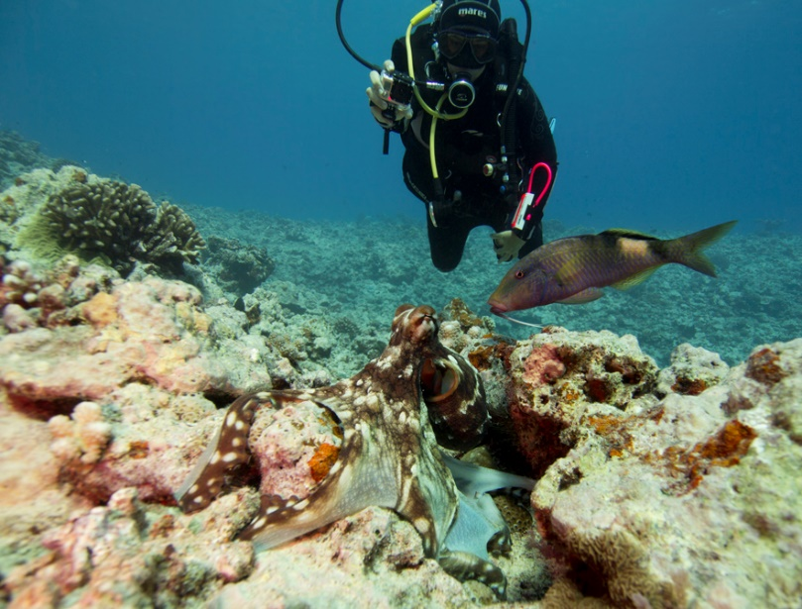
balancing the Value of Intelligence:
Short Lifespan
(6 months – 2 years)
Demanding complex environment

Slide 8
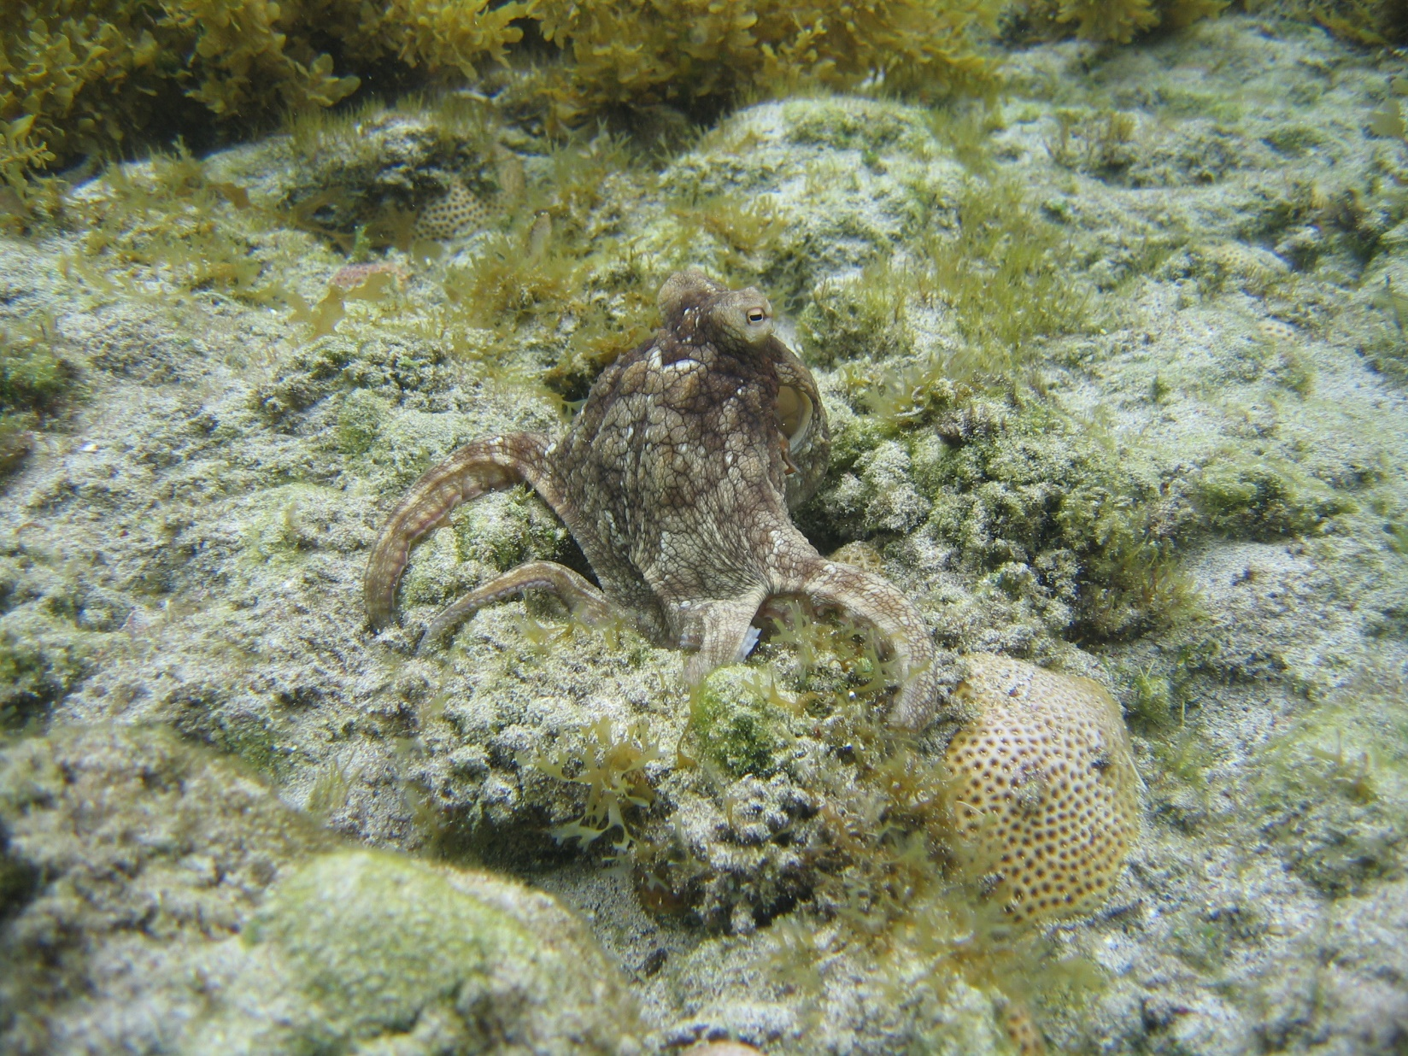
Premium on short retention time
Exploration
Win-switch foraging
Individual variation

Slide 9
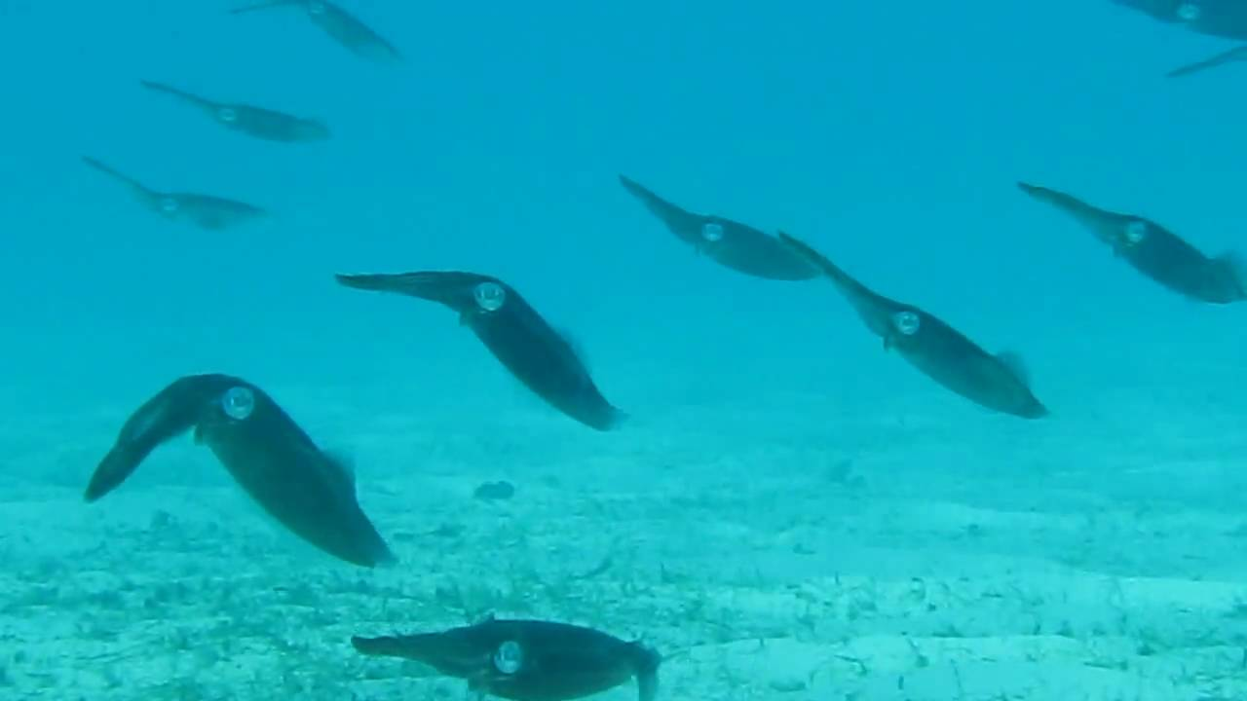
Simple social grouping
Octopus- solitary, hierarchy if crowded
Cuttlefish- gather for mating
Squid- permanent large groups

Slide 10
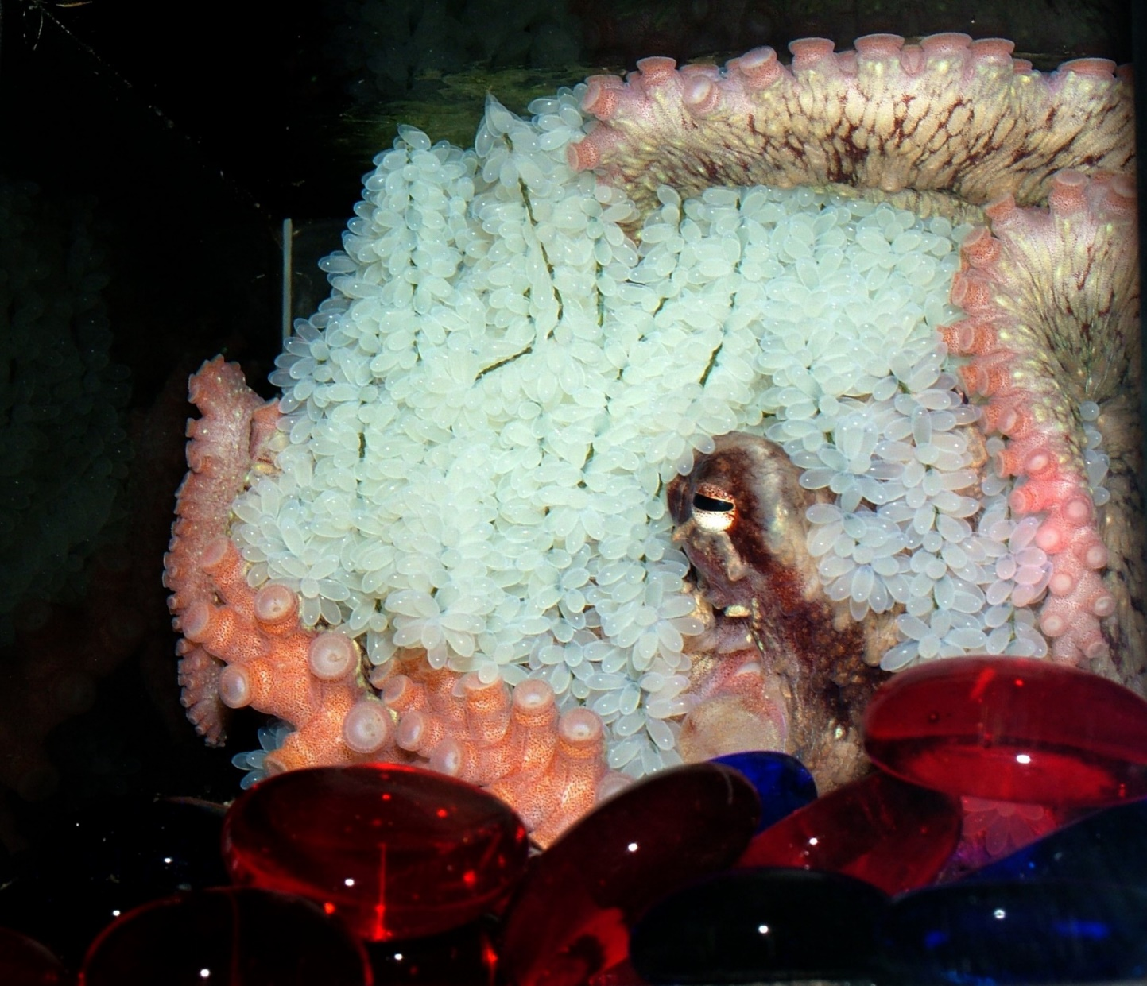
No guidance by parents or conspecifics
No overlap of generations
Wide juvenile dispersal

Slide 11
No Species or Cohort Recognition
Cannibalism in Cephalopods
Christian M. Ibanez • Friedemann Keyl
No cooperation

Slide 12
What Would Have to Change?
Limited dispersal - see big-egged octopuses
Having something more important to say – see squid

Slide 13
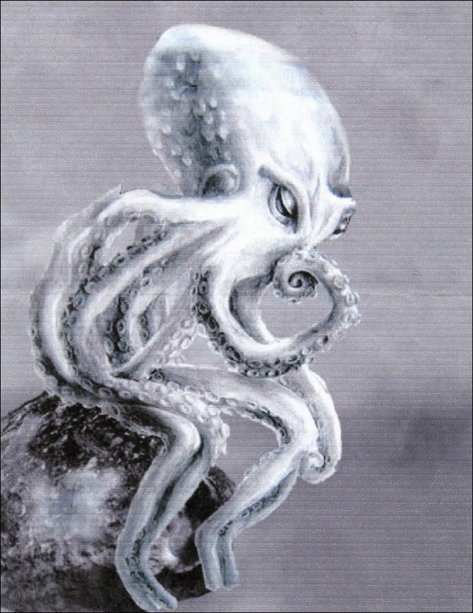
Give them a few millennia

