Slide 1
ME Dept Structure
Department Chair: Prof. Sean Andersson
Administrative staff: Anna Masland (Director), Emery Dutton
Undergrad Assoc Program Chair: Prof Farny
Undergrad Committee: 8 faculty members, 2 ME undergraduates
3 Course Review Panels: All ME-taught required courses
Design; Mechanical Systems; Thermal/fluid
Scheduling Committee: 3 faculty members, Chair, Director

Slide 2
Program Educational Objectives
Within a few years of graduating, our students will…
• Leverage their broad technical, creative, and leadership skillsets to generate and pursue innovative scientific, technical, or business initiatives.
• Uphold the highest ethical standards in the execution of professional roles in the field of mechanical engineering and related disciplines.
• Improve and expand their technical and professional skills through the pursuit of advanced degrees or through informal study.
• Contribute to the betterment of society by promoting a collaborative, diverse, and inclusive culture in the workplace and in their communities.

Slide 3
Registration Information
Sunday April 6th
Make sure to visit your advisor before registration AND settle account
Program planning sheet: https://www.bu.edu/eng/academics/resources/undergraduate-student-resources/eng-undergraduate-degree-requirements/program-planning-sheets/
Advanced electives: 4 ENG 300+ courses
  Natural Science and math 300+: petition process
  SI courses: SI480 and SI482
ME5xx courses: 1st-year graduate, ME senior courses
  Designated seats for ME grads, ME undergrads, concentration electives
Shared lab section times: 3-course sets share a common lab section time
  ME303, ME304, ME305: register for the SAME Cx lab section time slot
  ME302, ME306, ME419: register for the SAME Cx lab section time slot
Concentration: Required course *before* experiential component

Slide 4
Waitlist Process: Through MyBU
When registering for a course:
  Check Seat Restrictions / seat availability by hovering over gray triangle – all ME majors are: B10162 ENGME
  “Admin Reserved” – These seats will be manually filled by staff, please join the waitlist for consideration if necessary.
Begin registering; select to “join the waitlist if the class is full”.
You must request a specific lecture/discussion/lab section. Choose DIS/LAB based on your schedule and seat availability; you can make preferred changes once you get into the course via “Edit Enrollment”.
Request an automatic swap (drop the registered course to enroll in the waitlist request) if you have a schedule conflict with any requested component.
You will be skipped if:
  You have a compliance hold
  You have a schedule conflict
  You requested a full DIS and/or LAB
Ensure you have the pre/co-reqs for the course. Keep in mind student groups with the highest priority (seniors; concentrators; etc.).

Slide 7
ME 460 & ME 461
Fall 2025 & Spring 2026
**check your email!**
March 2025
Senior Design Overview

Slide 8
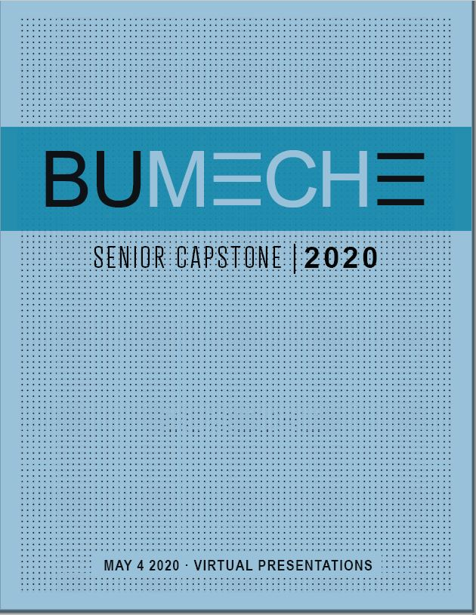
Senior Capstone: ME460 & ME461
A two-semester design experience
  Tentative times:
Monday / Wednesday A1: 4:30 – 6:15
Tuesday / Thursday A2: 3:30 – 5:15
4 Hub Units (WIN, OSC, RIL, DME)
Small teams (3 - 5 people)
Students may propose their own projects
Student project proposals are due by 1 August.
**check your email!**
Notes:
Our approach as capstone instructors has been to focus on achieving realism, in the belief that building on knowledge and skills acquired earlier will follow naturally.

Slide 9
Where Do Projects Come From?
(These categories may overlap)
External: industry/non-profit organizations
Interdepartmental with BME or ECE
BU Student Clubs
BU Faculty Research
Found through Faculty Initiative: 85%
Found through Student Initiative: 15%

Slide 10
About Interdisciplinary Projects
Projects that require skills outside of ME may become Interdisciplinary Projects.
Run from the department with the greatest technical content:
Convergent Interdisciplinary
  Projects are hosted by ME, ECE, or BME
  All team members (ME, ECE, or BME) register in their own department
  All team members attend the class sessions, meet the requirements, and are graded by the host department

Slide 11
You need to be aware that …
ME 302 / 305 / 360 / WR 15X are capstone pre-requisites
ME 408 is co-requisite for aerodynamics-related projects
Some projects have sizeable software content; you may need to teach yourself
Interdisciplinary projects: choose a project that has skills identified outside of ME in the project description.
Teams will be formed according to your project preferences.
Your teammates in ME 460 will be your teammates in ME 461

Slide 12
Register for one lecture section
Monday / Wednesday A1: 10:10 – 11:55
Tuesday / Thursday A2: 1:30 – 3:15
No separate lab or discussion section
All sections will cover the same material

Slide 13
Additional Information
→ Attend the 2025 Capstone Final Presentations on Friday May 2nd!
→ Talk with
  Prof. Tony Linn, Capstone Coordinator
  Members of this year’s senior class (potential carry-forward projects)
  Current capstone instructors
    Prof Gutierrez, Bunch, di Bella, Geiger (for Aero projects)
  See the Capstone Design Orientation site on Blackboard for further instructions, updated project lists and more.
Email communication: critical!

Slide 14
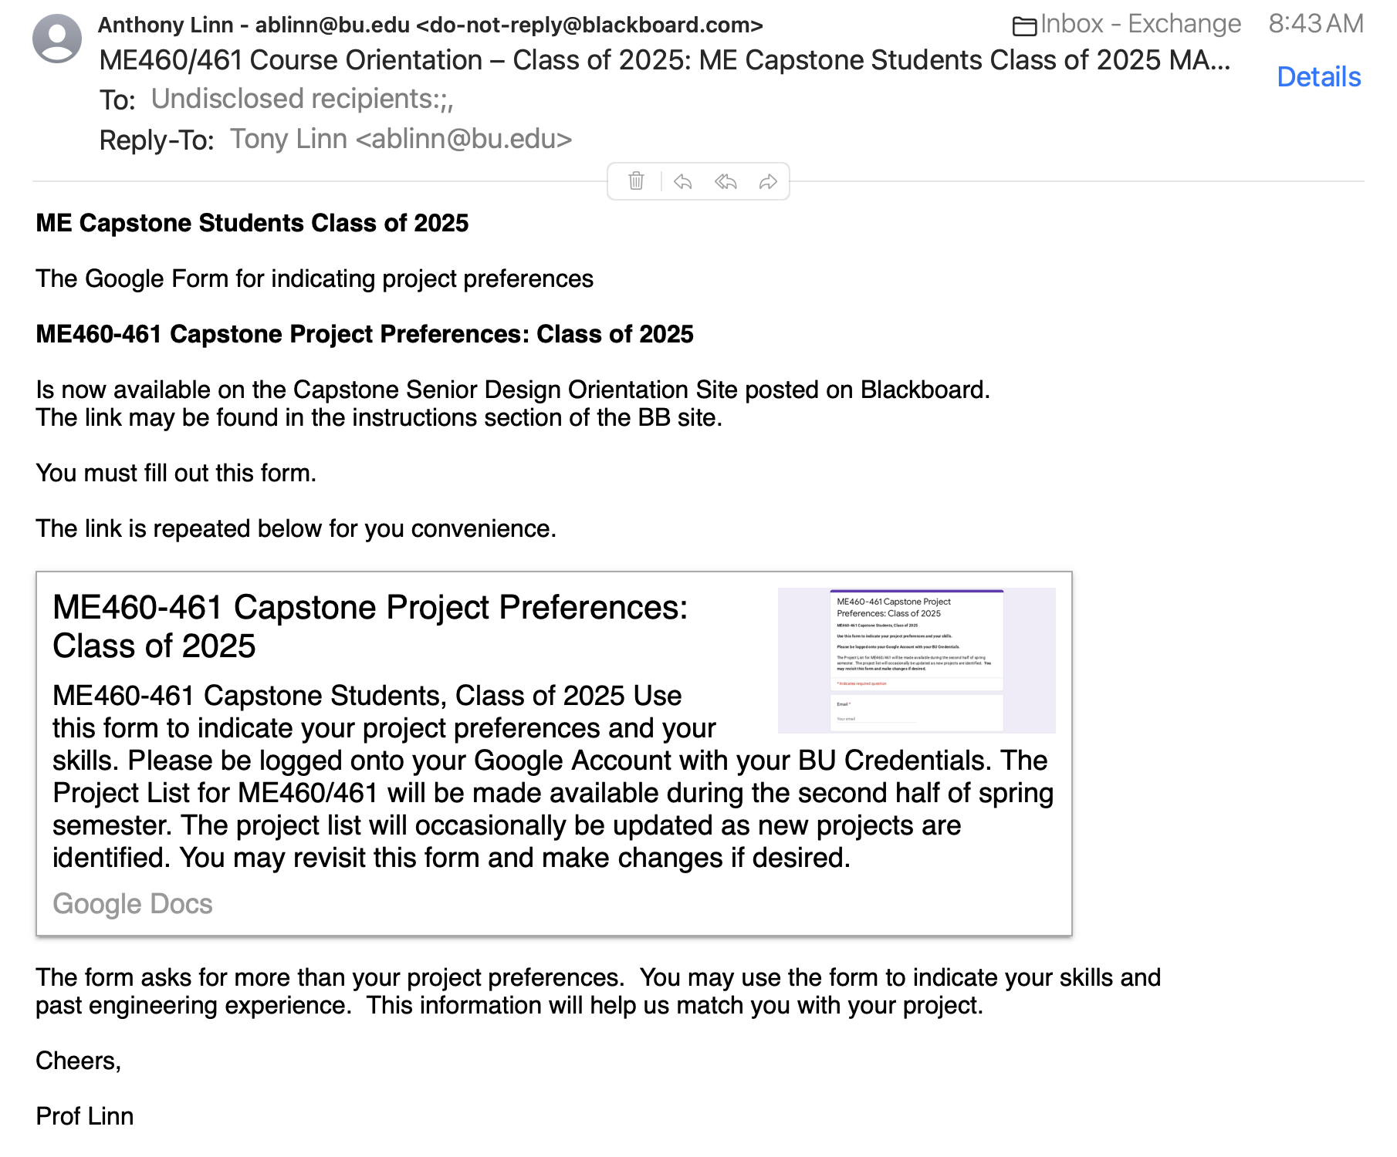

Slide 15
Program Feedback
Concentration: Required course *before* experiential component
Initiatives
CAD:
  Creo replaced by Solidworks
  OnShape: piloted this semester
  Solidworks vs OnShape?

Slide 16
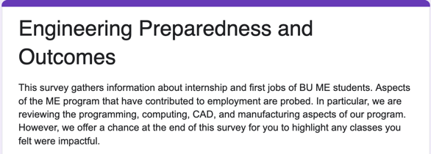
Your Turn!
Program survey:
https://docs.google.com/forms/d/e/1FAIpQLSczFma5etsVH2AS4LXqcCWiJ-7a6SCWcW4oBP8sUibyXeaKxQ/viewform
Feedback?
Concerns?
Initiative support?
Questions?

