Slide 1
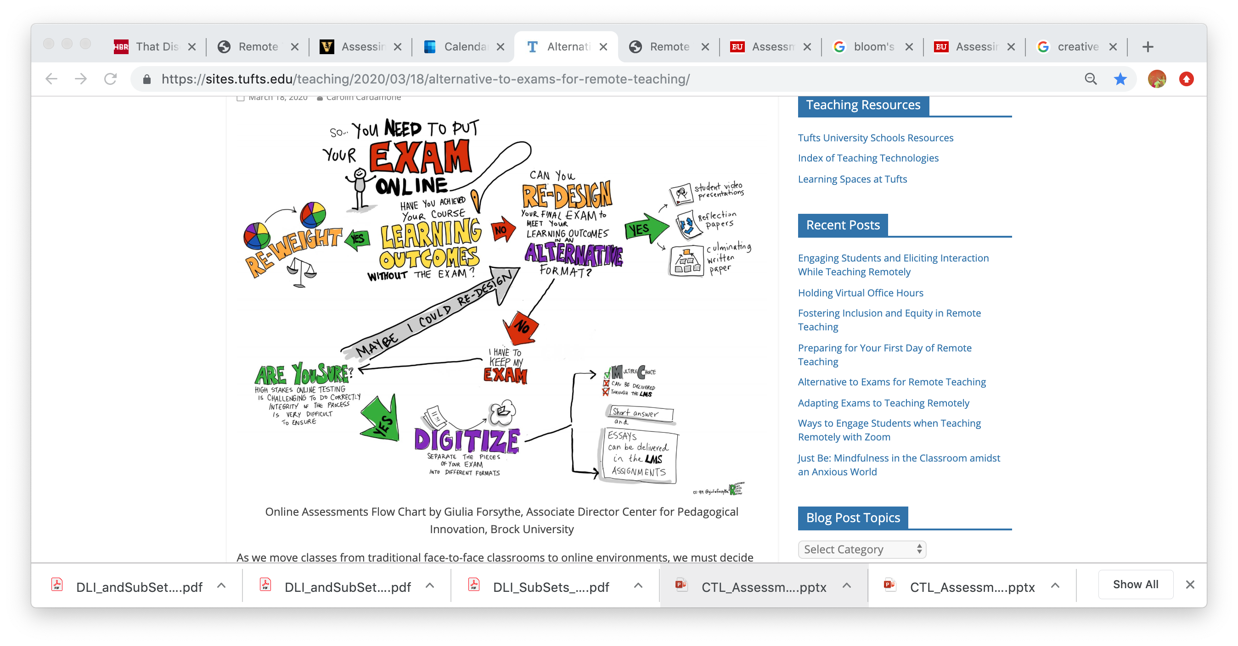

Deciding on Assessment Tasks and Tools
Discussion with RTCs
March 26/27, 2020
Center for Teaching & Learning
Educational Technology

Slide 2
Guiding Principles
Integrity
Transparency
Cognitive Load
Diverse learners
Digital Equity
Scaffolding

Slide 3
Some factors in making decisions
Type of assessment task
Platforms available (e.g. Blackboard) Student responsibility/choice
Synchronous vs asynchronous
Open-book vs closed book
Cost of services Faculty responsibility/choice
Exam security/integrity
Digital equity/access
Time/learning curve for creating assessment Institutional responsibility

Slide 4

Situational questions for faculty
How much time is involved in creating a specific assessment task, including learning about the technology to support it?
What costs are involved with additional technology, including an additional proctoring service?
What kind of support will I need and how do I access it?
How will course, program, school, or institutional decisions about Pass/Fail affect my choice?

Slide 5
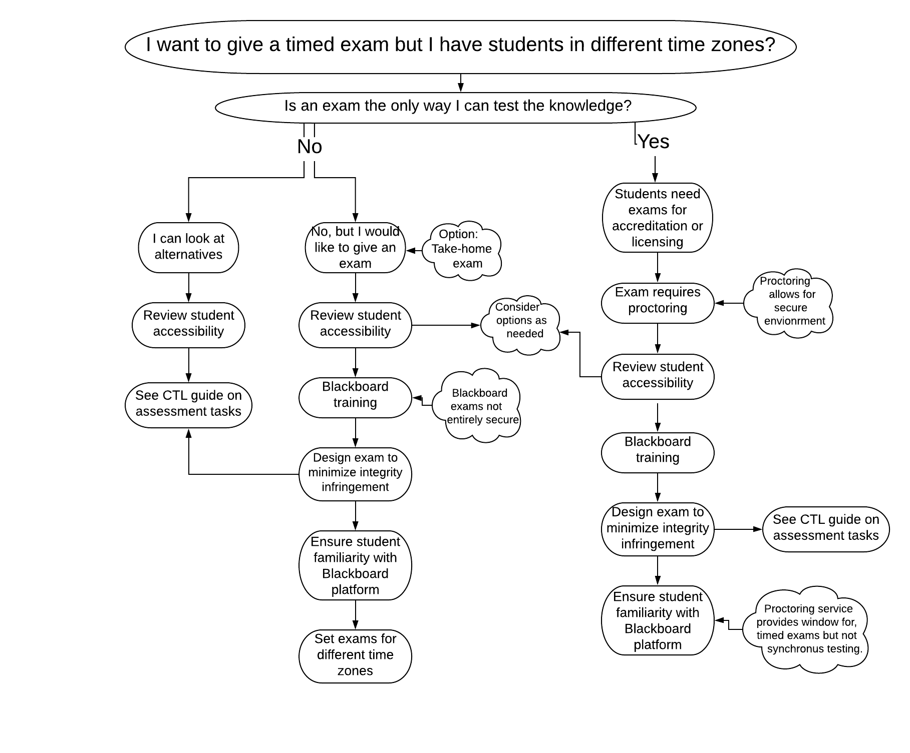
Example of RTC discussion with faculty
Thanks to Chris Greene, CTL, for flowchart

Slide 6
Examining exams…
Individual OR pair/group
Focused time (e.g. 1-2 hrs) OR open window (e.g. 24 hours)
Synchronous OR asynchronous
Closed book OR open-book, notes, other resources
Mode: multiple choice; short or precise answer OR extended analysis and application
Integrity: Institutional oversight OR individual student responsibility
Examining Exams…

Slide 7
Option: Exam with proctoring (*Examity)
Pros | Cons | DL&I Resources and Support
Exam will be a familiar genre so students will generally know what to expect Faculty may already have the exam prepared Exam is timed Exam may draw on secure design principles Visual proctoring helps provide a secure environment | Cost of proctoring service There may be approval process (approval not guaranteed) within your school Exam is not synchronous for all students: each student signs up for a slot on the day of the scheduled exam Faculty time and learning curve to put exam into Blackboard | Guidelines on Online Exam Proctoring Proctor Service Request Form Training in Blackboard, including secure features CTL support for exam design
If your tests and exams are related to pre-professional or professional accreditation or licensure, you may choose to provide an exam with additional proctoring services.

Slide 8
Example costs of Examity
Class Size | 1 hr exam $15.50/student | 1.5-2 hr exam $22/student
20 | $310 | $440
50 | $775 | $1100
75 | $1162.50 | $1650
100 | $1550 | $2200

Slide 9
Process
Contact the Remote Teaching Coordinator (RTC) or Dean’s designee in your school to request approval for online proctoring service (approval is at the discretion of the school)
Prepare your exam in Blackboard; if unfamiliar with creating exams/assignments in Blackboard, sign up for training
Become familiar with online proctoring framework
Ensure that students are able to practice accessing exam in Blackboard; they will also need to create profiles and be aware of any other requirements for the proctoring site ahead of the exam

Slide 10
Option: Timed assessment in Blackboard
Pros | Cons | DL&I Resources and Support
Students are generally familiar with Blackboard Exams can be timed and synchronous Exam design may draw on secure design principles (e.g. randomizing of questions) No additional cost | Faculty time and learning curve to put exam into Blackboard Not a completely secure environment | Training in Blackboard, including secure features CTL support for exam design
A traditional final exam or shorter quizzes may be offered through Blackboard.

Slide 11
Process
Prepare your exam in Blackboard; if unfamiliar with creating exams/assignments in Blackboard, sign up for training
If taking an exam through Blackboard is new for your students, plan a practice session (e.g. a low-stakes quiz) so they know what to expect on the day of the timed-exam.

Slide 12
Option: Alternative assessments
Pros | Cons | DL&I Resources and Support
Smaller spread-out assignments can reduce stress of one large assignment Assessment design can strengthen integrity framework May utilize integrity tools such as Turnitin, depending on task Students may appreciate a different form of assessment | Faculty time to design a different form of assessment Academic integrity relies on assessment design and individual student A different task and/or new technology/tools may increase cognitive load | Training in Blackboard will be helpful, but not essential CTL support for assignment design
Consider other ways that student knowledge may be demonstrated

Slide 13
Process
Consult with your students on possible options for weighting, timing, and format of alternative assessment task/s
Consult with EdTech and CTL as needed for training and support

Slide 14
Options not supported by DL&I
Pros | Cons | DL&I Resources and Support
Exam will be a familiar genre so students will generally know what to expect Faculty may already have the exam prepared Exam is timed and may be synchronous Exam may draw on secure design principles (e.g. randomizing of questions) Visual proctoring helps provide a secure environment | Cost of services, especially for proctoring There may be approval process (approval not guaranteed) within your school Faculty time and learning curve with new platform | These programs are not supported by EdTech; check with your program/school for approval, resources and support CTL support for exam design
Some schools (e.g. Law, Questrom, and Sargent) create their exams using ExamSoft and are now exploring an additional proctoring service, Examplify, to use with ExamSoft.
Other schools (e.g. CAS) are exploring additional platforms such as GradeScope, Goreact, and TopHat.

Slide 15
Process
Check with your Remote Teaching Coordinator for approved access to ExamSoft and the added proctoring service, Examplify; and/or for access to other platforms as needed
If you are approved to use one of these platforms, create at least one opportunity for students to understand how the technology and/or additional proctoring service will work

Slide 16
Resources and Support
For RTCs
Proctor Service Request Form
For Faculty
Guidelines on Online Exam Proctoring
Training in Blackboard, including secure features
Assessment and Remote Teaching
Giving Exams Online: Strategies and Tools (Vanderbilt University)
CTL for advice on assignment design ctl@bu.edu
For Students
Guidelines on Online Exam Proctoring
What other resources and support would be helpful to you and your faculty?
Please put questions and ideas in Chat.

