Slide 1
Climate Change and Its Impacts in Today’s World – and Prospects for the Future
Sea Level Rise and the Future of Coastal Cities
Boston University
14 November 2014

Slide 2
Outline
Context
What do we know, and how do we know?
Implications for the future
Actions for today

Slide 3
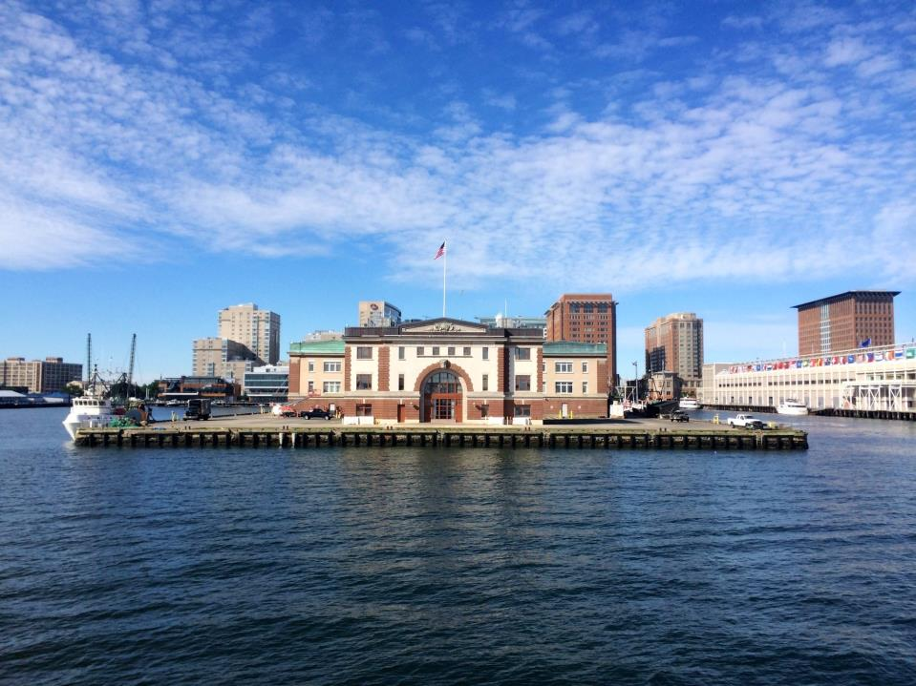
We are a coastal city…

Slide 4
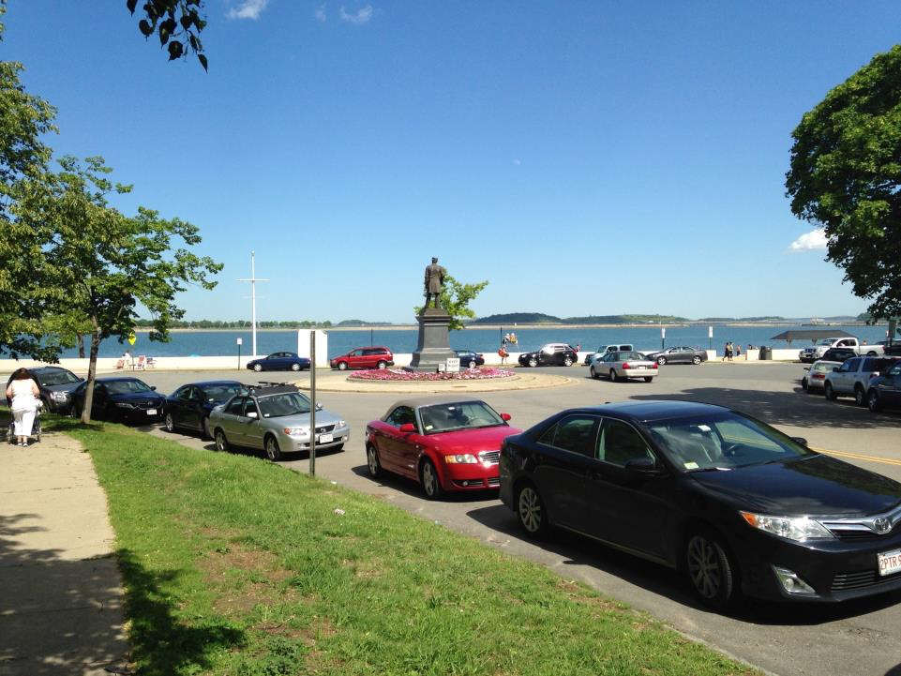
And we are a city of neighborhoods…

Slide 5
Why Does This Matter?
Because the global environmental changes about which we are rightly concerned have immediate local implications
As well as implications for decades to come
Are quality of life issues for residents and the entire region
Do not have the luxury to ignore what the facts tell us, or the experiences of others
Recognize that we are collectively managing risks even as we seek to understand more

Slide 6
A Long History
For over 25 years in the US, the federal government agencies have collaborated on all the fields of climate science
For the past 15, we have published our assessments of the state of the science regarding impacts in the US
Paralleling the international scientific assessment process
Where have we been, and where are we now in our understanding?

Slide 7
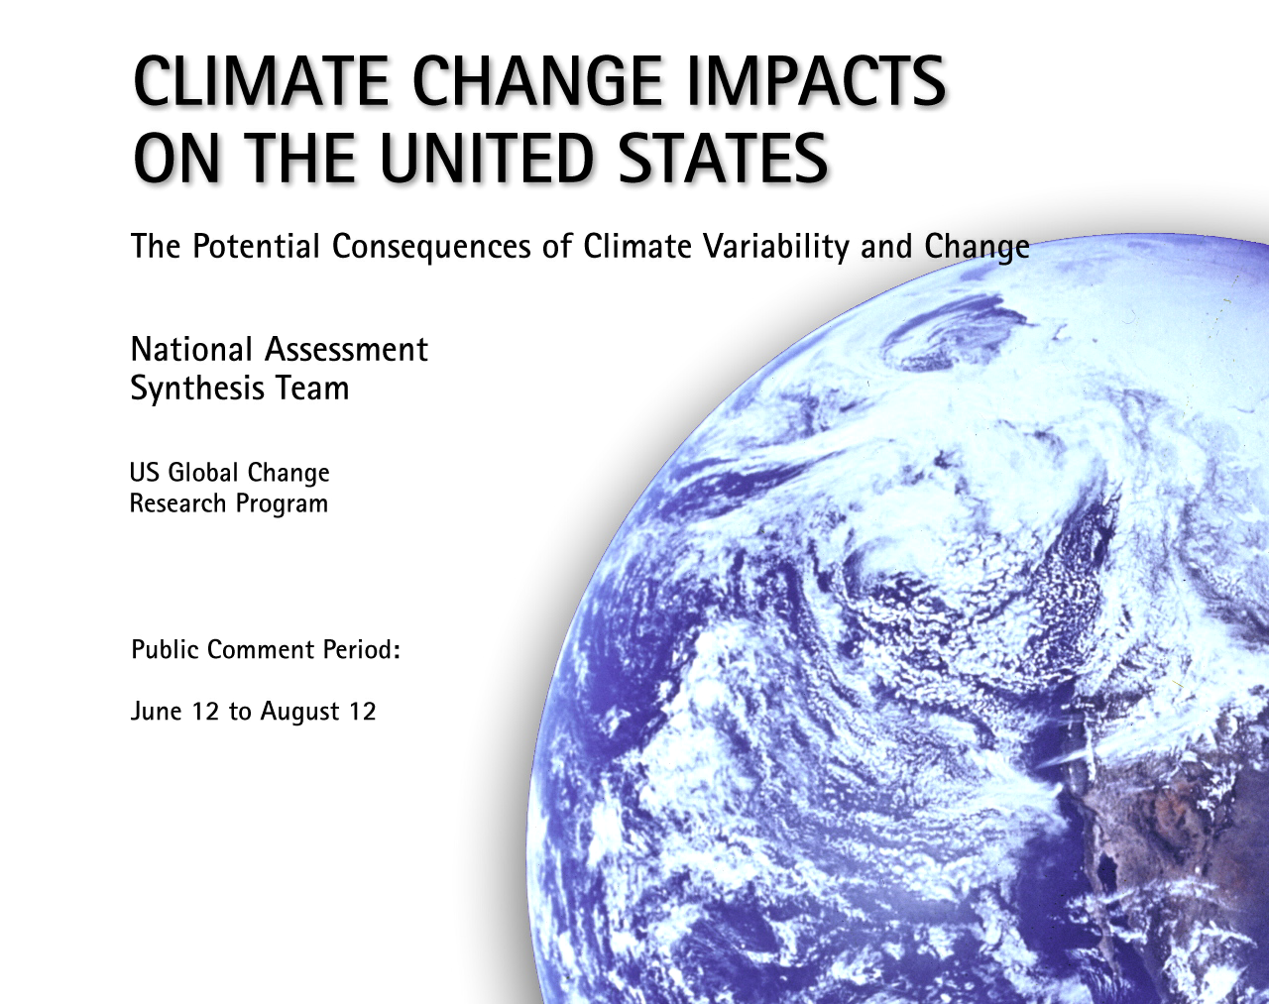
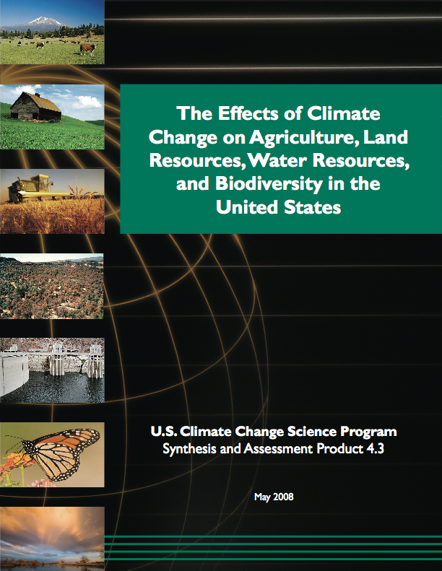
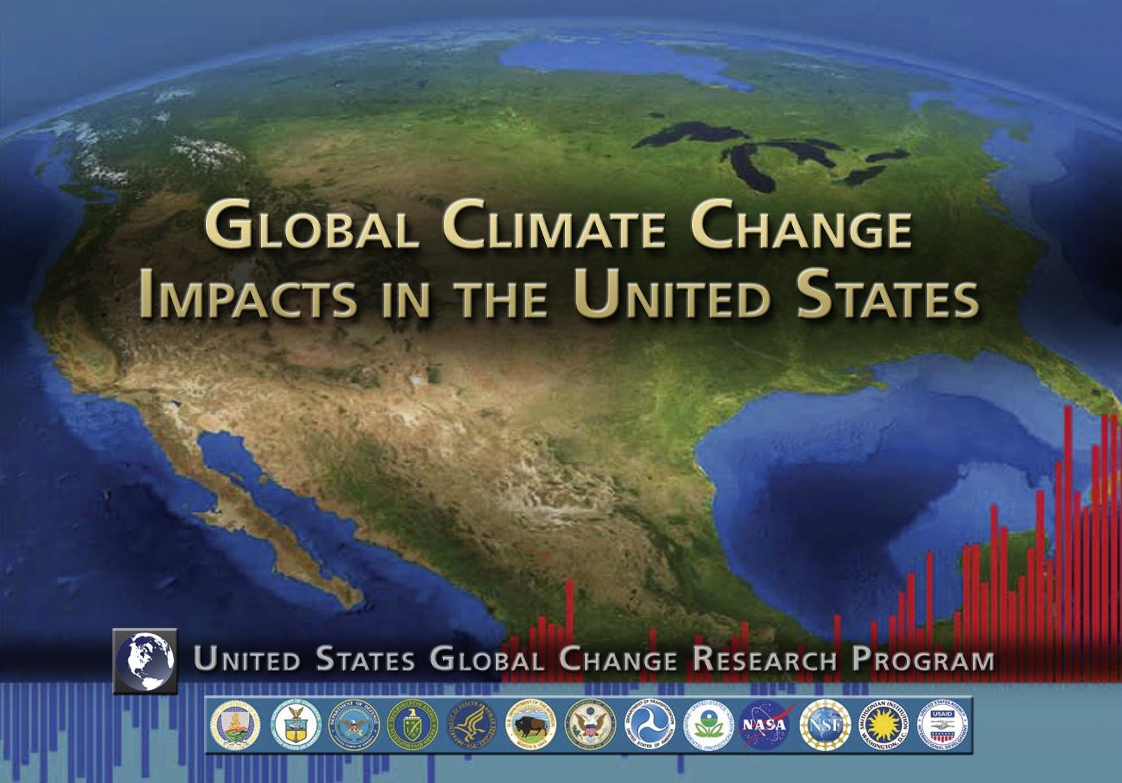

A History of US Assessments

Slide 8


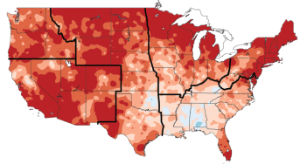
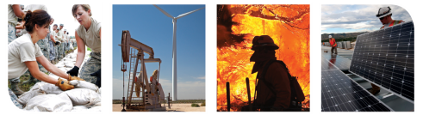
Climate Change Impacts in the United States
Third National Climate Assessment

Slide 9
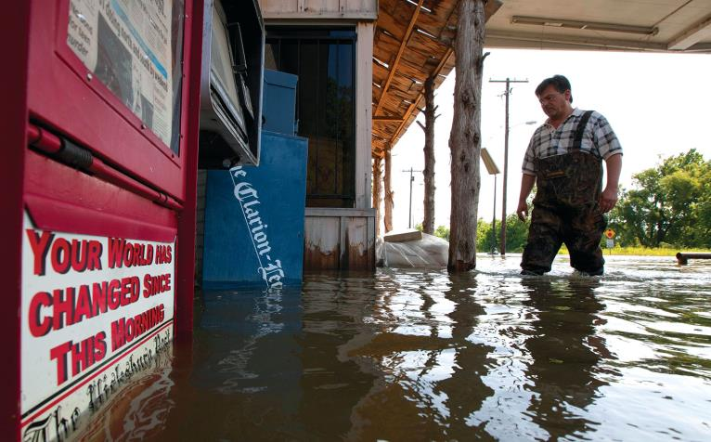
Human-induced climate change has moved firmly into the present.
© Dave Martin/AP/Corbis

Slide 10
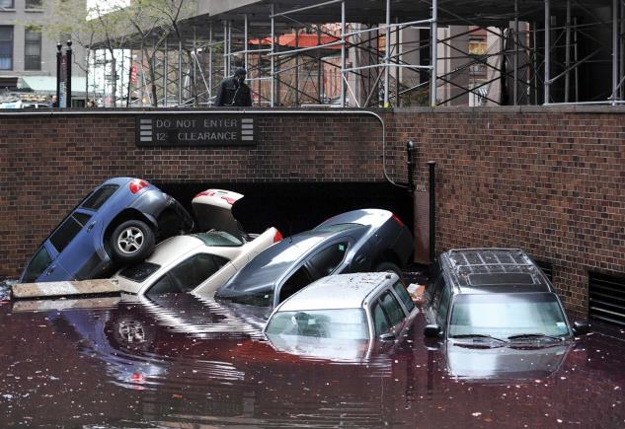
Americans are already feeling the effects of increases in some types of extreme weather and sea level rise.
© Stan Honda/AFP/Getty Images

Slide 11
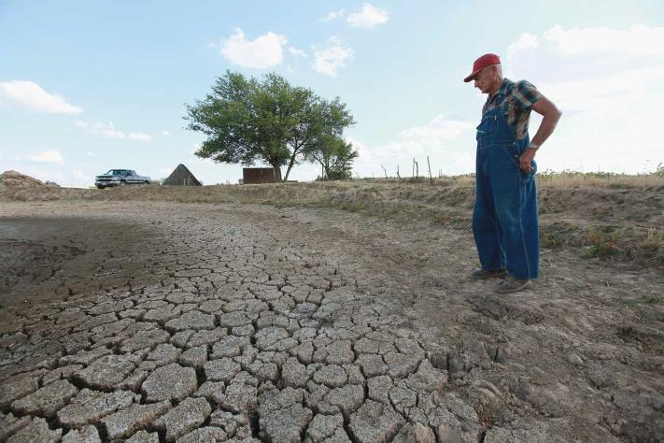
Impacts are apparent in every region and in important sectors including health, water, agriculture, energy, and more.
© Scott Olson/Getty Images

Slide 12
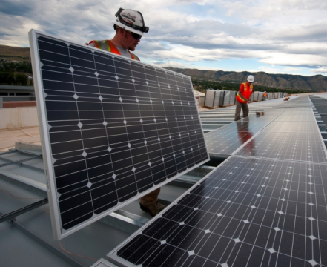
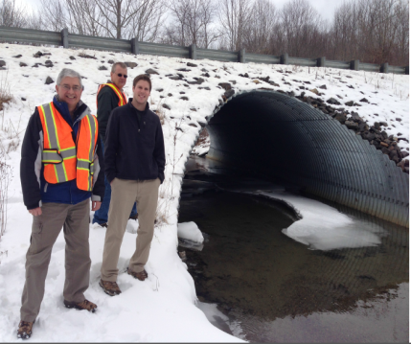
There are many actions we can take to reduce future climate change and its impacts and to prepare for the impacts we can’t avoid.
©Esperanza Stancioff, UMaine Extension and Maine Sea Grant
©Dennis Schroeder, NREL

Slide 13
The World is Warming
Numerous independent lines of evidence demonstrate that warming has continued.
Because human-induced warming is super-imposed on a naturally varying climate, rising temperatures are not evenly distributed across the globe or over time.

Slide 14
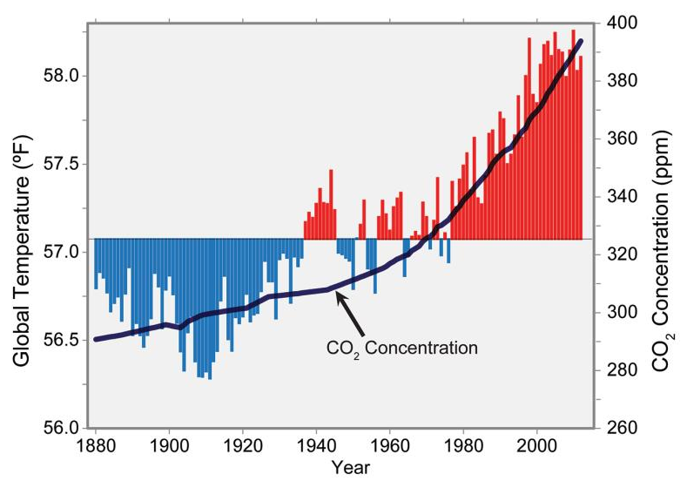
Global Temperature and Carbon Dioxide
Notes:
Global annual average temperature (as measured over both land and oceans) has increased by more than 1.5°F (0.8°C) since 1880 (through 2012). Red bars show temperatures above the long-term average, and blue bars indicate temperatures below the long-term average. The black line shows atmospheric carbon dioxide (CO2) concentration in parts per million (ppm). While there is a clear long-term global warming trend, some years do not show a temperature increase relative to the previous year, and some years show greater changes than others. These year-to-year fluctuations in temperature are due to natural processes, such as the effects of El Niños, La Niñas, and volcanic eruptions. (Figure source: updated from Karl et al. 2009¹).

Slide 15
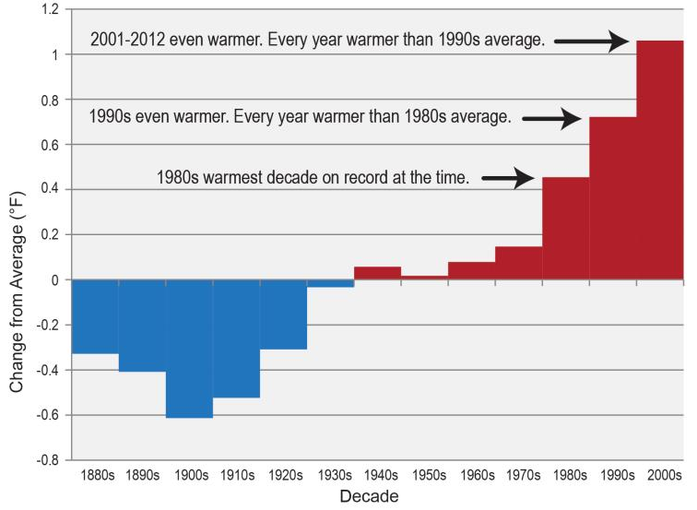
Temperature Change by Decade
Notes:
The last five decades have seen a progressive rise in the Earth’s average surface temperature. Bars show the difference between each decade’s average temperature and the overall average for 1901-2000. (Figure source: NOAA NCDC).

Slide 16
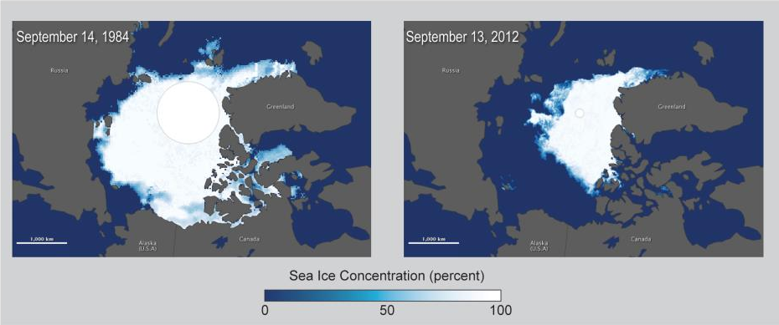
Arctic Sea Ice Decline
Notes:
The retreat of sea ice has occurred faster than climate models had predicted. Image on left shows Arctic minimum sea ice extent in 1984, which was about 2.59 million square miles, the average minimum extent for 1979-2000. Image on right shows that the extent of sea ice had dropped to 1.32 million square miles at the end of summer 2012. The dramatic loss of Arctic sea ice increases warming and has many other impacts on the region. Marine mammals including polar bears and many seal species depend on sea ice for nearly all aspects of their existence. Alaska Native coastal communities rely on sea ice for many reasons, including its role as a buffer against coastal erosion from storms and as a platform for hunting. (Figure source: NASA Earth Observatory 2012).

Slide 17
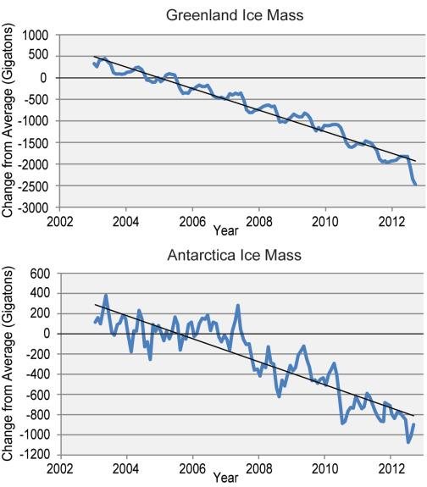
Ice Loss from the Two Polar Ice Sheets
Notes:
Satellite measurements show that both Greenland and Antarctica are losing ice as the atmosphere and oceans warm. Melting of the polar ice sheets and glaciers on land add water to the oceans and raise sea level. How fast these two polar ice sheets melt will largely determine how quickly sea level rises. (Figure source: adapted from Wouters et al. 2013).

Slide 18
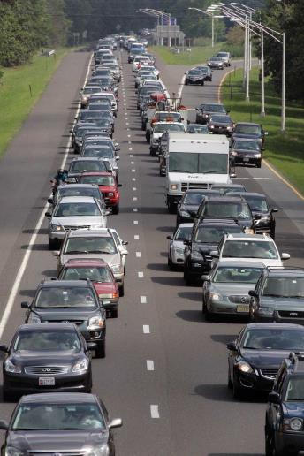
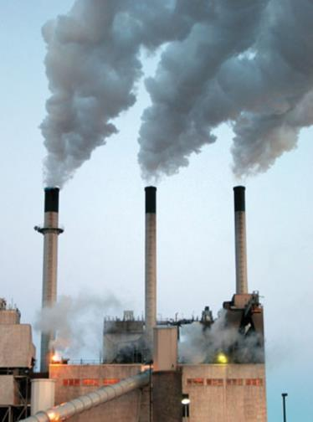
Human activity is the primary cause
©Tom Mihalek/Reuters/Corbis
© Phillip J. Redman, U.S. Geological Survey

Slide 19
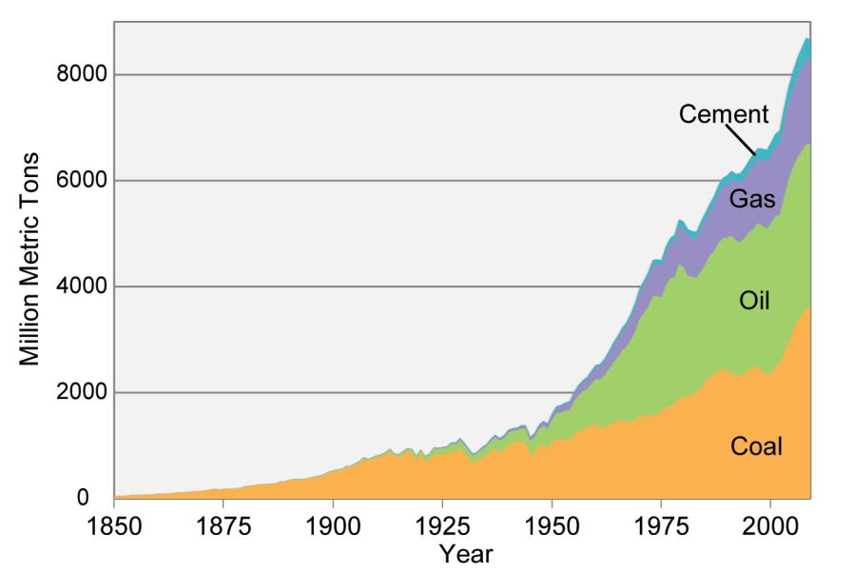
Carbon Emissions in the Industrial Age
Notes:
Carbon emissions from burning coal, oil, and gas and producing cement, in units of million metric tons of carbon. These emissions account for about 80% of the total emissions of carbon from human activities, with land-use changes (like cutting down forests) accounting for the other 20% in recent decades. (Data from Boden et al. 2012¹⁵).

Slide 20
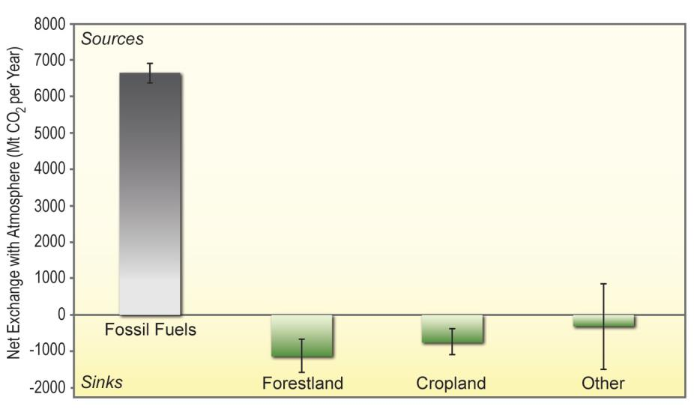
Major North American CO₂ Sources and Sinks
Notes:
The release of carbon dioxide from fossil fuel burning in North America (shown here for 2010) vastly exceeds the amount that is taken up and temporarily stored in forests, crops, and other ecosystems (shown here is the annual average for 2000-2006). (Figure source: King et al. 2012⁴).

Slide 21
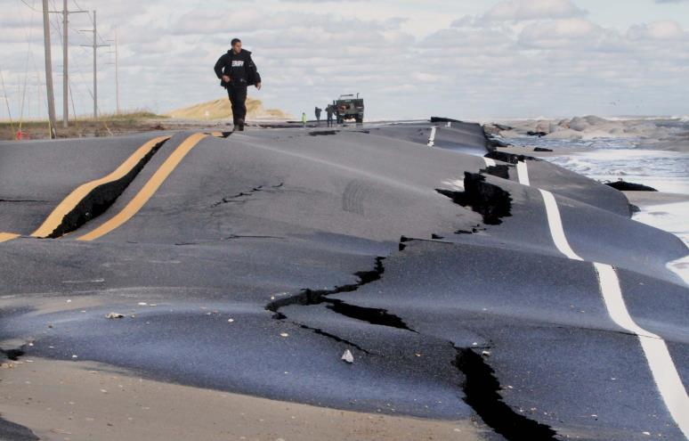
Impacts Are Already Widespread
©AP Photo/The Virginian-Pilot, Steve Earley

Slide 22
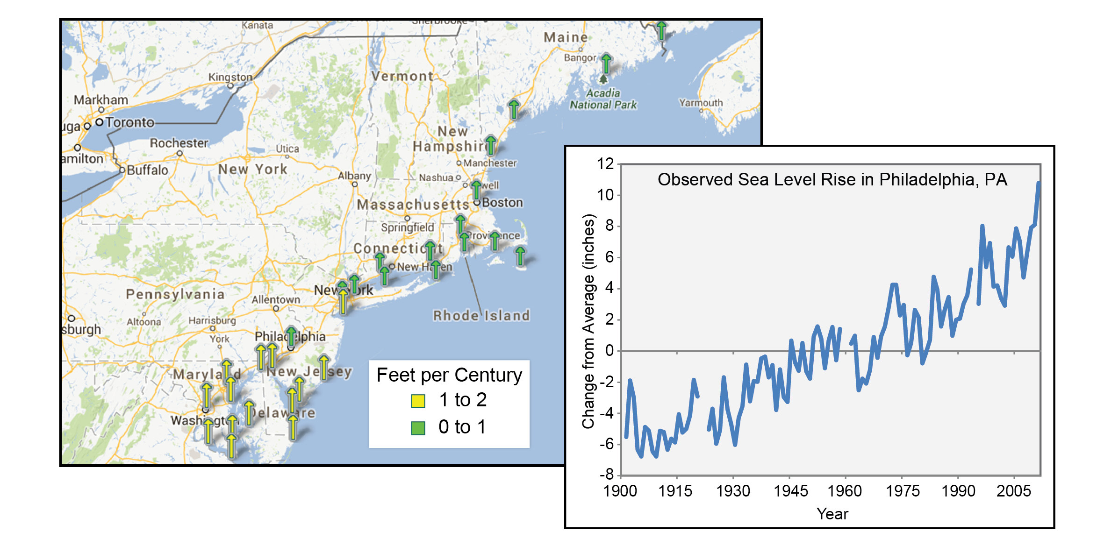
Sea Level is Rising
Data from Permanent Service for Mean Sea Level
Notes:
Figure 16.1: Local sea level trends in the Northeast region. Length of time series for each arrow varies by tide gauge location. (Figure source: NOAA1). (Graph) Observed sea level rise in Philadelphia, PA, has significantly exceeded the global average of 8 inches over the past century, increasing the risk of impacts to critical urban infrastructure in low-lying areas. Over 100 years (1901-2012), sea level increased 1.2 feet (Data from Permanent Service for Mean Sea Level).

Slide 23
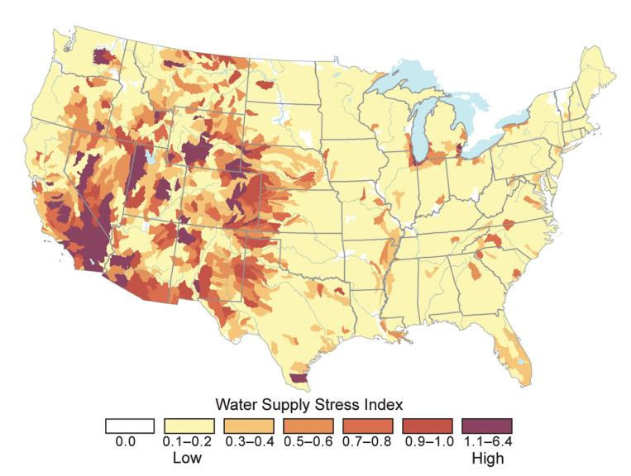
Water Stress in the U. S.
Notes:
In many places, competing demands for water create stress in local and regional watersheds. Map shows a “water supply stress index” for the U.S. based on observations, with widespread stress in much of the Southwest, western Great Plains, and parts of the Northwest. From an energy production and demand context, watersheds are considered stressed when water demand from agriculture, power plants, and municipalities exceeds 40% of available supply. This often causes conflict for water resources among sectors. In other contexts, many basins experience critical stresses far below this threshold. (Figure source: Averyt et al. 2011³).

Slide 24
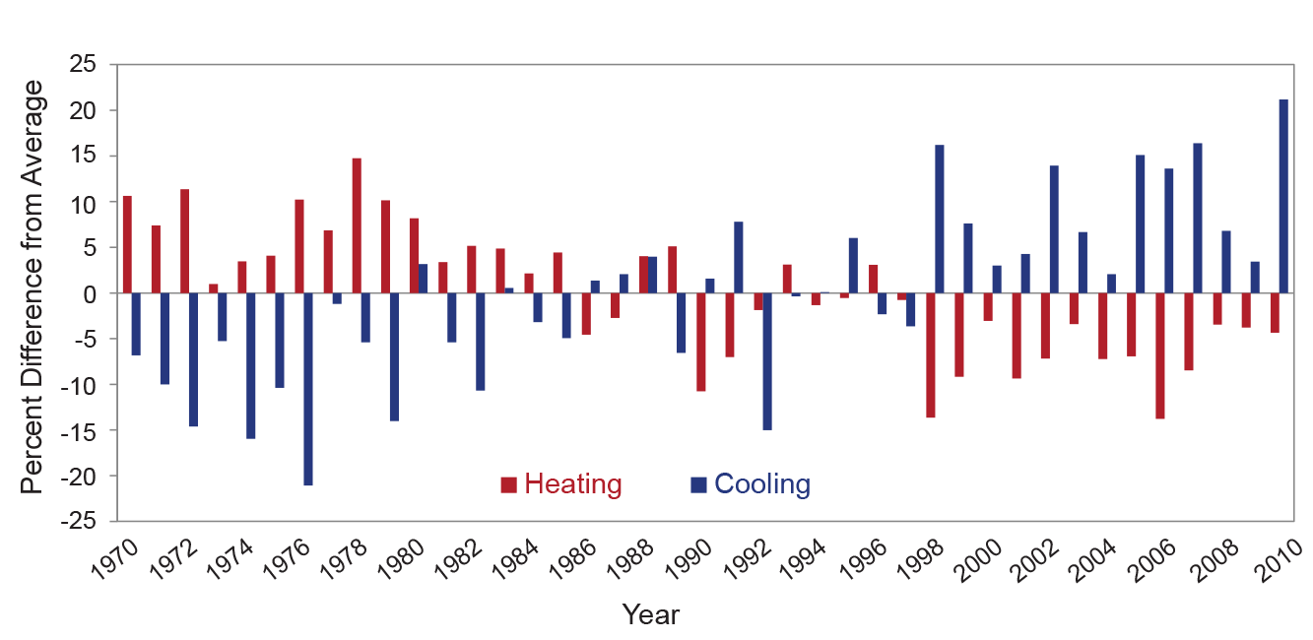
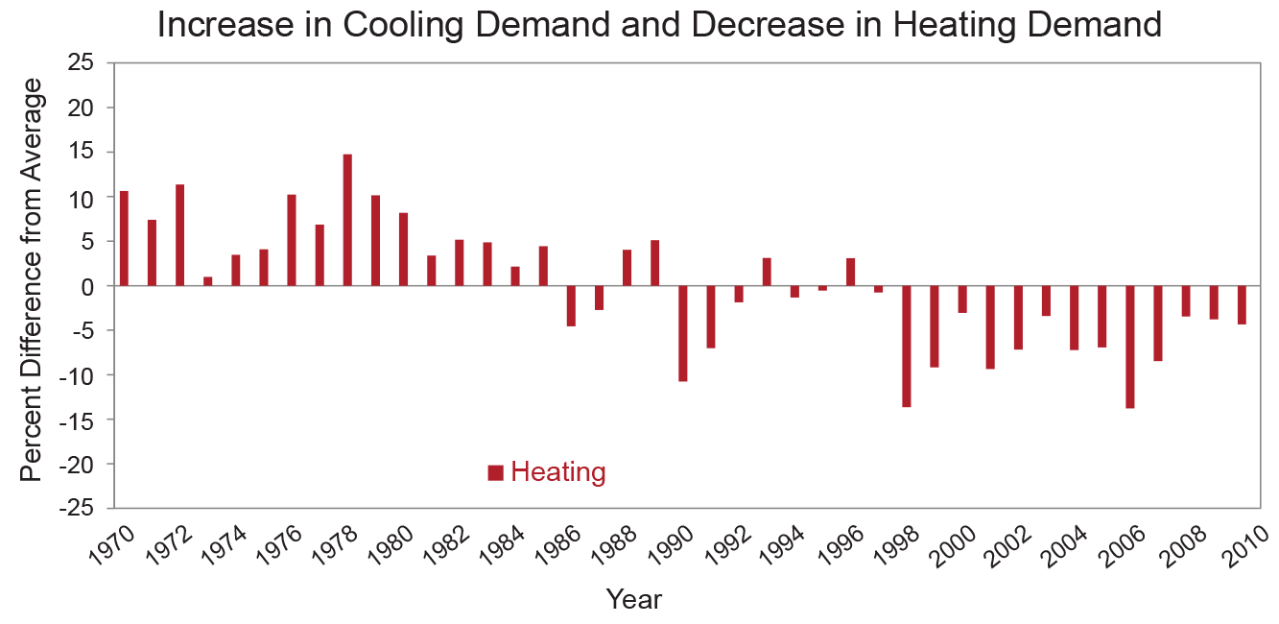
Increase in Cooling Demand and Decrease in Heating Demand
Notes:
The observed increase in cooling energy demand has been greater than the decrease in heating energy demand. Figure shows observed increases in population-weighted cooling degree days, which result in increased air conditioning use, and decreases in population-weighted heating degree days, meaning less energy required to heat buildings in winter, compared to the average for 1970-2000. Cooling degree days are defined as the number of degrees that a day’s average temperature is above 65ºF, while heating degree days are the number of degrees a day’s average temperature is below 65ºF. (Data from EIA 2008, 2009; U.S. Department of Energy 2012; and NOAA NCDC 2012⁸).

Slide 25
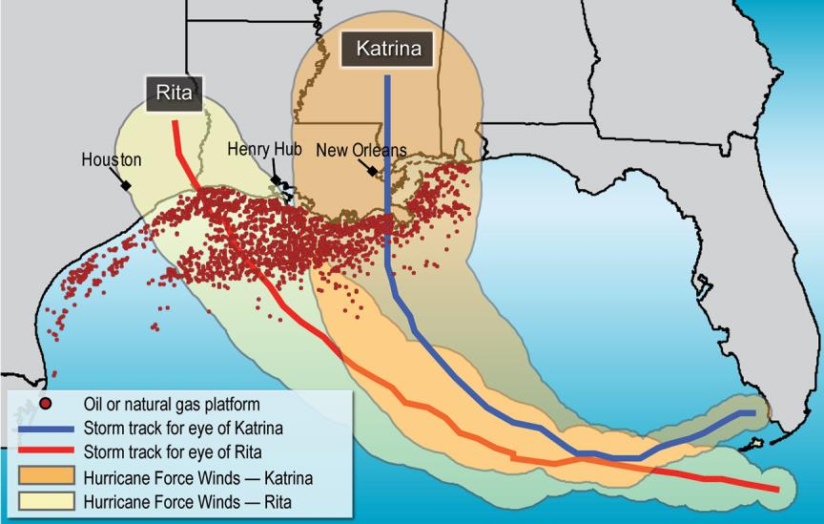
Paths of Hurricanes Katrina and Rita Relative to Oil and Gas Production Facilities
Notes:
A substantial portion of U.S. energy facilities are located on the Gulf Coast as well as offshore in the Gulf of Mexico, where they are particularly vulnerable to hurricanes and other storms and sea level rise. (Figure source: U.S. Government Accountability Office 2006⁴)

Slide 26
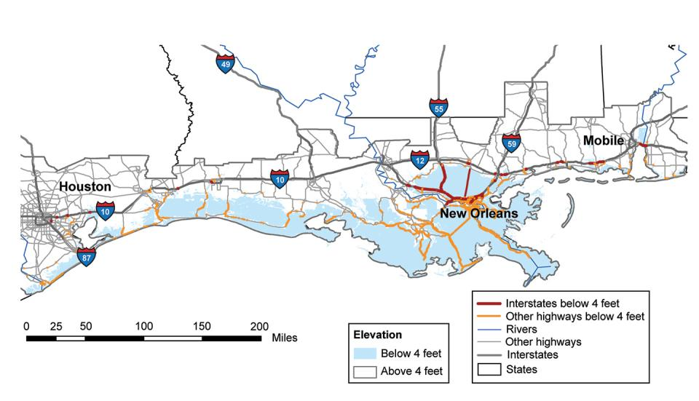
Gulf Coast Transportation Hubs at Risk
Notes:
Within this century, 2,400 miles of major roadway are projected to be inundated by sea level rise in the Gulf Coast region. The map shows roadways at risk in the event of a sea level rise of about 4 feet, which is within the range of projections for this region in this century. In total, 24% of interstate highway miles and 28% of secondary road miles in the Gulf Coast region are at elevations below 4 feet. (Figure source: Kafalenos et al. 2008⁶).

Slide 27
Energy Supply and Use http://nca2014.globalchange.gov/report/sectors/energy
Convening Lead Authors
  Jan Dell, ConocoPhillips
  Susan Tierney, Analysis Group Consultants
Lead Authors
  Guido Franco, California Energy Commission
  Richard G. Newell, Duke University
  Rich Richels, Electric Power Research Institute
  John Weyant, Stanford University
  Thomas J. Wilbanks, Oak Ridge National Laboratory

Slide 28
Disruptions from Extreme Weather
Extreme weather events are affecting energy production and delivery facilities, causing supply disruptions of varying lengths and magnitudes and affecting other infrastructure that depends on energy supply. The frequency and intensity of certain types of extreme weather events are expected to change.

Slide 29
Climate Change and Seasonal Energy Demands
Higher summer temperatures will increase electricity use, causing higher summer peak loads, while warmer winters will decrease energy demands for heating. Net electricity use is projected to increase.

Slide 30
Implications of Less Water for Energy Production
Changes in water availability, both episodic and long-lasting, will constrain different forms of energy production.

Slide 31
Sea Level Rise and Infrastructure Damage
In the longer term, sea level rise, extreme storm surge events, and high tides will affect coastal facilities and infrastructure on which many energy systems, markets, and consumers depend.

Slide 32
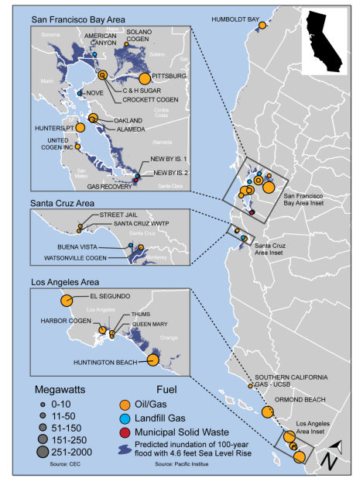
California Power Plants Potentially at Risk from Sea Level Rise
Figure source: Sathaye et al. 2011
Notes:
Figure 4.5: Rising sea levels will combine with storm surges and high tides to threaten power-generating facilities located in California coastal communities and around the San Francisco Bay. Sea level rise and more intense heavy precipitation events increase the risk of coastal flooding and damages to infrastructure (Ch. 3: Water). (Figure source: Sathaye et al. 2011¹).

Slide 33
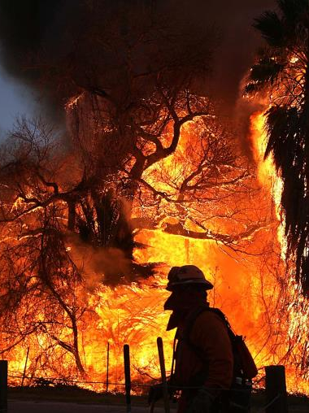
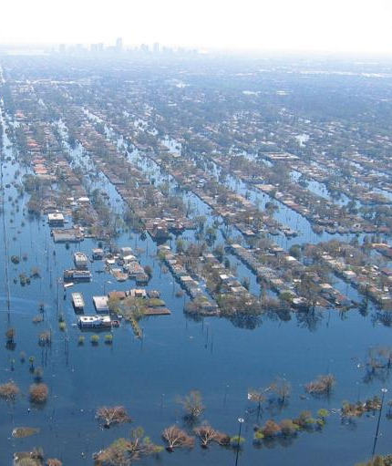
Impacts are Projected to Increase
©AP Photo/The Press-Enterprise, Terry Pierson
NOAA

Slide 34
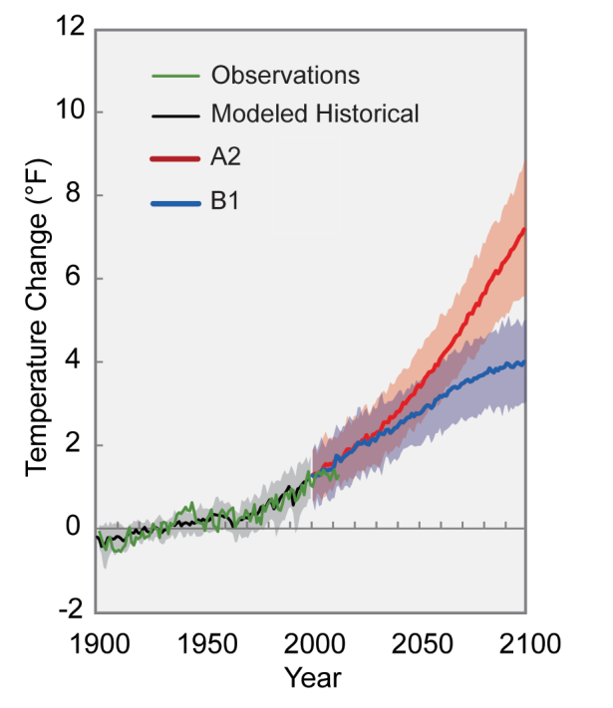
Projected Global Temperature Change
Notes:
Different amounts of heat-trapping gases released into the atmosphere by human activities produce different projected increases in Earth’s temperature. The lines on the graph represent a central estimate of global average temperature rise (relative to the 1901-1960 average) for the two main scenarios used in this report. A2 assumes continued increases in emissions throughout this century, and B1 assumes significant emissions reductions, though not due explicitly to climate change policies. Shading indicates the range (5 to 95 percentile) of results from a suite of climate models. In both cases, temperatures are expected to rise, although the difference between lower and higher emissions pathways is substantial. (Figure source: NOAA NCDC / CICS-NC).

Slide 35
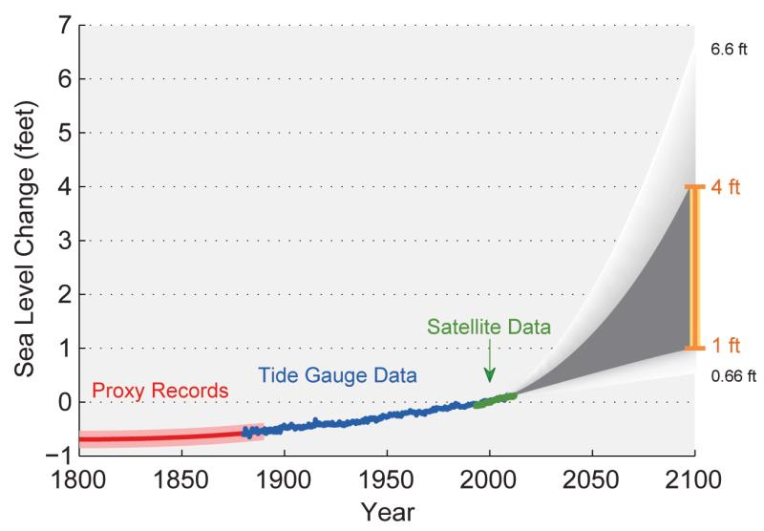
Past and Projected Changes in
Global Sea Level
Notes:
Figure shows estimated, observed, and possible amounts of global sea level rise from 1800 to 2100, relative to the year 2000. Estimates from proxy data⁴ (for example, based on sediment records) are shown in red (1800-1890, pink band shows uncertainty), tide gauge data in blue for 1880-2009,⁵ and satellite observations are shown in green from 1993 to 2012.⁶ The future scenarios range from 0.66 feet to 6.6 feet in 2100^{.7} These scenarios are not based on climate model simulations, but rather reflect the range of possible scenarios based on other kinds of scientific studies. The orange line at right shows the currently projected range of sea level rise of 1 to 4 feet by 2100, which falls within the larger risk-based scenario range. The large projected range reflects uncertainty about how glaciers and ice sheets will react to the warming ocean, the warming atmosphere, and changing winds and currents. As seen in the observations, there are year-to-year variations in the trend. (Figure source: NASA Jet Propulsion Laboratory).

Slide 36
The international process has led to strikingly similar conclusions

Slide 37
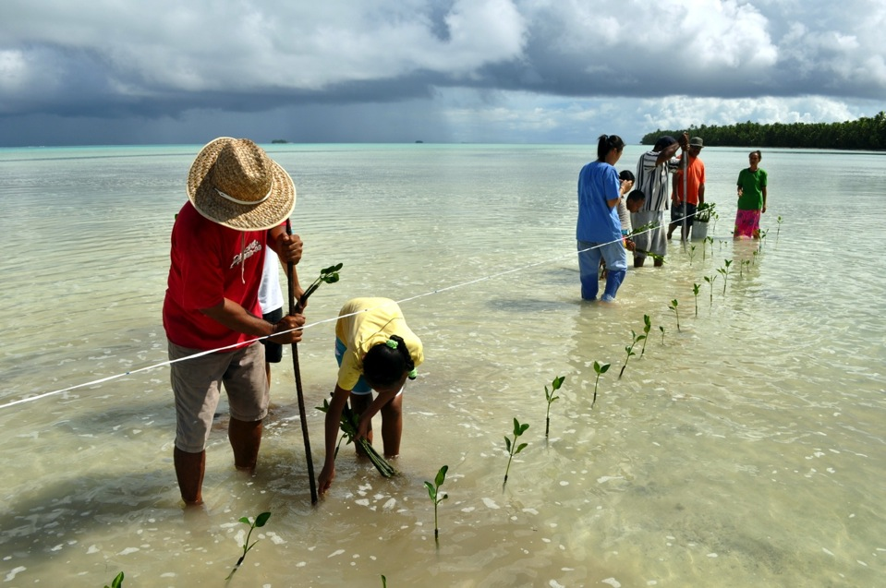
CLIMATE CHANGE 2014:
IMPACTS, ADAPTATION, AND VULNERABILITY

Slide 38
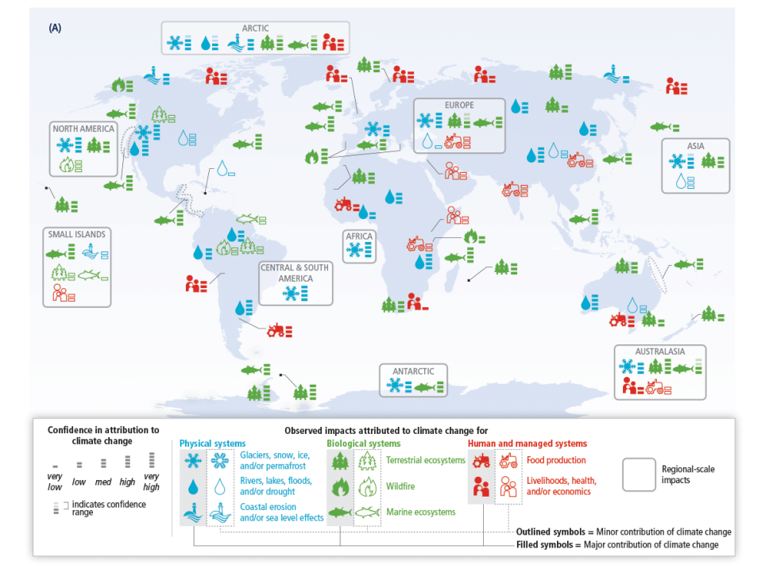
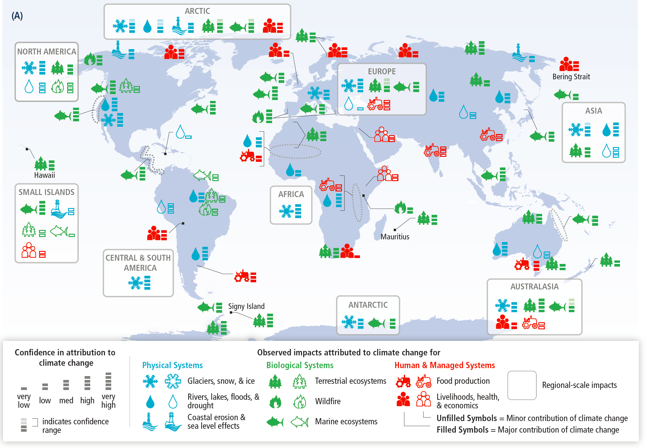

Slide 39
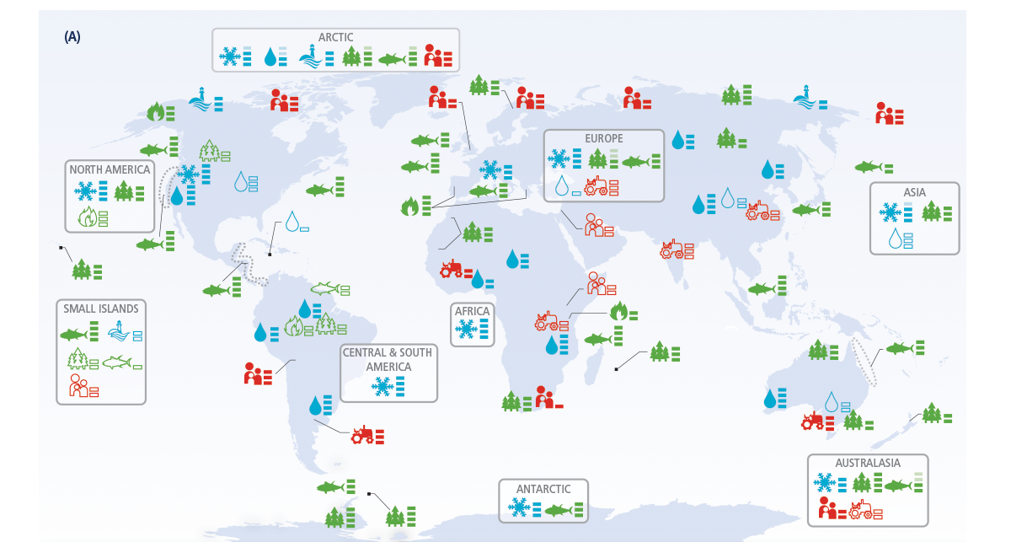

Slide 40
So What Do We Do?

Slide 41
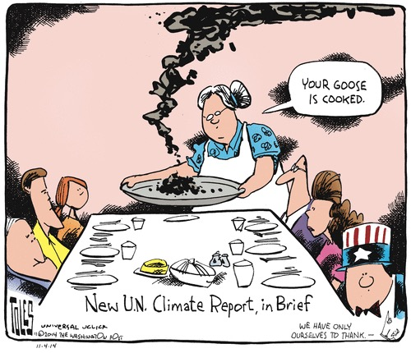

Slide 42
Responses
There are important opportunities to reduce future warming by reducing greenhouse gas emissions and increasing carbon dioxide uptake.
There are also actions we can take to prepare for impacts that are already unavoidable.
Some actions are already underway.

Slide 43
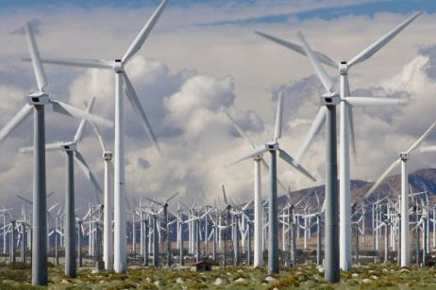

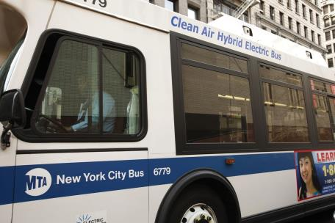
Mitigation
© Jerome Levitch/Corbis
©Dennis Schroeder, NREL
© Najlah Feanny/Corbis

Slide 44
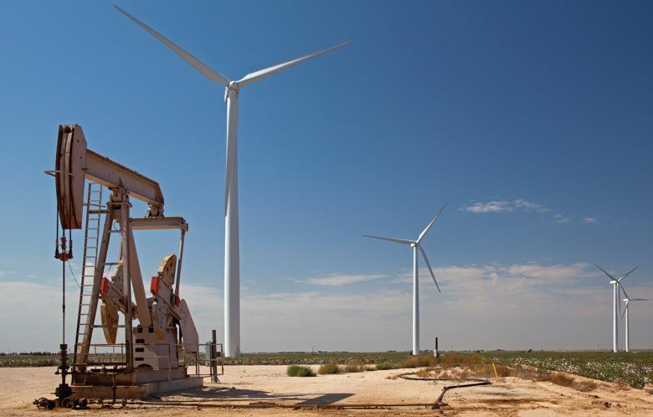
Future Climate Change Depends Primarily on Emissions Levels
© Jim West/imagebroker/Corbis

Slide 45
Mitigation http://nca2014.globalchange.gov/report/response-strategies/mitigation
Convening Lead Authors
  Henry D. Jacoby, Massachusetts Institute of Technology
  Anthony C. Janetos, Boston University
Lead Authors
  Richard Birdsey, U.S. Forest Service
  James Buizer, University of Arizona
  Katherine Calvin, Pacific Northwest National Laboratory, University of Maryland
  Francisco de la Chesnaye, Electric Power Research Institute
  David Schimel, NASA Jet Propulsion Laboratory
  Ian Sue Wing, Boston University
Contributing Authors
  Reid Detchon, United Nations Foundation
  Jae Edmonds, Pacific Northwest National Laboratory, University of Maryland
  Lynn Russell, Scripps Institution of Oceanography, University of California, San Diego
  Jason West, University of North Carolina

Slide 46
Key Message 1
Carbon dioxide is removed from the atmosphere by natural processes at a rate that is roughly half of the current rate of emissions from human activities.
Mitigation efforts that only stabilize global emissions will not reduce atmospheric concentrations of carbon dioxide, but will only limit their rate of increase.
The same is true for other long-lived greenhouse gases.

Slide 47
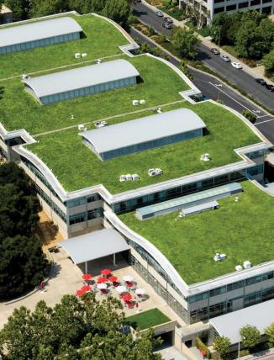
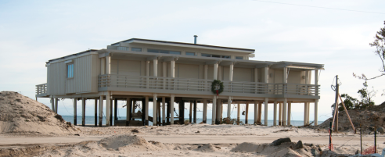
Adaptation
©Esperanza Stancioff, UMaine Extension and Maine Sea Grant
©Proehl Studios/Corbis
FEMA photo by Wendell A. Davis Jr.

Slide 48
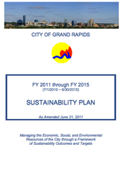
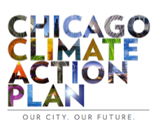
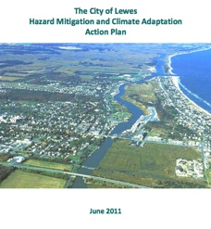
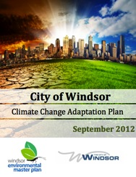
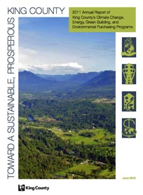
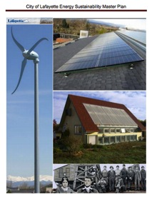
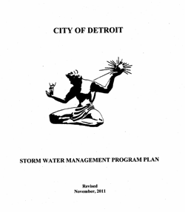
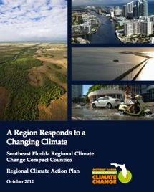
Lots of Local Action

Slide 49


Slide 50











Sustainability Plans for every Federal Agency

Slide 51
Effectiveness?
Plans more than actions
Challenge of developing a counterfactual
Academic knowledge not yet penetrating private and public institutions
Private and public experience not yet penetrating academic institutions

Slide 52
Where Are We Headed?
Future assessments clearly need to evaluate where scientific knowledge is moving
At the same time, keep track of progress on responses to climate change

Slide 53


Keep Your Eye on the Ball

Slide 54
Concluding Thoughts
We are clearly seeing the consequences of changes in the climate system
While we typically don’t use the phrase “settled science,” there is a lot of what we do know that is simply not in serious question
But we do have a very challenging problem of communicating

Slide 55
Concluding Thoughts
We need to acknowledge that the world will not wait while we sort out the things we’re not so sure about
We are managing risks as well as seeking to understand the world better
The very epitome of being useful while being interesting

Slide 56

Thank you…

