Slide 1
Travis Bristol
Research on Tap | Tackling Racial Inequities in Boston: What’s BU Learning?
Assistant Professor
School of Education
tbristol@bu.edu
@tjacksonbristol

Slide 2
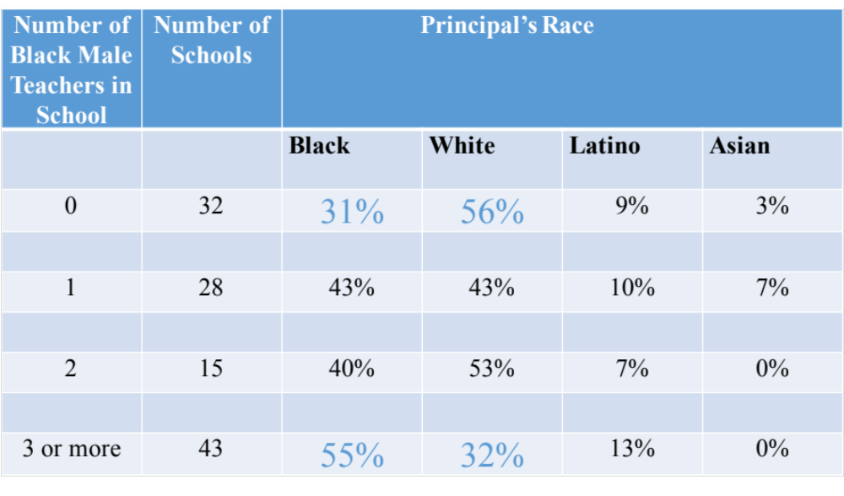
Table 1: 2012- 2013 BPS Schools that have 0, 1, 2 or 3 or more Black Teachers Disaggregated by the Percentage of the Principal’s Race in Boston Public Schools
Research on Tap | Tackling Racial Inequities in Boston: What’s BU Learning?
Notes:
In 2012, I approached then Bos. Pub Schools Supt., Carol Johnson to study Black male teachers’ decisions to enter, stay/leave the profession. Nationally, approx 80% of all U.S. public schools teachers are White, while approx 51% of U.S. public school stu are of color. In BPS 62% of teachers are White; 21% black, 10% Latino; 6% Asian.And, as many of you may know BPS is still under a 1974 federal deseg. court order that found the district adopted a prac. Of not hiring blk teachers. As part of the ruling, Judge Gerrity ruled that the district needed to have at least 25% of teachers as blk. So, back to Dr. Johnson she agreed to have me conduct study. First I surveyed teachers – this is what I found. Blk teachers were concentrated in certain types of schools. And their unequal distribution influnced their decisions to stay/leave.

Slide 3
Idea: BU Center for Evidence-based Policies and Practices Aimed at Closing the Opportunity Gap
Research:
How are teacher preparation programs organized to support the unique needs of pre-service teachers of color?
How do students and families perceive the “added-value” of teachers of color?
How are the school-based experiences of Native American, Asian, Black and Latino teachers similar and different?
Policy:
Include items on the School and Staffing Survey (SASS) that ask participants to report on school-based experiences related to race, gender, and sexuality
States should make publicly available the racial/ethnic composition of faculty/students in preparation programs
Practice:
Differentiating professional development to address the unique socio-emotional needs of pre and in service educators of color.
Local and state convenings that deepen teachers of color content and pedagogical content knowledge, while also providing these teachers with strategies to navigate challenging work environments.
Notes:
To address, I suggest BU create…

