Slide 1
Harold Cox
Research on Tap | Tackling Racial Inequities in Boston: What’s BU Learning?
Associate Dean for Public Health Practice,
Associate Professor of Community Health Sciences,
Director of the School of Public Health Activist Lab
School of Public Health
hcox@bu.edu

Slide 2

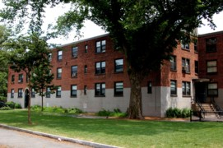
Partnership in Health & Housing
Research on Tap | Tackling Racial Inequities in Boston: What’s BU Learning?

Slide 3

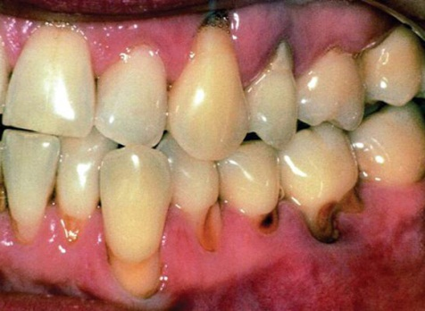
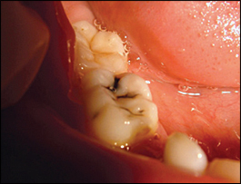
Boston Senior Oral Health Program
Research on Tap | Tackling Racial Inequities in Boston: What’s BU Learning?

