Slide 1
Yvette Cozier
Research on Tap | Tackling Racial Inequities in Boston: What’s BU Learning?
Assistant Professor, Epidemiology
Assistant Dean for Diversity & Inclusion
School of Public Health
yvettec@bu.edu

Slide 2
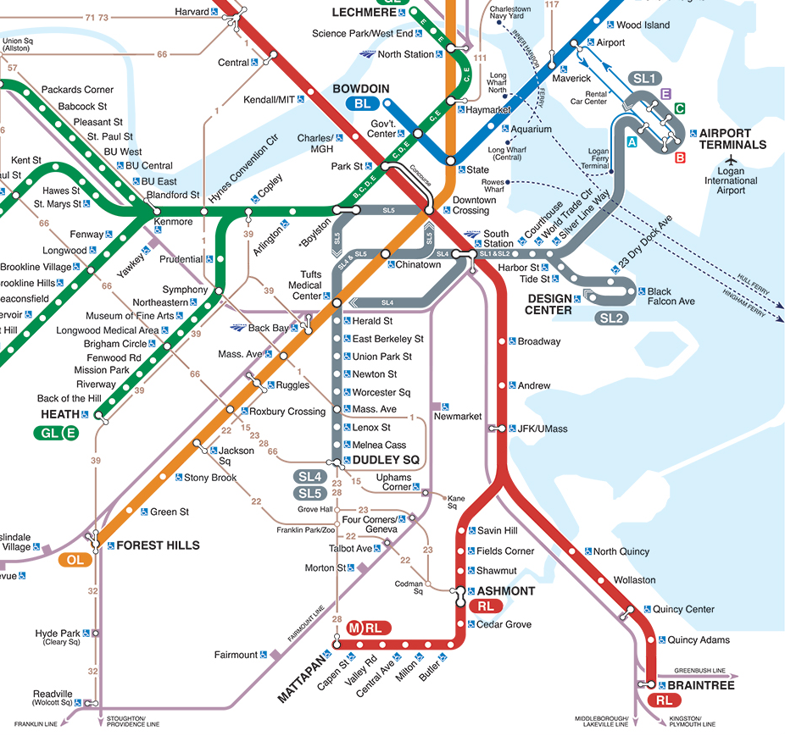
Boston Neighborhoods
Research on Tap | Tackling Racial Inequities in Boston: What’s BU Learning?
Maverick Square:
12% poverty
4.4 premature deaths per 1,000
Fenway:
14% poverty
4.3 premature deaths per 1,000
Arlington Street:
4% poverty
2.6 premature deaths per 1,000
Dudley Square:
32% poverty
5.7 premature deaths per 1,000
Mattapan Square:
16% poverty
4.4 premature deaths per 1,000
Adapted from S. Galea: https://www.bu.edu/sph/2015/03/29/health-of-a-city-health-inequalities-in-boston-by-t-stops-a-pictorial-essay/
Notes:
2

Slide 3
Boston Neighborhoods
Recognition that neighborhood of residence is an important risk factor for health outcomes
  Independent of individual–level factors (Cozier et al, 2007, 2014; Krishnan et al, 2010; Coogan et al, 2010)
Update policy, approach
  Neighborhood redevelopment initiatives must include local redevelopment authorities, urban planning boards, public health, medicine, education, finance, etc.
  “Redevelop and Remain” vs. Redevelop and Gentrify
Support all schools in all neighborhoods
  ALL BPS elementary schools should be pipelines to Boston Latin School (BLS)
  Expand the BLS model
  Expand the Vo-tech model

