Slide 1
Shea W. Cronin
Research on Tap | Tackling Racial Inequities in Boston: What’s BU Learning?
Assistant Professor, Department of Criminal Justice
Metropolitan College

Slide 2
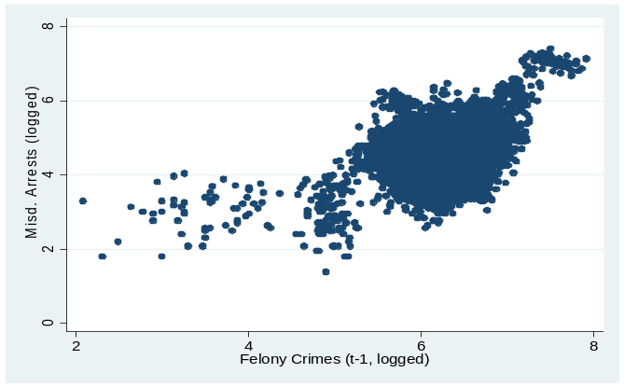
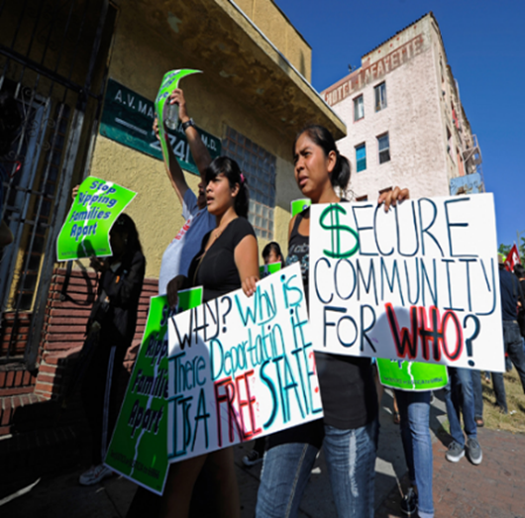

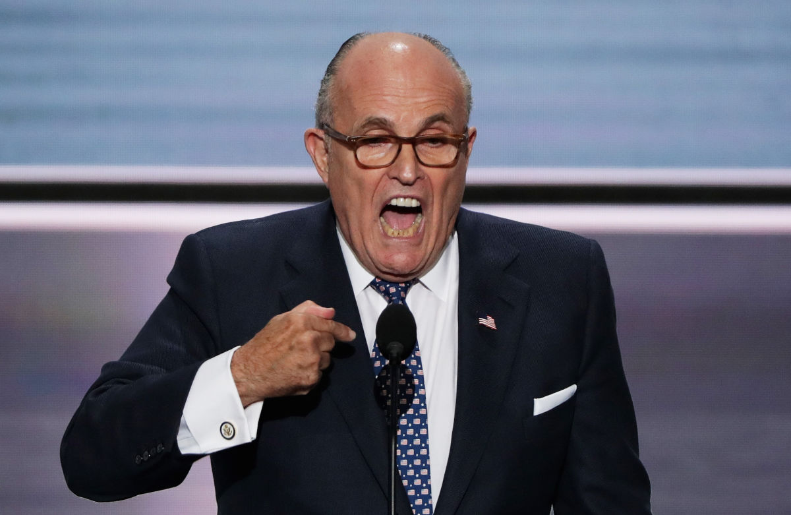
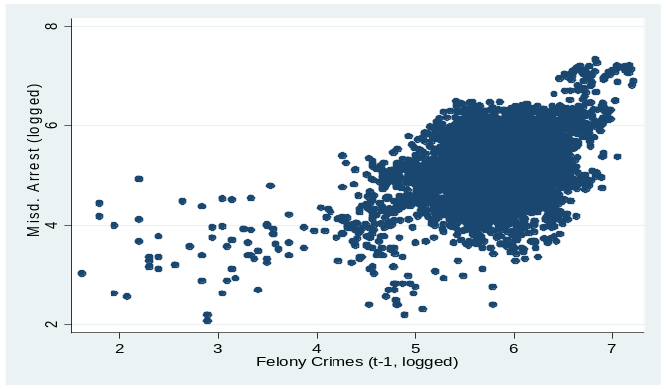
Research on Tap | Tackling Racial Inequities in Boston: What’s BU Learning?
Tackling Racial Inequities: Implications of What BU is Learning?
1. Political leadership change has implications for distribution of arrest practices across neighborhoods
2. Neighborhood political power can reduce association between activity and racial composition
3. Compstat does not improve the association between measures of crime and police activity levels
4. NIJ funded project led by SPH Profs. Siegel & Rothman will examine differential impact of gun legislation

Slide 3

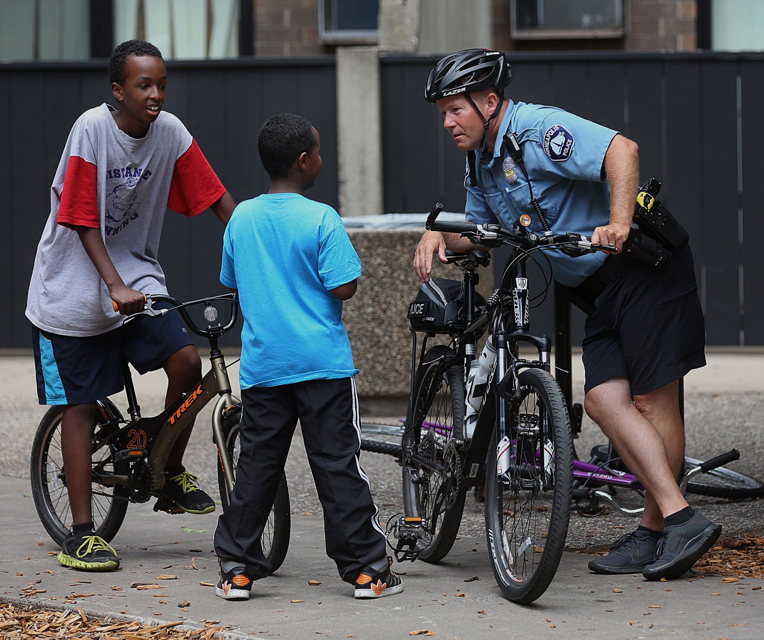
Research on Tap | Tackling Racial Inequities in Boston: What’s BU Learning?
Tackling Racial Inequities: What more can BU do?
1. Demonstrate the value and use of data-driven management and supervision responses to address disparities in police contacts & post-contact decisions
2. Understand variation in procedural justice practices & methods of institutionalizing practices within law enforcement agencies
3. Develop multidisciplinary, experiential learning course around diversity, justice policy and practice

