Slide 1
Jonathan Levy
Research on Tap | Tackling Racial Inequities in Boston: What’s BU Learning?
Professor, Environmental Health, and
Director, Center for Research on Environmental Health and Social Stressors in Housing Across the Life Course
School of Public Health
jonlevy@bu.edu

Slide 2



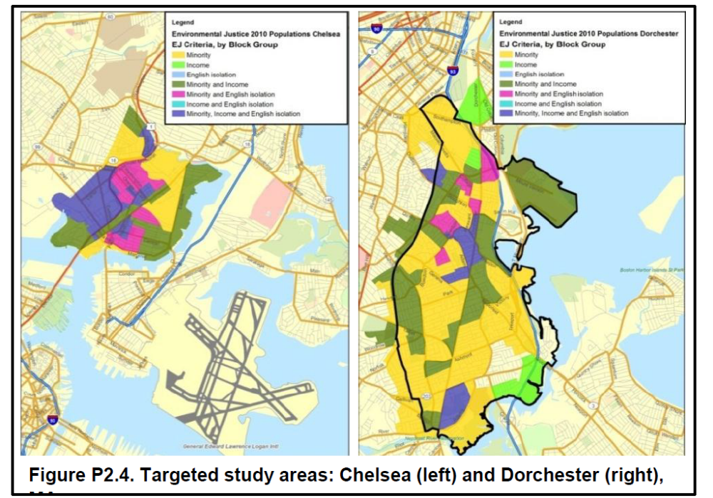
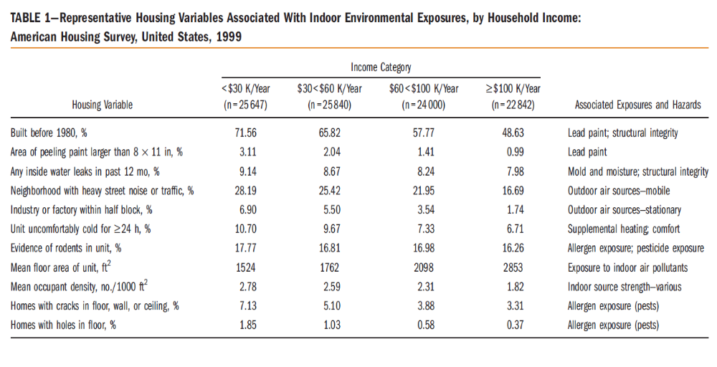

Slide 3
Advancing racial equity (from an Environmental Health perspective)
Research on Tap | Tackling Racial Inequities in Boston: What’s BU Learning?
Green housing to reduce energy costs and improve indoor environment
  Reduce indoor sources (smoking, lead paint, gas stoves, cockroaches)
  Improve ventilation
  Improve insulation
  Eliminate “heat or eat”
MassSave with a health component
Pollution controls, access to green space, no food deserts/swamps
Address community violence
  Stress, indoor environmental exposures

