Slide 1
Robert A. Margo
Research on Tap | Tackling Racial Inequities in Boston: What’s BU Learning?
Professor, Department of Economics
College of Arts & Sciences
Research Associate
National Bureau of Economic Research
margora@bu.edu

Slide 2
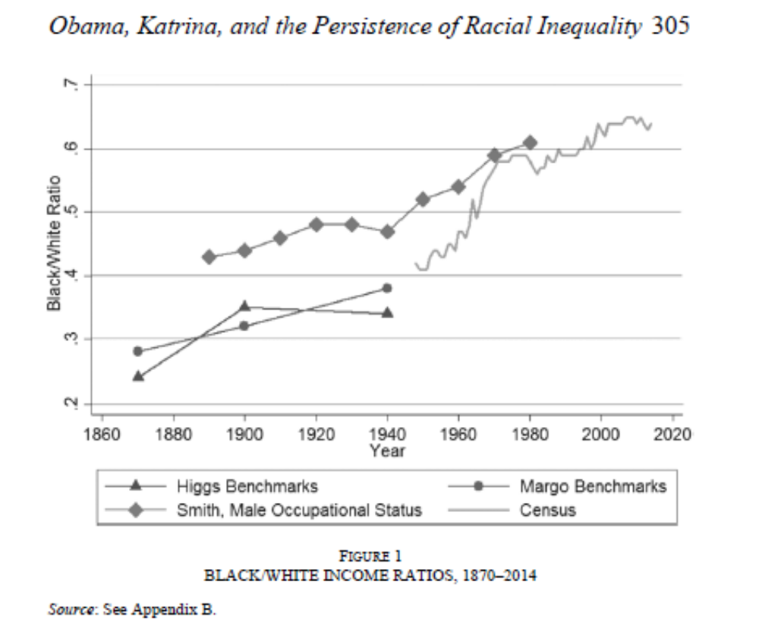
Black-White Income Differences in the Very Long Run
Notes:
My goal: big US picture to situate local context (Boston). From Margo (JEH 2016) presidential address to the Economic History Association, revises previous literature. B/W per capita income ratio in 1870 is 0.28, today is 0.64. Rate of convergence mostly steady, except (a) faster, 1940-70 (b) slower, recent.

Slide 3
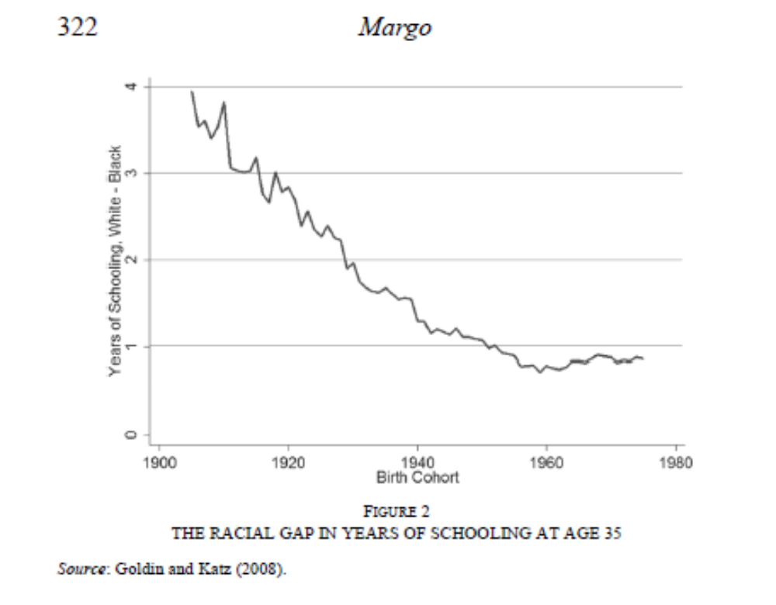
Black-White Income Differences in the Very Long Run
Notes:
Explaining B/W convergence: intergenerational model. Income in present generation function of “whiteness” and human capital, both positive effects. Whiteness and human capital are transmitted across generations tightly (high correlation). Key roles for de jure and de facto segregation (residential location and household formation). Shifts in labor market prices (whiteness and human capital) also important. Note narrowing racial gap in schooling until post-1980 cohorts.

