Slide 1
Linda Sprague Martinez
Research on Tap | Tackling Racial Inequities in Boston: What’s BU Learning?
Associate Professor
School of Social Work
lsmarti@bu.edu

Slide 2
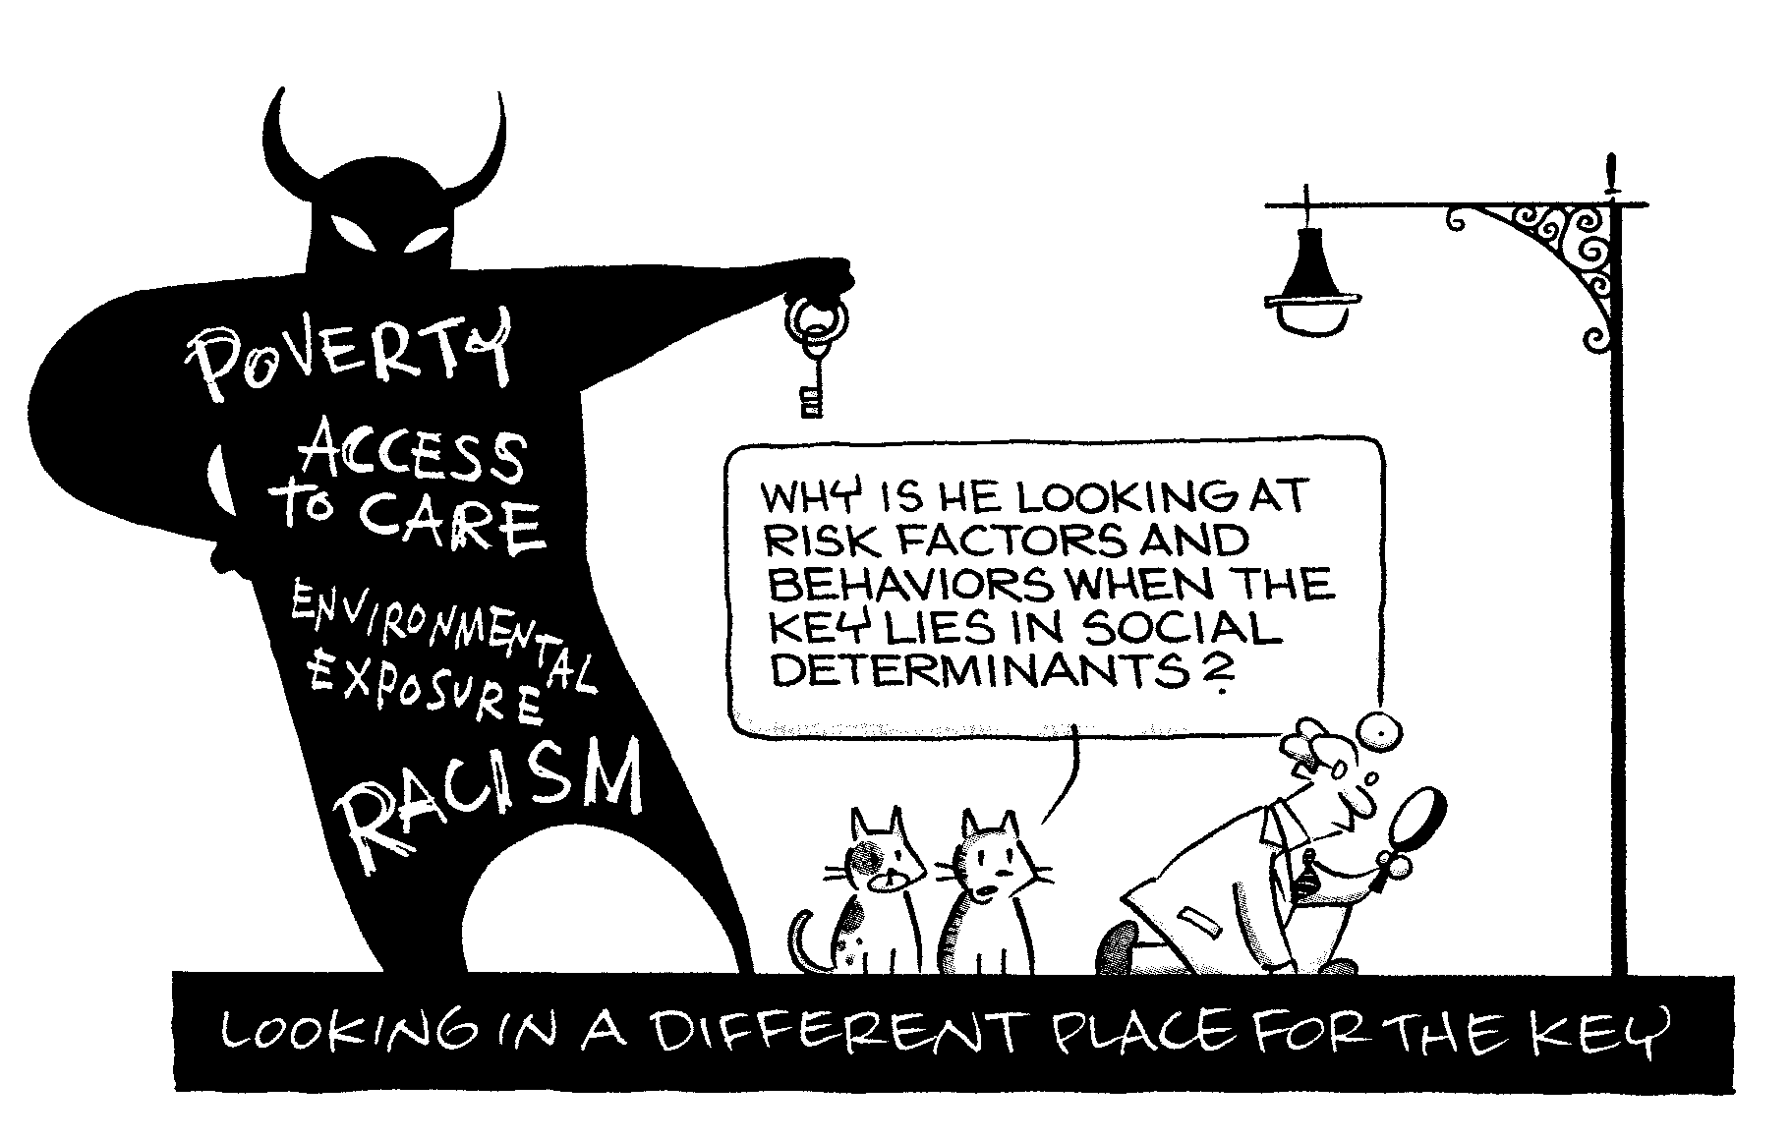
Looking for Causes
…in all the WRONG PLACES
Research on Tap | Tackling Racial Inequities in Boston: What’s BU Learning?
There’s an old joke about a man who late one night dropped his keys in the middle of a dark parking lot. He moves some distance over to the side of the lot and begins a fruitless search for them under a bright light. When asked why he was not looking where he actually dropped them, he replied, “because this is where the light is.”
Network, New England Research Institutes, Summer, 2002

Slide 3
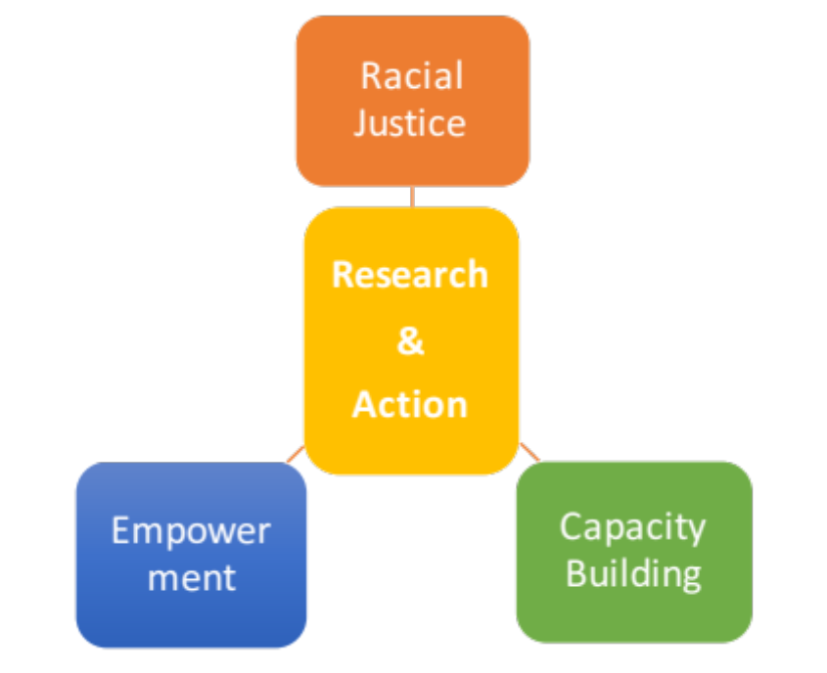
Advancing Equity through Community and Youth-led Research
Research on Tap | Tackling Racial Inequities in Boston: What’s BU Learning?
Center for Community Engaged Scholarship
  Community based participatory research partnerships
  Informal science education
  Workforce development
  College and career readiness
  Student research training
  (research-as-curriculum)

