Slide 1
Jessica Simes
Research on Tap | Tackling Racial Inequities in Boston: What’s BU Learning?
Assistant Professor, Department of Sociology
College of Arts & Sciences
simes@bu.edu

Slide 2
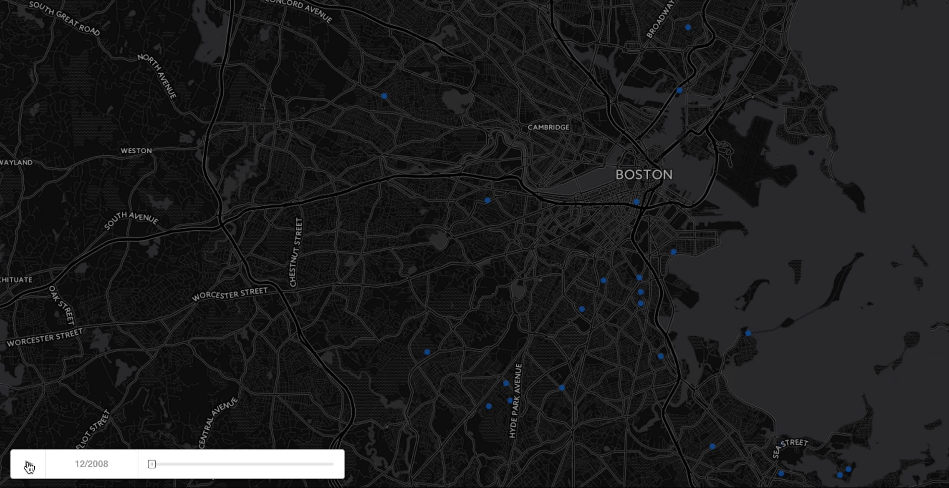
Prison Admissions in Greater Boston, 2009 to 2014

Slide 3
Alternatives to Excess Punishment
Policy Reform for Counties and the Commonwealth
End imprisonment for fines, fees and bail
Limit use of prison for pre-trial detainment
A Proposal for a BU Collaboration
A partnership with public health, social work and the social sciences
Goal: identify key policy and research areas to respond to the conditions of mass imprisonment in Boston neighborhoods
Research that informs criminal justice through a social justice and public health lens

