Slide 1
Universally Composable Security:
A Tutorial
Ran Canetti
BU, March 18-19 2016

Slide 2
Intro
Goal of the event:
  Explain the rationale and workings of the UC framework to non-cryptographers
  Alterior motive: Extend composable analysis beyond crypto
People’s backgrounds
Plan for the event
Website for products?
Practicalities: Food, facilities

Slide 3
Lecture plan
Session 1: Background
The UC framework – general idea
Session 2: Details of the framework
Session 3: Capturing attacks and concerns: examples
Session 4: Introduction of projects
Session 5: Work in groups

Slide 4
What do we want from security analysis?
Should faithfully represent realistic attacks
Should specify the security concerns and properties in a meaningful and precise way
Should capture “all realistic attacks” in the expected execution environment.
Should not be over-restrictive.
Guarantees should remain meaningful in many (any?) environment
Should be technically manageable
Should be modular:
  Simplify the analytic process
  Provide more meaningful security

Slide 5
Advocating a general model for security analysis
Pro:
Provides better understanding of security
Better expressibility, analysis is more meaningful
Enables modularity and composability
Overall simplification of the analytical work
Con:
Model can be complex
Hard to “get it right”

Slide 6
Frameworks for modeling distributed systems
CSP [Hoare]
pi-calculus [Milner] spi-calculus [Abadi-Gordon]
I/O automata [Lynch]
…
Pros: Much analytical work, verified, support modularity, some automated analysis
Cons:
Not easy to model computational concerns
Modeling a bit restrictive (scheduling, addressing)

Slide 7
Traditional cryptographic modeling
Semantic security
Zero Knowledge
Commitment
Secure function evaluation
…
Pro:
  Captures cryptographic security (against computationally bounded attacks)
  relatively simple
Con: Not modular, security guarantees not always meaningful in a larger context.

Slide 8
Want:
- The best of both…
- Be able to play on the tradeoff:
Simple/Abstract ⬅➔ Concrete/complex

Slide 9
Step 1: model computer systems and attacks
Model should:
Allow capturing:
  Realistic systems (processors, cores, ram, disks, networks, processes, os, applications, … delays, time… randomness…)
  Realistic attacks: network, exploits, side channels, Human
  Information seen by different components
  efficiency, resource bounds
Allow different levels of abstraction/detail
Be simple, natural, intuitive…
➔ Very tricky… the root of many deficiencies

Slide 10
Step 2: Capture security properties
For instance:
Trace properties (“correctness”): “In each execution, if event C happens then event E happens”
Probabilistic statements
Secrecy /privacy
Liveness
Timing of events
Costs and quantitative tradeoffs
Combinations of the above
  Eg “attack can either learn or modify, but not both”
  “attack can learn/modify, but only after a certain event”
  “success of attack is proportional to the amount of resources expended

Slide 11
Step 3: Prove that a system satisfies a given set of properties
Questions
By hand? Automated? How tractable?
Based on what assumptions?
  Model assumptions
  Computational hardness assumptions
Proof re-use:
  Modularity?
  Robustness?

Slide 12
The UC approach:
Specification via an Ideal-Service
The idea:
The security of a system is reflected only in its effects on the rest of the external environment.
Therefore to capture the desired security of system P:
  Write an “ideal system” F that captures the desired effect
  System P is “secure for F” if it “looks the same” as F to any external environment.
  Note: F need not be efficient or even realistically implemented. All we care about is its responses to the environment.

Slide 13
Specification via an Ideal-Service
Pro:
Expressive: Can naturally express any combination of properties
Amenable to modular analysis
Con:
Detailed, sometimes a bit roundabout

Slide 14
Specification via an Ideal-Service: Zoom in
First attempt:
P realizes F if for all environment E, E||P ~ E||F
(reminiscent of “observational equivalenve” [Milner])
Correspondence is too tight.. So too restricted… (eg, ~ is an equivalence relation)
How to relax?

Slide 15
Specification via an Ideal-Service:
Adding simulation
Idea:
Split the interaction of the system P with the external world:
  “Application Interface”: the inputs from the users of P and the outputs to the users of P . (This is the “functionality” of P).
  All the rest: consumed resources , communication, internal leakage of information, etc.
Allow “fudging” E’s view of the non-API interaction:
Def: P realizes F if there exists S such that for all E,
E||S||F ~ E||P

Slide 16
Recap: Simulation-based security specification
~
E
E
API
API
F
P
Side-effects
S
Side-effects
Side-effects
System P realizes specification F if there exists S such that for all E, Exec_{E,P} ~ Exec_{E,S,F}
(Exec_{E,…} returns the output of E from the execution …)

Slide 17
Specification via an Ideal-Service:
Adding simulation
Def: P realizes F if there exists S such that for all E,
Exec_{E,P} ~ Exec_{E,S,F}
Rationale for adding S:
“Any manipulation that P can do to E, could have done also by F (by adding S to E). Furthermore this can be done without modifying the API of F.”
Or:
“Any manipulation that E can do to P, could have done also to F (by using S). Furthermore this can be done without modifying the API of F.”
➔Definition is no longer symmetric

Slide 18
Compare with cryptographic-style simulation:
Semantic Security of Encryption
Semantic security of encryption:
Want to capture “Enc(m) gives no knowledge on m”
Game-based: An encryption algorithm Enc is sem. Secure if no (feasible) A wins w.p. >1/2+negl in game:
A → m₁,m₂
A ← Enc(m_{b}) b←{1,2}
A → b’, wins if b’=b
Simulation-based:
  For any A there is a simulator S such that for all m,
  Enc(m) ~ S(|m|)
  Thm: Enc is Sim-Sem-Sec iff it is Game-Sem-Sec.

Slide 19
Cryptographic-style simulation:
Zero-Knowledge & WI
[P,V] is an interactive protocol where P,V have joint input x, P has secret input w, (and V wants to learn whether R(x,w) for some relation R)
Want to capture “Interaction with P does not give V any knowledge on w”
[P,V] is zero knowledge if for all V* there is a simulator S such that for all V*,x,w, [P(x,w),V*(x)] ~ S(x)
[P,V] is “witness indistinguishable” (WI) if for all V*, x,w1,w2
[P(x,w1),V*(x)] ~ [P(x,w2),V(x)]
  Thm: ZK ➔ WI, but not vice versa!

Slide 20
Differences from “traditional” cryptographic simulation
  Captures both secrecy and “correctness” guarantees
  Focus on the effect on the environment, rather than on protocol
  Require a single simulator (as opposed to a simulator per adversary)
Partial credits to this definitional style:
[Goldreich Micali Wigderson87,Goldwasser Levin 90,Micali Rogaway 91, Beaver 91, Canetti 92-95-00-01,Pfitzmann-Waidner 93-98-00…]

Slide 21
Recap: Simulation-based security specification
~
E
E
API
API
F
P
Side-effects
S
Side-effects
Side-effects
System P realizes specification F if there exists S such that for all E, Exec_{E,P} ~ Exec_{E,S,F}

Slide 22
Example:
Authenticated message transmission
F_{auth}:
On input (Send,m,”B”) from “A”, output (Sent,m,”A”) to “B”.
F has no side-effects, S needs to generate side-effects on its own, without knowing anything…
Need to relax:

Slide 23
Example:
Authenticated message transmission
F_{auth}:
On input (Send,m,”B”) from “A”, leak (A,B,m) to S
When S returns “ok”, output (Sent,m,”A”) to “R”.
S learns A,B,m, and *can delay delivery*
(Analysis of MAC-based protocol on board)

Slide 24
Example:
Secure message transmission
F_{smt}:
On input (Send,m,”B”) from “A”, leak (A,B,|m|) to S
When S returns “ok”, output (Sent,m,”A”) to “B”.
S learns A,B,|m|, and *can delay delivery*
(Analysis of Enc-based protocol on board)
How to model leaky/imperfect encryption?

Slide 25
Example:
Zero Knowledge proofs
F_{zk(R)}:
On input (Prove,x,w,B) from A, leak (A,B,x,R(x,w)) to S
When S returns “ok”, output (Verified,A,x,R(x,w)) to B.
B learns whether R(x,w)
S,B learn only R(x,w), w remains secret.

Slide 26
Example:
Key Exchange
F_{ke}:
On input (KE,B) from A, choose a key k and leak (A,B) to S.
On input (KE,B) from A, leak (A,B) to S.
When S returns (ok,P) for P={A,B}, output (A,B,k) to P.
A,B obtain a fresh joint key
S learns that A,B share a key.

Slide 27
Example:
File System with Integrity
F_{fsi}:
On input (Init,fname,UID) record (fname,UID)
On input (W,fname,update-contents,UID’):
If UID’=UID then update the fname with update-contents,
else return an error code.
On input (read,fname,UID) leak fname to S. When S says ok, return the contents of fname to UID.
Write-control Integrity is guaranteed, no confidentiality guarantees.

Slide 28
Composition of protocols and systems
What happens to our security guarantees when the analyzed system runs alongside others?
How do the systems interact?
  Intentionally?
  Adversarially?
Do the systems have joint inputs? State? Modules?
Do they run in parallel? concurrently?
Does one system use the other?
Are the systems coordinated? Same system?

Slide 29
What Can Go wrong?
Protocols reuse state (eg, keying material)
Security guarantees break due to bad interaction (ZK…)
Security guarantees become inadequate (NM-Com)
Security APIs don’t hold up
…

Slide 30
Example: The Needham-Schroeder key exchange protocol
If identity and nonce
checks are ok then
output N_{B} and send

Slide 31
The protocol satisfies the requirements:
Key agreement: If A, B locally output a key with each other,
then this key must be N_{B}. (Follows from the “untamperability”
of the encryption.)
Key secrecy: The adversary only sees encryptions of the key,
thus the key remains secret. (Follows from the secrecy
of the encryption.)
Indeed, the protocol complies with early notions of security
(e.g. [Dolev-Yao83, Bellare-Rogaway93,
Datta-Derek-Mitchell-Warinschi06]).

Slide 32
Using the key for encrypting messages

Slide 33
An attack against the composed protocol:
E can check whether
C=N_{B}+ “sell”, or C=N_{B}+ “buy”:
Let C'=C+”sell”.
Note: If M= ”sell” then C'=(N_{B}+”sell”)+”sell”=N_{B}. Else C' != N_{B}.
Thus, B accepts the exchange if and only if M= “sell”.

Slide 34
The problem: The adversary uses B as an “oracle” for whether it has the right key.
But the weakness comes to play only in conjunction with another protocol (which gives the adversary two possible candidates for the key...)
Consequently, need to explicitly incorporate the encryption protocol in the analysis of the key exchange protocol...

Slide 35
Want: A way to argue about the propagation of security in such situations
The methodology: Security preserving composition.
Will see:
A (single) composition operation on systems
Can express most other composition methods
Preserves security

Slide 36
The composition operation: Universal Composition
Ingredients:
Protocol (system) π that realizes ideal service φ
Protocol (System) ρ that makes API calls to φ
Result: A protocol ρ^{φ→π} Where:
the calls to φ are replaced by calls to π
Values returned from π are treated as coming from φ
Note:
Just like subroutine substitution in sequential algorithms, except that
each protocol/system may have many participants. (Still, calls are
made locally by each participant.)
There may be multiple instances of φ and π.
φ and π have similar API but very different “non-API” behavior
(number of parties components, communication etc)

Slide 37
The universal composition operation
E
E
API
API
➔
ρ
ρ
Side-effects
Side-effects
φ
φ
φ
π
π
π
…
…
Note: each protocol can consist on many smaller components and parties.

Slide 38
The universal composition theorem
E
E
~
API
API
φ
π
Side-effects
Side-effects
S
Side-effects
➔
E
E
API
API
~
ρ
ρ
Side-effects
Side-effects
π
π
π
φ
φ
φ
…
…I

Slide 39
The composition theorem:
If protocol π realizes ideal service φ and protocol ρ
realizes Ideal Service γ, then protocol ρ^{φ→π} realizes γ.
More generally, protocol ρ^{φ→π} is “just as secure” as protocol ρ.
Corollaries:
Allows for modular security analysis
Allows arguing about security in arbitrary environments
Gives concurrency “for free”…

Slide 40
Session 2

Slide 41
The actual framework
The system model: Computing elements, scheduling, addressing, time bounds
Model of protocol execution
Protocol emulation, ideal services
The composition operation and theorem

Slide 42
The basic computing unit:
An interactive machine (IM)
An abstract computing device
Can model a node (cpu+RAM), a cluster of nodes, a process, an enclave,…
Formally, an IM is a TM* with:
  some special tapes (ports):
      Identity tape (with code + id string, id=(pid,sid))
      Input tape
      Incoming communication tape
      Incoming subroutine output tape
      Outgoing message tape
    An “external write” instruction (tbd)
    * Can also think of an IM as a program in some higher language, e.g. Python or Java, with the appropriate data structures.

Slide 43
A system of IMs
  A system is a pair (I,C) where
    I is an IM
    C is a control function C:{0,1}* → {allow,disallow}
  An instance of an IM M is a pair μ=(M,id) where id is the contents of the identity tape
  A configuration of μ is the entire contents of tape and control
  An execution is a sequence of configurations:
    In each config a single machien is active, initially I
    Initial config is the initial config of I
    The active machine runs till it performs external write. Then, the activation is suspended, the message on outgoing tape is delivered and the recipient machine is activated.
    The execution ends when I halts. The output is output of I.

Slide 44
Message delivery and order of activations
  The information on the outgoing message tape consists of:
    μ - ID of sending machine
    μ’ =(M’,id’) - ID of target machine
    Tape name (input, incoming message, subroutine output)
    r ԑ {0,1} “reveal” bit
    m – message
  Effect:
  If C(currrent execution prefix)=disallow then message is not delivered and I is activated.
  Else:
    If no MI with identity id’ exists in the execution prefix then one is created and initialized with code M’. (unless M’=@, in which case I gets activated)
    If M’=@ or M’ is the code of the MI with id’ then the message is written to the appropriate tape of that MI
    Else (Mi with id’ exists but with code different than M’) then μ transitions to an error state and I is activated next.

Slide 45
Notes
Number of MI’s is unbounded
Allows dynamic code generation
ID of each MI is unique in the system
Need to know ID of an MI in order to send to it
Mis know their IDs
Scheduling is sequential and unfair…

Slide 46
More definitions
Extended systems:
  C(exec prefix) = new ID and code for source and target
μ is a subroutine of μ’ if μ wrote to the subroutine output tape for μ’ or μ’ wrote to the input tape of μ.
A protocol is an interactive machine.
An instance of protocol P in an execution prefix is a set of MI’s with program P and the same SID

Slide 47
Polynomial time
A machine M is polynomial time if its runtime is bounded by a polynomial in N, where
N = # bits written on M’s input tap –
# bits that M wrote on input tapes of other machines.
Can see: If all machines in a system of ITMS are polynomial (and are all bounded by the same polynomial) then the system halts within polynomial time.
Parameterized systems: All machines get inputs of at least some polynomial length.

Slide 48
The model of protocol execution
On board
The idea: Keep it simple. Run a single instance of the protocol, with an environment and an adversary.
Participants: Environment E, adversary A, parties of protocol π.
  E starts, invokes A, gives inputs to parties of a single instance of π, obtains outputs from parties of π.
  Parties of π generate subroutines, outputs, and send messages to each other *via the adversary*.
  Adversary obtains messages from parties, and either delivers some (arbitrarily modified) incoming messages to parties, or generates output for E.
(Rules are enforced by the control function.)

Slide 49
The model of protocol execution
Note: The model is very rudimentary:
Parties communicate only via the adversary
No “party corruption” operations
Done for sake of simplicity and generality. Will add later.
(Note: Control F erases ID of E is from inputs to parties, and erases code of parties from outputs to E)

Slide 50
Protocol emulation
E
~
E
API
API
π
φ
Side-effects
A
S
Side-effects
Side-effects
Protocol π UC-emulates protocol φ if for all A there exists S such that for all E*, Exec_{E,A,π} ~ Exec_{E,S,φ .}
(Exec_{E,…} returns the output of E from the execution …)
* Quantify only over “balanced” environments

Slide 51
Notes
Security with “dummy adversary”: Above def is equivalent to one where A is only a channel for E.
Emulation is transitive: If protocol A UC-emulates protocol B and B UC-emulates protocol C then A UC-emulates C.
Quantitative formulations: Measure the complexity overhead of S vs A, and the probability of distinguishing.

Slide 52
IDEAL_{F}: The ideal protocol for ideal service F
DP
DP
DP
F
S
Dummy parties: Only transfer message from E to parties and back
Communication between A and F is critical!
P UC-realizes F if P UC-emulated IDEAL_{F}

Slide 53
Universal composition
Ingredients:
Protocol π that emulates protocol φ
Protocol ρ that makes subroutine calls to φ
Result: A protocol ρ^{φ→π} Where:
The calls to each MI of φ are replaced by calls to a MI of π with same id
Values returned from each MI of π are treated as coming from a MI of φ with same id

Slide 54




The composition operation (single call to F)
$$ρ$$
$$ρ$$
$$ρ$$
$$ρ$$
➔
F

Slide 55







The composition operation (single call to F)
$$ρ$$
$$ρ$$
$$ρ$$
$$ρ$$
$$π$$
$$π$$
 
$$ρ$$
$$ρ$$
$$ρ$$
$$ρ$$
$$π$$
$$π$$
F

Slide 56




















The composition operation (multiple calls to F)
$$ρ$$
$$ρ$$
$$ρ$$
$$ρ$$
$$π$$
$$π$$
$$π$$
$$π$$
$$π$$
 
$$π$$
$$ρ$$
$$ρ$$
$$ρ$$
$$ρ$$
$$π$$
$$π$$
$$π$$
$$π$$
$$π$$
$$π$$
F
F
F

Slide 57
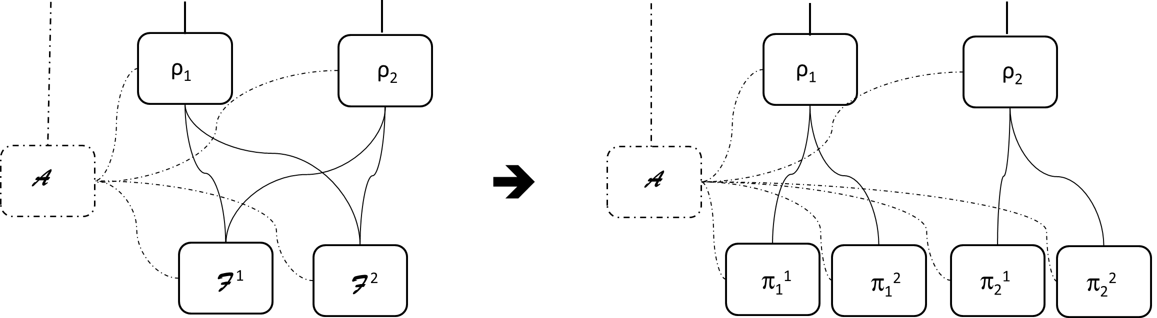
The composition operation (multiple calls to F)

Slide 58
The composition theorem:
If protocol π UC-emulates protocol φ,
then protocol ρ^{φ→π} UC-emulates protocol ρ.

Slide 59
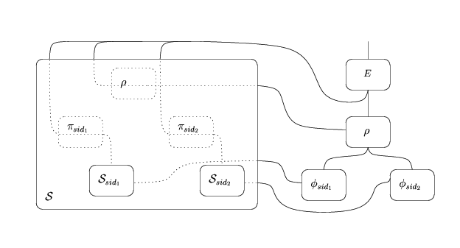
Proof outline: the combined simulator
On board

Slide 60
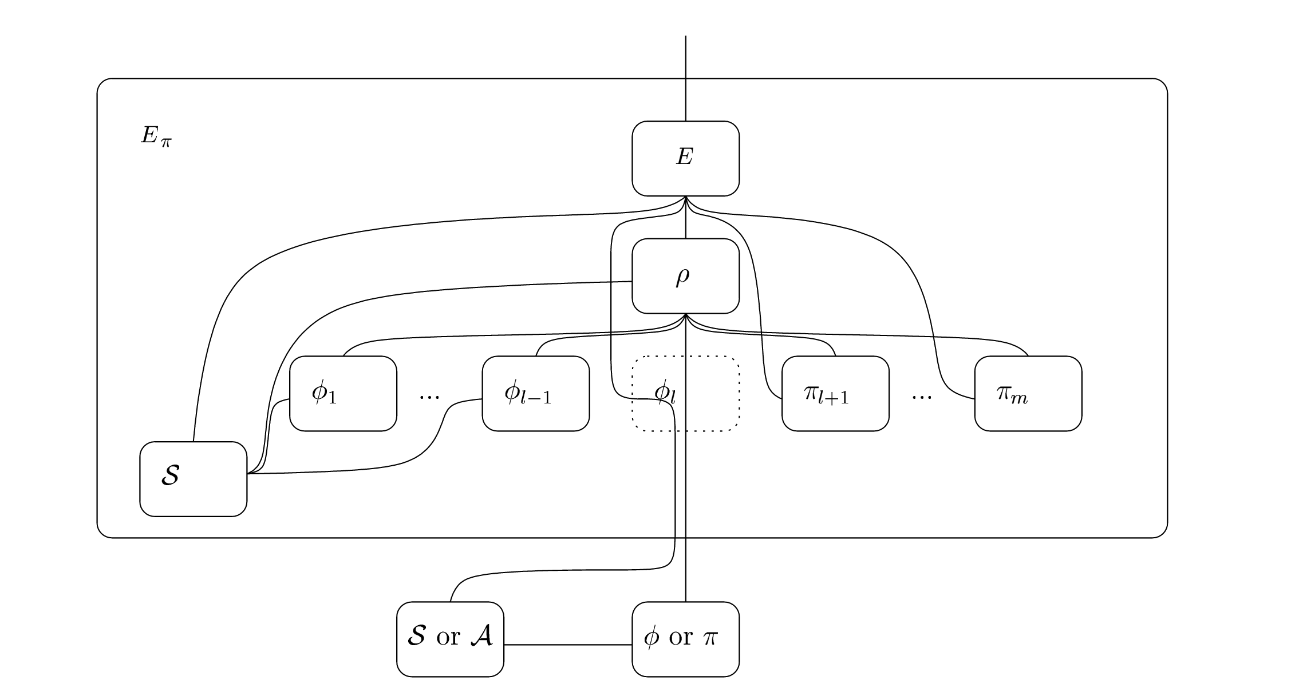
The distinguishing Environment

Slide 61
Modeling corruptions
The shell construct: Allows encoding modeling instructions in a protocol
Notification to Environment
Types of corruption:
  Byzantine
  Honest-but-curious
  Fail-stop
  Transient
  Leakage
  Erasures
Modeling aggregate information

Slide 62
synchronous communication
On board

Slide 63
Key exchange & secure channels
Auth + Enc
KE
Sig
Cert
PKI
How to multiplex a single PKI over many sessions?
➔ Use JUC

Slide 64
De-composing “entangled systems”
Q: How can we de-compose systems to “independent components” even when the components have joint modules?
A: Can be done when the joint modules “behave like multiple independent instances” of a simpler module.
Example: Key exchange authenticated using PKI

Slide 65
Multi-session extensions
ρ̂ is the multi-session extension of ρ if it “behaves like multiple independent sessions of ρ”. That is:
  ρ̂ runs multiple independent sessions of ρ, each with its own sub-session-id (ssid).
  Upon receiving message m=(s,m’), ρ̂ activates session s of ρ with input m’.
  When session s of ρ wishes to send message m’, ρ̂ sends (s,m’) to specified recipient.

Slide 66
Universal composition with Joint State (JUC)
Ingredients:
Protocol π that emulates protocol φ ̂
Protocol ρ that makes subroutine calls to φ
Result: A protocol ρ^{φ ̂ →π} Where:
The calls to (the single instance of) φ ̂ are replaced by calls to (multiple instances of) π with:
  same pid
  ssid turns into sid
Values returned from each MI of π are treated as coming from the MI of φ ̂ with same pid, sid turns to ssid.

Slide 67
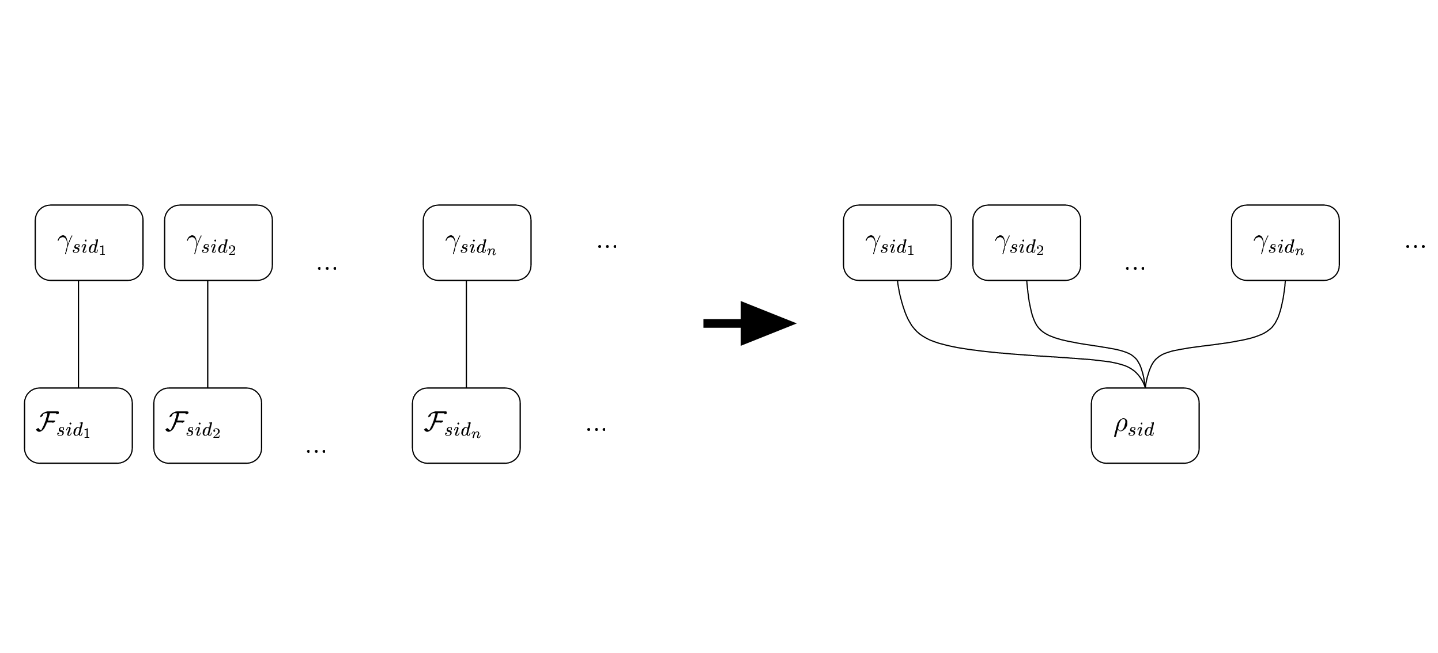
Universal composition with Joint State
ρ
ρ
π

Slide 68
JUC Theorem [C-Rabin03]:
If protocol π UC-emulates protocol φ ̂,
then protocol ρ^{φ ̂ →π} UC-emulates protocol ρ.

Slide 69
Authenticated filesystem
On board

