Slide 1
BChain: High-Throughput BFT Protocols
Haibin Zhang (UConn)
haibin.zhang@uconn.edu

Slide 2
Research Interests: Security and Reliability
Connecting theory and practice
  Applied cryptography
  Systems and Distributed Systems
  Cloud storage and cloud computing

Slide 3
This Talk
State Machine Replication (SMR)
  Crash Fault-Tolerant (CFT)
  Byzantine Fault-Tolerant (BFT)
BChain: A high-throughput BFT SMR protocol

Slide 4
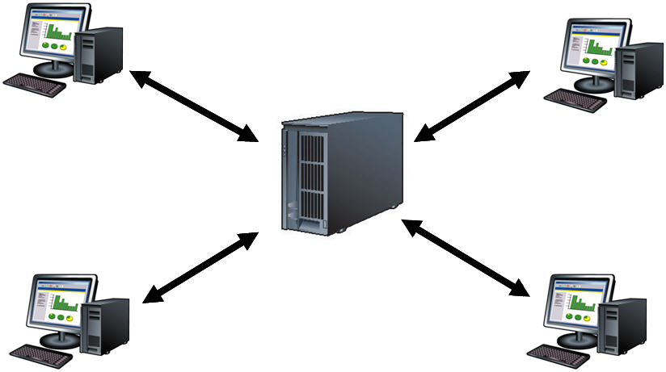
Client-Server Model
client
client
Server/state machine
client
client
Scenario 1: With a single server

Slide 5
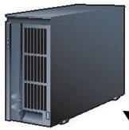
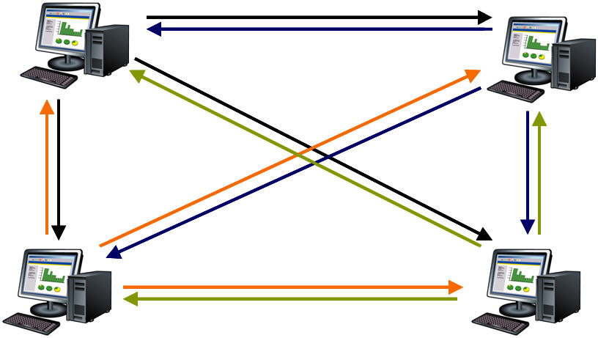
Client-Server Model
client
client
replicated servers/state machines
client
client
Scenario 2: With replicated servers

Slide 6
State Machine Replication (SMR)
Replicas maintain the same state
  Replicas start in the same state
  Operations are deterministic
  Replicas execute operations in the same order
Replicas send replies to clients
Clients vote on replica replies

Slide 7
Crash Fault-Tolerant SMR
Example:
  Paxos: SMR for crash failures
The “most” important backbone architecture
Each major service
  BigTable, Chubby, Spanner, Azure, Amazon Web Services, Ceph, IBM SAN, VMware NSX, …
[Lamport, ACM TOCS 1998]; going back to 1980s

Slide 8
BFT SMR = BFT Protocols
Traditionally important
  Powerful: arbitrary failures & attacks
  Systems, distributed systems, theory, crypto, security, …
Recently gain prominence
  Cryptocurrencies, or blockchains
  Secure and reliable cloud
  Pub/Sub, SDN, Storage …

Slide 9
Leader-Based (BFT) SMR
Leader-based SMR
  Primary (one of the replicas) orders the operations
  Other replicas follow the order
  Other replicas monitor the primary and do a view change if primary fails/behaves maliciously

Slide 10
Leader-Based SMR: Broadcast- vs. Chain-Based
Broadcast-based SMR
  CFT: e.g., Paxos
  BFT: e.g., PBFT
  Zyzzyva
  Reasonable performance + Robust against attacks
Chain-based SMR
  CFT: Chain replication
  BFT: BChain (this talk)
  Better performance + No such protocols until BChain
[Castro and Liskov, ACM TOCS 2002]; earlier version [OSDI 1999]
[Kotla et al. SOSP 07]
[Renesse and Schneider,OSDI 04]
[Duan, Meling, Sean, and Zhang, OPODIS 2014]

Slide 11
Some Efforts towards Chain-Based BFT
Aliph-Chain
  A sub-protocol of a BFT protocol
  Only works in the failure-free case
  Has to switch to a (slower) backup BFT protocol; The switch is slow
Byzantine Chain Replication
  Relies on trusted data center Olympus (to help achieve liveness)
[Aublin et al., ACM TOCS 2015];
earlier version [EuroSys 2010]
[Renesse,Ho, and Schiper,OPODIS 12]

Slide 12
BChain
Fully fledged BFT
High throughput
Failure handling
  Avoiding view changes (for most failure scenarios)
Proactive security
  Reconfiguring failures
Not as robust as broadcast-based BFT under certain performance attacks

Slide 13
BChain Overview: BChain-3 and BChain-5
Chaining
  Failure-free case
Re-chaining
  Normal case: there are failures but primary is correct
Reconfiguration
  May or may not need
View Change
  Primary is faulty

Slide 14
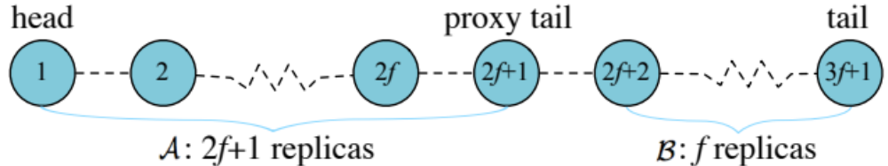
BChain-3
3f+1 replicas
Replicas are in a chain
Two sets
  A: Agreement set (2f+1 replicas)
  B: Backup set – For failure reconfiguration

Slide 15
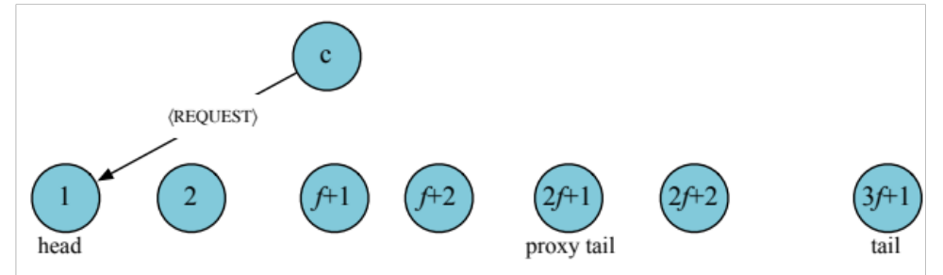
BChain-3: Chaining
Free-free case
  Client sends a request to the head

Slide 16
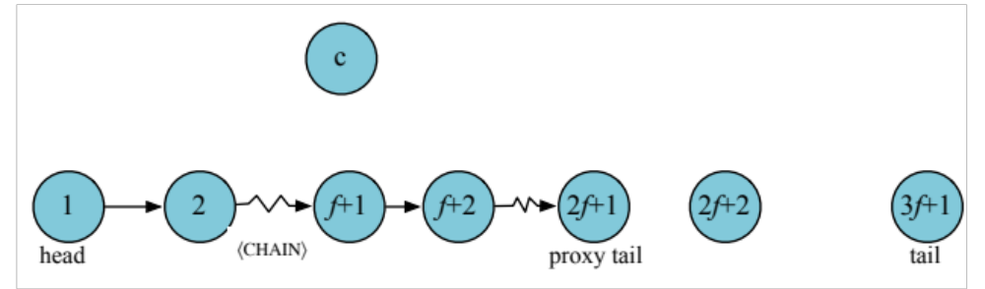
BChain-3: Chaining
  Head assigns sequence number and sends <chain> message
  Replicas in A execute request and send <chain> message

Slide 17
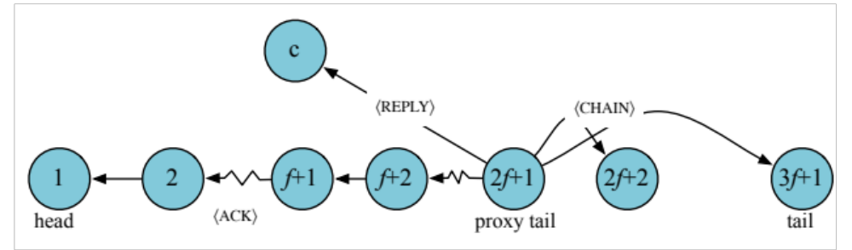
BChain-3: Chaining
  Proxy tail sends <reply> to the client and commits
  An <ack> message is sent backward to the head
  Set A replicas verify <ack> message and commit
  Replicas that have committed the requests forward <chain> messages to set B

Slide 18
BChain-3: Re-chaining
Normal case: during failures but head is correct
  Re-chaining!
  Much faster than view change or protocol switch

Slide 19
BChain-3: Re-chaining
Replica monitors its successor
  Sets up a timer when sending <chain>
  Suspects its successor if it did not receive <ack> in time
When there are “reported” failures
  Re-chaining: Head reassigns the order of the chain
  Reconfiguration: Replicas in set B get reconfigured

Slide 20
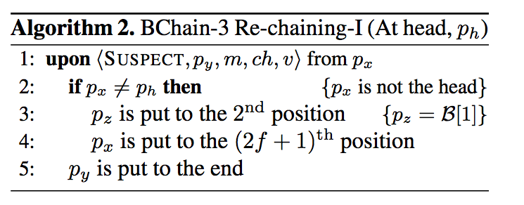
BChain-3: Re-chaining Algorithm

Slide 21
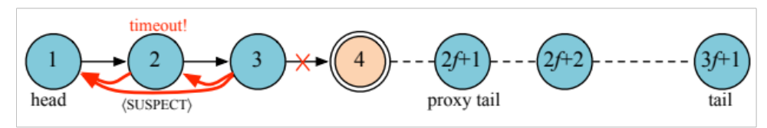
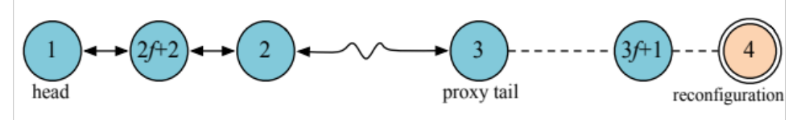
BChain-3: Re-chaining
Type I: Faulty replica (in yellow, replica 4) did not send <ack> (or <chain>) in time

Slide 22
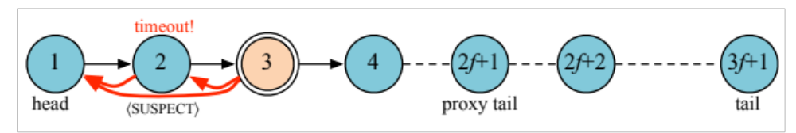
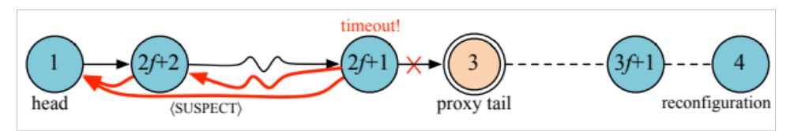
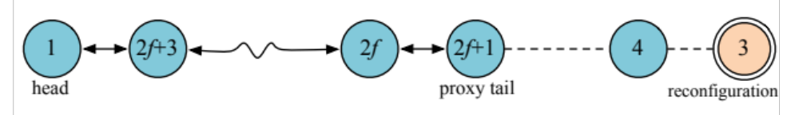
BChain-3: Re-chaining
Type II: Faulty replica (in yellow, replica 3) tries to frame its correct successor (replica 4).

Slide 23
BChain-3: Reconfiguration
When replicas are moved to set B
  It is replaced with a new one
  Faulty replicas are reconfigured before they are moved back to set A
  Replicas in set A keeps running without waiting

Slide 24
BChain-3 Summary
3f+1 replicas
Reconfiguration needed
Re-chaining algorithms are simple
  Proofs are very complex

Slide 25
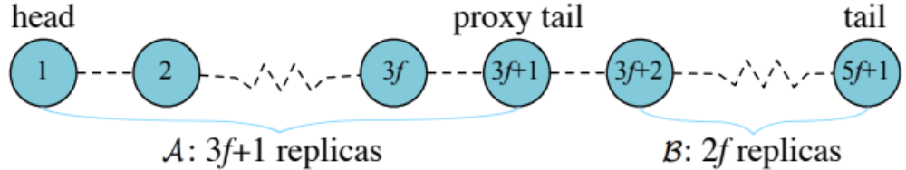
BChain-5
5f+1 replicas; Byzantine quorum is 3f+1
Re-chaining: When a replica suspects its successor, both are moved to set B
No reconfiguration needed (but you still can!)

Slide 26
BChain Optimizations
Almost all signatures can be replaced with MACs
A hybrid protocol
  Signatures needed only for re-chaining
In its most applicable case for BChain-3:
  f=1 and n=4
  No reconfiguration needed
  All MACs

Slide 27
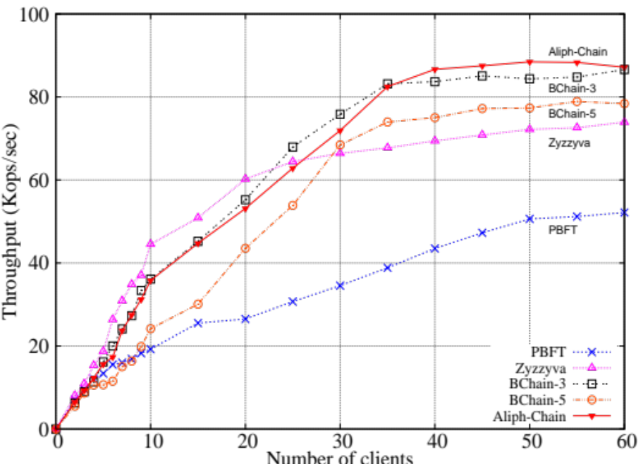
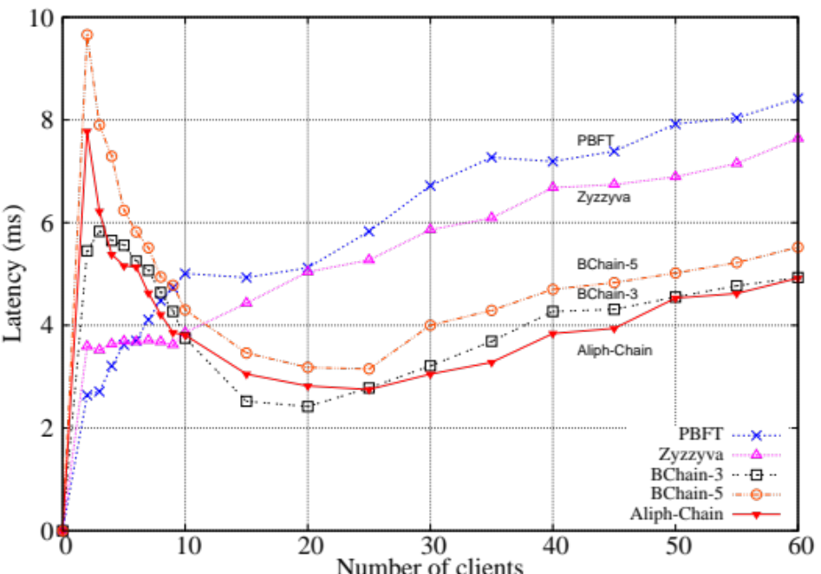
Implementation and Evaluation
Failure-free: BChain is almost as efficient as Aliph-Chain

Slide 28
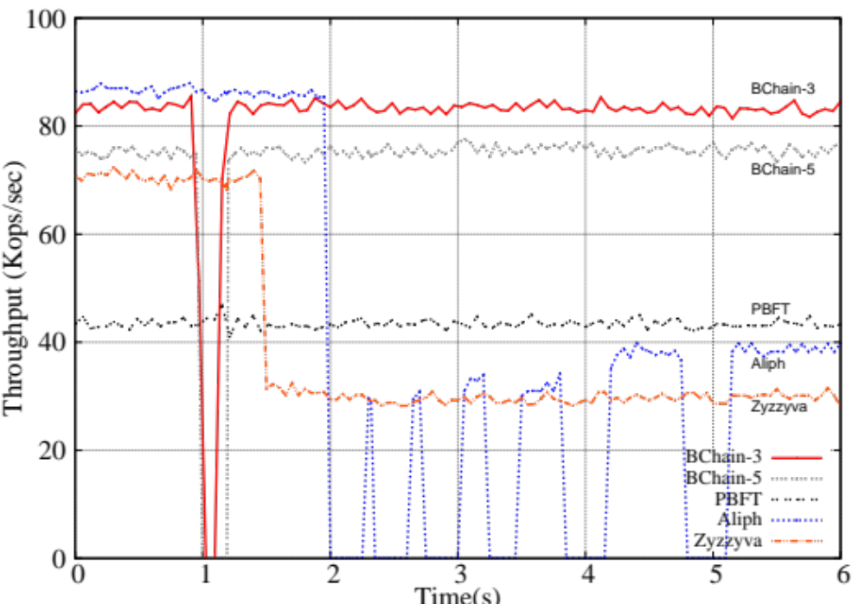
Implementation and Evaluation
Under failures: BChain quickly recovers steady state performance

Slide 29
BFT
Three most important security goals:
  Integrity (= Safety)
  Availability (= Liveness)
  Confidentiality
BFT naturally achieves Integrity and Availability
What about BFT with Confidentiality?

Slide 30
BFT + Confidentiality?
Cloud Storage
Achieving confidentiality in replicated state machines is difficult
Why?
  replication increases reliability
  replication reduces confidentiality (by, say, taking control of the weakest replica)

Slide 31
CBFT and CP-BFT
[Yin et al., SOSP 03]
CBFT: confidential BFT
  Separating agreement from execution
CP-BFT: causality-preserving BFT
  A confidentiality notion that only exists in BFT/atomic broadcast/distributed systems
[Duan and Zhang, SRDS 16]
[Reiter and Birman, TOPLAS 94]
[Reiter and Zhang, 2016]

Slide 32
CP-BFT Scenario
A trading service that trades stocks.
A client issues a request to purchase stock shares.
A corrupt replica could collude with a corrupt client to issue a request for the same stock.
If the new request is processed earlier than the original request,
  this may adjust the demand for the stock

Slide 33
MACS Related Projects
  UC Isolated Computation
  UC Keystone
  Secure and Fault-Tolerant Keystone and Swift

Slide 34
Thank you!

