Slide 1
Universal Composability Security Analysis of OpenStack
Hoda Maleki
A joint work with:
Ran Canetti, Marten van Dijk, Jason Hennessey, Kyle Hogan, Reza Rahaeimehr, Mayank Varia, and Haibin Zhang

Slide 2
Outlines
OpenStack
Universal Composability
Security Analysis
Results
Conclusion

Slide 3
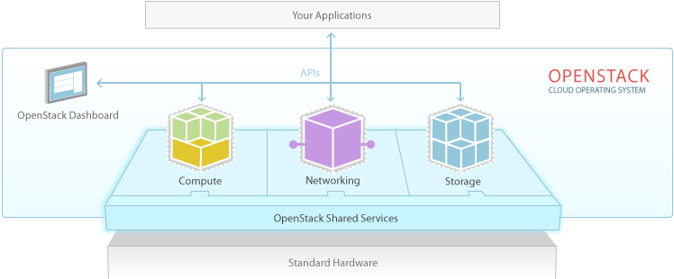
OpenStack
Reliable Open Source Cloud Platform
Widely Used
  75% of clouds in production or full operational use
Infrastructure as a Service (IaaS)
Highly Modular
  23 main modules
  Many plug-ins
Community based development Model
  More than 6500 contributors
Rapidly growing
  6-month cycles

Slide 4
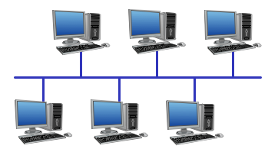
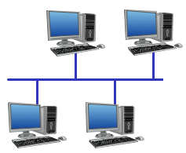

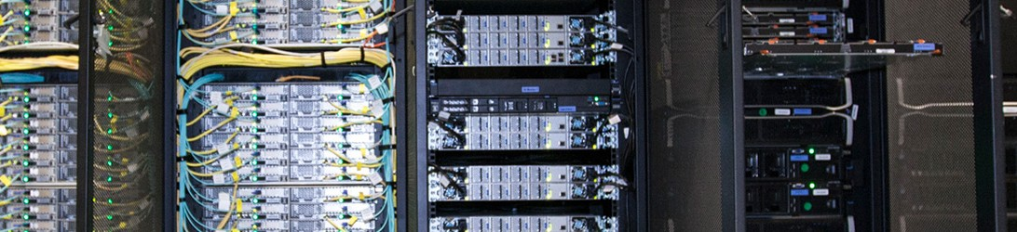
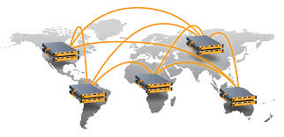
IaaS
Cloud Platform

Slide 5

Cloud Issues
Cloud Platform
  Huge software
  Many bugs
Cloud servers several different applications
  Isolation
    Shared underling hardware
    Bugs
Cloud serves many people
  Attackers, Hackers
  Privacy, Confidentiality

Slide 6
OpenStack Security Issues
Cloud issues
Difficulty of security analysis
  More than 10 million lines of code
  More than 6,500 contributors
Lack of clear security model
Not well defined APIs
Lots of plug ins
  VMM: KVM, XEN, Hyper-V, VMware

Slide 7






Main Services
Object storage
Identity
Compute
Networking
Block Storage
Image Service
SWIFT KEYSTONE NOVA NEUTRON CINDER GLANCE

Slide 8
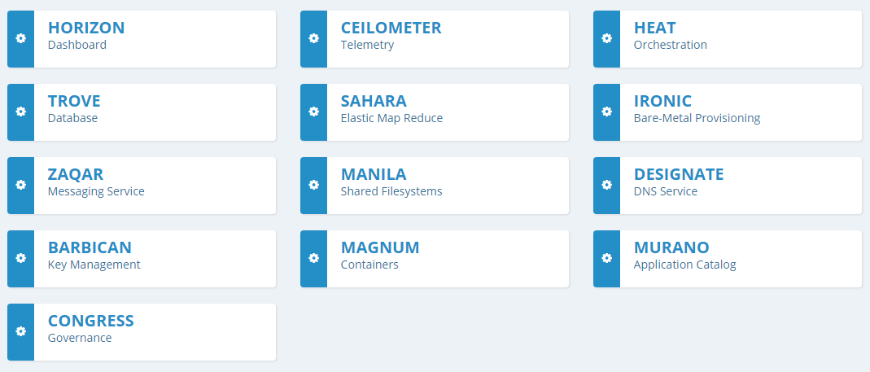
Optional Services

Slide 9
User Request flow in OpenStack
User Dashboard
UserName/Password
Validation result
Bearer Token
Token,Request
Token
Result
Identity
Token,Request
Token
Block Storage
Compute
Validation result
result
Image Service
Object Storage
Networking

Slide 10
Universal Composability
General-purpose model for security analysis of protocols
Common understanding and common language
The UC approach:
Specification via an Ideal-Service
  The security of a system is reflected only in its effects on the rest of the external environment.
  Therefore to capture the desired security of system π:
  Write an “ideal system” φ that captures the desired effect

Slide 11
Universal Composability
General-purpose model for security analysis of protocols
Common understanding and common language
The UC approach:
Specification via an Ideal-Service
  The security of a system is reflected only in its effects on the rest of the external environment.
  Therefore to capture the desired security of system π:
  Write an “ideal system” φ that captures the desired effect

Slide 12
Protocol emulation
E
~
E
API
API
π
φ
Side-effects
A
S
Side-effects
Side-effects
Protocol π UC-emulates protocol φ if for all A there exists S such that for all E, Exec_{E,A,π} ~ Exec_{E,S,φ .}
(Exec_{E,…} returns the output of E from the execution …)

Slide 13
The universal composition theorem
Protocol π that emulates protocol φ
Protocol ρ that makes subprotocol calls to φ
Result: A protocol ρ^{φ→π} Where:
The calls to each MI of φ are replaced by calls to a MI of π
Values returned from each MI of π are treated as coming from a MI of φ
Universal Composability: If we can show that a protocol satisfies some security properties, these security properties will remain even when we compose it with other protocols.
E
E
API
API
~
φ
π
Side-effects
S
Side-effects
Side-effects
➔
E
E
API
API
~
ρ
ρ
Side-effects
Side-effects
π
π
…
π
φ
φ
…
φ

Slide 14
Universal Composability Analysis of OpenStack
Steps
  Define Functionality of Ideal system
  Define Functionality of the real system
  Show that real system realize the Ideal system Functionality
  Propose OpenStack Modifications to realize the Functionalities

Slide 15
Services we analyze
Identity
Compute
Block Storage
Image Service
Notes:
The services that we model

Slide 16
Ideal Cloud
Environment
Our ideal cloud functionality provides the user with the following set of commands:
We study the security properties provided by OpenStack when viewed as a service to external users (which is a typical model for most large scale applications). This includes properties such as:
  Confidentiality and integrity of data (both in storage and in transition)
  Confidentiality and correctness of computations
Delete Node
Create Node
Access Node
…
Attach Volume
Create Node | Attach Volume
Delete Node | Detach Volume
Access Node
F_{OpenStack}
APIs
Notes:
AccessNode: Allows a user to execute a command on one of their nodes.
AttachVolume: Allows a user to attach one of their volumes to an existing node.
DetachVolume: Allows a user to detach a volume that had been attached to one of their nodes.

Slide 17
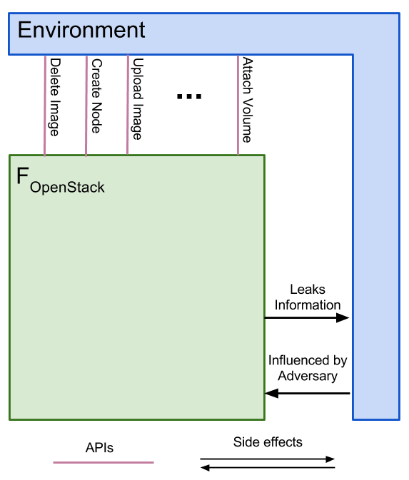
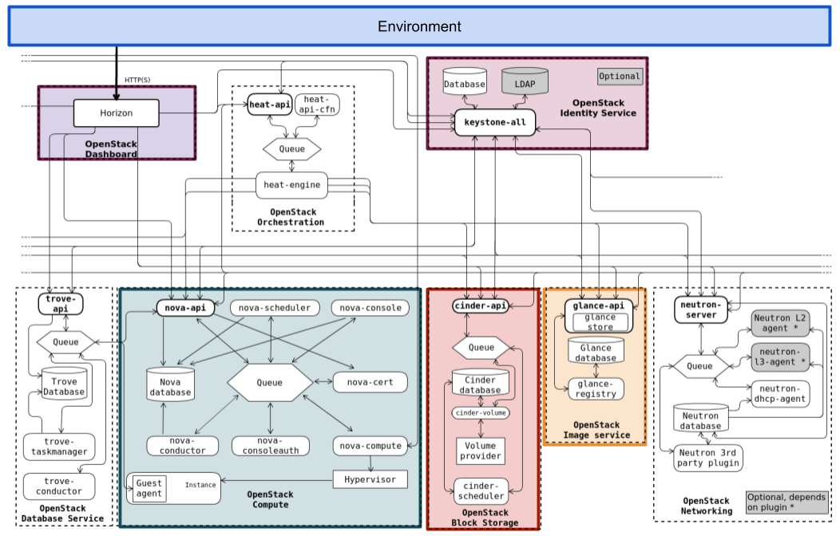
Security Analysis
≈
Simulator

Slide 18
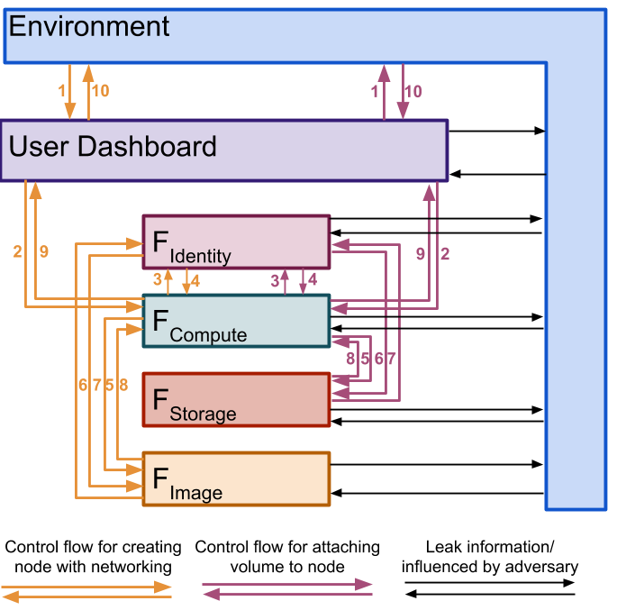
Hybrid World
F_{SMT}: Represents the TLS-enabled message bus. It is a secure message transmission functionality that protects the integrity of messages; additionally, it protects the confidentiality of tokens.
This is a deviation from OpenStack as-is, which would allow any compromised service to breach message integrity and token confidentiality.
F_{ExtNet}: External communication between services and users (or their Dashboards) is handled by this functionality, which provides data confidentiality but does not authenticate the message’s sender.
This modeling decision reflects the fact that OpenStack never verifies whether the user sending the message is actually the owner of the credentials contained therein.
Notes:
Message bus: OpenStack’s internal message queue that handles communication between services.

Slide 19
Security Analysis
≈
Simulator

Slide 20
Steps
Ideal World
Hybrid World 1
Hybrid World 2
Hybrid World n
Real World
≈
≈
…
≈
Emulation is transitive:
If protocol A UC-emulates protocol B and B UC-emulates protocol C then A UC-emulates C.

Slide 21
Example: Delete Node
Environment
1- (Receiver, “Delete Node”, session-id, node-id)
2- (”Delete Node”, session-id, node-id, Success/fail)
2
1
Ideal Cloud

Slide 22
Example: Delete Node
Environment
1- (Receiver, “Delete Node”, session-id, node-id)
2- (U_{Dashboard}, F_{Compute}, Request-Message, token)
3- leak the message after removing token
4- continue message from E
5-Send message (2) to F_{Compute}
6-(F_{Compute}, F_{Identity}, ”Service Validation”, session-id, Service token, token, ”Delete node-id ”)
7-leak the message after removing token
8- continue message from E
9-Send message (6) to F_{Identity}
10- (F_{Identity}, Receiver, ”Service Validated”, session-id, user-id, service-id, Request, valid);
18
1
User
Dashboard Protocol
17
2
3,15
External Network
4,16
14
5
Compute
Identity
13
6
9
10
7, 11
SMT
8, 12

Slide 23
Example: Delete Node
Environment
11- leak to E
12- continue message from E
13-Send message (10) to F_{Compute}
14-(F_{Compute}, Receiver, ”Delete Node”, session-id, node-id, Successful);
15,16- leakage and continue message
17- send result message (14) to U_{Dashboard}
18- user receives the result
18
1
User
Dashboard Protocol
17
2
3,15
External Network
4,16
14
5
Compute
Identity
13
6
9
10
7, 11
SMT
8, 12

Slide 24
Example: Delete Node
Environment
Environment
18
1
16
1
2
User
Ideal Cloud
Simulator
3
Dashboard Protocol
4
5
17
2
6
3,15
7
External Network
4,16
8
14
5
9
10
Compute
Identity
11
13
6
9
10
12
7, 11
13
SMT
8, 12
14
15

Slide 25
Corrupted Service
Different Services get compromise
  In this situation, we needed to relax ideal cloud in order to provide more information to the simulator. This means less security!
  Result:
    When E compromises F_{Identity} essentially has full control of OpenStack.
    For other services, if they get compromised, the adversary get access to all the tokens that are being used by that service and may apply different functionalities that the service is able to do or any arbitrary action as well.

Slide 26
Security Assertions
Authentication & authorization: As long as F_{Identity} is uncompromised, E is limited to perform only those actions authorized by her projects and roles. Corrupt services can perform actions within their scope on behalf of the environment, but cannot influence uncorrupted services to perform unauthorized actions.
User control: By moving away from bearer tokens, we can provide some user control even in the face of service level compromises. Bearer tokens allow a corrupted service to impersonate a user to other, uncorrupted services and perform unintended actions.
Resource control: The environment gets restricted from accessing and tampering with user’s computing nodes, data volumes, and images as long as two services remain uncompromised: F_{Identity} and the service managing the object.
Notes:
Our analysis shows that

Slide 27
Conclusion & future work
This work lays the foundation for a full-scope composable security analysis for the popular cloud management framework OpenStack.
It brings a number of communities together:
  Cryptography and programming languages communities
  Development community
Much more work is needed to be done.
Mechanizing the analysis, and in particular the proofs of security.

Slide 28
Reference
“On the Universally Composable Security of OpenStack”, Cryptology ePrint Archive, Report 2018/602. http:// ePrint.iacr.org/. 2018.
Thanks!

