Slide 1

Is there an Oblivious RAM Lower Bound for Online Reads?
Mor Weiss (Northeastern $→$ IDC, Herzliya)
Daniel Wichs (Northeastern)

Slide 2


Oblivious RAM [Goldreich 87, Ostrovsky 90, GO 96]
Read and write to memory, hide which locations are being accessed
Physical access pattern hides virtual access pattern
Overhead: # physical accesses per virtual access
read j₁
ORAM
(secret state)
read i
write j₂ b
read j₃
virtual memory
physical memory

Slide 3
Minimizing Overhead
O(log³ N) [Goldreich-Ostrovsky 96]
O(log² N/ log log N) [Kushilevitz, Lu, and Ostrovsky 12]
O(log N) with big block-size [Wang, Chan, Shi 15]
O(log N poly (log log N)) [Patel et al. 18]
O(log N) [Asharov et al. 18]
Can we get o(log N)? Are there lower bounds?
N = virtual memory size

Slide 4
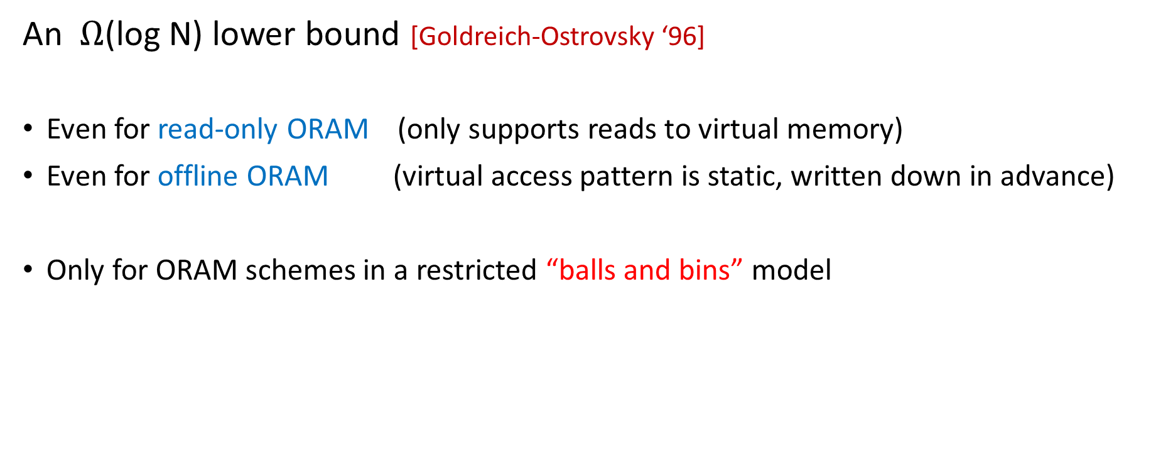
ORAM Lower Bound
An $Ω$(log N) lower bound [Goldreich-Ostrovsky ‘96]
Even for read-only ORAM (only supports reads to virtual memory)
Even for offline ORAM (virtual access pattern is static, written down in advance)
Only for ORAM schemes in a restricted “balls and bins” model

Slide 5
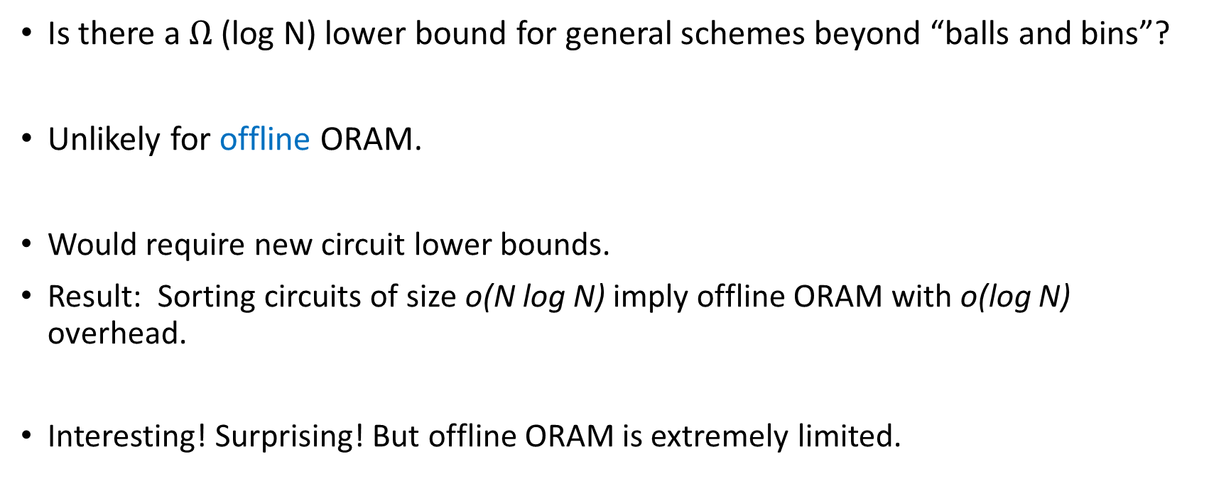
Is there an ORAM lower bound?
[Boyle-Naor ‘16]
Is there a $Ω$(log N) lower bound for general schemes beyond “balls and bins”?
Unlikely for offline ORAM.
Would require new circuit lower bounds.
Result: Sorting circuits of size o(N log N) imply offline ORAM with o(log N) overhead.
Interesting! Surprising! But offline ORAM is extremely limited.

Slide 6
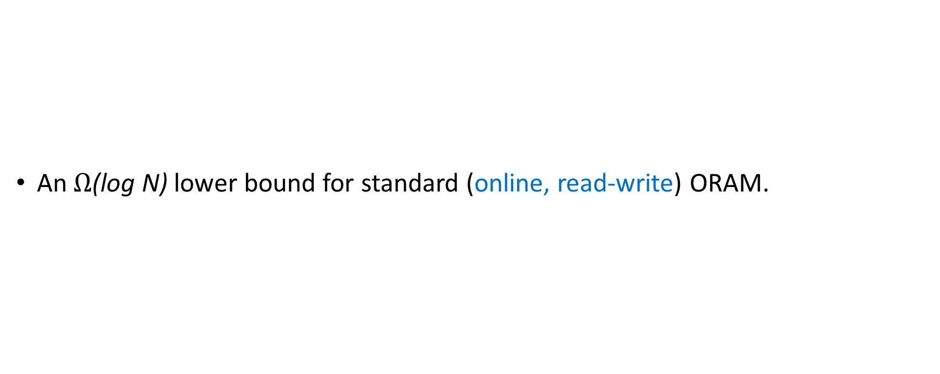
Yes, there is an oblivious RAM lower bound!
[Larsen-Nielsen ‘18]
An $Ω$(log N) lower bound for standard (online, read-write) ORAM.

Slide 7
lower bound in “balls and bins” model [Goldreich-Ostrovsky ‘96]
  Even for offline ORAM
  Even for read-only ORAM
general lower bound unlikely for offline ORAM
[Boyle-Naor ‘16]
general lower bound for standard (online, read/write) ORAM [Larsen-Nielsen ‘18]
What about read-only ORAM?

Slide 8
lower bound in “balls and bins” model [Goldreich-Ostrovsky ‘96]
  Even for offline ORAM
  Even for read-only ORAM
general lower bound unlikely for offline ORAM
[Boyle-Naor ‘16]
general lower bound for standard (online, read/write) ORAM [Larsen-Nielsen ‘18]
This work:
general lower bound unlikely for read-only ORAM

Slide 9
Main Result
Given “amazing sorting circuits” and “amazing locally-decodable codes (LDCs)”, get a read-only ORAM with overhead as low as O(log log N).
Amazing sorting circuits: linear size
Amazing LDCs: constant # queries, polynomial-size codeword
(have 3-query LDCs with exp(N^{o(1)}) codeword size. )
Don’t have either, but also no lower bounds despite much study!
Barrier to a lower bound for read-only ORAM.

Slide 10
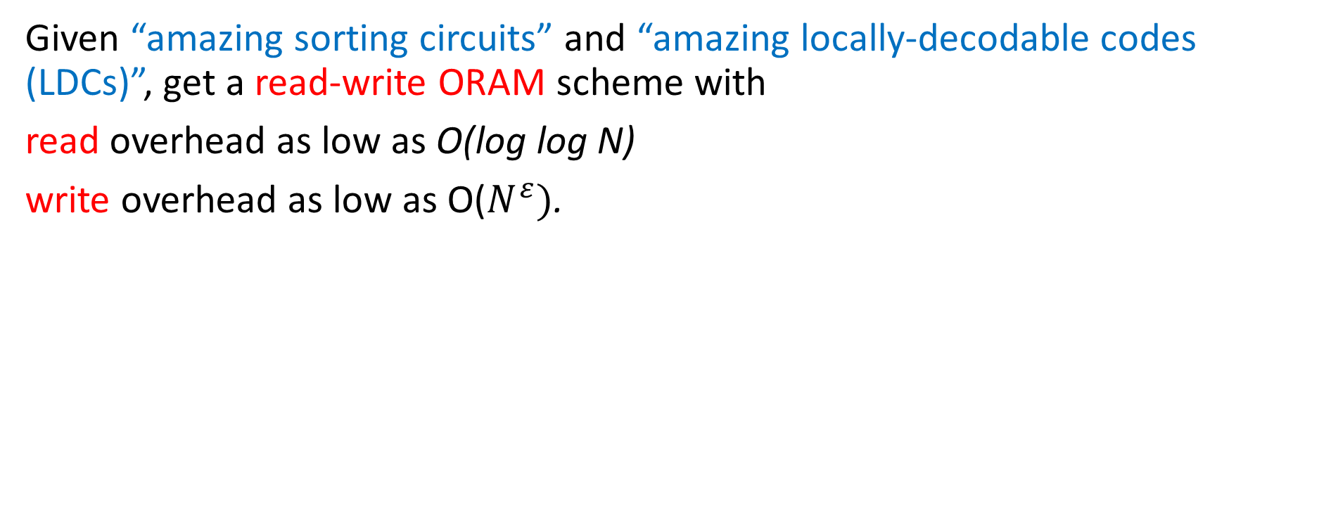
Extended Result
Given “amazing sorting circuits” and “amazing locally-decodable codes (LDCs)”, get a read-write ORAM scheme with
read overhead as low as O(log log N)
write overhead as low as O($N^{ε})$.

Slide 11
Caveat: Large Block Size
Physical memory consists of words of w = log N bits.
Virtual memory consists of blocks of B = polylog N words.
Reasonable model for e.g. a filesystem
Overhead = (# of physical words accessed per virtual block access) / B
Large block size allows us to access polylog N size meta-data for free.

Slide 12

Construction Idea: Start with LDCs
Assume LDC with k = O(1) queries and codeword size M = poly(N).
Smoothness: codeword locations j_{t} are individually uniform
$$c_{M}$$ |  |  |  | $$…$$ | $$c_{2}$$ | $$c_{1}$$
codeword
read j₁
read j₂
read j_{k}
LDC
read i
message

Slide 13






Construction Idea: Permuted LDCs
Make k randomly permuted copies of the codeword.
Read each codeword location from different copy.
How to store/access permutations? Meta-Data!
$$c_{1}$$ |  |  |  | $$c_{2}$$ | $$c_{M}$$
 | $$c_{M}$$ | $$c_{2}$$ |  | $$…$$ | $$c_{1}$$
codeword
 | $$c_{1}$$ | $$c_{M}$$ |  |  |  | $$c_{2}$$
read $π_{2}($j₂)
read $π_{1}($j₁)
read $π_{k}($j_{k})
ORAM
read i

Slide 14
Construction Idea: Security of Permuted LDCs
Key property: if locations are fresh, then have security
$$c_{1}$$ |  |  |  | $$c_{2}$$ | $$c_{M}$$
 | $$c_{M}$$ | $$c_{2}$$ |  | $$…$$ | $$c_{1}$$
codeword
 | $$c_{1}$$ | $$c_{M}$$ |  |  |  | $$c_{2}$$
read $π_{2}($j₂)
read $π_{1}($j₁)
read $π_{k}($j_{k})
ORAM
read i

Slide 15
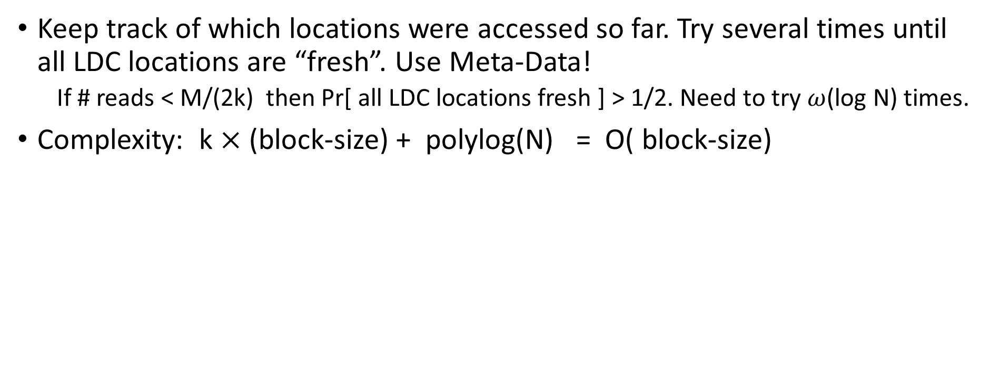
Construction Idea: Bounded-Access ORAM
Keep track of which locations were accessed so far. Try several times until all LDC locations are “fresh”. Use Meta-Data!
  If # reads < M/(2k) then Pr[ all LDC locations fresh ] > 1/2. Need to try $ω$(log N) times.
Complexity: k $×$ (block-size) + polylog(N) = O( block-size)
$$c_{1}$$ |  |  |  | $$c_{2}$$ | $$c_{M}$$
 | $$c_{M}$$ | $$c_{2}$$ |  | $$…$$ | $$c_{1}$$
 | $$c_{1}$$ | $$c_{M}$$ |  |  |  | $$c_{2}$$
read $π_{2}($j₂)
read $π_{1}($j₁)
read $π_{k}($j_{k})
ORAM
read i

Slide 16
Construction Idea: Unbounded Access
After every M/(2k) reads, freshly and obliviously re-permute all codewords.
Use linear-size sorting circuits!
$$c_{1}$$ |  |  |  | $$c_{2}$$ | $$c_{M}$$
 | $$c_{M}$$ | $$c_{2}$$ |  | $$…$$ | $$c_{1}$$
 | $$c_{1}$$ | $$c_{M}$$ |  |  |  | $$c_{2}$$
read $π_{2}($j₂)
read $π_{1}($j₁)
read $π_{k}($j_{k})
ORAM
read i

Slide 17
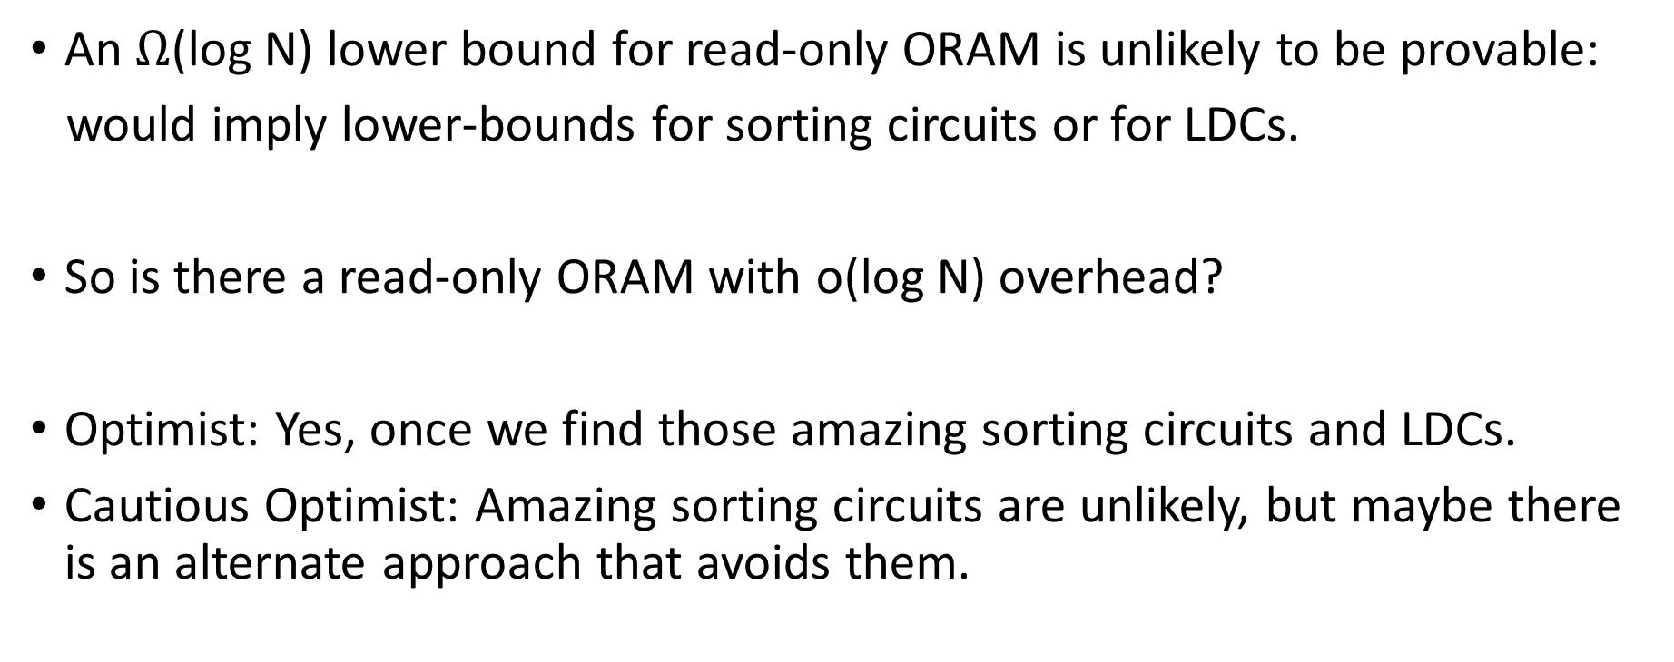
Summary
An $Ω$(log N) lower bound for read-only ORAM is unlikely to be provable:
would imply lower-bounds for sorting circuits or for LDCs.
So is there a read-only ORAM with o(log N) overhead?
Optimist: Yes, once we find those amazing sorting circuits and LDCs.
Cautious Optimist: Amazing sorting circuits are unlikely, but maybe there is an alternate approach that avoids them.

Slide 18

This Photo by Unknown Author is licensed under CC BY

