Slide 1

Pathways to Decarbonization in China and India: Evidence of Integrated Governance Solutions
Bruce Gilley
Portland State University

Slide 4
Needed to limit temperature rise to 2.5C

Slide 5
Main Findings
Successful mitigation by China and India requires them to remedy different weaknesses in their integrated governance of greenhouse gases
For China, where “state signaling” dominates, the need is for intra-governmental linkages – e.g. the case of Guangzhou
For India, where “market plus” dominates, the need is for state-society linkages – e.g. the case of Gujarat

Slide 6
Politics
Policy
Administration
Capacity and Management
6 I’s
Effectiveness, Efficiency, and Predictability

Slide 7
Politics | Policy | Administration
Policy
Administration
Politics
= Not Feasible
= Feasible, Not
Integrated
= Integrated

Slide 8
Failing Models
 | Politics | Policy | Administration
CHINA (lost signals) | Mixed priorities | Reliance on a few old sticks | Weak, non-existent networks
INDIA (market failure) | Missing political leadership | Reliance on a few new sermons | Need for federal intervention

Slide 10


China

Slide 11
The Case of Guangzhou

Slide 12
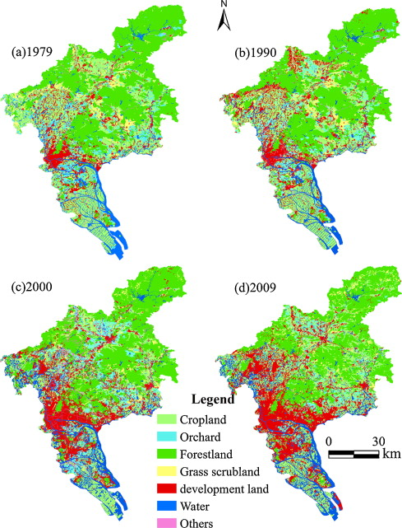
Guangzhou Land Use Changes

Slide 13
Life’s a Bus: Guangzhou
Guangzhou Bus Rapid Transit System
https://vimeo.com/61517675

Slide 14

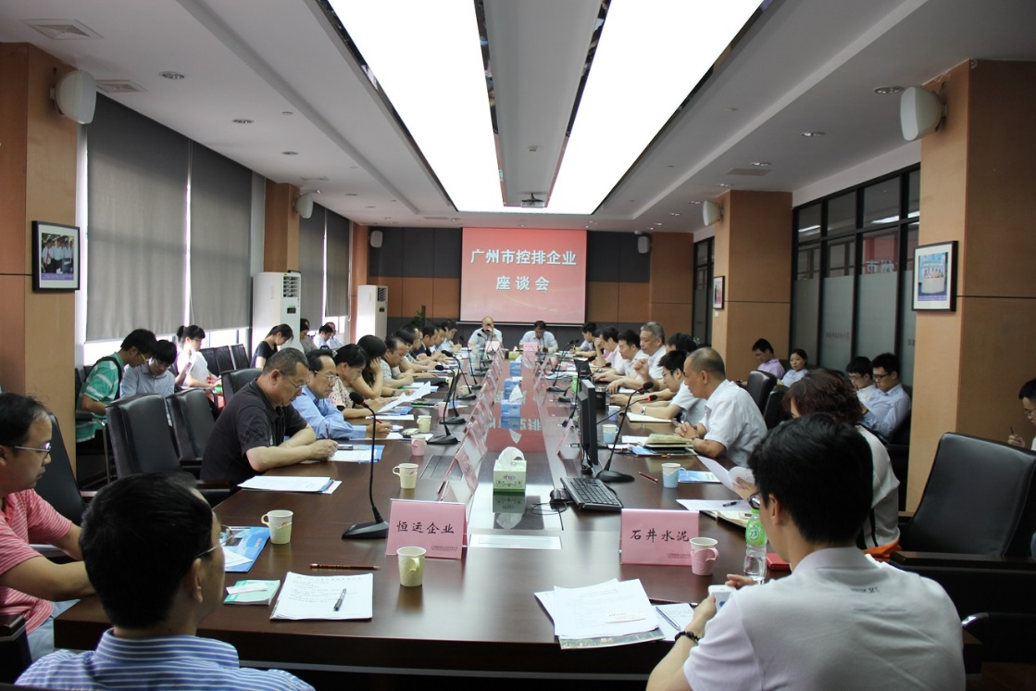
City of Guangzhou Tiered Electricity Pricing Hearing, May 2012
City of Guangzhou Carbon Emissions Trading Compliance Meeting, June 2014

Slide 15
Successful Models
 | Politics | Policy | Administration
CHINA (intra-state linked-up governance) | Local green branding of national policies | Innovative new sticks | Local intra-governmental networks

Slide 16
Gujarat’s CO2 Emissions as % India Total

Slide 17
Life’s a Bus: Ahmedabad
Ahmedabad Bus Rapid Transit System
https://vimeo.com/60441334

Slide 18

India Success Case: Gujarat

Slide 19
Successful Models
 | Politics | Policy | Administration
INDIA (state-society linked-up governance) | Local leadership linked to co-benefits alliance | Multiple sticks and sermons | State-business network

Slide 20
Lessons Learned
Comparative Pathways of China and India
Applicability to Other Large Emitters
Policy Implications

