Slide 1
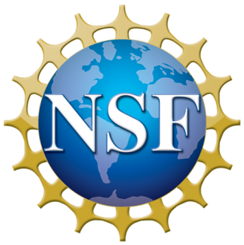
NSF and geosciences updates
Boston University
September 27, 2018
Bill Easterling, AD for Geosciences

Slide 2
Topics
Budgets
Cross-Directorate Activities: Convergence Science
Sexual Harassment Policy
Overview of What’s Happening in
  the Geosciences Directorate

Slide 3
Budget updates
FY 2019
NSF FY 2019 Request is $ 7.47 Billion. Includes construction funding for Antarctic Infrastructure Modernization for Science (AIMS).
House Committee on Appropriations report for FY 2019 budget expresses support for AIMS and includes recommendation for $127.09 million for the construction of three Regional Class Research Vessels (RCRVs).
Senate report is pending.
FY 2020 Budget planning is well underway.

Slide 4
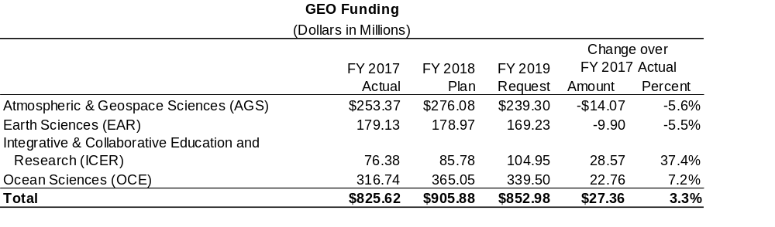

Slide 5


You’ve all heard the chant: NSF’s mission is to support fundamental curiosity-driven research. It’s the Lord’s work.
Applied research is for lesser minds
JUST KIDDING, IN CASE ANYONE THOUGHT I WAS SERIOUS!
But things have changed and NSF—i.e., the “research community”—sees a shiny new rock called “use-inspired” basic research!

Slide 6
NSF’s “Ten Big Ideas”
Started with push from the National Science Board
Internal discussions among and between NSF directorates
Beginning in FY18

Slide 7
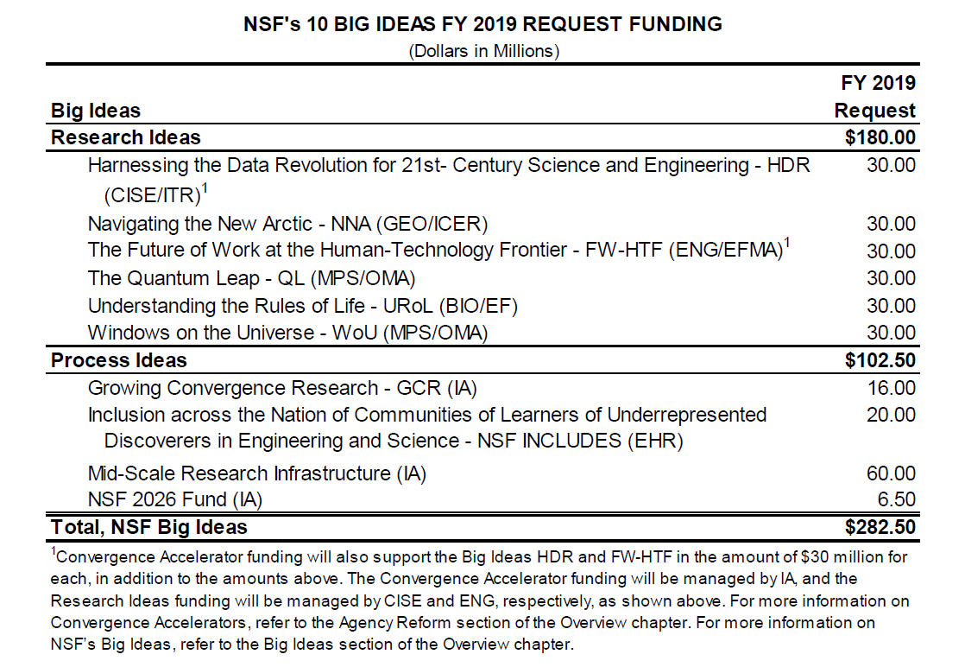

Slide 8

Growing Convergent Research at NSF
Grand challenges will not be solved by one discipline alone.
Convergence blends scientific disciplines in a coordinated, reciprocal way—fosters collaborations.
Going beyond forcing old models to play together
Deep integration of disciplines that encourages
convergence of theories

Slide 9
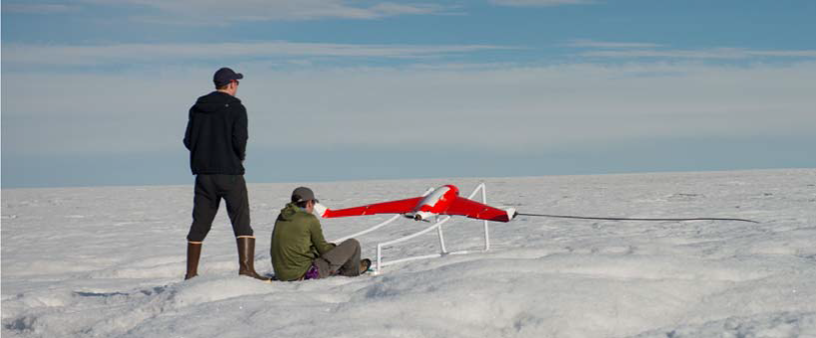
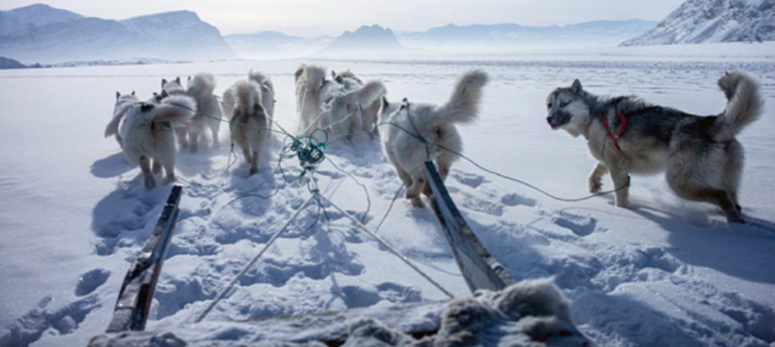
NSF Big Idea: Navigating the New Arctic (NNA):
How will rapid Arctic warming change the jet stream and affect weather patterns that impact economic activities and ecosystems in the Arctic and lower latitudes? How can 21st-century development in the Arctic occur without compromising the environment or indigenous cultures while still benefiting global and Arctic inhabitants?
How will rapid Arctic warming change the jet stream and affect weather patterns that impact economic activities and ecosystems in the Arctic and lower latitudes?
How is Arctic haline circulation changing and what are the consequences?
How can observations inform smart choices for built infrastructure of the future Arctic?
How can observations of Arctic social, economic, and environmental systems be optimized and networked to serve people everywhere?

Slide 10
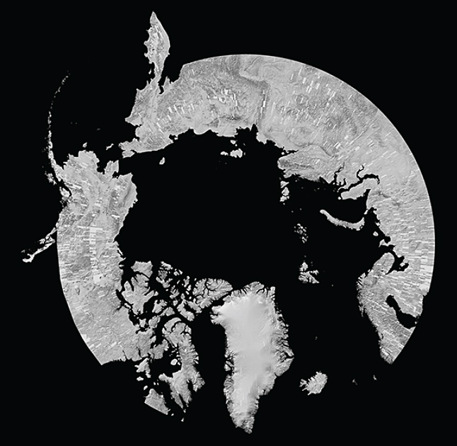
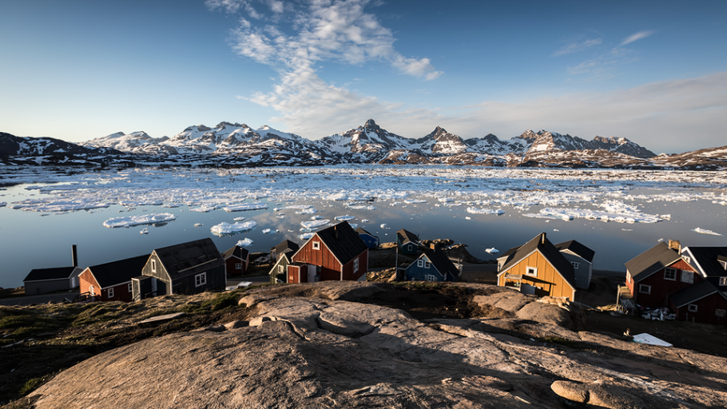
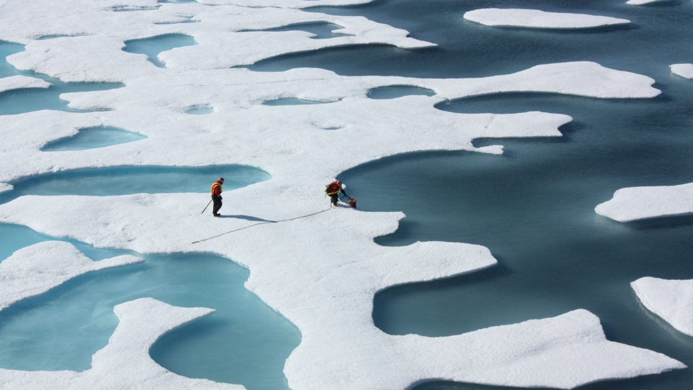
NNA
FY 2017
Awards under Convergence DCL. Focus areas: Observing systems, coastal erosion, transportation, food security, community resilience.
Build on existing investments and capabilities.
FY 2018
DCL issued (NSF 18-048).
Multidisciplinary drifting Observatory for the Study of Arctic Climate MOSAiC (Year Of Polar Predictions).
FY 2019
Request is $30.00 million. Working Group developing solicitation to support:
  Robust, integrated pan-Arctic observational network.
  Integrated modeling natural and human activities.
  Partnering with governments, indigenous peoples and international organizations.
Notes:
These awards were made in 2017 under a Convergence Dear Colleague Letter. So projects had to support convergent research concepts and practices, while addressing the goals of Navigating the new Arctic. A natural fit. NNA has many close connections and areas of mutual interest with Big Ideas including INCLUDES, Rules of Life, Harnessing the Data Revolution, Convergence, and Mid-Scale Infrastructure.
The success of this Big Idea critically depends on being inclusive
The Alaska natives must be part of crafting a research agenda, help collect observations, and understand and have input into how the results will be used for resilience and adaptation.

Slide 11
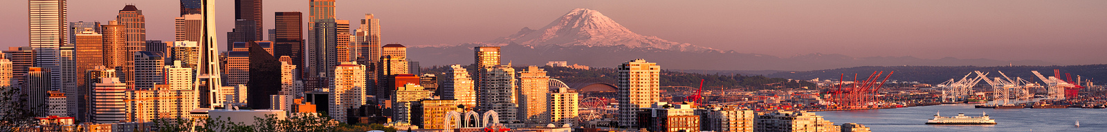
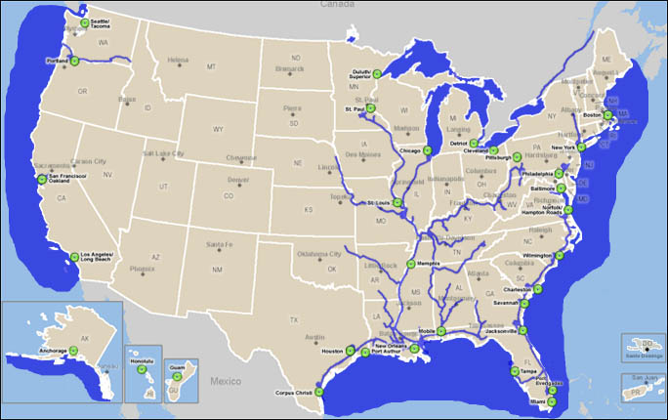
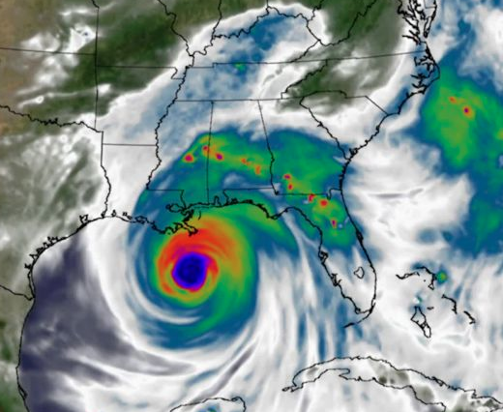
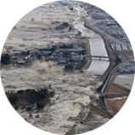
Coastlines and People: CoPe
Urban
flooding
Subduction zone
earthquakes
NSF is developing a novel, interdisciplinary research program that could lead to predictive + responsive capabilities that will directly help decision-makers in populated coastal regions
Sea-level rise
Severe storm surge
CoPe builds on other successful activities:
Core Programs CNH PREEVENTS Coastal-SEES CRISP NHERI
Hurricanes
Tsunamis triggered
by earthquakes
CoPe provides an avenue for Convergence research, and will engage with NSF INCLUDES
Notes:
Coasts are important
NSF is positioned to contribute the fundamental research that informs societal decision making and the mission agencies
Did an inventory of activities over the last 5ish years to ensure we weren’t doing something that was redundant
Came up with what we think is a unique model for addressing this multidisciplinary / convergent theme, while also broadening participation in STEM but especially the Geosciences, which really needs it
Can also tie to Navigating the New Arctic and Big Data

Slide 12
Coastlines and People: CoPe
The Vision: Coastal Science Hubs
September 26-28, 2018: 4 concurrent scoping workshops (San Diego, Chicago, Atlanta, and virtual)
Facilitated by Know Innovation (lots of NSF experience w/ EarthCube, GOLD, etc)
Approx. 100 people/workshop via an open application process
Applications due August 12:
“Coastal Research” means a lot of things to a lot of different disciplines
NSF will be involved in selecting participants, so let us know if interested in helping in that process!
coastlinesandpeople.org

Slide 13
Coastlines and People: CoPe
The Vision: Coastal Science Hubs
- Locations determined through competitive proposal process
- They likely won’t all focus on the same scientific problems or discipline
- They will aim to:
Identify fundamental scientific questions that cannot be addressed outside of a convergent Hub-style activity
Identify scientific gaps via an approach that will promote synergy between agencies
Identify the appropriate + effective administrative structure of a Hub that will promote scientific discovery while enhancing/diversifying the STEM workforce
Develop a plan for engagement + knowledge transfer with coastal communities + local agencies

Slide 14
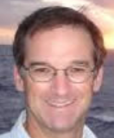
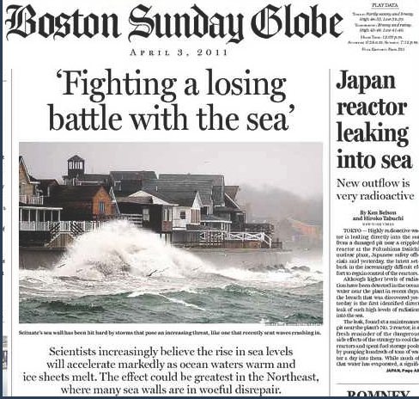

(From Rick Murray, BU)

Slide 15
The Next Slide Requires a Preamble
As you know, I was a dean at Penn State
  Was part of the University’s leadership team that dealt with the Sandusky Sex Scandal
    What it’s like at Ground Zero
  Not my intention to lecture
  But………

Slide 16
NSF Sexual harassment policy
What we’re doing: require awardee organizations to report findings of sexual harassment. Was posted in the Federal Register last week– in effect Oct. 21, 2018.
Why: NSF is committed to promoting safe, productive research and education environments for current and future scientists and engineers.
NSF will not tolerate harassment, including sexual or sexual assault within the agency, at awardee organizations, field sites, or anywhere NSF-funded science and education is conducted.
Upon implementation, the new term and condition will require awardee organizations to notify NSF of any findings/determinations of sexual harassment, other forms of harassment, or sexual assault regarding an NSF funded PI or co-PI.

Slide 17
For purposes of the term and condition, the following definitions apply:
Sexual harassment: May include but is not limited to gender or sex-based harassment, unwelcome sexual attention, sexual coercion, or creating a hostile environment, as set forth in organizational policies or codes of conduct, statutes, regulations, or executive orders.
Other Forms of Harassment: Non-gender or non-sex-based harassment of individuals protected under federal civil rights laws, as set forth in organizational policies or codes of conduct, statutes, regulations, or executive orders.
For more details see: https://www.nsf.gov/news/news_summ.jsp?cntn_id=296671 or Google ‘NSF Sexual Harassment Policy’

Slide 18
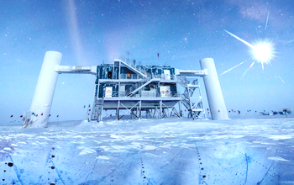
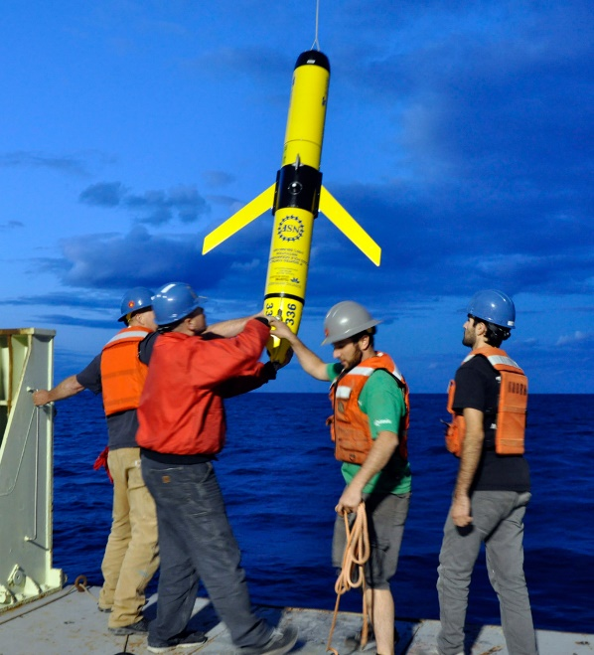
GEO Overview
Majority of fundamental research support for Earth, Atmospheric, and Ocean sciences, and all scientific disciplines in Polar.
Observation-based science reliant upon on multi-purpose, multi-user facilities.
Scientific and technological advances highly interdependent.
On this last point—some cool science just hitting the streets comes next…………
Notes:
GEO AND PP PROVIDE MOST OF NATION’S FUNDING FOR FUNDAMENTAL RESEARCH AND EDUCATION ACROSS EARTH AND POLAR SCIENCES
EARTH AND POLAR ARE HIGHLY OBSERVATION-BASED SCIENCES, HENCE RELIANCE ON LARGE FACILITIES LIKE NCAR, THE ACADEMIC RESEARCH FLEET AND THE PALMER STATION IN ANTARCTICA.

Slide 19
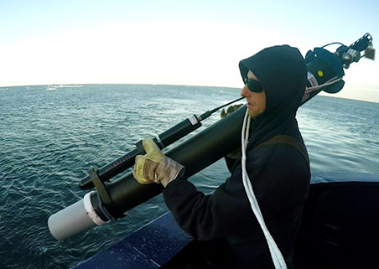
Data from diving robots reveal surprise: Southern Ocean releases significantly more carbon dioxide in winter than previously believed.
Team from Princeton wonders: should we be confident that ship-based summer-only observations give us the year-around picture of C exchange?
~200 autonomous robotic floats in winter.
Upwelling at ice margins rich in CO₂
Large, previously undocumented winter-time CO₂ outgassing at ice edge has implications for global carbon cycling.
Notes:
WE ARE CONTINUALLY LEARNING GROUNDBREAKING KNOWLEDGE, IN THIS CASE ABOUT HOW NEW OBSERVING TECHNOLOGY REVEALS A SURPRISE IN THE SOUTHERN OCEAN C-CYCLE!

Slide 20
While on the topic of biogeochemical cycles………

Slide 21
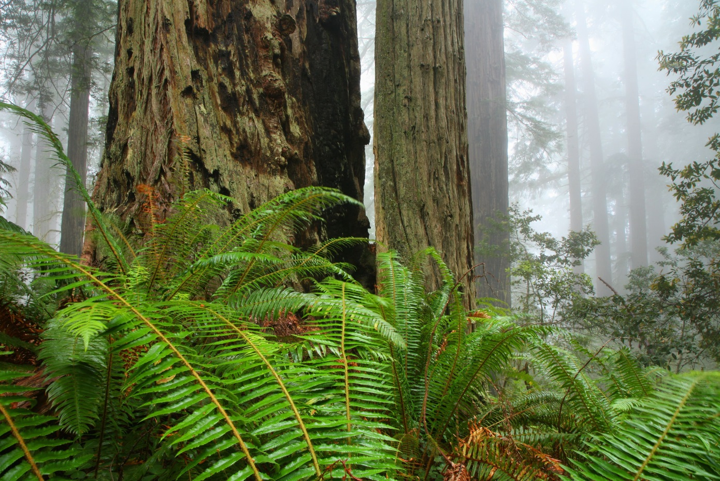
Finding the missing nitrogen
For centuries all N used by terrestrial biota
assumed to come from atmosphere
But couldn’t balance the global N cycle—too much N in biota to have all come from atmosphere
Missing source = ~1/4 of total global N
UC-Davis (Ben Houlton) thinks bedrock: used field observation combined with global bedrock weathering models
Found that certain sedimentary rocks contain unanticipated high amounts of N
Now we know why soils in redwood deep root systems are so N-rich!
Calculated that 26% of global N comes from bedrock---BALANCE!
Implications for N & C mgmt

Slide 22
The year of facilities in geo!
And no small thanks to Rick Murray for his massive contributions!

Slide 23
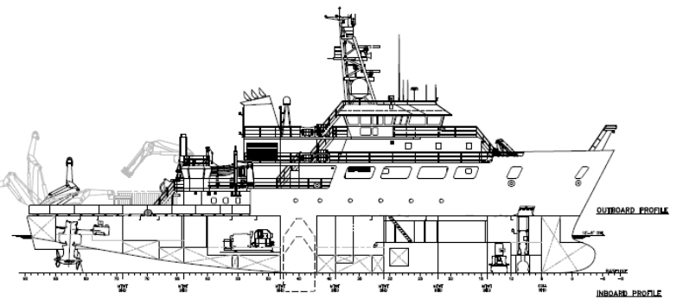
GEO/OPP Major research Equipment and facilities construction (MREFC) Status Update
Regional Class Research Vessels (3)
Construction, Design Verification and Transfer phases underway.
RCRV-1 Keel Laying, NOV 2018.
Deliveries in 2021, 2022, and 2023.
Antarctic Infrastructure Modernization for Science
Final Design Review, fall 2018.
NSB approval to enter Construction phase expected FEB 2019.
Notes:
JUST A QUICK STATUS UPDATE ON WHERE WE ARE WITH THE RCRVS AND AIMS.

Slide 24
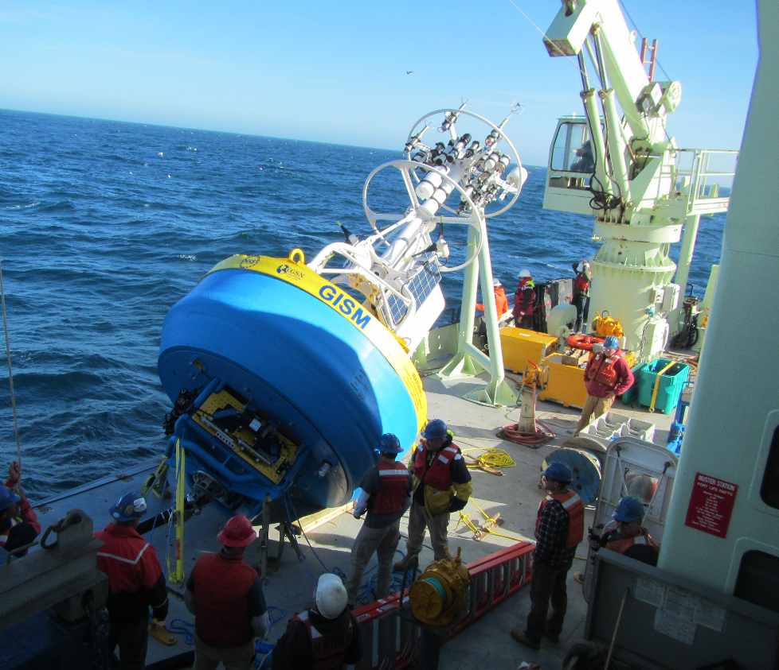
Ocean Observatories Initiative (OOI Program)
Networked system of instruments, platforms, and arrays enables researchers to examine complex, physical, chemical, biological, and geological processes over short and long periods of time.
NSB approves new Five-year Operations and Management Award @ $44M/year starts 1 October.
  WHOI - Program Management Office
    Global Irminger Sea Array
    Global Station Papa Array
    Coastal Pioneer Array
  University of Washington – Cabled Array
  OSU – Coastal Endurance Array
  Rutgers University - Cyberinfrastructure
Notes:
Data is flowing, exciting research results (e.g., AGU Press Conference regarding Axial Seamount).
Recompetition of Management and Operations is underway.
Development of Advisory Structure.

Slide 25
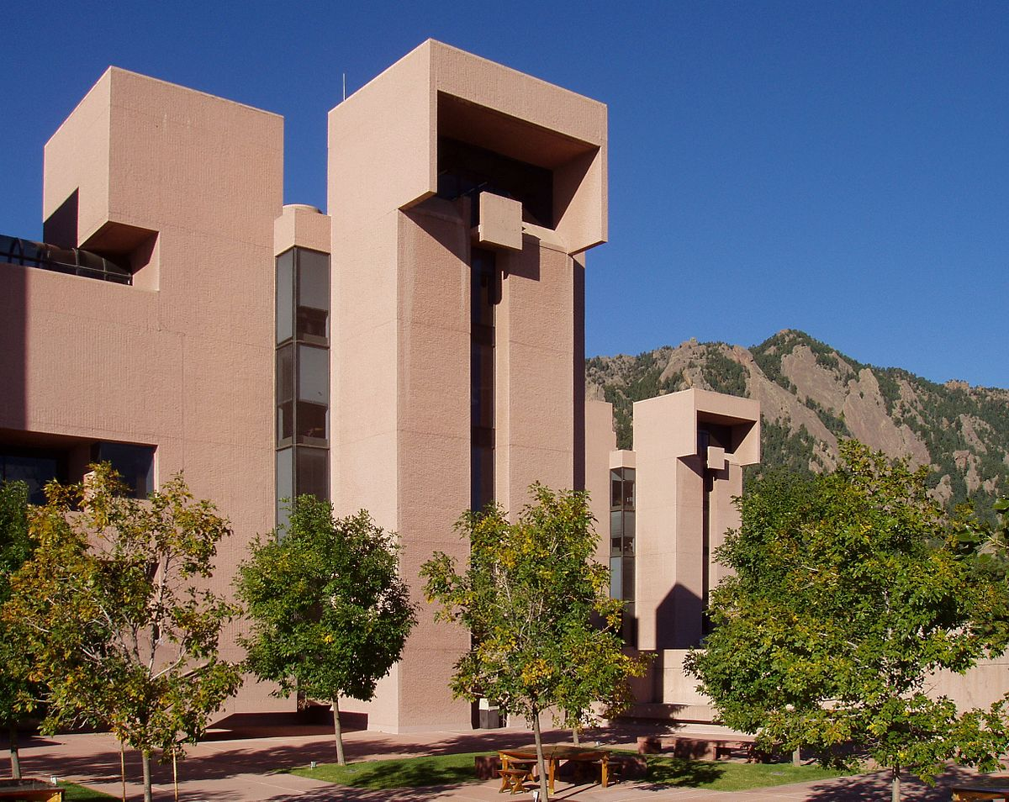
NATIONAL CENTER FOR ATMOSPHERIC RESEARCH (ncAR) AWARD
Five year award to University Corporation for Atmospheric Research (UCAR) to continue management of NCAR, effective October 01, 2018.
Additional NSF funding provided to:
  Renovate the NCAR aviation facility
  Conduct essential maintenance at the Mesa Laboratory.
  Start a new early career visitors’ program for social sciences.
Notes:
competitive review process, NSF negotiated a cooperative agreement with UCAR.

Slide 26
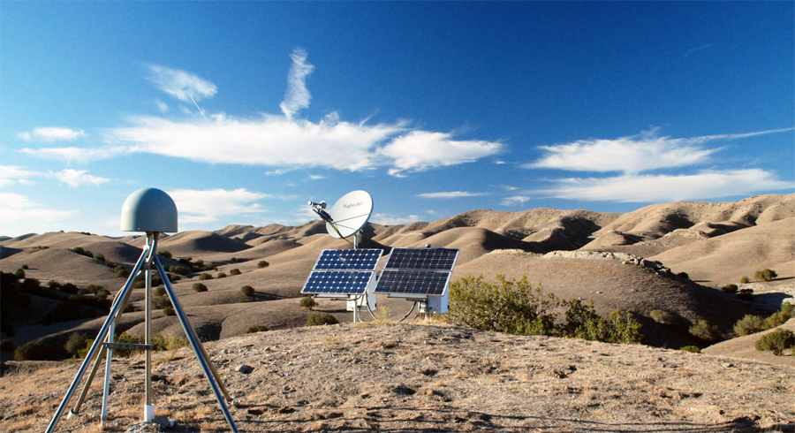
Awards for Earth Sciences’ large facilities
NSB recently approved five-year awards for operation and management of EAR’s two large geophysical facilities:
SAGE (Seismological Facility for the Advancement of Geoscience) award to IRIS.
GAGE (Geodetic Facility for the Advancement of Geoscience) award to UNAVCO.
Promote advances in understanding:
  - Earth structure and dynamics
  - earthquakes and volcanic eruptions
  - interactions between the solid Earth, hydrosphere, and atmosphere.
Notes:
1) Global and regional continuously operating seismic and geodetic networks; 2) Portable geophysical instrumentation; 3) data management systems; and 4) education, workforce development, and public outreach programs.

Slide 27
So, Things are going well in NSF GEO!
THANK YOU—HAPPY TO ANSWER QUESTIONS

Slide 28
Background slides

Slide 29
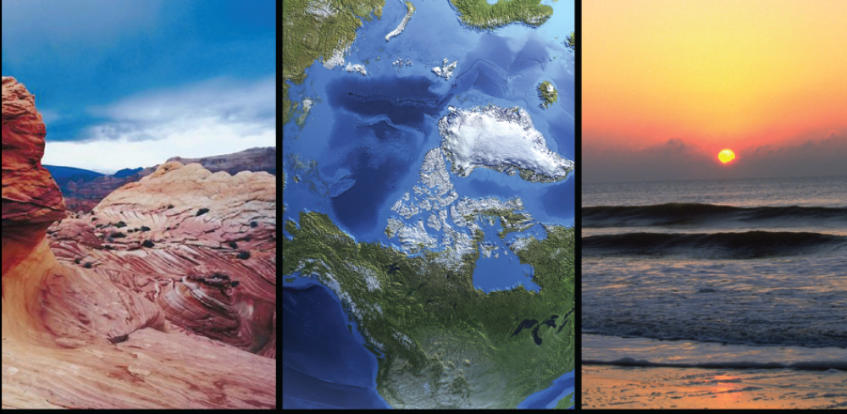
Connection to Community Priorities
Dynamic Earth, AC GEO, 2014
GEO Research Frontiers
Earth Systems Processes that Cross the Land/Ocean Interface
High Latitude Ocean-Atmosphere-Ice-Ecosystem Interactions and Processes
Urban Geo-system Science
Early Earth

Slide 30
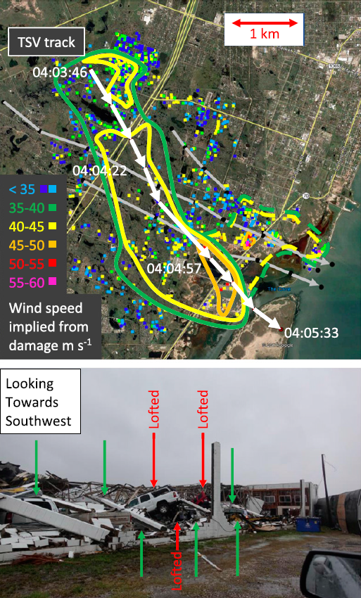
NSF Crucial in Federal Landscape of Hurricane Research support
Fast-response mechanism (RAPID) to study hurricane impacts on natural and built environments - used extensively on Harvey, Irma and Maria.
Mobile Doppler radar and dropsondes from aircraft, provide data on storms at unprecedented detail.
Support to increase understanding of the interaction of hurricanes and the built environment, including programs on resilient and sustainable infrastructure.
Studies on communications and decisions regarding evacuations during hurricanes.
Research example: mobile radar data from the eye of Hurricane Harvey, combined with ground-based damage surveys, show the impact of extremely small scale vortices inside hurricane eyewall.
Notes:
THE APPROACH OF HURRICANE FLORENCE GIVES PERFECT ENTRY FOR AGS HURRICANE RESEARCH—RAPID RESOPNSE TO SURVEIL IMPACTS, IMPROVE PREDICTION, RESILIENCY, COMMUNICATIONS (SOCIAL SCIENCE)

Slide 31
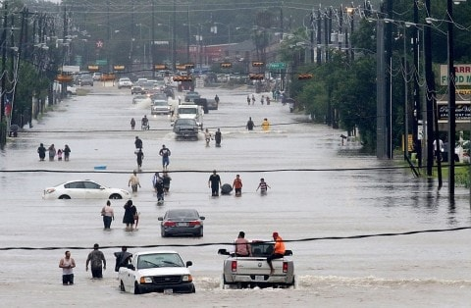
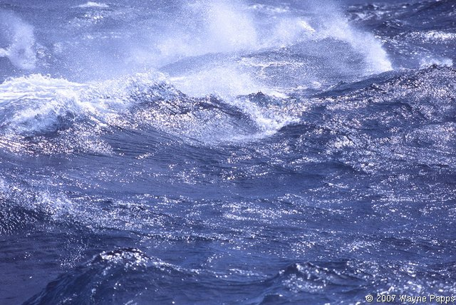
Rapid Response Hurricane Research
Fast-response mechanism (RAPID) to study hurricane impacts supported $5 million in research on Harvey, Irma and Maria.
Damage to wastewater infrastructure during Harvey: sewage contamination into surface waters and the potential for widespread microbial pathogen exposure to humans in Gulf.

Slide 32
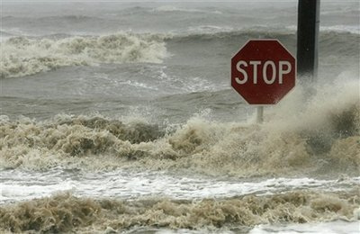
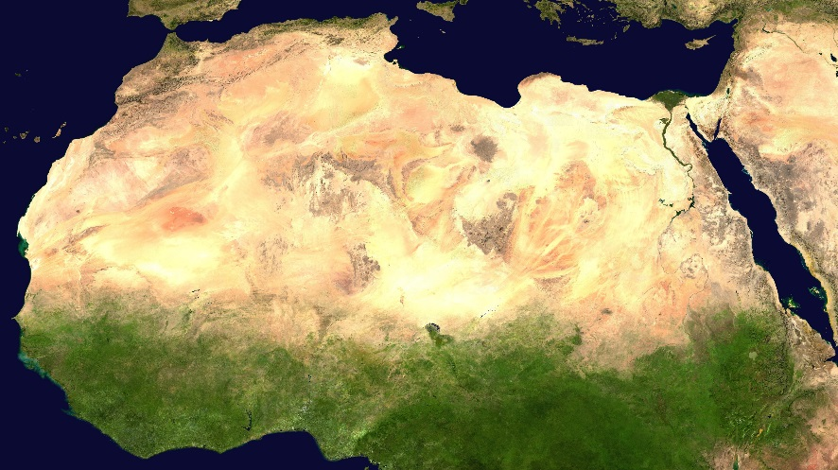
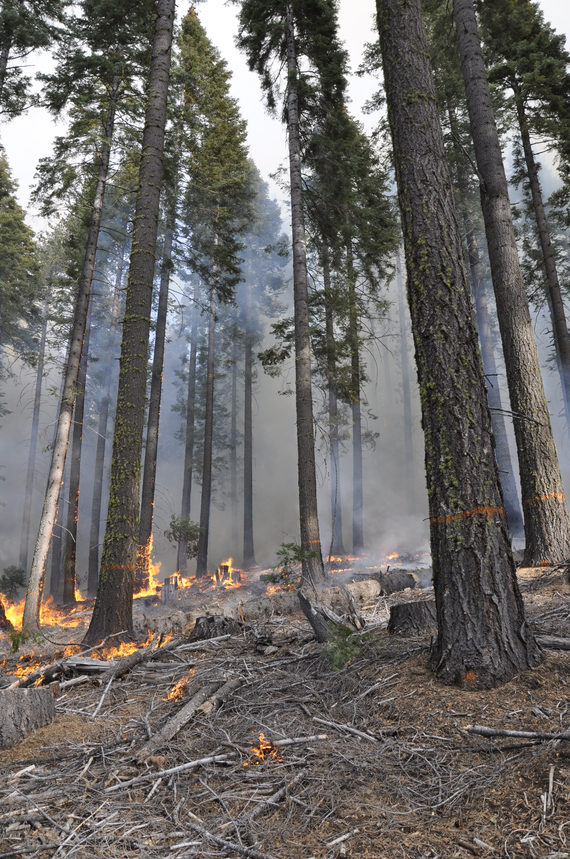
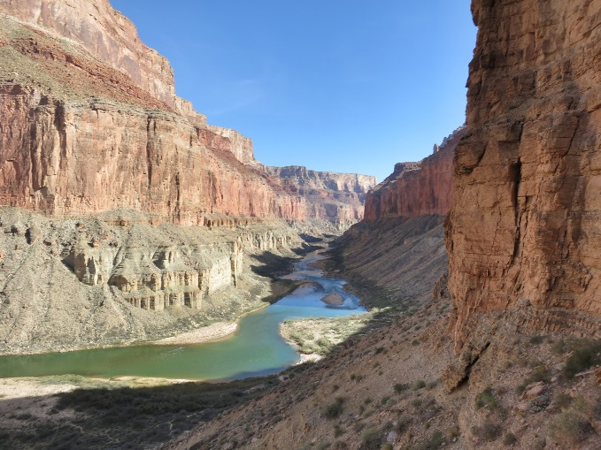
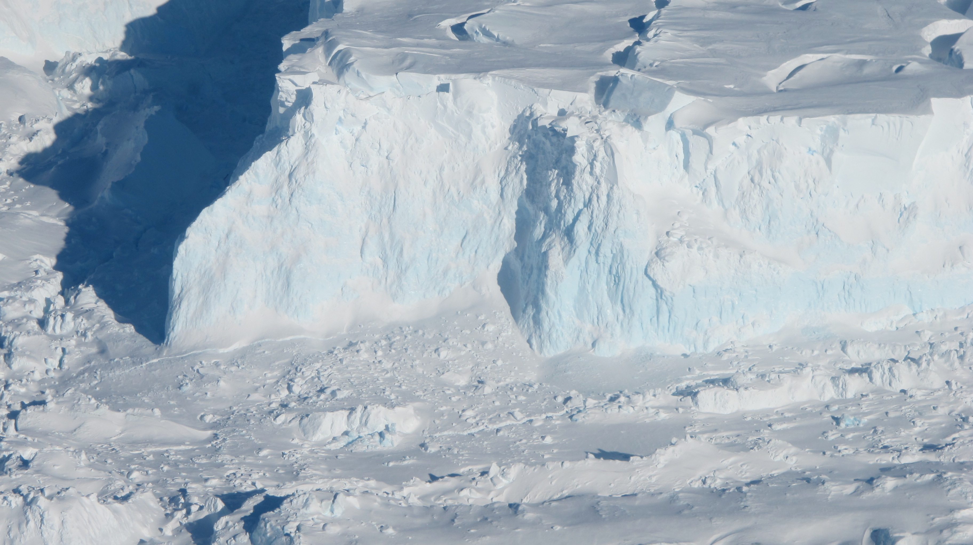
GEO in the News
New study finds world’s largest desert, the Sahara, has grown by 10 percent since 1920.
Future hurricanes could drop significantly more rain.
Image Credit: Wikimedia
Image Credit: NASA
New source of global nitrogen discovered: Earth’s bedrock.
US and UK join forces to understand how quickly a massive Antarctic glacier could collapse.
Billions of gallons of water saved by thinning forests.
Image Credit: Scott Morford
Image Credit: Eric Knapp, USFS
Image Credit: Wikipedia

Slide 33
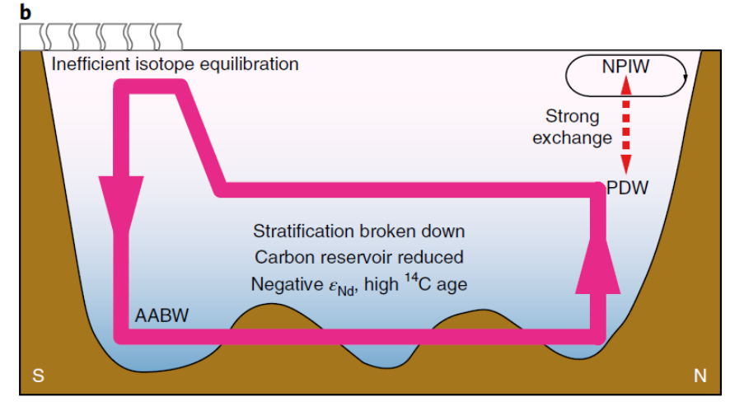
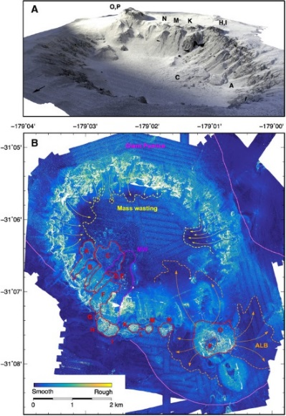
Ocean Sciences Highlights
Deep-ocean volcanic eruptions
Advanced mapping, observations, and sampling capabilities reveal far more sub-aqueous volcanic eruptions than previously thought, re-opening assumptions regarding terrigenous records in the deep sea, and improving understanding of heat flow, microbial biosphere, and geohazards.
Paleoclimate advances
Enhanced understanding of the mechanisms responsible for atmospheric CO₂ increase during the last deglaciation enabled by novel isotopic proxies used on IODP Expedition sediment samples.
Two-dimensional surface roughness map and three-dimensional rendering of Havre submarine volcano.
Deglacial flushing event. Strong overturning and weak deep stratification. Deep carbon reservoir is released to the atmosphere and reaches intermediate depth. Preformed ages are high.
Science Advances 4, e1701121 (2018).
NSF grants OCE 1357443, 1357216, EAR 1447559.
Jianghui Du, Brian A. Haley, Alan C. Mix, Maureen H. Walczak, Summer K. Praetorius
https://doi.org/10.1038/s41561-018-0205-6

