Slide 1
IS&T Application Development and Acquisition Standards
February 6, 2012

Slide 2
Agenda
Goal
How to Achieve the Goal
Benefits
Approach
Governance
Build vs. Buy
Development Standards
Database
Integration
Content Management
Document Management & Collaboration
Application Portfolio Decision Tree

Slide 3
Goal
Provide a higher level of value to the University by establishing a long term application portfolio that meets the needs of the organization, while minimizing the cost of overlapping or redundant technologies.

Slide 4
How to Achieve the Goal
Establish clear standards, based on industry experience, Boston University domain knowledge and Boston University institutional objectives, for selecting the appropriate technology, or IT platform for new application development or acquisition
Ensure that new development is done using standard development frameworks that impose structure, facilitate reuse and provide tools for more efficient development
Establish/Improve governance model for selecting appropriate platforms and technologies based on the development and acquisition standards

Slide 5
Next Steps
Ensure development competencies are in place to support the new standards
Ensure the proper physical/virtual environments are in place to support strategic technologies

Slide 6
Benefits
Quicker response to client needs
Lower total cost of ownership
Enables the Applications group to focus on building competencies in strategic technologies
Enables the Systems group to focus on building infrastructure (dev./test/production) around strategic technologies
Makes it easier to establish and maintain standard processes, i.e. build & release management
Simplification / reduce integration work
Streamlines the architectural platform decision process

Slide 7
Approach
Gartner’s Systematic vs. Opportunistic application project model was used as a general guideline to help organize our standards definition exercise. The Systematic vs. Opportunistic approach breaks applications into two categories, Systematic and Opportunistic.
For more information see: Gartner “Systematic and Opportunistic Projects: The Yin and Yang of Enterprise AD” Published: 21 March 2011 ID:G00211519

Slide 8
Governance
The standards will be used by Solutions Architects to determine the appropriate technology to fulfill new application requests, or requests for major enhancements to existing applications. Major enhancements can include a single, large effort or a collection of smaller, low effort level enhancements.
Deviation from these standards will require approval from the Assistant VP of Applications. These standards will be used to determine areas of focus for training, process improvement and investments in the environments required to sustain these technologies.

Slide 9
Build vs. Buy
Can an existing in-house commercial or open/community source solution be reused?
no
Investigate if a commercial, or open/community source solution can be acquired to meet the client need
no
Investigate if an existing custom built application, built on .Net or Java frameworks, can be reused or extended.
no
Develop new custom application using development standards

Slide 10
Development Standards
OPPORTUNISTIC PROJECTS
  Python, using the Django application framework, will be used to fulfill opportunistic project requests. The Python/Django application framework is suited to building web based, custom applications with short lifecycles that are typically developed via agile development methodologies.
  Microsoft .Net will be considered for use in the opportunistic space when the request is slightly more complex and the requirements are clearly defined. The Python vs. .Net decision will be based on scope, traffic, number of users, authentication/integration requirements, etc.

Slide 11
Development Standards
SYSTEMATIC PROJECTS
  The .Net or Java frameworks will be considered for custom systematic application development projects. Java will be considered first for larger more complex projects with a larger user base and where requirements for integration with other applications or packages are critical. .Net will be positioned for small to medium, less complex projects, but both frameworks will be considered viable options for most systematic projects

Slide 12
Database
OPPORTUNISTIC PROJECTS
  MySQL will be the primary database to support opportunistic applications at the University, backing a variety of web-based applications which run the gamut from single-user use to campus-wide and general public use.
SYSTEMATIC PROJECTS
  MS-SQL and Oracle will be the primary databases of choice for systematic application projects. Since the strategy for systematic application projects favors purchase verses build, the database selection will be largely determined by vendor recommendation. Oracle will be the database of choice for large enterprise systems.

Slide 13
Integration
Technologies to integrate between applications will be done using Web Service (SOAP and/or RESTful), or XML Gateway. SAP PI will be considered first for integration with SAP and Informatica considered secondary.

Slide 14
Development Technologies
Opportunistic Complexity Systematic
Django/Python
MySQL or Shared Env.
MS .Net
MS-SQL
Java EE
Oracle / MS-SQL
Web Service, XML Gateway, SAP PI

Slide 15
Content Management
WordPress will be the web content management system of choice. BU has invested heavily in WordPress with a strong trend towards migrating departmental and public websites to the WordPress CMS platform over the past two years. This is expected to continue.

Slide 16
Document Mgt. & Collaboration
SharePoint will primarily be positioned as a self-service tool for site-owner managed collaboration and site-owner managed document sharing repositories. In addition to self-service purposes, IS&T will provide a service to customize / configure sites using out-of-box administrations tools, SharePoint Designer and InfoPath Designer
OnBase is the enterprise document management platform of choice. It will be used when one or more of the following functionality is required:
  Document annotations, highlighting, sticky notes, and text comments
  Document retrieval using keywords or custom queries
  Document routing through complex workflows
  Data files exchange with IS&T legacy applications, or other third-party software
  Document retention and archiving
  Regulatory document retention requirements exist
OnBase will not be used for small document repository that is intended to share documents within or between groups that do not require a moderate to high level of structure and control.

Slide 17



Collaboration, Document Content Mgt.
Opportunistic Complexity Systematic
Document Management, Collaboration
SharePoint
Document Management
OnBase
Content Management
WordPress

Slide 18
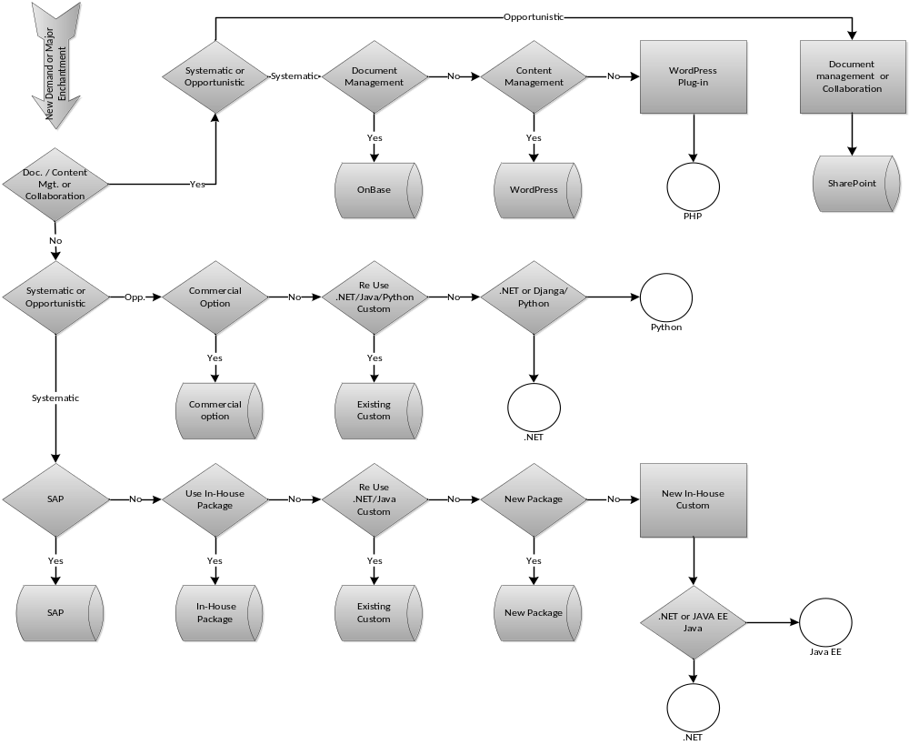
Application Portfolio Decision Tree
Note: “Commercial option” is equivalent to “commercial or open/community source solution”

