Slide 1

The European Central Bank and Monetary Policy
Chapter 12
© Dünhaupt, Dullien, Goodwin, Harris, Nelson, Roach, Torras

Slide 2
Chapter outline
The European Central Bank
Monetary Policy
The Theory of Interest Rates, Money, and
Aggregate Expenditure
Monetary Policies in Practice
The Theory of Money, Prices, and Inflation

Slide 3
Learning goals
After today‘s lecture, you will be able to:
  Understand the basic workings of central banks.
  Describe the tools the ECB can use to carry out monetary policy.
  Explain how monetary policy is expected to affect investment and aggregate demand.
  Explain the European monetary policy experience of the 1999-2015 period.
  Become familiar with the notions of “liquidity trap” and “credit rationing.”
  Understand the quantity equation, the quantity theory of money, and monetarism.
  Describe possible sources of inflation.
  Understand the controversy over rules versus activism in monetary policy.

Slide 4
The European Central Bank

Slide 5

The European Central Bank in Frankfurt
By http://www.flickr.com/photos/maveric2003/ - Eric Chan [CC BY 2.0 (http://creativecommons.org/licenses/by/2.0)], via Wikimedia Commons

Slide 6
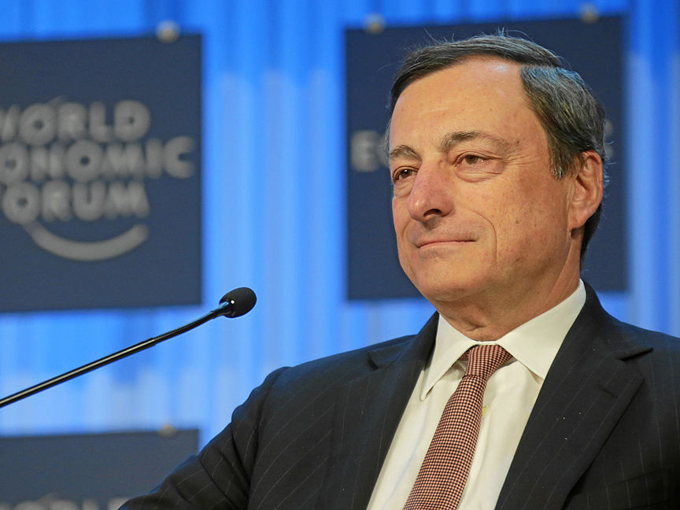
ECB president Mario Draghi
By World Economic Forum (Flickr: Special Address: Mario Draghi) [CC BY-SA 2.0 (http://creativecommons.org/licenses/by-sa/2.0)], via Wikimedia Commons

Slide 7
Stages of economic and monetary union
fluctuations in the exchange rate obstacle for creating a truly single market
1992:
Maastricht Treaty
- decision to introduce a common currency
- criteria on inflation, government debt and deficits
1999: single monetary policy by ECB
exchange rates between national currencies fixed
11 member countries:
Germany, France, Italy, Spain, Ireland, the Netherlands, Austria, Belgium, Portugal, Finland, Luxembourg
2016:
19 EU countries part of the euro-area
2002: Introduction of euro notes and euro coins

Slide 8
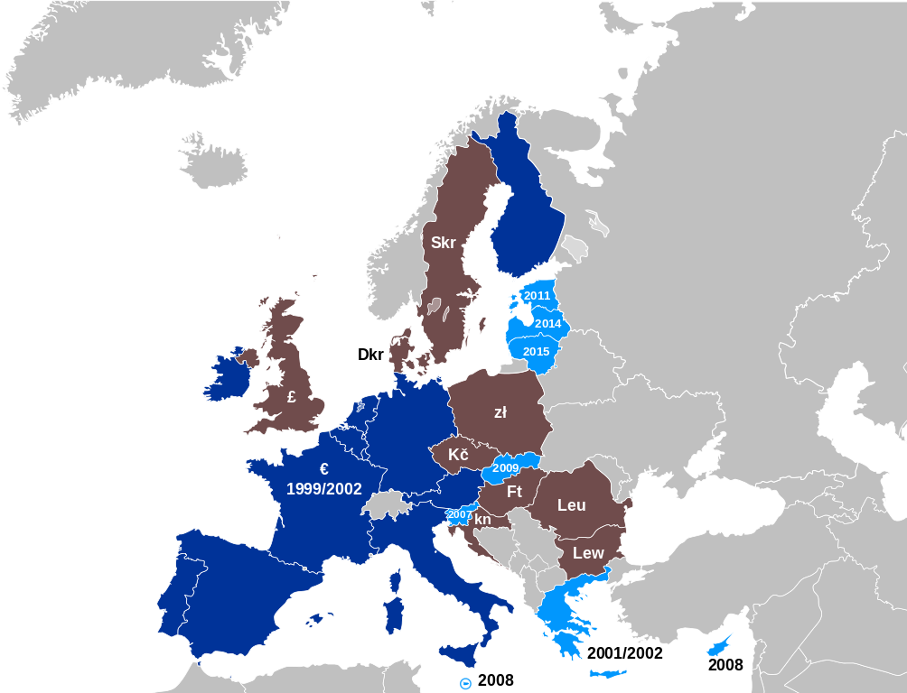
Where the euro is used…
https://de.wikipedia.org/wiki/Datei:Eurozone_main_map.svg#filelinks CC BY-SA 3.0 via Wikimedia Comons

Slide 9
The ECB has been given a primary mandate by the European Treaties
“maintain price stability”
“[w]ithout prejudice to the objective of price stability, the [ECB] shall support the general economic policies in the Union”
“price stability” : annual consumer price inflation “of below, but close to 2 percent”
focus primarily on price stability, and if this goal is not put into jeopardy, to support other goals such as stimulating employment and economic growth

Slide 10
The ECB’s mandate is very different from that of other central banks
United States Federal Reserve, for example, has a broader mandate:
It is supposed to aim at “maximum employment, stable prices, and moderate long-term interest rates”
sometimes criticized for prioritizing price stabilization above the other goals

Slide 11
The ECB is independent
completely free from influence of national governments or European institutions
independence guaranteed by the European treaties, which can only be changed by unanimous vote of all 28 EU members
prohibited to give loans to governments or to finance governments’ budget deficits

Slide 12
The role of national central banks
implement decisions of the ECB
deal with national commercial banks
deliver cash
inform decision-making level in the ECB about economic and financial situation in member states
vote in interest rate decisions of the ECB
set-up of national centrals banks and ECB is called Eurosystem

Slide 13
Monetary Policy

Slide 14
How the ECB influences the money market interest rate
influence corporations’ and households’ price-setting behavior indirectly
main instrument: main refinancing rate
  the interest rate at which commercial banks can borrow funds from the ECB

Slide 15
If inflation picks up…
the ECB increases the interest rate
commercial banks have to pay more for the funds they can get at the ECB
  commercial banks tighten their credit supply
  increase the interest rates they charge to their customers
less credit creation compared to a situation of unchanged interest rates

Slide 16
If inflation is too low…
…because the economy is not growing strongly enough and corporations cannot increase prices…
the ECB cuts interest rates
  commercial banks can get funds more cheaply
  they will provide more and cheaper loans to their customers
  customers spend more on structures, dwellings, machines or new consumer goods
the ECB cannot force banks to lend out more or corporations and households to borrow

Slide 17
The ECB’s Governing Council
takes decisions about monetary policy tools, including interest rates
consists of 6 members of the ECB’s Executive Board and (currently 19) heads of national central banks
  members of the Executive Board have permanent voting rights
  voting rights of the heads of the national central banks rotate
    at any given moment, 15 of them have the right to vote
meets every two weeks on Thursday
every six weeks, it decides on changes in its monetary policy

Slide 18
The main refinancing rate
interest rate at which the ECB auctions off liquidity to commercial banks in its weekly main refinancing operations
commercial banks provide the ECB with some collateral
the ECB lends to the banks a certain share of the collateral’s value for usually one week
commercial banks either hold these funds as reserves at the ECB, use it to make payments to other banks or change them into cash, or lend the funds to other commercial banks

Slide 19
Table 12.1 A simplified balance sheet of the European Central Bank
monetary base: Currency in circulation and bank reserves (liabilities of the central bank on which the creation of other monetary aggregates such as M1, M2 or M3 is based)
Assets |  | Liabilities
Loans to banks | €1800 billion | Currency in circulation Bank reserves | €1000 billion €800 billion

Slide 20
Table 12.2 ABC bank makes a loan to Castello Construction
Change in ABC Bank’s Balance Sheet
Assets |  | Liabilities
Loans to Castello Construction | +€10 million | Deposits | +€10 million
M1 has increased by €10 million
ECB’s balance sheet has not changed yet
monetary base has not changed

Slide 21
Table 12.3 ABC bank borrows the required reserves from the ECB
(a) Change in the ECB‘s Balance Sheet
Assets |  | Liabilities
Loans to commercial banks | +€100,000 | Bank reserves | +€100,000
(b) Change in ABC Bank’s Balance Sheet
Assets |  | Liabilities
Reserves | +€100,000 | Loans from the ECB | +€100,000
M1 has not changed
monetary base has increased by €100,000

Slide 22
The money multiplier
ECB creates reserves by crediting funds to commercial bank’s account at the central bank
the amount of money which can be used for payment purposes (M1) has increased by much more than the amount of reserves the ECB has created
largest part of money supply is deposit money created by banks
it has no backing in physical currency in circulation

Slide 23
How much money can be created on a single euro provided by the ECB?
reserve requirements as a guideline:
  if commercial banks have to hold 1 percent of their deposits in reserves, then €1 of reserves can support €100 in deposits
some money is exchanged into cash and carried around
empirically, the ratio between M1 and the monetary base is much smaller.

Slide 24
Two standing facilities are open to commercial banks permanently
The marginal lending facility
  slightly higher interest rate than under main refinancing operations (good-quality collateral required)
  usually upper border of interest rates charged in the money market
The deposit facility
  banks deposit excessive reserves at the ECB
  get an interest rate on these deposits
  usually the bottom for interest rates in the money market

Slide 25
Figure 12.1 Money market rate and ECB interest rates
The money market interest rate generally remains close to the ECB’s main refinancing rate and does not leave the corridor between the rates of the deposit facility and the marginal lending facility.

Slide 26
New instruments of the ECB (since the euro crisis)
ECB has lent large amounts of reserves to commercial banks in operations with very long maturities (several years instead of the usual one week)
ECB has bought directly government bonds and corporate bonds from commercial banks
ECB has moved its deposit interest rate into negative territories

Slide 27
The Theory of Interest Rates, Money, and Aggregate Expenditure

Slide 28
Interest rates and investment
Empirically, interest rates work most on housing investment
  Changes in mortgage rate usually have a strong influence on building activity
For firms’ investment, effect usually is considered to be smaller
  General mood of firms might be more important
  accelerator principle: the idea that high GDP growth leads to high investment growth
  However, given a certain state of growth, interest rates do influence investment

Slide 29
Figure 12.2 The intended investment schedule
All else equal, if the interest rate falls (from r₀ to r₁), intended investment should rise (from I₀ to I₁).
r₀
Interest rate (r )
r₁
I_{I}
I_{I0}
I_{I1}
Intended Investment (I_{I} )

Slide 30
Figure 12.3 An increase in investor confidence
If firms become more confident about future sales, and want to increase their capacity, the intended investment schedule shifts to the right.
Interest rate (r )
r
I_{I1}
I_{I0}
I_{I0}
I_{I1}
Intended Investment (I_{I} )

Slide 31
Chain of causation for monetary policy
Expansionary monetary policy
Lower interest rates
Investment is encouraged
Aggregate demand rises
Equilibrium GDP rises

Slide 32
How is monetary policy used (I)?
If there is a danger of recession, interest rates are often cut
expansionary monetary policy: the use of monetary policy tools to increase the money supply, lower interest rates, and stimulate a higher level of economic activity
accommodating monetary policy: loose or expansionary monetary policy intended to counteract recessionary tendencies in the economy

Slide 33
How is monetary policy used (II)?
If there is a danger of inflationary overheating, interest rates are often increased
contractionary monetary policy: the use of monetary policy tools to limit the money supply, raise interest rates, and encourage a leveling off or reduction in economic activity

Slide 34
Figure 12.4 Expansionary monetary policy and the AE curve
In this model, expansionary monetary policy lowers interest rates, raises investment spending, and raises aggregate expenditure, income, and output.
AE₁ (with new, lower interest rate, r₁)
E₁
AE₀ (with old interest rate, r₀)
Aggregate Expenditure and Output
E₀
45
Y₀
Y₁
Income

Slide 35
Figure 12.5 The ECB’s main refinancing rate and the AE Curve
Everything else being equal, lower interest rates lead to higher investment spending, and higher aggregate expenditure. The AE-curve is downward sloping.
r₀
Main refinancing rate (r )
r₁
AE
AE₀
AE₁
Aggregate Expenditure (AE)

Slide 36
Figure 12.6 The ECB’s reaction function
As the ECB’s primary objective is to keep inflation low and stable, it will react to increases in inflationary pressure with hikes in its main refinancing rate
π₁
Inflation rate (π )
If inflation rises…
A
π₀
B
…the ECB increases interest rates
r₀
r₁
Interest rate (r)

Slide 37
Monetary Policies in Practice

Slide 38
Figure 12.7 Monetary policy and investment,
1999–2015
ECB Main Refinancing Rate (%)
Source: Eurostat and ECB, 2016.

Slide 39
Figure 12.7 Monetary policy and Investment
Source: Eurostat and ECB, 2016.

Slide 40
Figure 12.7 Monetary policy and investment,
1999–2015
ECB Main Refinancing Rate (%)
Source: Eurostat and ECB, 2016.

Slide 41
Figure 12.7 Monetary policy and investment,
1999–2015
2001–3: the ECB steadily pushed interest rates down
ECB Main Refinancing Rate (%)
Source: Eurostat and ECB, 2016.

Slide 42
Figure 12.7 Monetary policy and Investment,
1999–2015
In 2001–3, from 2008 on, and after 2011, interest rate cuts helped spur residential and nonresidential investment, although the responses were slow.
Private Fixed Investment
(billions of 2010 chained euros)

Slide 43
Figure 12.8 Expansionary monetary policy in an environment of pessimism
If investors become pessimistic (shift A), the level of intended investment can still fall, even though ECB actions lower the interest rate (shift B). The net effect is that intended investment falls from I_{I}* to I_{I}**
I_{I1}
I_{I0}
A
Interest rate (r )
Original Target Rate
8%
B
5%
New Target Rate
I**
I*
Intended Investment (I_{I})

Slide 44
Figure 12.7 Monetary policy and investment,
1999–2015
late 2008: expansionary monetary stance
9/15 default of Lehman Brothers
financial crisis and deep recession
ECB Main Refinancing Rate (%)
2005-2008
inflationary pressures
Source: Eurostat and ECB, 2016.

Slide 45
Figure 12.7 Monetary policy and investment,
1999–2015
2011: investment started to pick up
ECB Main Refinancing Rate (%)
fear of double-dip recession
mid 2011-2016
interest-rate cuts
Source: Eurostat and ECB, 2016.

Slide 46
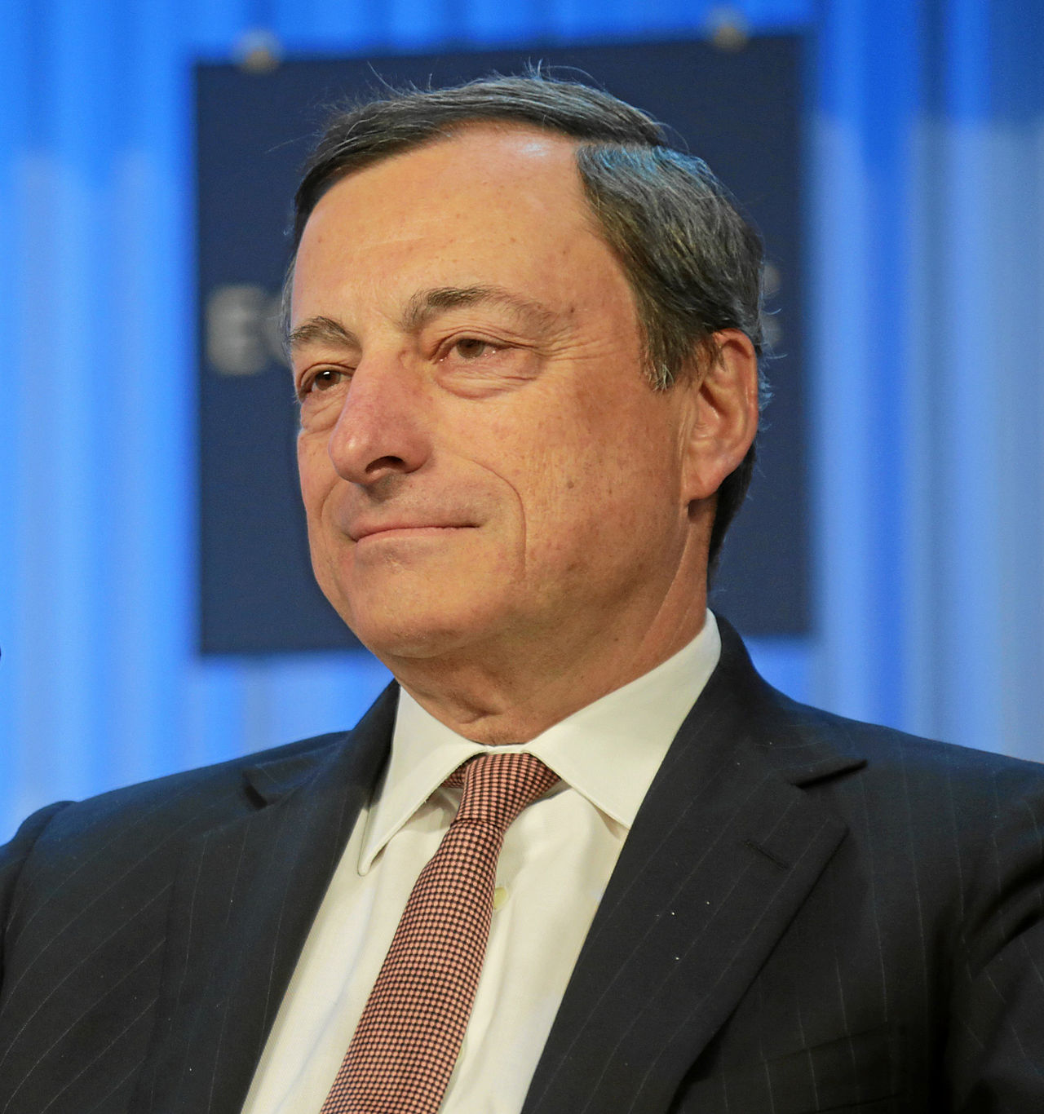
Unconventional measures of the ECB
Since 2008/9: Interest rate cuts were not sufficient to stabilize the economy
2012: Mario Draghi promises to do
“Whatever it takes” to preserve the
Euro
2012: ECB starts to buy government
bonds
2014: negative deposit rate
2015: quantitative easing
By World Economic Forum (Flickr: Special Address: Mario Draghi)
[CC BY-SA 2.0 (http://creativecommons.org/licenses/by-sa/2.0)],
via Wikimedia Commons

Slide 47
Quantitative easing
The purchase of financial assets including long-term bonds by the ECB, creating more monetary reserves and lowering long-term interest rates
Hopes:
get banks to lend more to firms and households
get households and other investors to invest in more risky assets
provide corporations with finance through non-banks

Slide 48
2016: No normalization of monetary policy
yields for German government bonds below 0 percent
economy recovered and investment slowly picking up
unemployment still high
inflation around 0 percent
critics:
  low interest rates as a way to “expropriate savers”
  fueling financial bubbles or causing inflation to rise

Slide 49

Why was there such a weak reaction to such a strong monetary stimulus?
Possible reason I:
nominal interest rates were low,
real interest rates have not been very low
Real interest rate
Nominal interest rate minus inflation

Slide 50
Why was there such a weak reaction to such a strong monetary stimulus?
Possible reason II:
existence of of a liquidity trap
  a situation in which interest rates are so low that the central bank finds it impossible to reduce them further
  banks engage in credit rationing to ensure their own profitability and deny loans to some potential borrowers

Slide 51
Why was there such a weak reaction to such a strong monetary stimulus?
Possible reason III:
problems in the banking sector
  in a situation with problems in the banking sector, banks might refrain from lending even if interest rates fall
  a cut in interest rates then does not translate into an increase in aggregate demand any more

Slide 52
Figure 12.9 The ECB’s main refinancing rate and the AE Curve when there are problems in the banking sector
If there are problems in the banking system, from a certain point onwards cuts in the interest no longer translate in an increase of aggregate demand.
Main refinancing rate (r )
AE
r₀
r₁
AE₀=AE₁
Aggregate Expenditure (AE)

Slide 53
Does that mean that the ECB’s efforts are fruitless?
No!
over a longer period, low interest rates may help businesses to pay back debt and banks to accumulate profits
as of 2016, banks in the euro-area made new loans to households (even if not yet to firms)
increase in the overall amount of loans

Slide 54
Concerns about The ECB’s monetary policy
money might go to the wrong places, creating bubbles in asset prices
increase in excess reserves might in the future lead to a sudden outbreak of inflation
negative interest rates might depress banks’ profitability and further keep them from lending

Slide 55
The Theory of Money, Prices, and Inflation

Slide 56
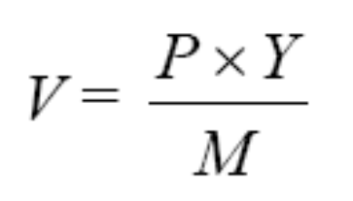
Quantity equation
Quantity equation: M × V = P × Y, where M is the money supply, V is the velocity of money, P is the price level and Y is real output
Velocity of money: the number of times a euro has to change hands in a year, in order to support the level of output and exchange represented by nominal GDP

Slide 57
What does the quantity equation mean?
by itself, it is just an accounting identity
when assuming that the velocity of money remains constant, then it becomes the quantity theory of money
quantity theory of money: the theory that money supply is directly related to nominal GDP, according to the equation
M × V = P × Y

Slide 58
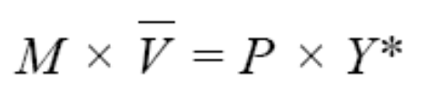
Classical monetary theory
Builds on quantity theory
Plus: Remeber that output is always at full employment output in classical theory
Hence:
Thus, in this theory, a central bank can only influence P with a change in the money supply
monetary neutrality: the idea that changes in the money supply may affect only prices, while leaving output unchanged
money supply rule: committing to letting the money supply grow at a fixed percentage rate per year

Slide 59
Monetarism
a theory associated with Milton Friedman, which claims that macroeconomic objectives are best met by having the money supply grow at a steady rate
believes in power of monetary policy
doubts that monetary policy will more often do harm than good by using monetary policy

Slide 60
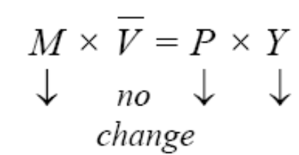
Friedman and Schwartz on the Great Depression
Friedman and Schwartz believed that the US Federal Reserve made Great Depression much worse:
they argued: the contraction in the money supply caused the reductions in the price level and real GDP
Friedman: money supply should grow at a steady rate

Slide 61
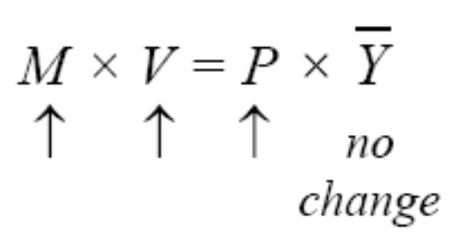
Money and hyperinflation
hyperinflation happens if government uses the printing press
monetizing the deficit: when a central bank buys government debt as it is issued (equivalent to "running the printing presses")
in a situation of hyperinflation, people want to pass on money as quickly as possible
this might make inflation worse:

Slide 62
Complications and Policy Controversies

Slide 63
The ECB’s dilemma
it sounds easy: cut interest rates in a downturn, increase them in an upswing…
…but there are a lot of unanswered questions
  What amount of inflation is acceptable?
  How early do you need to dampen growth so that inflation does not pick up?
  How to deal with imported inflation?

Slide 64
What about timing?
Inside lag:
  decisions about monetary policy can be made quick (ECB‘s Governing Council meets every two weeks; decisions on interest rates every six weeks)
Outside lag:
  monetary policy has only an effect on aggregate demand as people change their (long-term) plans abound investment and spending
  danger of exacerbating the business cycle instead of flattening it out

Slide 65
The ECB and its mandate
remember: maintain price stability primary objective
Central Banks contributed to real estate bubble because they did not increase interest rates in the 2000s
No traditional instrument able to pop bubbles without causing damage:
increase interest rates might counter asset bubble, but dampen investment
consequence might be unemployment and very low inflation

Slide 66
Has the ECB gone too far with its use of unconventional monetary policy instruments?
no signs of hyperinflation
central banks in other countries (UK, US) that also increased excess reserves by quantitative easing have later increased interest rates again (no hyperinflation, no inflation)
ECB’s policies might lead to hyperinflation
increase in excess reserves might lead to large amounts of credit creation
suddenly increase monetary aggregates M1 or M2
this might lead to jump in prices

Slide 67
What about the ECB’s decision on the negative deposit rate and the purchase of government bonds?
negative interest rates redistribute between savers (in the “Northern countries) and borrowers (in the “Southern” countries)
ultra-low interest rates endanger traditional savings banks
negative return on government bonds result of an imbalance of investments and savings

Slide 68
Does the ECB take to much pressure off governments to reform?
the ECB does not have the mandate to impose structural reforms or permanent budget cuts on member states
slightly higher interest rates would probably not lead to more reforms
ECB policy has led to very low government bond yields even for countries with high debt levels
low interest rates lower incentives of governments to implement structural reforms and cut budget deficits permanently

Slide 69
What to take home (I)
Banks are important for the creation of money
Credit conditions are important for aggregate expenditure
The European Central Bank decides on monetary policy in the euro area
Monetary policy influences the rate of interest
By changing the interest rate, monetary policy influences behaviour of commercial banks

Slide 70
What to take home (II)
Depending on the position in the business cycle, ECB tries to increase or lower aggregate demand
ECB can only influence inflation indirectly
There remain a number of disputes

