Slide 1
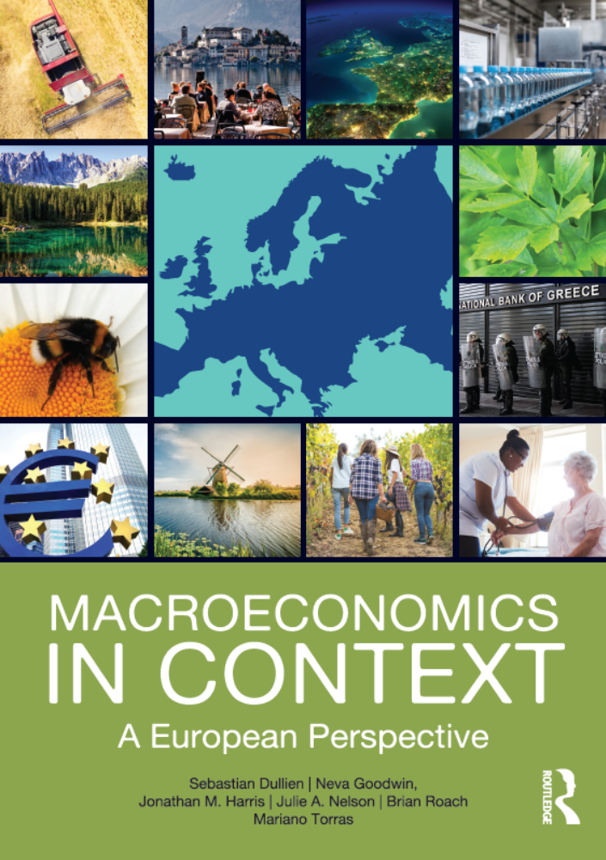
International Linkages and Economic Policy
Chapter 14
© Dünhaupt, Dullien, Goodwin, Harris, Nelson, Roach, Torras

Slide 2
Chapter outline
Macroeconomics in a Global Context
The Trade Balance: Completing the Picture
International Finance
Macroeconomics in an Open Economy
International Financial Institutions

Slide 3
Learning goals
After today’s lecture, you will be able to:
  Describe various ways in which national economies are economically interconnected.
  Understand the major policy tools countries have used to manage the degree of “openness” of their economies.
  Describe major recent developments in the volume of international trade and financial flows.
  Explain the macroeconomic impact of imports and exports using the circular flow model.
  Understand basic principles of international finance.
  Understand the implications of “openness” for monetary policy.
  Identity important international institutions concerned with trade and finance.

Slide 4
Macroeconomics in a Global Context

Slide 5
Economic linkages among countries can take many forms
  international income flows
  international trade flows
  international transactions
  in assets
  international flows
  of people
  international sharing of and impact on common environmental resources
  international flows of technological knowledge, cultural products, and other intangibles

Slide 6
Institutional environment created by
international monetary institutions
international trade agreements
international military
aid arrangements
banks
corporations
other private entities that operate at an international scale

Slide 7
How can governments control the degree of openness of an economy?
most drastic way: trade ban
  a law preventing the import or export of goods
  or services
less drastic: trade quota
  a restriction on the quantity of a good that can be imported or exported
  helps domestic producers by shielding them from lower price competition

Slide 8
Further policy tools: tariffs and non-tariff barriers
tariffs
  taxes on imports or exports
  tariffs make internationally traded goods more costly to buy or sell
  import tariffs provide monetary benefits to the government
non-tariff barriers to trade
  use of licensing or other requirements to limit the volume of trade

Slide 9
Further policy tools: trade-related subsidies and import substitution
trade-related subsidies
  payments given by governments to producers to encourage more production, either for export or as a substitute for imports
import substitution:
  the policy of subsidizing domestic producers to make products that can be used in place of imported goods

Slide 10
Governments can also influence international capital transactions
capital controls:
  restrictions or taxes on transactions in financial assets such as currency, stocks, or bonds, or on foreign ownership of domestic assets such as buisness or land
domestic content requirement:
  laws requiring traded goods to contain a certain percentage of goods produced by domestic companies

Slide 11
Trade policy tools: foreign trade zone and migration controls
foreign trade zone:
  a designated area of a country within which foreign-owned manufacturers can operate free of many taxes, tariffs, and regulations
migration controls:
  restrictions on the flow of people into and out of a country

Slide 12
The European Union and trade policy
within the European Union, there are
  no tariffs
  no quotas
  no trade subsidies
  no capital controls
  no migration controls
regulations have increasingly been harmonized in order to reduce nontariff barriers

Slide 13
History of the European Union: 1951 − 1957
1951: Treaty of Paris: the European Coal and Steel Community
  Germany, France, Italy, the Netherlands, Belgium and Luxembourg
1957: Treaty of Rome: the European Economic Community (EEC)
  customs union: tariffs and quotas between members were abolished and a common external tariffs introduced

Slide 14
History of the European Union: 1973 − 1986
1973: Britain, Ireland and Denmark joined the EEC
1980s: Greece, Spain and Portugal were admitted to the EU
1986: the Single European Act:
  reduction of nontariff barriers, harmonized regulation, European institutions were given more power to further the single market

Slide 15
History of the European Union: 1993 − 2013
1993: the Maastricht Treaty:
  framework for the introduction of a common currency, creation of the European Union
1995: Austria, Finland and Sweden
2004: Czech Republic, Estonia, Cyprus, Latvia, Lithuania, Hungary, Malta, Poland, Slovakia and Slovenia
2007: Bulgaria and Rumania
2013: Croatia

Slide 16
Why has trade grown over time?
many governments have, over time, lowered their tariffs and other barriers to trade
  globally, the World Trade Organization (163 member countries) conducts negotiations and mediates trade disputes
improvements in transportation technology
advances in telecommunications

Slide 17
Figure 14.1 Trade expressed as a percentage of production, world and European Union countries, 1960–2014
The worldwide volume of trade, including both imports and exports, expressed as a percentage of global GDP, has been increasing over the past four decades. This trend has been especially strong in the European Union the members of which are much more open that the world on average
Source: World Development Indicators, World Bank, 2016.

Slide 18
Figure 14.2 Top purchasers of goods from the EU28 and suppliers of goods to the EU28, 2014
The other two large players in world trade, the U.S. and China, are also the main trading partners of the EU.
Source: European Commission, Directorate General for Trade, 2016.

Slide 19
Figure 14.2 Top purchasers of goods from the EU28 and suppliers of goods to the EU28, 2014
Source: European Commission, Directorate General for Trade, 2016.

Slide 20
Figure 14.3 Share of exports to other EU countries as a share of total exports, 2014
Source: WTO, Country Trade Profiles, 2015.

Slide 21
The Trade Balance: Completing the Picture

Slide 22
The current account
summarizes the total of imports, exports, and income flows from abroad
current account surplus:
  selling goods and services abroad and receiving incomes from abroad > buying goods and services and paying incomes to foreign workers and investors
current account deficit:
  the funds paid > the funds received

Slide 23
What is the impact of our exports and imports on aggregate demand and GDP?
AE = C + I_{I} + G + NX
net exports (NX): exports minus imports (X – IM)
intended investment (I_{I})
government spending (G)
Imports represent a leakage from domestic aggregate expenditure — a portion of income that is not spent on domestic goods and services

Slide 24
Figure 14.4 Leakages and injections in a complete macroeconomic model
Leakages from the circular flow include taxes, saving, and imports. Injections include intended investment, government spending, and exports. The level of macroeconomic equilibrium will depend on the balance of all these flows as well as consumption levels.
Production generates income to households
Output (Y)
Income Y)
leakages
Taxes (T)
Savings (S)
Consumption (C)
Spending (AD)
Imports (IM)
injections
Intended investment (I_{I})
Government spending (G)
Exports (X)

Slide 25
Effects on the multiplier
the multiplier effect for an increase in exports is essentially the same as that for an increase in I_{I} or G
some portion of income “leaks” away into imports
  this portion does not stimulate the domestic economy
  multiplier effects are smaller and the economic response a bit less dynamic
in an open economy, a portion of any aggregate demand increase goes to stimulate someone else’s economy via imports

Slide 26
Balance between savings, investment, and net borrowing
In an open economy, a country can borrow from, or lend to, the foreign sector
if a country had extra savings, above what is being used for domestic investment, it could lend it to foreigners so they could buy its goods
S_{total} = I_{total} + net foreign lending
a country in which savings are less than investment it can fill the gap with foreign borrowing
S_{total} = I_{total} − net foreign lending

Slide 27
International Finance

Slide 28
Purchasing power parity
the exchange rate between the currencies of two countries should be such that the purchasing power of currencies is equalized
only under idealized conditions:
  if currencies could be traded freely against one another
  if goods were freely traded across countries
  if transportation costs were not important

Slide 29
Purchasing power parity adjustments
adjustments to international income statistics to take into account the differences in the cost of living across countries
the “Big Mac Index”
  published every year by The Economist
  attempt to determine how much exchange rates and the price of goods vary from PPP predictions by comparing the prices (converted into dollars using market exchange rates) of a McDonald’s hamburger across various countries

Slide 30
Currency exchange rates
when currencies are traded against each other on a market, the “price” is the exchange rate – the number of units of the other currency that are required to buy a unit of the currency in question

Slide 31
Currency depreciation and appreciation
currency depreciation: when a currency becomes less valuable
  e.g. due to a decrease in demand for a country’s exports, or an increase in its demand for imports
currency appreciation: when a currency becomes more valuable
  e.g., when increased demand for a country’s exports causes an increase in demand for its currency
factors that influence a currency’s price:
  relative prices, GDP growth, interest rates, speculation

Slide 32
Figure 14.5 A foreign exchange market for Euros
When currencies are traded against each other on a market, the “price” is the exchange rate, that is, the number of units of the other currency that are required to buy a unit of the currency in question.
S
Pounds per Euro
E
D
Quantity of Euros

Slide 33
Figure 14.6 A supply shift in a foreign exchange market
When people become more eager to sell a currency, this causes it to lose value, that is, to depreciate.
Pounds per Euro
S₁
S₂
E₁
Depreciation of the Euro
E₂
D
Quantity of Euros

Slide 34
The real exchange rate
real exchange rate: the exchange rate between two currencies, adjusted for inflation in each country
a country with high inflation experiences a steady depreciation of its nominal exchange rate against the currencies of lower-inflation countries, even without any changes in demand for its items

Slide 35
Foreign exchange
currencies that are broadly acceptable by foreigners in commercial and investment transactions
  dollar
  euro
  yen

Slide 36
The balance of payments
Current Account
Goods
Services
Capital Account
Non-Produced Non-Financial Assets
Capital Transfers
Financial Account
Direct Investment
Portfolio Investment
Primary Income
Secondary Income
Errors and Omissions
Financial Derivatives
Other Investment
Reserve Assets
+
+
=

Slide 37
The current and capital account
current account
  balance in trade in goods
  balance of trade in services
  net primary income (income received from an employee
  or from an investment)
  net secondary income (remittances, taxes and
  cross-border social security payments)
capital account
  one-time transfers (e.g. debt relied for a developing country; investment grants paid to a foreign government after a natural disaster) and acquisition and disposals of nonproduced, nonfinancial assets (such as mining rights)

Slide 38
Table 14.1 Balance of Payment Accounts, Euro area, 2015, in billion €
 |  |  | Credits | Debits | Net
Goods and services account
 |  | Goods | 2076.5 | 1754.9 | 321,6
 |  | Services | 765.1 | 698.8 | 66,4
 | Goods and services |  | 2841.6 | 2453.7 | 388.0
Primary income account
 |  | Compensation of employees | 36.7 | 15.4 | 21,3
 |  | Investment Income | 571.7 | 538.6 | 33,1
 |  | Other primary income | 38.6 | 18.3 | 20,4
 | Primary income |  | 647.1 | 572.2 | 74.8
Secondary income account
 | Secondary income |  | 103.2 | 236.4 | -133.2
Current account balance |  |  | 3591.9 | 3262.3 | 329.5
Capital account
Capital account balance |  |  |  |  | -14.4
Balance on the current and capital account |  |  |  |  | 315.2

Slide 39
Table 14.1 Balance of payment Accounts, Euro area, 2015, in billion € (cont.)
Financial account |  | Change in assets | Change in liabilities | Balance
 | Direct investment | 601.5 | 486.8 | 114.6
 | Portfolio investment | 394.5 | 160.5 | 234.0
 | Financial derivatives etc. |  |  | 70.5
 | Other investment | -263.5 | -140.4 | -123,2
 | Reserve assets | 10.7 |  | 10,7
Total change in assets/liabilities |  |  |  | 306.6
Net lending/net borrowing |  |  |  | 306.6
Net errors and ommissions |  |  |  | -8.5
Balance of Payments |  |  |  | 0.0
Source: International Monetary Fund, Balance of Payment Statistics, 2016 (with authors‘ rearrangements)

Slide 40
Figure 14.7 Current account balance of the euro area, the U.S., and the UK, in percent of GDP, 1997–2015
Current Account Balance in Percent of GDP
Source: IMF World Economic Outlook Database, April 2016.

Slide 41
How can a country steadily import more than it exports?
countries can finance a trade deficit by borrowing or selling assets
these transactions are listed in the financial account
  portfolio investment: investment in stocks or bonds of a foreign country or company
  foreign direct investment (FDI): investment in a business in a foreign country
  reserve assets: a line in the foreign account reflecting the foreign exchange market operations of a country’s central bank

Slide 42
Macroeconomics in an Open Economy

Slide 43
Fiscal policy
a government’s budget balance is correlated with its nation’s trade balance
a government deficit, not financed from domestic savings, implies a trade deficit

Slide 44
A country’s budget balance can influence its trade balance
deficit spending can lead to higher interest rates
  higher interest rates attract more foreign investment in the form of bond purchases
  demand for euro increases
  appreciation of the currency compared to other currencies
  less exports
  budget deficit might increase the size of the trade deficit

Slide 45
A country’s budget balance can influence its trade balance (cont.)
deficit spending boosts aggregate demand
  increase in spending → generating greater employment and more income
  spending on imports increases
  rise in imports increases global supply of euros
  euro depreciates
  more exports and less imports
  depreciation of the euro narrows the trade deficit

Slide 46
Monetary policy
In an open economy, monetary policy is more effective in changing aggregate demand, because, unlike fiscal policy, its global effects unambiguously reinforce the domestic policy
Expansionary monetary policy
Lowers interest rates
Investment is encouraged
Aggregate expenditure rises
Equilibrium GDP rises
Reduces capital inflows
Reduces demand for dollars, leading to depreciation
Reduces imports and increases exports

Slide 47
Managed versus flexible foreign exchange
flexible (floating) exchange rates
exchange rate pegs
fixed
exchange rates
exchange rates are determined by market forces of supply and demand
currency is “pegged” to a particular foreign currency, or by letting “float” within certain bounds
currencies are traded at fixed costs

Slide 48
Bretton Woods system
a system of fixed exchange rates
established after World War II; lasting until 1972
countries set a target rate and allowed the fixed rate to fluctuate within this band
U.S. dollar official reserve currency and convertible to gold
USA suffered large currency outflows and eliminated gold convertibility and allowed the currency to float

Slide 49
How does a country keep its exchange rate fixed, or within bounds?
capital controls
  only allowing highly regulated transactions
foreign exchange market intervention
  an action by central banks to buy or sell foreign exchange reserves in order to keep exchange rates at desired levels

Slide 50
Figure 14.8 Foreign exchange intervention
In order to keep the exchange rate at the target level e*, the central bank has to buy up the surplus of domestic currency, using in payment its reserves of foreign exchange.
S_{market}
surplus
e*
Units of Foreign Exchange
Per Unit of Domestic Currency
D_{with intervention}
D_{market}
Quantity of the Domestic Currency

Slide 51
A balance-of-payment crisis
when a country gets precariously close to running out of foreign exchange and is therefore unable to purchase imports or service its existing debt
if the country runs out of foreign exchange, it is unable to support the currency and be forced to devalue

Slide 52
Is devaluation a bad thing?
good for exporters → country’s goods become cheaper abroad
imports are more expensive
if debt is denominated in foreign currency, a depreciation increases the value of this debt in local currency and might push the lenders into default

Slide 53
Exchange rate manipulation and complications with fixed exchange rates
a country can keep its exchange rate lower than market forces would dictate
  by creating domestic currency and selling it on international financial markets
fixed exchange rates make it difficult to conduct independent monetary policy
  the central bank cannot control the domestic interest rate if funds are allowed to move freely into and out of the country

Slide 54
International Financial Institutions

Slide 55
International financial institutions
World Bank: an international agency charged with promoting economic development through loans and other programs
International Monetary Fund (IMF): an international agency charged with overseeing international finance, including exchange rates, international payments, and balance-of-payments management

Slide 56
Washington consensus
policy prescriptions of the 1980s and 1990s used by the IMF and the World Bank
goal of helping developing countries to avoid crisis and maintain stability
“one-size-fits-all” application
  trade liberalization
  privatization
  deregulation
  small government

Slide 57
What to take home (I)
governments can control the degree of openness through trade bans, trade quotas, tariffs and nontariff barriers to trade
within the European Union, there are no tariffs, no quotas, no trade subsidies, no capital controls, and no migration controls
in all EU countries, trade with other countries of the trading bloc is more important than with any other country of the world. In many cases, more than half of the trade is conducted within the EU

Slide 58
What to take home (II)
the total of imports, exports, and income flows from abroad is summarized in the current account
in an open economy, a country can borrow from, or lend to, the foreign sector
the exchange rate is the number of units of one currency that can be exchanged for a unit of another currency
the balance of payments (BOP) account is the national account that tracks inflows and outflows arising from international trade, earnings, transfers, and transactions in assets
exchange rate regimes range from fixed regimes at one end and floating (fully flexible)

