Slide 1
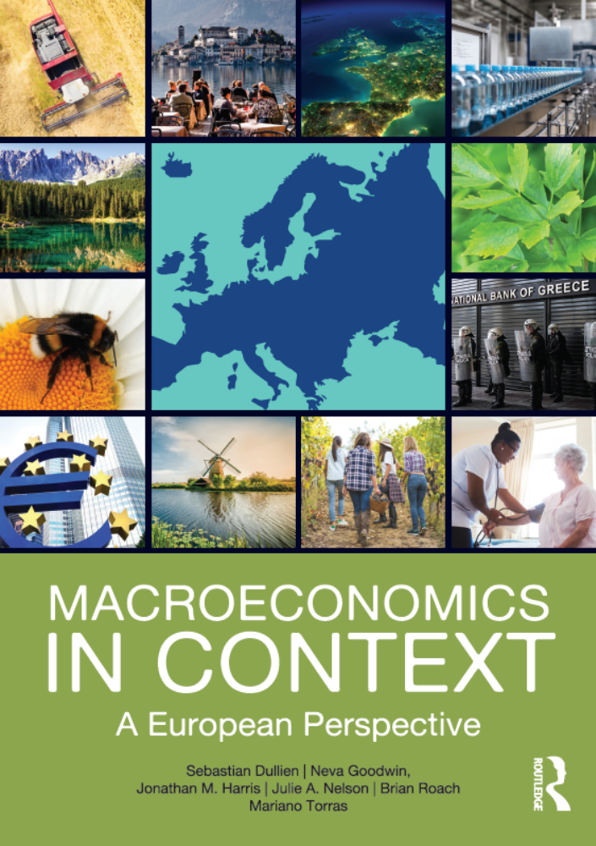
How Economies Grow and Develop
Chapter 18
© Dünhaupt, Dullien, Goodwin, Harris, Nelson, Roach, Torras

Slide 2
Chapter outline
Development and Economic Growth
Country Growth Experiences
Understanding Poverty
Inequality

Slide 3
Learning goals
After today’s lecture, you will be able to:
  Explain the difference between “economic growth” and “economic development.”
  Understand the relevance to economics—and to economic growth in particular—of the Industrial Revolution.
  Describe general patterns of economic growth over time and across different regions and countries.
  Discuss the controversy concerning whether global inequality is increasing or decreasing.
  List various factors that play a role in development.
  Explain how poverty, economic growth, and human development are related.

Slide 4
Development and Economic Growth

Slide 5
Standard economic growth theory
how is economic growth related to economic development?
for people’s incomes on average to increase over time, GDP growth rate > rate of population growth

Slide 6
Figure 18.1 Economic growth in the AS/AD Model
AS₀
AS₁
Economic growth increases the maximum productive capacity of the economy. It involves both supply-side and demand-side expansions, and does not necessarily involve a change in the rate of inflation.
Inflation rate (π)
AD₁
AD₀
Expanded maximum capacity
Output (Y )

Slide 7
What causes economic output to increase?
one way that output could increase is if there is an expansion in the inputs used to produce it:
  natural capital
  manufactured capital
  human capital
  social capital
  financial capital

Slide 8
Production function
production function: a mathematical relation between various inputs and the level of output
factors of production: the essential inputs for economic activity, including labor, capital, and natural resources
technology is the other important variable that influences economic output, and productivity depends crucially on the level of technology
total factor productivity reflects all contributions to total production not already reflected in the input levels

Slide 9
The industrial revolution
a process of social, technological, and economic change, which began in Britain and Western Europe in the 18th century
  new methods of production
  new work organization
  → greater output per worker

Slide 10
The 1950s: Rostow: from underdevelopment to development
from “underdevelopment” to development :
  traditional agrarian society
  preconditions for take-off
  takeoff
  drive to maturity
  age of high mass consumption
if domestic savings were insufficient to enable a country to reach the “takeoff ” stage, “foreign saving” should help compensate for the shortfall

Slide 11
The 1980s: Development through structural reforms
the main principles of the Washington Consensus
  fiscal discipline
  market liberalization and privatization
  trade liberalization and openness to foreign investment
loans from the World Bank, the IMF, and other institutions were made conditional on structural reforms
idea: make developing economies appealing and „safe“ for foreign investment

Slide 12
Table 18.1 Per capita annual real GDP growth in selected Latin American countries, 1980–2015 (%)
Country | Real GDP Growth (in %)
Bolivia | 0.9
Brazil | 1.2
Chile | 3.3
Colombia | 2.0
Ecuador | 1.1
Mexico | 0.8
Peru | 1.4
Venezuela |  | –0.3
All Middle Income Countries average | 2.7
Source: World Bank, World Development Indicators Database, 2016.

Slide 13
Country Growth Experiences

Slide 14
Figure 18.2 World economic growth, 1971–2015
All series are shown using an index of 100 for 1971 levels. During the period 1971–2015, population nearly doubled, energy use more than doubled, food production trippled, and gross world product increased by 280 percent.
Index (1971=100
Source: World Bank, World Development Indicators Database, 2016.

Slide 15
Table 18.2 Income, growth, and population comparisons, selected countries and country groups
Country or Category | GDP per Capita, 2015 (PPP, constant 2011 international $) |  | Percent Growth in GDP per Capita (PPP. Annual Average. 1991-2015) | Percent of World Population (2011)
High Income | 42,261 |  | 1.4% | 16.2%
Hong Kong | 53,380 |  | 2.6% | 0.1%
United States | 52,549 |  | 1.5% | 4.4%
Japan | 35,804 |  | 0.7% | 1.7%
France | 37,306 |  | 0.9% | 0.9%
South Korea | 34,387 |  | 3.9% | 0.7%
Middle Income | 10,104 |  | 3.3% | 74.6%
Russia | 23,895 |  | 0.8% | 2.0%
Turkey | 18,959 |  | 2.4% | 1.1%
Brazil | 14,455 |  | 1.4% | 2.8%
China | 13,400 |  | 8.8% | 18.7%
India | 5,730 |  | 4.8% | 17.8%

Slide 16
Table 18.2 Income, growth, and population comparisons, selected countries and country groups
Country or Category | GDP per Capita, 2015 (PPP, constant 2011 international $) |  | Percent Growth in GDP per Capita (PPP. Annual Average. 1991-2015) |  | Percent of World Population (2011)
Bangladesh | 3,137 |  | 3.6% |  | 2.2%
Nepal | 2,313 |  | 2.5% |  | 0.4%
Haiti* | 1,658 |  |  | -0.3% | 0.1%
Ethiopia | 1,530 |  | 3.9% |  | 1.4%
Congo, DR | 737 |  |  | -1.7% | 1.1%
Source: World Bank, World Development Indicators Database, 2016.
*Data for Haiti growth rate is for 1999–2015.

Slide 17
What accounts for the striking differences in economic growth across countries?
economies such as the U.S., Europe, and Japan benefitted from many decades of economic growth (with periods of slowdown or recession)
GDP increase due to a combination of factors:
  aggregate demand
  labor productivity
  technological innovation
  investment in manufactured capital
  taking advantage of trade opportunities

Slide 18
Successful economic growth from taking advantage of trade opportunities
industrialized countries used protectionism
  tariffs and quotas to limit trade – to foster development of important domestic industries
developed countries “kicked away” the
(protectionist) ladder
→ they now insist that poor countries follow free trade rules

Slide 19
The virtuous cycle of the Asian tigers
self-reinforcing patterns of:
  high savings and investment leading to greater productivity
  competitive export industry
  growth of domestic industries
  → resulting financial capital invested in machines, tools, factories, and other equipment that can enhance productivity
  → cycle begins again

Slide 20
Are developing countries catching up?
convergence: the idea that poorer countries or regions are on a path to “catch up”
  idea: underlying economic forces will cause poorer countries and regions to “catch up” with richer ones
evidence suggests that while some developing countries are on a path to catch up with the richer ones in GDP terms, others are not
since 2000 there has been significantly more progress towards convergence
  this is mainly driven by the rapid growth in China and India, but applies to other countries also

Slide 21
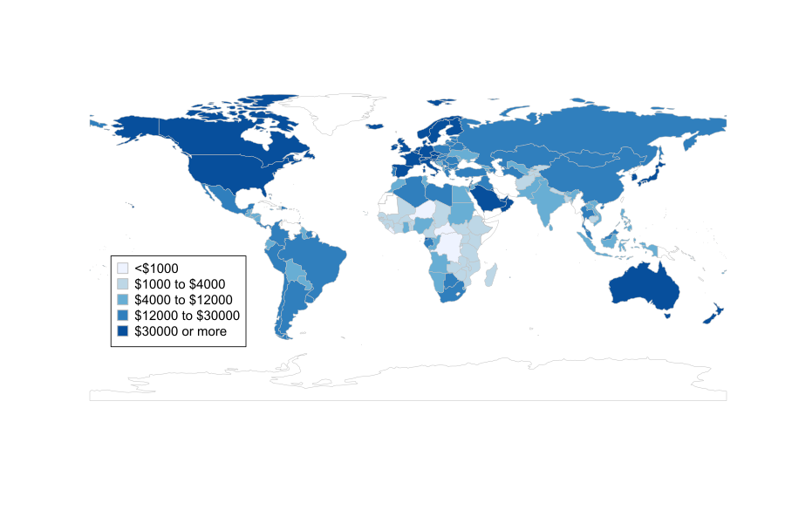
Figure 18.3 GDP per capita in 2015 (in current PPP $ per person)
Income per person is highest in the industrialized countries of North America and Europe, along with Japan, Australia, and New Zealand. Income per person is lowest in many African and Asian countries.
Source: World Bank, World Development Indicators Database, 2016.

Slide 22
Figures 18.4a Per capita GDP expressed as a percentage of per-capita GDP in the USA
Source: Feenstra, Robert C., Robert Inklaar and Marcel P. Timmer (2015), "The Next Generation of the Penn World Table" American Economic Review, 105(10), 3150-3182, available for download at www.ggdc.net/pwt .

Slide 23
Figure 18.4b Per capita GDP expressed as a percentage of per-capita GDP in the USA
Brazil
Bolivia
Nigeria
Congo, DR
Source: Feenstra, Robert C., Robert Inklaar and Marcel P. Timmer (2015), "The Next Generation of the Penn World Table" American Economic Review, 105(10), 3150-3182, available for download at www.ggdc.net/pwt .

Slide 24
Figure 18.5 Growth and income relationship with area proportional to population
Source: World Bank, World Development Indicators Database, 2016.

Slide 25
What accounts for the striking differences in economic fortunes across countries?
a great variety of factors plays a role in development
their significance and the direction of effect (positive or negative) may vary greatly from country to country
it is impossible to make all-encompassing statements about why many developing countries have failed to achieve sustained growth

Slide 26
Natural resources
arable land, rich mineral and energy resources, good natural port facilities and healthy climate make it easier for a country to prosper
overexploitation of natural resources lead to environmental degradation and economic distortion
misdirected oil revenues can lead to corruption and waste
other sectors are starved of investment and resources

Slide 27
Savings and investment
investment in manufactured capital, agriculture and human capital are essential to growth
education in science and technologies likely to have significant effects on growth
additions to capital do not automatically lead to growth
capital intensive technologies might be inappropriate in countries with high unemployment
labor intensive products generate less export revenue

Slide 28
Allocation of investment
market allocation of investment might ignore social priorities
public goods such as environmental quality and water supplies require public role
governments can play a role in planning industrial investments through industrial policy and to promote infant industries

Slide 29
Foreign sources of financial capital
bilateral development assistance: grants or loans made by rich country’s governments to poorer countries
multilateral development assistance: aid or loans from international organizations (World Bank, IMF)
private foreign investment
empirical evidence is mixed:
  aid went to corrupt leaders
  poor countries highly indebted and spend a lot on debt service
  FDI might crowd out local initiatives

Slide 30
Domestic demand versus export orientation
level of aggregate demand important for growth
underdeveloped domestic markets
countries become dependent on exports
  problematic if world demand is limited
  terms of trade (price of exports relative to imports)

Slide 31
Financial, legal and regulatory institutions
effective systems of property rights and contract enforcement allow entrepreneurs to benefit from their investments
corporate and bank regulation
corruption, internal conflict, and other factors make it difficult for effective institutions to take root
political instability leads to economic inefficiency and difficulty to attract FDI
less saving for future investment

Slide 32
Capitalism
characterized by private ownership of productive assets
laissez-faire capitalism: great reliance on exchange as a mode of coordination (with relatively little coordination by public administration)
  UK and U.S.
administrative capitalism: substantial reliance on public administration (as well as exchange) as a mode of coordination
  Germany, Italy, France, Australia, Japan

Slide 33
Socialism
system that relies more on public ownership
administrative socialism: state ownership predominates and activity is coordinated primarily by public administration
  Soviet Union, North Korea
market socialism: state ownership predominates but economic activity is coordinated through markets
  China, Vietnam

Slide 34
Understanding Poverty

Slide 35
How to define poverty
poverty line: the income threshold below which members of a population are classified as poor
  minimum standard to escape extreme poverty is $1.90 per day
  threshold for being considered at risk of poverty is calculated relative to national incomes
  disadvantage: not useful for comparing across countries
  advantage: allows a country to define poverty according to its own standard of living

Slide 36
Table 18.3 Growth rates and changes in poverty rates, selected countries
 | Period | Annual growth rate in per capita GDP, % | Poverty rate at beginning of period, % |  | Poverty rate at end of period, %
Bangladesh | 1983 - 2010 | 2.6 | 22.4 |  | 11.2
Brazil | 1981 - 2013 | 1.1 | 9.8 |  | 2.8
China | 1981 - 2010 | 8.9 | 43.2 |  | 2.7
Ethiopia | 1982 - 2010 | 1.1 | 24.3* |  | 9.0
India | 1983 - 2011 | 4.3 | 16.1 |  | 4.3
Indonesia | 1984 - 2010 | 3.5 | 27.9 |  | 2.9
Mexico | 1984 - 2012 | 0.8 | 9.7 |  | 0.7
Nigeria | 1985 - 2009 | 1.7 | 17.4 |  | 21.8
Philippines | 1985 - 2012 | 1.3 | 9.3 |  | 2.7
South Africa | 1992 - 2011 | 1.0 | 11.0 |  | 4.9
Thailand | 1981 - 2012 | 4.3 | 5.0 |  | 0.0
Source: World Bank, World Development Indicators Database, 2013.
Note: The poverty rate is based on a poverty line of $1.90 per day.

Slide 37
The Multidimensional Poverty Index
based on Amartya Sen’s capability approach:
  capabilities: the opportunities that people have to pursue important aspects of well-being, such as being healthy and having access to education
the Multidimensional Poverty Index considers several elements that are critical for a decent life:
  physical living standards, education, and health
in some countries, there are large discrepancies between MPI poor and income poor

Slide 38
Human development and the
Millennium Development Goals
human development: an approach to development that stresses the provision of basic needs such as food, shelter, and health care
Millennium Development Goals: a set of goals declared by the United Nations in 2000 (deadline 2015 for achievement)
  eradication of extreme poverty
  promotion of education, gender equity and health
  environmental sustainability
  partnership between rich and poor countries

Slide 39
Were the Millennium Development Goals a success?
between 2000 and 2015, many dimensions of human development improved more rapidly
by 2015, global poverty rate decreased from 47% to 14%
  progress very uneven
  much misery and poverty remained
countries did not open up markets to the products of poorer countries
inadequate funding
degree of incompatibility between goals and macroeconomic strategies

Slide 40
The Sustainable Development Goals
a set of goals set forth by the United Nations in 2015, building on and expanding the Millennium Development Goals,
including goals such as
  battling inequality worldwide
  promoting inclusive growth
  limiting climate change

Slide 41
Inequality

Slide 42
The Kuznets Curve
inverted-U relationship between economic growth and inequality
initial stage of economic growth:
  inequality increases as investment opportunities create a wealthy class
  influx of rural laborers into cities keeps wages down
further industrialization:
  democratization, increases in education and safety-net policies
  inequality declines

Slide 43

Figure 18.6. The unequal distribution of the world’s income, 2007
Top 20%: 82.8%
of world income
Next 20%: 9.9%
of world income
Third 20%: 4.2%
of world income
Fourth 20%: 2.1%
of world income
Poorest 20%: 1.0%
of world income
Source: I. Ortiz and M. Cummings, “Global Inequality: Beyond the Bottom Billion,” UNICEF Social and Economic Policy Working Paper, April 2011.

Slide 44
Policies that promote GDP growth and a reduction in the degree of income inequality
promote education
well-designed labor market policies and institutions
immigration and discrimination policies
tax policies

Slide 45
Recent studies of inequality
countries that are more unequal in terms of income perform more poorly on many well-being indicators
at very low levels of income per head, increases in per-capita income are associated with steep increases in life expectancy
after a middle-income is reached, increases in income are associated with much more modest increases in life expectancy
at high incomes the relationship flattens out

Slide 46
Figure 18.7 The relation between life expectancy and income, with area proportional to population
Source: World Bank, World Development Indicators Database, 2013.

Slide 47
Economic development and human development
benefits of economic growth have been unevenly distributed
much of the world’s population has been left out in terms of living standards and well-being
policies to achieve GDP growth should be balanced with promotion of human development goals
indefinite GDP growth will be in the long term ecologically unsustainable

Slide 48
What to take home (I)
for purposes of evaluating how economic growth is related to economic development, it is often helpful to focus on the growth rate of GDP per capita, that is, output per person.
economic historian W.W. Rostow advanced the thesis that progress from “underdevelopment” to development invariably followed five steps
the main principles of the Washington Consensus were: fiscal discipline, market liberalization and privatization, trade liberalization and openness to foreign investment.

Slide 49
What to take home (II)
although industrialized countries have generally benefited from openness to trade, they have also typically used protectionism—tariffs and quotas to limit trade—to foster the development of important domestic industries
poverty can be defined as the percentage of the population below what is known as the poverty line
it is impossible to make all-encompassing statements about why many developing countries have failed to achieve sustained growth
one factor that appears to be essential in almost every case for promoting growth and development is human capital

