Slide 1
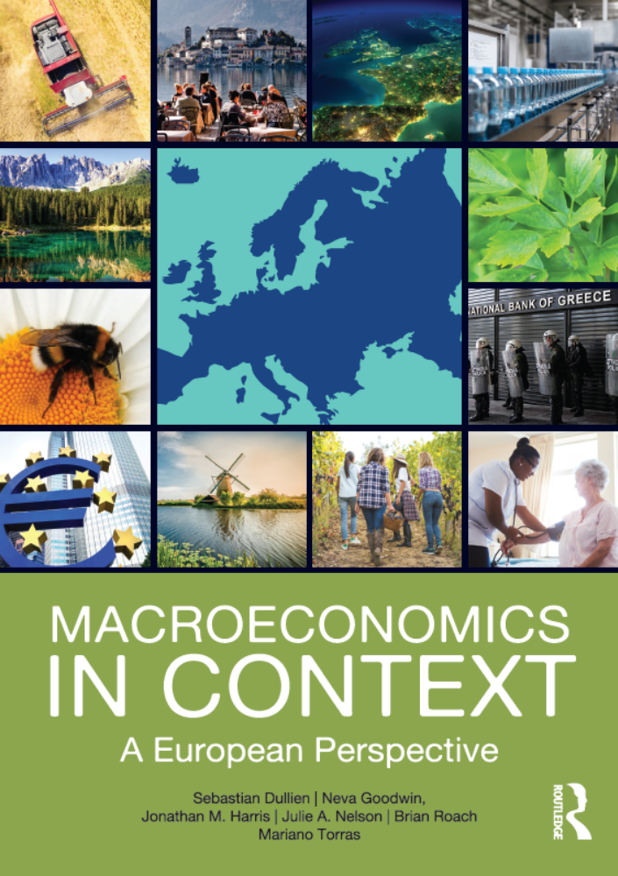
Growth and Sustainability in the 21st Century
Chapter 19
© Dünhaupt, Dullien, Goodwin, Harris, Nelson, Roach, Torras

Slide 2
Chapter outline
Macroeconomic Goals: Looking Forward
Macroeconomic and Ecological Sustainability
The Race between Technology and Resource Depletion
Climate Change
Economic Growth and the Environment
Are Stabilization and Sustainability in Conflict?
Concluding Thoughts

Slide 3
Learning Goals
After today‘s lecture, you will be able to:
  Recognize ecological sustainability as major economic issues for the 21st century.
  Identify major environmental challenges.
  Have a basic understanding of the relationship of climate change to economic growth
  Be familiar with the Environmental Kuznets Curve and its limitations.
  Understand the concepts of limits to growth and a steady-state economy.
  Describe several policies directed towards sustainable development.

Slide 4
Macroeconomic Goals: Looking Forward

Slide 5
Macroeconomic goals: looking forward
remember: Macroeconomics focuses on human well-being
but: traditional macroeconomics has often a narrow focus on stability and growth in GDP
changes in the conditions of work, stresses imposed on families, and development in the social and financial infrastructure of an economy are often ignored
  environmental degradation
  growing inequality
  inadequacies in health care, child care and education
economic growth is not sufficient to improve human well-being
finite planetary limits might make unlimited GDP growth infeasible

Slide 6
Macroeconomic and Ecological Sustainability

Slide 7
Major environmental issues: global population
dramatic increase in world population:
  in 1960: 3 billion
  in 2000: 6 billion
  in 2011: 7 billion
human population growth contributes to increases in many environmental pressures:
  e.g. food production:
  land degradation
  pollution from fertilizers and pesticides
  overtaxing of water supplies

Slide 8
Major environmental issues: resource depletion
world's fisheries are in decline due to overfishing
tropical forests are lost at a rapid rate
a billion people live in countries where usable water is scarce
stocks of mineral resources are being depleted
global production of oil will peak within the next few decades
current dependence on fossil fuels could challenge potential for industrialized countries to maintain their living standards and for developing countries to reduce poverty

Slide 9
Major environmental issues: pollution and wastes
industrial countries generate major share of the world’s pollution and waste
(two-thirds of global industrial waste)
toxic wastes are exported from industrialized countries to low-income countries

Slide 10
Major environmental issues: the race between technology and resource depletion
economic growth is associated with productivity gains from being able to produce goods and services with progressively cheaper resources
  when wood and whale oil became scarce, they were replaced by fossil fuels
  “Technological optimists” believe than humans will always be able to come up with technical solutions for resource scarcity
but:
  Do substitutes exist for all resources?
  Are some resources more essential than others? (There is no substitute for potable water)

Slide 11
Even renewables might be exhaustible
fish: a renewable or reproducible resource
but: renewable ≠ inexhaustible
many deep-sea-fish are seriously depleted
technological change has contributed to the decline
  larger boats
  drift nets
  Sonar technology for finding fish

Slide 12
Climate Change

Slide 13
Greenhouse emissions and global temperature change
emissions of various greenhouse gases trap heat near the earth’s surface, leading to:
  general warming trend
  sea-level rise
  ecological disruption
  increase in severe weather events (hurricanes, floods, droughts…)

Slide 14
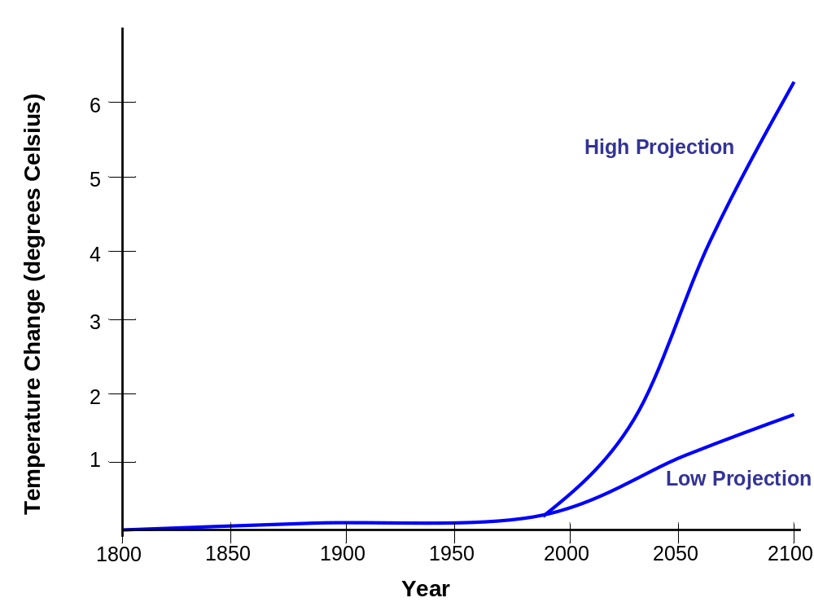
Figure 19.1 Global temperature trends, 1900–2100
Global average temperature is predicted to be between 3 and 7 degrees Fahrenheit warmer in 2100 compared to preindustrial levels.
High Projection
Temperature Change (degrees Celsius)
Low Projection
Year

Slide 15
Costs of climate change
costs of climate change in the 21st century between
5 % and 20 % of global GDP
most severe effects of climate change could be avoided at a cost of approximately 1 % of GDP
most dangerous impacts of climate change are not likely to occur for several decades or more, the actions taken in the next few decades will almost surely have a profound effect on those ultimate impacts
climate change is likely to exacerbate global inequalities and impede economic development in poorer countries

Slide 16
National and global responses to the climate challenge
modern environmental problems require a coordinated international response
Kyoto Protocol: committed industrialized countries to reduce their greenhouse gas emissions by an average of
5 % below their 1990 emissions by the period 2008-2012
  drafted in 1997; ratified in 2005
Paris Agreement: December 2015
  each country is supposed to set its own goal for the reduction in greenhouse gas emission
  treaty does not include any mechanism to actually enforce the commitments

Slide 17
The cost of responding versus the cost of inaction
large-scale energy transition away from fossil fuels have significant costs
but: modest on a macroeconomic scale
costs should be balanced against growing costs that are likely to be caused by climate change:
  damage from extreme weather events
  agricultural output losses
  possible effects of famine, armed conflict, mass migration

Slide 18
Economic Growth and the Environment

Slide 19
The environmental Kuznets Curve Hypothesis
idea: in the long-run, economic development reduces per-capita environmental damage
  sufficient wealth and technology → countries adopt clean production methods and move to service-based economy
inverted U-shaped relationship between economic development and environmental damages
  environmental damage per capita increases in the early stages of economic development, reaches a maximum, and then diminishes as a country attains higher levels of income

Slide 20
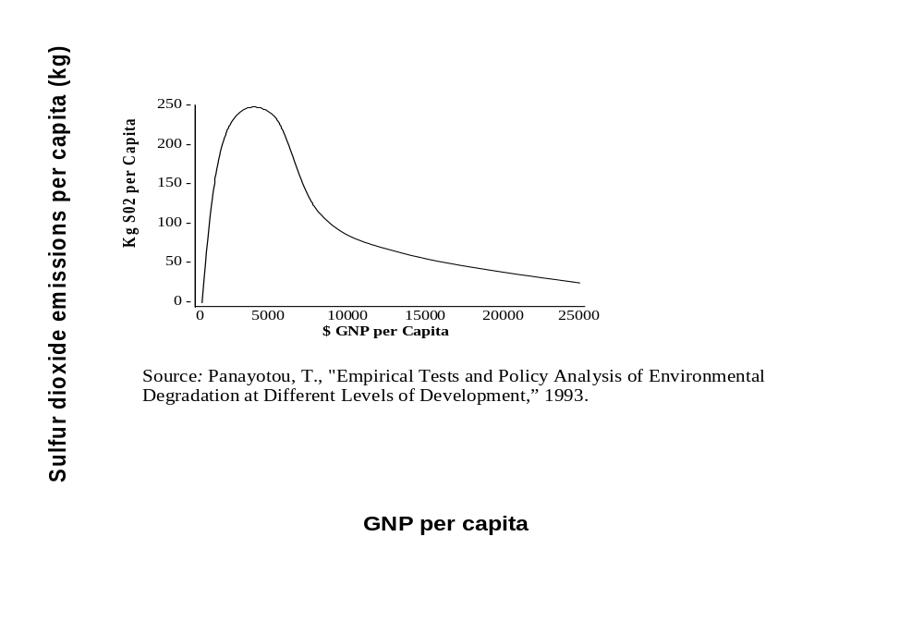
Figure 19.2 Environmental Kuznets Curve for Sulfur Dioxide Emissions
The empirical relationship between sulfur dioxide emissions and the level of economic development in a country supports the EKC hypothesis.
Sulfur dioxide emissions per capita (kg)
Source: T. Panayotou, “Empirical Tests and Policy Analysis of Environmental Degradation at Different Levels of Development,” International Labour Office Working Paper, 1993.
GNP per capita

Slide 21
Figure 19.3 Carbon Dioxide Emissions vs. GDP per Capita, 2009
Carbon dioxide emissions per capita tend to increase with higher levels of economic development in a country.
Source: World Bank, World Development Indicators Database, 2013.

Slide 22
Does the environmental Kuznets curve hold?
not for many environmental problems:
  studies on municipal waste and energy use:
  environmental problems continue to rise as income rise
  CO₂ emissions show a positive relationship with average income
→ economic growth appears unlikely to provide a guaranteed path to environmental sustainability

Slide 23
The relationship is complex
average income is not the only relevant factor in determining environmental impacts:
  structure of the economy and lifestyles
  distribution of wealth and income
sustainable development needs to include reducing economic inequalities along with preserving the environment

Slide 24
What kind of policies would be required to promote ecological sustainability?
How can these policies be designed so that they also maintain well-being and promote human development, especially in developing countries?
“sustainable growth”: a contradiction in terms?
  no system can grow without limit
there is nothing in standard macroeconomics to guarantee that economic growth will be either equitable or environmentally benign
specific policies for sustainable development are needed

Slide 25
Green taxes
make it more expensive to undertake activities that deplete important natural resources or contribute to environmental degradation
discourage energy- and material-intensive economic activities while favoring the provision of services and labor-intensive industries
green taxes as a means of internalizing negative externalities such as pollution
objections:
  green taxes fall disproportionately on lower-income households
  green taxes are politically unpopular

Slide 26
Figure 19.4 Environmentally based taxes as a share of total tax revenue, selected industrialized countries, 2013
Environmentally based taxes account for 9 percent of total tax revenue in Denmark and the Netherlands, but only about 3 percent of total revenue in the United States.
Source: OECD, 2016.

Slide 27
Eliminating subsidies
agricultural and energy subsidies that encourage the overuse of energy, fertilizer, pesticides, and irrigation water could be reduced or eliminated
this would improve government finances
money saved could be used to:
  lower taxes
  promote more sustainable agricultural systems

Slide 28
Recycling and renewable energy
promote greater recycling of materials and the use of renewable energy through policies such as:
  deposit/refund systems
  targeted subsidies
governments can support expansion of energy from solar power, wind, and geothermal heat

Slide 29
Tradable permits
set an overall limit on pollution
  limited number of permits
  allowing the emission of specific quantities and types of pollution
a process of pollution reduction may be most efficiently achieved by allowing businesses to choose between finding low-cost ways to reduce their emissions and paying to buy permits
after permits are distributed to firms, they can then buy them from or sell them to other firms

Slide 30
Nudging toward sustainable transportation
efficient transportation systems can replace energy-intensive automotive transport
  high-speed trains
  public transit
  greater use of bicycles
  redesign of cities and suburbs to minimize transportations needs
government needs to finance and conduct investments

Slide 31
Feed-in tariffs
used to promote the construction of renewable energy supplies
suppliers of power from renewable energies get the right to feed their electricity into the grid at a predetermined rate (above the market rate for electricity)
  allows renewable energy to be competitive
  creating an incentive for the installation of renewable energy capacities

Slide 32
Debt-for-nature swaps
forgiving debt of developing countries in exchange for agreements to protect nature reserves or pursue environmentally friendly policies
  in 2002, the U.S. cancelled $5.5 million in debt owed to it by Peru in return for Peru’s agreement to conserve 10 rainforest areas covering more than 27.5 million acres

Slide 33
Sustainability and consumption
idea: replace the goal of ever increasing consumption with the goal of sufficiency
  at the individual level:
    the amount of consumption that is sufficient to support human well-being
  at the macro level:
    what kinds or amounts of consumption can be sustained, by humanity as a whole, without destructive environmental consequences

Slide 34
Table 19.1 Global population classification by income and environmental impacts, 2013
 | Global lower-income | Global middle-income | Global high-income
Population (millions) | 817 | 5,022 | 1,135
Average income per capita (U.S. dollars) | 571 | 4,148 | 39,860
Energy use per capita (kg oil equivalent) | 363 | 1,310 | 5,000
Electricity power consumption per capita (kWh) | 242 | 1,823 | 9,415
Carbon dioxide emissions per capita (metric tons) | 0.3 | 3.5 | 11.4
Passenger cars per 1,000 population | 10 | 60 | 620
Source: World Bank, Little Green Data Book 2013; World Development Indicators 2013.

Slide 35
Each of the three groups needs to approach environmental sustainability with different
objectives
high-income
group
middle-income group
lower-income group
find a way to reduce environmental impacts per capita through
technological improvements
intelligently designed policies
changes in lifestyle aspirations
keep overall environmental impacts per capita relatively stable
pursue a development path that avoids a reliance on fossil fuels, disposable products, and ever-increasing levels of material consumption
improving material living standards and
expanding options
taking advantage of environmentally friendly technologies

Slide 36
Figure 19.5 A consumption possibilities frontier
The diagram illustrates the tradeoff between consumption and leisure time. Europeans on average live at a lower material standard than people in the United States, because they do not work as many hours, hence earn less income. On the plus side, they enjoy more leisure time, which Americans sacrifice in order to be able to consume more.
Europe
Leisure
United States
Income, Consumption

Slide 37
Sustainability and investment
strategic investments that focus on areas such as
  alternative energy
  public transportation
  sustainable agriculture
  education
  health services
could move countries toward a more environmentally sustainable economy

Slide 38
Are Stabilization and Sustainability in Conflict?

Slide 39
What do we really want from employment?
quality, types and intensity of employment
people benefit from hours they spend away from paid employment
keep employment levels high while reducing material and energy throughput
What sorts of and how much employment do we really want?

Slide 40
What do we really want from production?
composition of output makes a very big difference
  shifting toward producing goods and services that are environmental beneficial could allow an economy to maintain consumption, investment, and employment in a less environmentally damaging way
population stabilization
  growing ratio of retirees to active workers
  increased demand for workers in medical and social services
investment
  investments in energy-saving infrastructure for transportation
  in wetland restoration
  in conversion of residential and commercial buildings to more environmental friendly patterns of energy and chemical use

Slide 41
Problem: transitioning to a more sustainable macroeconomy
transition requires changes in human and manufactured capital
conversion to a less resource-intensive economy in not a matter of if but, rather, a matter of when and how

Slide 42
Sustainability at the local level
sustainable development can also be developed from the bottom up
many changes in the organization of modern human life that are central for a shift toward more sustainability can only be brought about at the initiative of the local level
e.g. enable people to go to work, take their children to school, and do their shopping without the excessive use of cars
residential and commercial areas need to be planned to be reached easily, and noncar transportation links such as bicycles lanes or trams need to be provided

Slide 43
Macroeconomic policies for stabilization and sustainability
rather than growing indefinitely, national and global economic systems must follow a logistic pattern, in which growth is limited
  leading to a steady-state economy
environmental limits on growth apply to resource and energy consumption
environmental neutral or friendly activities could continue to grow

Slide 44
Figure 19.6 Growth reaching a steady-state
After starting with an exponential growth pattern, an economy adapting to a steady-state reduces its rate of growth in what is called a logistical pattern, approaching a maximum level at which economic activity stabilizes.
Resource-using Economic Activities
Steady State
Time

Slide 45
Example: “LOWGROW”
model of transition to a steady-state economy by Canadian economist Peter Victor
“socio-eco-environmental” paths that offer attractive social and environmental outcomes without requiring economic growth
slower growth leading to no growth can be consistent with full employment, virtual elimination of poverty, more leisure, considerable reduction in GHG emissions, and fiscal balance

Slide 46
Figure 19.7 A No-growth scenario for the Canadian economy
Even though projected GDP/ capita stops growing in this macroeconomic model, wellbeing continues to increase, with declining unemployment, poverty, and debt, and improved environmental conditions.
300
250
200
Index (2005=100)
GDP/Capita
150
100
GHG
Unemployment
50
Poverty
Debt to GDP
0
2005 2010 2015 2020 2025 2030 2035
Source: Adapted from Peter Victor, Managing Without Growth: Slower by Design, not Disaster. Northampton, MA: Edward Elgar, 2008, p. 182.
Year

Slide 47
Challenges of LOWGROW approach
Some measures necessary might be highly unpopular:
  Taxes would be increased strongly to finance more public services and to limit private consumption
  Status symbols such as large cars would become unaffordable
LOWGROW is potentially incompatible with current financial system and current system of international trade

Slide 48
What to take home
macroeconomics need to adapt to new realities
economic analysis must take into account the need for technologies that can provide energy and material for human consumption in ways that are ecologically sound and that help to remedy past damages
transition to a more sustainable economy will have economic costs but also significant benefits
macroeconomics of the twenty-first century must be truly global

