Slide 1

Supply and Demand
Chapter 4
© Dünhaupt, Dullien, Goodwin, Harris, Nelson, Roach, Torras

Slide 2
Chapter Outline
Market and Macroeconomics
The Theory of Supply
The Theory of Demand
The Theory of Market Adjustment
Macroeconomics and the Dynamics of Real-World Markets

Slide 3
Learning goals
After today’s lecture, you will be able to:
  Describe the concept of the supply curve.
  Explain the difference between “change in quantity supplied” and “change in supply.”
  Describe the concept of the demand curve.
  Explain the difference between “change in quantity demanded” and “change in demand.”
  Explain the difference between a “substitute good” and a “complementary good.”
  Demonstrate an understanding of surplus, shortage, and equilibrium situations using the supply and demand graphical model.
  Demonstrate an understanding of the difference between movement along a curve versus a shift in a curve using supply and demand analysis.
  Describe the concept of price elasticity.
  Describe the concept of a speculative bubble.

Slide 4
Markets and Macroeconomics

Slide 5
Classical and Keynesian views of markets
Classical Economics
markets generally function smoothly at least as long as governments do not interfere
Keynesian Economics
market economies need more help from government policies
understanding the workings of the macroeconomy requires that one goes beyond the model of supply and demand

Slide 6
Market competitiveness
The market in the classical world:
perfectly competitive:
  many buyers and sellers
  all units of the good are identical
  free entry and exit
  perfect information
self-correcting market:
  automatically adjusts to any imbalances between sellers (supply) and buyers (demand)

Slide 7
The Theory of Supply

Slide 8
Table 4.1 A supply schedule for coffee
Price (€/cup) | Cups of coffee supplied/week
0.70 | 300
0.80 | 400
0.90 | 500
1.00 | 600
1.10 | 700
1.20 | 800
1.30 | 900
1.40 | 1,000
1.50 | 1,100
1.60 | 1,200

Slide 9
Figure 4.1 The supply curve for cups of coffee
Price of Coffee (€ per Cup)
The supply curve shows the same information as the supply schedule. At higher prices, more cups of coffee are offered on the market by people who are in a position to sell.
Cups of Coffee Supplied per Week

Slide 10
Figure 4.2 An increase in supply
The supply curve shifts outward (to the right) when sellers decide to supply a larger quantity to the market at a given price, or to charge less for a given quantity.
Price of Coffee (€ per Cup)
S₁
S₂
Cups of Coffee Supplied per Week

Slide 11
Figure 4.3 A decrease in supply
The supply curve shifts backward (to the left) when sellers decide to supply a smaller quantity to the market at a given price, or to charge more for a given quantity.
Price of Coffee (€ per Cup)
S₂
S₁
Cups of Coffee Supplied per Week

Slide 12
The Theory of Demand

Slide 13
Table 4.2 A demand schedule for coffee
Price (€/cup) | Cups of coffee demanded/week
0.20 | 1,000
0.50 | 900
0.80 | 800
1.10 | 700
1.40 | 600
1.70 | 500
2.00 | 400
2.30 | 300

Slide 14
Figure 4.4 The demand curve for cups of coffee
The demand curve shows the same information as the demand schedule. At higher prices, fewer cups of coffee are desired by people looking to buy.
Price of Coffee (€ per Cup)
Cups of Coffee Demanded per Week

Slide 15
Figure 4.5 An increase in demand
The demand curve shifts outward (to the right) when more buyers want to buy at a given price, or buyers are willing to pay a higher price for a given quantity.
D₁
D₂

Slide 16
Figure 4.6 A decrease in demand
When the demand curve shifts inward (to the left), we say that demand has decreased.
D₂
D₁

Slide 17
The Theory of Market Adjustment

Slide 18
Figure 4.7 Surplus, shortage, and equilibrium
Price of Coffee (€ per Cup)
(D=600)
•
(S=1000)
(S=400)
(D=800)
Cups of Coffee per Week

Slide 19
Surplus, shortage, and equilibrium
at a price of €1.40 a surplus occurs because the quantity of cups of coffee being offered for sale is larger than the quantity that people want to buy
on the other hand, at a price of €0.80 many people want to buy cups of coffee but few want to sell, so a shortage occurs
only at market equilibrium (point E) does quantity supplied equal quantity demanded

Slide 20
Figure 4.8 Market adjustment to an increase in supply
Price of Coffee (€ per Cup)
S₁
S₂
E₁
Surplus
E₂
Demand
Cups of Coffee per Week

Slide 21
Market adjustment to an increase in supply
with an increase in the supply of cups of coffee, there now would be a surplus at the original equilibrium price of €1.10
market adjustment forces should cause the price to fall, until a new equilibrium is established at a price of €0.80. 700 cups of coffee will sell at this new equilibrium price
the equilibrium price has fallen and the equilibrium quantity has risen

Slide 22
Figure 4.9 Market adjustment to an increase in demand
D₁
D₂
E₂
Supply
E₁
Shortage

Slide 23
Market adjustment to an increase in demand
with an increase in demand, there would be a shortage of cups of coffee at the original equilibrium price of €1.10
market forces should cause the price to rise, until a new equilibrium is established at €1.40 1000 cups of coffee will sell at this new equilibrium price
the equilibrium price has risen and the equilibrium quantity has risen

Slide 24
Elasticity
when there is a change in market price, by how much will the equilibrium quantity change?
the price elasticity of demand measures the degree to which buyers of a good respond to a change in its price

Slide 25
Price elasticity of supply
when suppliers respond to a small increase in price by offering a much larger quantity of goods, we say that supply is relatively elastic
if they hardly react at all, supply is relatively inelastic

Slide 26
Figure 4.10 Price elasticity of demand
(a) Relatively price-elastic demand
Price
When a small change in price leads buyers to make a large change in the quantity they demand, demand is said to be relatively elastic.
S₂
S₁
P₂
P₁
D
Q₂
Q₁
Quantity

Slide 27
Figure 4.10 Price elasticity of demand
(b) Relatively price-inelastic demand.
Price
If buyers’ response is weak, demand is said to be relatively inelastic.
S₂
S₁
P₂
P₁
D
Q₂
Q₁
Quantity

Slide 28
Macroeconomics and the Dynamics of Real-World-Markets

Slide 29
The dynamics of real-world-markets
few if any markets truly approach perfect competition
markets are characterized by market power
there are different brands and types of product with different characteristics
buyers and sellers may have imperfect information, or be bound by long-term contracts
the role of assumptions and expectations can be significant

Slide 30
How long will it take our hypothetical coffee traders to reach equilibrium?
Minutes?
An hour?
A day?
the theory of supply and demand does not tell us

Slide 31
When price adjustments are slow
quantity adjustments: a response by suppliers in which they react to unexpectedly low sales of their good primarily by reducing production levels rather than by reducing the price and to unexpectedly high sales by increasing production rather than raising the price
menu costs: the costs to a supplier
of changing prices listed on order forms, brochures, menus, and the like

Slide 32
When prices swing too much: market instability
very rapid adjustments of prices create problems
there are markets in which buyers are not really interested in the item itself at all—only in its price and the direction in which it is likely to go.
speculation is the buying and selling of assets with the expectation of profiting from appreciation or depreciation in their values, usually over a relatively short period of time
speculative bubble: the situation that occurs when mutually reinforcing investor optimism raises the value of an asset far above what can be justified by fundamental value

Slide 33
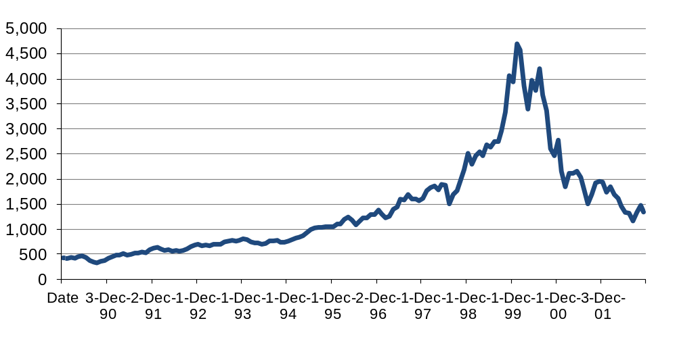
Figure 4.11 The stock market bubble of 1999–2000
Enthusiasm about new technologies, and Internet e-commerce in particular, temporarily drove the prices of many companies’ stocks very high. During the bubble, the prices of stocks as determined by supply and demand rose far above the prices that would occur if valuation had been based on the companies’ actual performances.
Nasdaq Composite Stock Index
1991 1992 1993 1994 1995 1996 1997 1998 1999 2000 2001 2002
Source: Yahoo! Finance, Monthly data.

Slide 34
From microeconomics to macroeconomics
how far does the model of supply and demand get us in explaining macroeconomic phenomena?
  are markets in the real world similar to the one portrayed in the model?
  even to the extent that individual markets do behave as the model predicts, might explaining national-level economic phenomena require different theoretical tools? In other words,
does it follow that what works for a market necessarily works for entire economies?

Slide 35
What to take home
Classical and Keynesian economists have opposing views on how markets function
the market in the classical view is perfectly competitive and self-correcting
the price elasticity of demand measures the degree to which buyers of a good respond to a change in its price
price adjustments can be slow
speculation can create problems

