Slide 1

Macroeconomic Measurement – The Current Approach
Chapter 5
© Dünhaupt, Dullien, Goodwin, Harris, Nelson, Roach, Torras

Slide 2
Learning goals
After today‘s lecture, you will:
  Know what Gross Domestic Product (GDP) is
  Understand the sectorial classification used to compute GDP
  Understand and apply the three different approaches of computing GDP
  Be able to compute growth rates of GDP, nominal and real GDP
  Understand and be able to compute commonly used price indicators and the inflation rate

Slide 3
Chapter Outline
An Overview of National Accounting
Defining Gross Domestic Product
Measuring Gross Domestic Product
Growth, Price Changes and Real GDP
Savings, Investment and Trade

Slide 4
Why should you care about Gross Domestic Product?
GDP is the measure most often used to gauge the performance of a country‘s economy
  Levels of GDP are used in international comparisons
  Rate of change in GDP is what we usually refer to as „economic growth“
  Recessions are usually defined as a fall in GDP

Slide 5
An Overview of National Accounting

Slide 6
Historical Origins of National Accounts
In the 19th century: First attempts to measure national income in England and France
By 1900, only 9 countries computed national income
Great Depression and World War II increased interests in national income measurement
By 1940, 33 countries computed national income
Today, all countries measure national income
  In the European Union, national statistical offices and the European statistical Eurostat compile national accounts
  There are broad standards, but conventions differ between e.g. the United States of America and EU countries

Slide 7
National Accounting Sectors
Household sector: Households and non-profit organization, including household firms
Non-financial corporations sector: All private and public corporate enterprises that produce goods or provide non-financial services to the market
Government sector: All central, state, regional and local governments and social security funds
Financial corporations sector: All private and public entities
engaged in financial intermediation
Rest of the world: All entities located outside a country’s borders

Slide 8
Conventions about Capital Stocks
Components of manufactured capital:
  Fixed assets: equipment owned by businesses and governments (e.g. structures, dwellings, software, intellectual property products)
  Inventories: stocks of raw materials or manufactured goods held until they can be used or sold
  Consumer durable goods: equipment owned by households that is used in household production of goods and services

Slide 9
Table 5.1 The Estimated Size of Euro Area
Manufactured Capital Stock, 2013
Type of capital | Value in trillions of euros at the end of the year
Machinery and equipment (total economy) | 4.28
Other buildings and structures (total economy) | 11.66
Cultivated assets and Intangible fixed assets (total economy) | 0.41
Dwellings (households, non-profit institutions serving households) | 14.29
Dwellings (government and corporations) | 2.43
Total value of manufactured capital | 33.07
Sources: ECB, Statistical Data Warehouse. May 18, 2016, and authors’ calculations.

Slide 10
Conventions about Investment
Investment:
  Addition to stocks of nonfinancial assets
Gross investment:
  All flows into the capital stock over a period of time
Net investment:
  Gross investment minus depreciation
Depreciation:
  Decrease in the quantity or quality of a stock of capital

Slide 11
Defining
Gross Domestic Product

Slide 12
Gross Domestic Product
A measure of the total market value of final goods and services newly produced within a country‘s borders over a period of time (usually one year)

Slide 13
Defining Gross Domestic Product
Market value
  For most components of GDP, we can simply refer to the market prices of goods and services to determine their contribution to GDP

Slide 14
Defining Gross Domestic Product
Final goods and services
  a good that is ready for use, needing no further processing
  In contrast, an intermediate good is a good that will undergo further processing
  Excluding intermediate goods and services avoids double counting

Slide 15
Final goods and services
  a good that is ready for use, needing no further processing
  Excluding intermediate goods and services avoids double counting
GDP = €4

Slide 16
Defining Gross Domestic Product
Over a period of time
  GDP measures production during a specific time period, normally a year or a quarter of a year
Newly produced
  Only new goods and services are counted
Within a country‘s borders
  The goods and services are produced within the physical borders of the country

Slide 17
Measuring
Gross Domestic Product

Slide 18
Measuring Gross Domestic Product
Production approach
  sums up the euro value of all final goods and services produced in each national accounting sector
Spending approach
  who buys the final goods and services that have been produced
Income approach
  totals compensation received by everyone involved in production
Value of Production = Value of Spending = Value of Income

Slide 19
Three Approaches of Measuring
Gross Domestic Product
Production
Expenditure
Income
Market value of final goods and services
Consumption
Labor Income
=
=
Investment
Government spending
Capital Income
Net exports
Chapter 5
19

Slide 20
The Product Approach
Measures the value of all final goods and services by their market value in respective currency
Value-added approach: adds up all value-added contributions at each step in the production process
Imputations are used to estimate values of components of GDP

Slide 21
The Product Approach: Value Added
Adds up all value-added contributions at each step in the production process

Slide 22
The Product Approach
Business production
+ Households and institutions production
+ Government production
− Taxes less subsidies on products
= GDP

Slide 23
Convention about household production
Counted as household production:
  Imputed rent of owner-occupied dwellings
Not counted as household production:
  Domestic and personal services produced and consumed within the same household (e.g. cleaning, preparation of meals or the care of sick and elderly)
  Volunteer service that do not lead to the production of goods, e.g. care-taking or cleaning without payment

Slide 24
Table 5.2 Gross Domestic Product, Euro Area,
Product Approach, 2015
Sector and subsector | Production by sector (trillions of euros)
Households and nonprofit institutions production | 0.33
Business production | 7.17
Government production | 1.82
Total: Gross value added | 9.33
Taxes less subsidies on products | 1.07
Total: Gross domestic product | 10.40
Source: Eurostat, National Accounts Database. May 17, 2016
Note: Totals may not add up exactly due to rounding.

Slide 25
The Spending Approach
  Adds up the value of newly produced goods and services bought by the household and institution, business, foreign, and government sectors.

Slide 26
The Spending Approach
Personal consumption
+ Private investment
+ Government consumption
+ Government investment
+ Net exports
= GDP

Slide 27
The Spending Approach
Household and institution spending
+ Business spending
+ Net foreign sector spending
+ Government spending
= GDP

Slide 28
Table 5.3 Gross Domestic Product, Euro Area,
Spending Approach, 2015
Type of spending | Spending by category (trillions of euros) |  | Spending by sub-category (trillions of euros)
Household and NPISH final consumption expenditure | 5.74
Final consumption expenditure of general government | 2.17
Gross capital formation | 2.03
Gross fixed capital formation Changes in inventories and acquisitions less disposals of valuables |  |  | 2.05 -0.02
External balance of goods and services | 0.46
Exports of goods and services |  |  | 4.75
Less: Imports of goods and services |  |  | 4.29
Gross domestic product | 10.40
Source Eurostat, National Accounts Database. May 18, 2016.
Note: Totals may not add up exactly due to rounding.

Slide 29
Box 5.2 Sex, Drugs and GDP
In October 2014, euro area GDP increased by more than
€300 billion – overnight!
Background: Eurostat changed rules:
Research & Development was classified as investment (counted in GDP), not intermediate consumption (not counted in GDP)
Illegal market activities were counted (prostitution, sale of drugs such as cannabis, ecstasy or LSD)
Italian GDP was revised up by 1 percent, British GDP by 0.6 percent and Danish GDP by 0.2 percent

Slide 30
The Income Approach
Production related incomes (wages, rents, and profits) earned by all people and organizations inside the euro area are summed up in national income
  Income from foreign production received by domestic residents is subtracted
  Income from domestic production received by foreign residents is added
  Add depreciation
  Statistical discrepancy: results from income approach not exactly reconciles results from product and spending approaches

Slide 31
The Income Approach
National Income
− Net income payments from the foreign sector
+ Depreciation
= GDP

Slide 32
Table 5.4 Gross Domestic Product, Euro Area,
Income Approach, 2015
Types of income and adjustments | Income and adjustments (trillions of euros)
National income | 8.62
Less: Net income receipts from the rest of the world | 0.07
Plus: Depreciation (consumption of fixed capital) | 1.84
Total: Gross domestic product | 10.40
Source: Eurostat, National Accounts Database. May 18, 2016, and authors’ calculations.
Note: Totals may not add up exactly due to rounding.

Slide 33
Growth, Price Changes and Real GDP

Slide 34
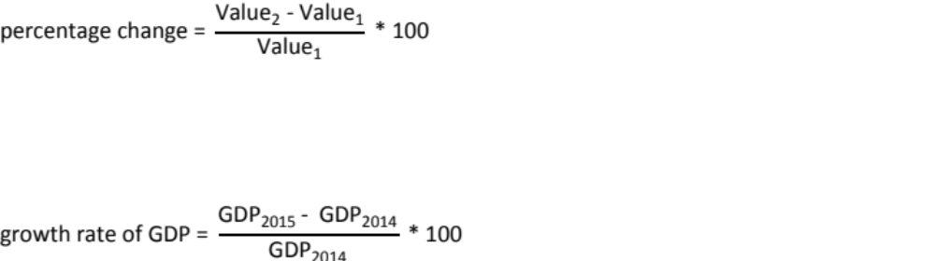
Calculation of GDP Growth Rates

Slide 35

Example: Calculate GDP Growth Rate Euro Area
Euro Area
 | 2014 | 2015
GDP | € 10.1 trillion | €10.4 trillion

Slide 36
Nominal vs. Real GDP
Nominal (current euro) GDP: gross domestic product expressed in terms of current prices
Real GDP: a measure of gross domestic product that seeks to reflect the actual value of goods and services produced, by removing the effect of changes in prices

Slide 37
Nominal vs. Real GDP
Remove price effect
Nominal GDP |  |  | Real GDP
Total Production valued at current prices |  |  | Actual value of goods and services produced

Slide 38
Table 5.5 Calculation of Nominal GDP in an
“Apples-and-Oranges” Economy
(1) | (2) | (3) | (4)
Description | Price per kilogram (€) | Quantity (kilograms) | Contribution to nominal GDP [(2) × (3)] (€)
Year 1
Apples | €1.00 | 100 | €100
Oranges | €2.00 | 50 | €100
 |  |  | €200
Year 2
Apples | €1.50 | 100 | €150
Oranges | €2.00 | 75 | €150
 |  |  | €300

Slide 39
Calculating Real GDP
Constant-prices method (until the 1990s)
  Use prices from one particular year, the base year, to evaluate value of production in all years
  Constant-Price Real GDP = Total production valued at base year prices
Chain-linked prices (since the 1990s)
  Real and nominal GDP are equal in the reference year
  Yields a unique growth rate
  Computationally complex

Slide 40
Table 5.6 Calculation of Constant-Euro Real GDP
(1) | (2) | (3) | (4)
Description | Price per kilogram in base year (€) | Quantity (kilograms) | Contribution to real GDP [(2) × (3)] (€)
Year 1 (Base)
Apples | €1.00 | 100 | €100
Oranges | €2.00 | 50 | €100
 |  |  | €200
Year 2
Apples | €1.00 | 100 | €100
Oranges | €2.00 | 75 | €150
 |  |  | €250
*Bold type indicates base year prices

Slide 41
Figure 5.1 Real versus Nominal GDP,
Chained 2010 euros, 1995-2015
Nominal GDP grows faster than real GDP when prices are rising
.
Source: Eurostat

Slide 42
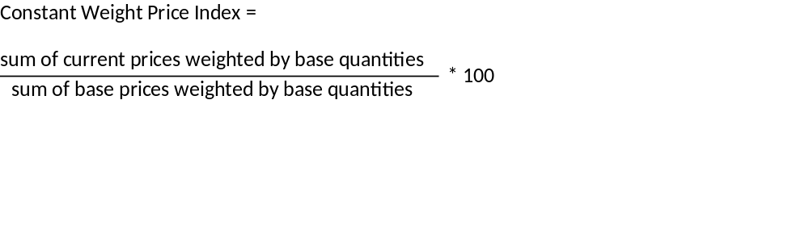
Consumer Price Index
Consumer price index (CPI) measures changes in the prices of goods and services bought by households
calculated using a weighted average of the prices of various goods and services it tracks

Slide 43
Table 5.7 Calculation of a Constant-Weight Price Index
(1) | (2) | (3) | (4)
Description | Price per kilogram (€) | Quantity in base year | Sum of (prices × base quantities) (2) × (3)] (€)
Year 1 (Base)
Apples | €1.00 | 100 | €100
Oranges | €2.00 | 50 | €100
 |  |  | €200
Year 2
Apples | €1.50 | 100 | €150
Oranges | €2.00 | 50 | €100
 |  |  | €250
*Bold type indicates base year quantities

Slide 44
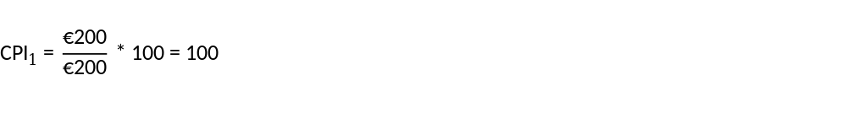
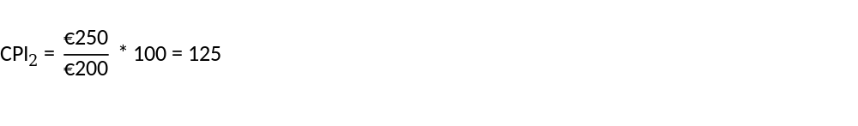
Table 5.7 Calculation of a Constant-Weight Price Index
(1) | (2) | (3) | (4)
Description | Price per kilogram (€) | Quantity in base year | Sum of (prices × base quantities) (2) × (3)] (€)
Year 1 (Base)
Apples | €1.00 | 100 | €100
Oranges | €2.00 | 50 | €100
 |  |  | €200
Year 2
Apples | €1.50 | 100 | €150
Oranges | €2.00 | 50 | €100
 |  |  | €250
*Bold type indicates base year quantities

Slide 45
Harmonised Consumer Price Index (HCPI)
Item Weights 2017
Source: Eurostat 2017

Slide 46


Inflation Rate: Definition and Calculation
Inflation is the percentage change in the Consumer Price Index
Our example:

Slide 47
Savings, Investment, and Trade

Slide 48
The Relationship of Savings, Investment and Trade
Spending Approach to GDP:
  GDP = Personal consumption + Private investment + Net exports + Government consumption + Government investment
Rearranging:
  GDP – Personal consumption – Government consumption = Private investment + Government investment + Net exports
Saving = Investment + Net exports

Slide 49
The Relationship of Savings, Investment and Trade
GDP = Personal consumption + Private investment + Government consumption + Government investment + Net exports
=
C
+
I
GDP
+
GC+
+ GI
+ X-M
GDP − Personal consumption − Government consumption = Private Investment + Government investment + Net exports
GDP
− C -
GC
=
I +
GI
+ X-M
Saving = Investment + Net exports
S
=
I +
X-M

Slide 50
Net Domestic Product and Saving
Net domestic product: national production in excess of that needed to replace worn-out manufactured capital
Net domestic product
=
GDP
−
Depreciation
Net saving: how much is put aside for the future
Net saving
=
(Gross) Saving
−
Depreciation

Slide 51
Net Domestic Product and Saving
Net domestic product (NDP): a measure of national production in excess of that needed to replace worn-out manufactured capital, by subtracting depreciation from GDP
  Net domestic product = GDP – Depreciation
Net saving is a better measure that gross saving of whether we are “putting aside for the future”
  Net saving = (Gross) Saving - Depreciation

Slide 52
What to take home
GDP is the predominant measure for national income
In European national accounting, five sectors are distinguished
  Household sector, non-financial corporations sector, government sector, financial corporations sector, rest of the world
GDP can be measured using the production, spending, or income approach
Inflation is the change of prices over time
GDP can be computed in real terms (correcting for inflation) or in nominal terms

Slide 53
Chain-Linked Real GDP
Appendix

Slide 54
How to Calculate Chain-Linked Real GDP
Calculate Fisher quantity index
Set chain-type quantity index to 100 in reference year
Multiply with Fisher index from current year
Multiply chain-type quantity index times level of nominal GDP in reference year
Divide by 100

Slide 55
Example: “Apples and Oranges” Economy
Plug in values from Table 5.5 and 5.6:
Fisher quantity index

Slide 56
Table 5.8 Deriving Real GDP in Chained (Year 1) Euros
Type of measure | Year 1 | Year 2
Nominal GDP | €200 | €300
Fisher quantity index (current to previous year) |  | 1.225
Chain-type quantity index | 100 | 100 × 1.225 =122.5
Real GDP (chained Year 1 euros) | = €200 | (122.5 × €200)/100 = €245

