Slide 1
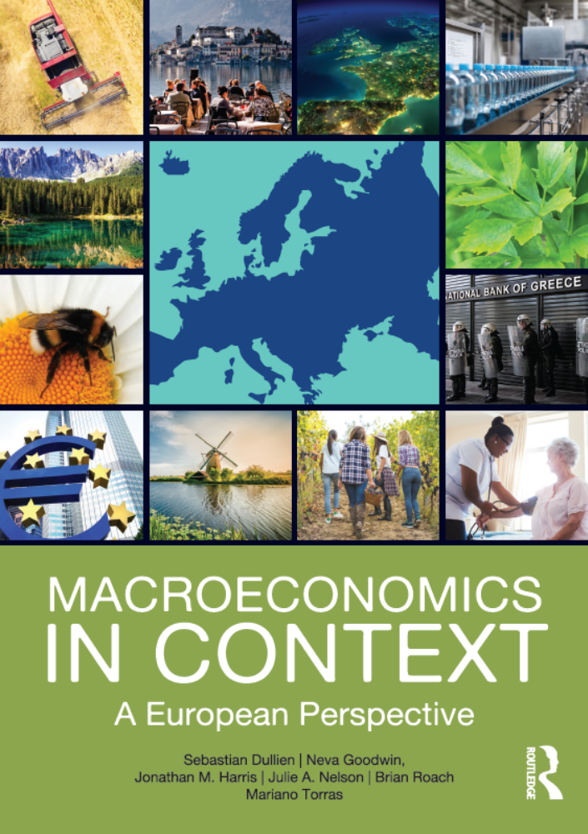
Macroeconomic Measurement –
Environmental and Social Dimensions
Chapter 6
© Dünhaupt, Dullien, Goodwin, Harris, Nelson, Roach, Torras

Slide 2
Learning goals
After today‘s lecture, you will:
  Understand why GDP does not measure well-being
  Be able to identify dimensions of well-being
  Get to know alternative approaches to represent well-being
  Be able to explain and critique the historical exclusion of household production from the national accounts
  Know three economic functions of the environment

Slide 3
Chapter Outline
A Broader View of National Income Accounting
Why GDP is Not a Measure of Well-Being
Alternative Approaches to Representing Well-Being
Measuring Household Production
Accounting for the Environment
Conclusion: Measuring Economic Well-Being

Slide 4
A Broader View of National Income Accounting

Slide 5
A Broader View of National Income Accounting
GDP as the official barometer
of living standards
of business cycles
measure of government performance
indicator of economic, political, and social progress
Justified?

Slide 6
!
Market Activity
≠
National Well-Being

Slide 7
What should we measure…?
…GDP measures only economic production…
But what about …
…Health outcomes?
…Environmental quality?
Should other parts be excluded…
…because they harm well-being?

Slide 8
What Should be Used as the Unit of Measurement?
GDP is measured in currency units (€, $, etc.)
How to measure…
…Education?
…Levels of violence?
…Air quality?

Slide 9
Should we seek to combine disparate well-being indicators into a single “bottom-line” number, or keep variables disaggregated?
Should we convert all variables to euros?
But how to measure environmental quality or social capital in euros?

Slide 10
Satellite Accounts
Additional or parallel accounting systems that provide measures of social or environmental faxtors in physical terms, without necessarily including monetary valuations

Slide 11
Dashboard/scoreboard approach
Combining traditional GDP data with information from other indicators and indicating in how far certain goals are met
  Example: Europe 2020 (details later)

Slide 12
Why GDP is Not a Measure of Well-Being

Slide 13

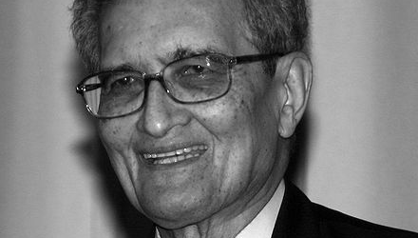
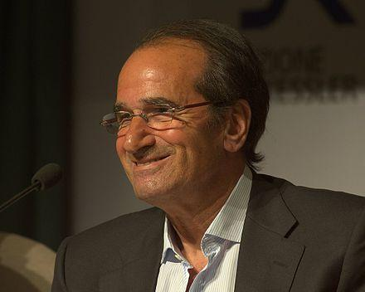
Limitations of GDP became a Political Issue
Amartya Sen
© Photo: Elke Wetzig/ CC BY-SA 3.0 (via Wikimedia Commons)
Jean-Paul Fitoussi
© Andreas Caranti/ CC BY-SA 2.0 (via Wikimedia Commons)
Joseph Stiglitz
© Raimond Spekking / CC BY-SA 4.0 (via Wikimedia Commons)
Commission on the Measurement of Economic Performance and Social Progress established by Former French President Sarkozy (in 2008)
Commission chaired two Nobel Prize winners: Joseph Stiglitz and
Amartya Sen; coordinator: Jean-Paul Fitoussi
Conclusion: shift emphasis from measuring economic production to measuring economic well-being
Distinguish between current well-being and sustainability

Slide 14
Stiglitz-Sen-Fitoussi Commission:
Well-being is Multi-Dimensional
Material living standards (income, consumption and wealth)
Health
Education
Personal activities including work
Political voice and governance
Social connections and relationships
Environment (present and future conditions)
Insecurity, of an economic as well as a physical nature

Slide 15
Stiglitz-Sen-Fitoussi Commission:
Well-being is Multi-Dimensional
Material living standards
Insecurity
Health
Environment
Well-being
Education
Social connections and relationships
Personal activities (including work)
Political voice and governance

Slide 16
Objective vs. Subjective Well-being
Objective data
  Average life expectancy
  Literacy rates
  Air pollution levels
But how do these figures relate to well-being?

Slide 17
Subjective Well-being
a measure of welfare based on survey questions asking people about their own degree of life satisfaction
Questionnaire
All things considered, how satisfied are you with your life as a whole these days?
Please cross the box next to the number that matches your opinion
☞
Not at all satisfied
Completely satisfied
1
2
3
4
5
6
7
8
9
10

Slide 18
Is there a correlation between SWB results with standard economic measures of welfare?
Are average SWB levels higher in countries with higher GDP?
As GDP per capita increases in a particular country over time, do SWB levels rise?

Slide 19
Average Subjective Well-being and GDP per Capita
Sources: SWB from World Values Survey online data analysis, 2010–2014 survey wave;
GDP from World Development Indicators online database.

Slide 20
Missing and Misleading Elements of GDP
Household production
  E.g. unpaid child care or gardening
Significant services provided for free
  E.g. internet services such as Wikipedia, Gmail or YouTube
  (main product sold advertising, which is an intermediate input)
Leisure
  overwork might increase GDP while reducing well-being (Vice versa)

Slide 21
Missing and Misleading Elements of GDP (cont.)
Human and social capital formation
  Social and political factors that affect well-being (e.g. health and education levels, political participation, government effectiveness, issues of trust, corruption, other aspects of economic and social culture…)
Interactions between economy and natural world
  E.g. economic degradation and resource depletion

Slide 22
Missing and Misleading Elements of GDP (cont.)
Defensive expenditure
  Money spent to counteract economic activities that have caused harm to human or environmental health
  E.g. money spent cleaning up after Deepwater Horizon oil Spill in the Gulf of Mexico
Products or production methods that reduce rather than increase, well-being
  E.g. unhealthy foods, drugs, dangerous equipment …

Slide 23
Missing and Misleading Elements of GDP (cont.)
Financial debt
  Debt-financed consumption increases GDP but might reduce future consumption
Rising inequality
  rising GDP might contribute to a rise in inequality if the gains are not equally shared; hence, rising GDP does not necessarily lead to a rise in well-being

Slide 24
Alternative Approaches to Representing Well-Being

Slide 25
Europe 2020
Ten-year job and growth strategy launched in in 2010
Create conditions for smart, sustainable and inclusive growth
Five headline targets to achieve by the end of 2020
  Employment
  Research and development
  Climate/energy
  Education
  Social inclusion and poverty reduction

Slide 26
Europe 2020
Scoreboard of nine headline indicators
  Monitored on a regular basis
  Member states formulate national strategies to reach defined targets

Slide 27
Table 6.1 Europe 2020 goals and actual developments 2008-2014, EU 28
Employment 75% of the population aged 20-64 should be employed
Indicator | Unit | 2008 | 2014 | Target
Employment rate – age group 20-64 | % of population aged 20-64 | 70.3 | 69.2 | 75

Slide 28
Table 6.1 Europe 2020 goals and actual developments 2008-2014, EU 28
Research and Development 3% of the EU's GDP should be invested in R&D
Indicator | Unit | 2008 | 2014 | Target
Gross domestic expenditure on R&D | % of GDP | 1.85 | 2.03 | 3

Slide 29
Table 6.1 Europe 2020 goals and actual developments 2008-2014, EU 28
Environment Greenhouse gas emissions should be reduced by 20% compared to 1990 The share of renewable energy sources in final energy consumption should be increased to 20% Energy efficiency should improve by 20%
Indicator | Unit | 2008 | 2014 | Target
Greenhouse gas emissions | Index 1990 = 100 | 90.3 | 77.3 | 80
Share of renewable energy in gross final energy consumption | % | 11 | 16 | 20
Primary energy consumption | million tonnes of oil equivalent (TOE) | 1693 | 1507 | 1483

Slide 30
Table 6.1 Europe 2020 goals and actual developments 2008-2014, EU 28
Education The share of early school leavers should be under 10% and at least 40% of individuals 30-34 years old should have completed a tertiary or equivalent education
Indicator | Unit | 2008 | 2014 | Target
Early leavers from education and training | % of population aged 18-24 | 14.7 | 11.2 | 10
Tertiary educational attainment | % of population aged 30-34 | 31.1 | 37.9 | 40

Slide 31
Table 6.1 Europe 2020 goals and actual developments 2008-2014, EU 28
Poverty and social exclusion Poverty should be reduced by lifting at least 20 million people out of the risk of poverty or social exclusion in the EU-27
Indicator | Unit | 2008 | 2014 | Target
People at risk of poverty or social exclusion | Cumulative difference from 2008 in thousand | 0 | 4,725 | -20,000
Source: Eurostat, “Europe 2020 Headline Indicators: Scoreboard”, http://ec.europa.eu/eurostat/web/europe-2020-indicators/europe-2020-strategy/headline-indicators-scoreboard, October 10, 2016.

Slide 32
The Better Life Index (BLI)
Mixed approach by the OECD
Combines a large number of dimensions (many cannot be measured in monetary terms) into one single indicator
Well-being a function of 11 topics, each built on one to four specific indicators
All indicators combined into one single indicator
By default, all indicators weighted equally
35 OECD countries covered

Slide 33
The Better Life Index (BLI)
Income, Wealth, Inequality
Jobs and Earnings
Housing Conditions
Health Status
Work and Life Balance
Education and Skills
Social Connections
Civic Engagement and Governance
Environmental Quality
Personal Security
Subjective Well-Being
Well-being

Slide 34
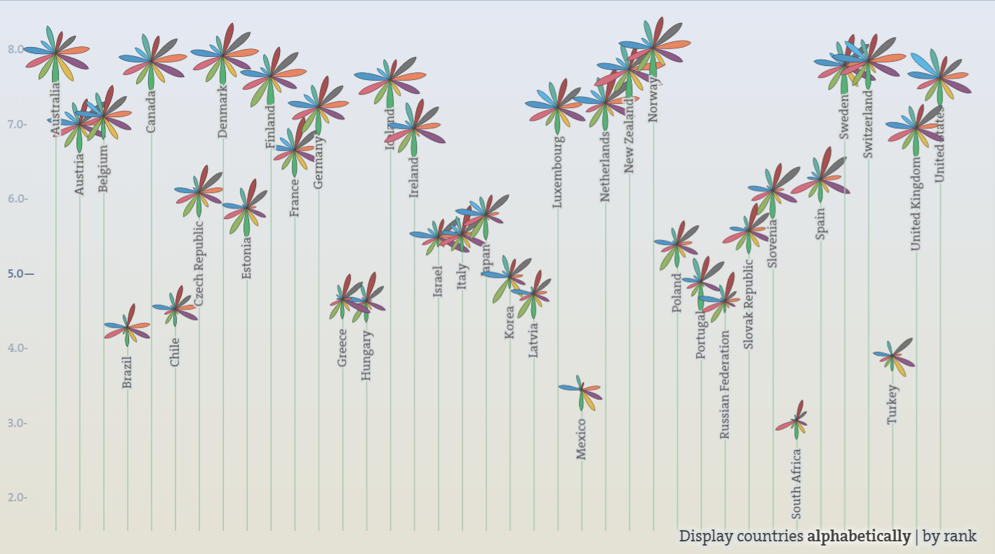
The Better Life Index (BLI)
Compares well-being across OECD countries
Each flower represents one country
Each petal represents one of the eleven topics
The length of a petal represents the country’s score in a topic, while its width represents the importance assigned to that topic
Source: www.oecdbetterlifeindex.org
Accessed: 7/4/2017.

Slide 35
Human Development Index (HDI)
“
”
  An index just as vulgar as GDP but it stands for better things. (Amartya Sen)
Provided by the United Nations Development Program (UNDP) and featured on an annual basis in the Human Development Report
GDP vs. HDI = commodity-centred vs. human-centred
HDI: health, education, and income

Slide 36
Human Development Index (HDI)
Dimensions | Long and healthy life | Knowledge |  | A decent standard of living
Indicators | Life expectancy at birth | Mean years of schooling | Expected years | GNI per capita (PPP US$)
Dimension Index | Life expectancy index | Education index |  | GNI index
 | Human Development Index

Slide 37
Human Development Index (HDI)
Similar income, different HDI
 | Income per capita | Life expectancy | Mean Years of Schooling | Expected Years of Schooling | HDI
Poland | 23,177 | 77.4 | 11.8 | 15.5 | 0.843
Equatorial Guinea | 21, 056 | 57.6 | 5.5 | 9.0 | 0.587
Similar HDI, different income
Paraguay | 7,643 | 72.9 | 7.7 | 11.9 | 0.679
Gabon | 16,367 | 64.4 | 7.8 | 12.5 | 0.684
Source: Human Development Report 2015

Slide 38
Table 6.2 Selected countries as ranked in the
Human Development Index
Human Development Index (Scale: 0 - 1)
0.90 – 1.00 | Norway, Australia, Switzerland, Denmark, Netherlands, Germany, Ireland, United States, Canada, New Zealand, Singapore, Sweden, United Kingdom
0.85 – <0.90 | Korea, Iceland, Israel, Luxembourg, Japan, Belgium, France, Austria, Finland, Slovenia, Spain, Italy, Czech Republic, Greece, Estonia
0.80 – <0.85 | Poland, Argentina, Portugal, Hungary, Latvia, Croatia
0.75 – <0.80 | Russia, Romania, Bulgaria, Turkey, Mexico, Brazil
0.70 – <0.75 | Ukraine, Algeria, Albania, China, Thailand, Libya, Tunisia
0.65 – <0.70 | Egypt, Indonesia
0.60 – <0.65 | India, South Africa
0.55 – <0.60 | Syria, Ghana, Bangladesh
0.50 – <0.55 | Pakistan, Nigeria
0.45 – <0.50 | Haiti, Afghanistan
Source: UNDP, Human Development Report, 2011 data.

Slide 39
Human Development Index
Development of supplementary indices
  Inequality adjusted HDI
  Gender Development Index
  Gender Inequality Index
  Multidimensional Poverty Index

Slide 40
Other National Accounting Alternatives
Genuine Progress Indicator (GPI)
  Computed for the US 1950 until 2004
  Single figure for well-being
  Adds up personal consumption (adjusted for inequality), the value of household and volunteer work, services from consumer durables
  Subtracts costs of crime, accidents, pollution and resource depletion

Slide 41
Other National Accounting Alternatives
Happy Planet Index (HPI)
  Similar to HDI
  Designed to compare success of different countries, to see how efficiently (in environmental terms) each country promotes well-being of its inhabitants
  Average subjective well-being (scaled between 0 and 1) multiplied by life expectancy = happy life years
  HPI = Happy life years / Ecological Footprint

Slide 42
Other National Accounting Alternatives (cont.)
National Welfare Index
  Proposed in Germany
  Similar to the Genuine Progress Indicator
  It also includes
  + public spending on health and education
  − costs of alcohol, tobacco and drug abuse
  − usage of nuclear energy
  Index with 100 in its base year
Regional Quality of Development Index
Gross National Happiness

Slide 43
Other National Accounting Alternatives (cont.)
Regional Quality of Development Index
  Developed in Italy
  Composite Index of 45 variables pertaining to environment, education, culture, working conditions, health, and political participation

Slide 44
Other National Accounting Alternatives (cont.)
Fleurbaey/Gaulier Indicator
  Developed in France
  Similar to GPI
  includes more monetary values of nonmonetary factors (job security, healthy life expectancy, environmental sustainability) using subjective valuations of these factors to create adjusted “equivalent incomes”
  They are aggregated and then reduced by the degree of inequality in the equivalet incomes

Slide 45
Other National Accounting Alternatives (cont.)
Gross National Happiness (GNH)
  Developed in Bhutan (1972)
  Holistic approach to improve quality of people’s lives
  In 2010 formally defined along nine dimensions of welfare. Including 33 distinct indicators

Slide 46
Summing-up
There is not necessarily a positive correlation between the total final purchases in an economy and other measures of well-being
Often, GDP is rising while other measures stay flat or fall

Slide 47
Measuring Household Production

Slide 48
Measuring Household Production
Many countries use time-use surveys to aid understanding of unpaid productive activities
In 1921, economists estimated household services in the US to be about 25 to 30 percent of marketed production
In the early 2000s, household services in Germany were around €820 billion– if included, the German GDP would have been 34 percent higher than reported

Slide 49
Neglecting Household Production
leads to an understatement of the level of GDP
gives a wrong impression about growth trends
Major shift during the 20th century:
  large proportion of women shifted from unpaid full-time homemakers to paid employment outside the home
  In 1870, 40 percent of all US workers were women working at full-time homemakers; by 2000, only 16 percent
  Increase in work outside the home and substitutes for home production (e.g. paid child care and prepared foods) counted as an increase in GDP

Slide 50
Measuring Household Production
makes comparison between countries difficult
  household production more important in the global South than in the global North
  important activity unreported in national income accounts
Why does this matter?
economic decisions are based on national accounts
  e.g. European pension systems: payments based on market wages and years in paid work

Slide 51
Time-Use Surveys
To determine value of household production, find out how much time people spend in unpaid productive activities
In the EU, many states conduct time-use surveys
Adults in national samples are asked to report in detail how they used time on one particular day

Slide 52
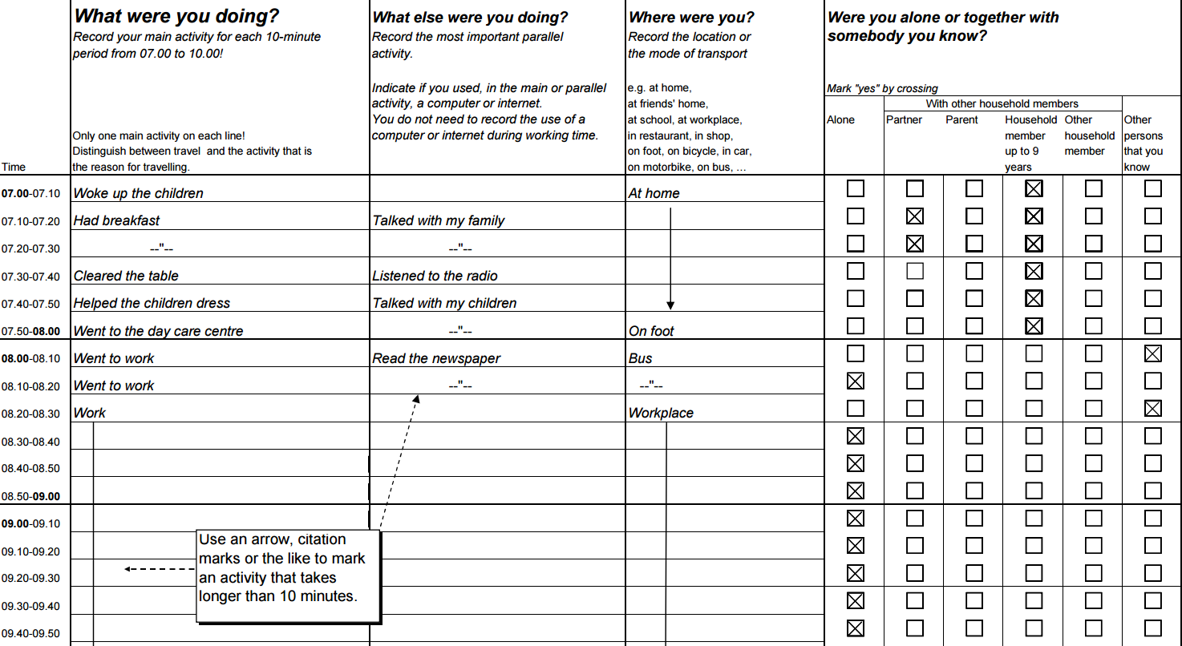
Harmonised European Time Use Survey – Questionnaire
Source: Eurostat. Harmonised European time use surveys – 2008 guidelines.
http://ec.europa.eu/eurostat/ramon/statmanuals/files/KS-RA-08-014-EN.pdf. Accessed: 7/4/2017.

Slide 53
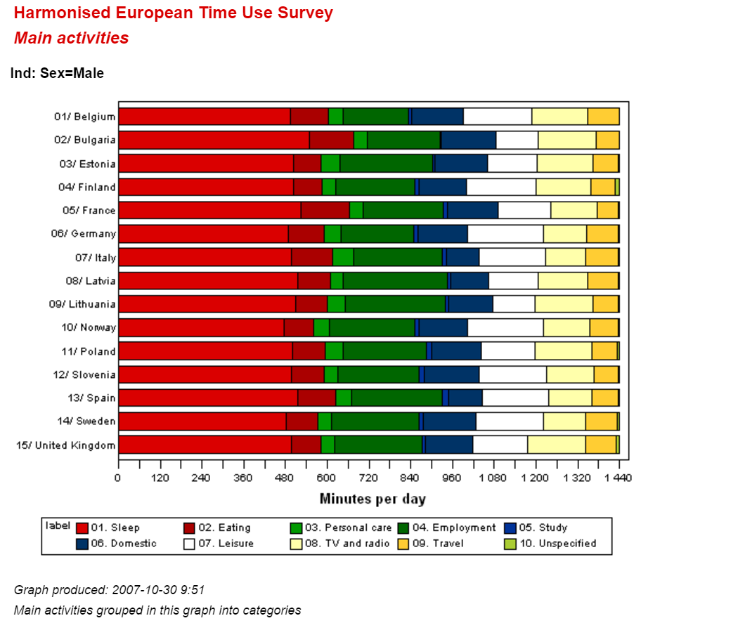
Results from the Harmonized European Time Use Survey for Males in 15 EU countries
Source: https://www.h5.scb.se/tus/tus/StatMeanMact1.html
Accessed: 7/4/2017.

Slide 54
Methods of Valuing Household Production
time use measured in terms of hours spent on various activities
  assign a monetary value to these hours using market or quasi-market prices
Two methods:
  Replacement-cost method
  Opportunity-cost method

Slide 55
Methods of Valuing Household Production
Replacement-cost method (for estimating the value of household production): valuing hours at the amount it would be necessary to pay someone to do the work
Opportunity-cost method (for estimating the value of household production): valuing hours at the amount that the unpaid worker could have earned at a paid job

Slide 56
Accounting for the Environment

Slide 57
Accounting for the Environment
The natural environment underpins all economic activities
e.g.: a developing country depending heavily on natural resources
  forests cut down
  soil fertility depleted country becomes poorer
  water supplies polluted
National accounting: record market value of
  timber
  agricultural produce positive contribution to GDP
  industrial output

Slide 58
Economic Functions of the Natural World
Resource functions | Environmental service functions | Sink functions
inputs into human production processes | basic habitat of clean air, drinkable water, and suitable climate Water filtration provided by wetlands erosion control provided by tree-covered hillsides | absorbs (up to a point) the pollution and waste generated by economic activity
 |  | Car exhaust dissipates into the atmosphere …
Mineral ores Crude petroleum Fish Soil Forests …

Slide 59
Accounting for the Environment
In the past, environmental functions were treated as
  provided for free
  in unlimited amounts
Recently:
  depletion of resources
  degradation of environmental services
  overuse of environmental sink function
became apparent!

Slide 60
Environmentally Adjusted Net Domestic Product
GDP less depreciation of both manufactured and natural capital
estimate natural capital depreciation in monetary terms (rather than physical units e.g. biomass volume or habitat area)
estimate all types of natural capital depreciation in monetary terms rather difficult

Slide 61
Environmentally Adjusted Net Domestic Product
EDP estimate for Indonesia, 1971-84
deducted the value of depreciation for three categories of natural capital
  oil
  forests
  soil

Slide 62
Figure 6.3 Indonesian GDP Adjusted for Resource Depreciation
Source: Robert Repetto, et al., Wasting Assets: Natural Resources in the National Income Accounts. Washington, D.C.: World
Resources Institute, 1989.

Slide 63
Indonesian GDP Adjusted for Resource Depreciation – Main Findings
Natural capital depreciation can amount to a significant portion of GDP; here: 20 percent
  natural capital depreciation offsets about 20 percent of total economic production
  GDP presents overly positive assessment of social welfare
Differences in GDP growth rates
  GDP growth rate: 7.1 percent vs. EDP growth rate 4.0 percent
Monetization of natural capital to be approached carefully
  Spike in 1974 due to oil crisis and rise in oil prices!

Slide 64
Valuing Environmental Factors
damage-cost approach: assigning a monetary value to an environmental service that is equal to the actual damage done when the service is withdrawn
maintenance-cost approach: assigning a monetary value to an environmental service that is equal to what it would cost to maintain the same standard of services using an alternative method

Slide 65
What to take home
GDP is not to be confused with national well-being
there are many missing and misleading elements of GDP
  (household production, significant services provided for free, human and social capital formation, interactions between the economy and the natural world, defensive expenditure, production methods that reduce, rather than increase well-being, financial debt, rising inequality)
there are many alternative indicators that adjust and/or supplement GDP

