Slide 1
Germany

Slide 2
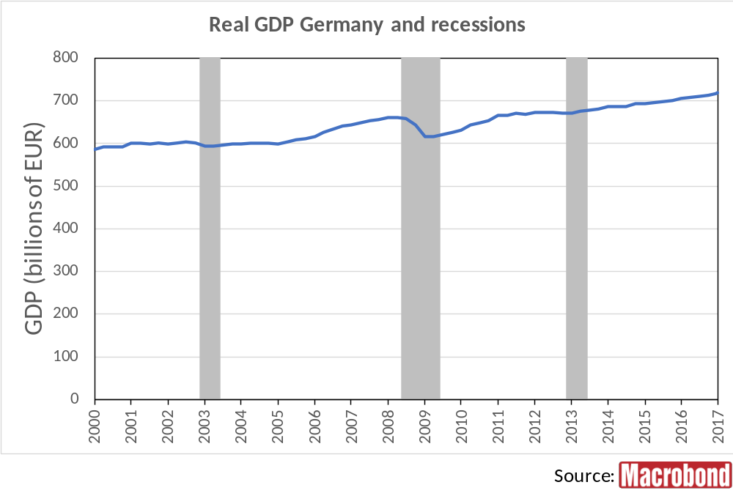
Notes:
Macrobond Series:
Germany, Gross Domestic Product, Total, Calendar Adjusted (X-12 ARIMA), Constant Prices, SA (X-12 ARIMA), Chained, EUR
Germany, Macrobond, Business Cycle Reference Dates

Slide 3
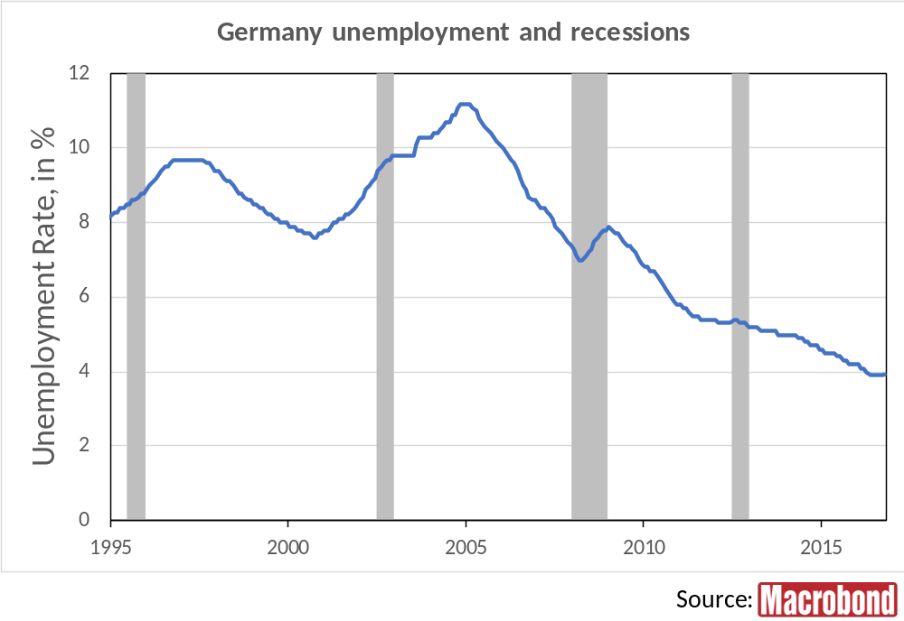
Notes:
Macrobond Series:
Germany, Eurostat, Unemployment, Males & Females, All Ages, Total, Percentage of Active Population, SA
Germany, Macrobond, Business Cycle Reference Dates

Slide 4
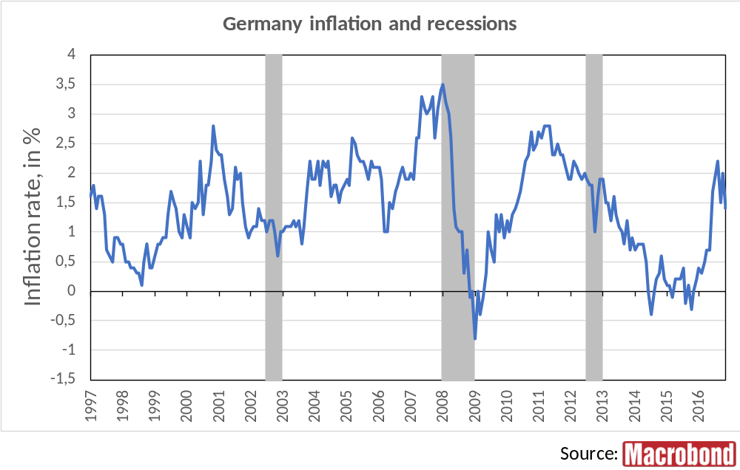
Notes:
Macrobond Series:
Germany, Eurostat, HICP, All-Items HICP, Change Y/Y
Germany, Macrobond, Business Cycle Reference Dates

Slide 5
UK

Slide 6
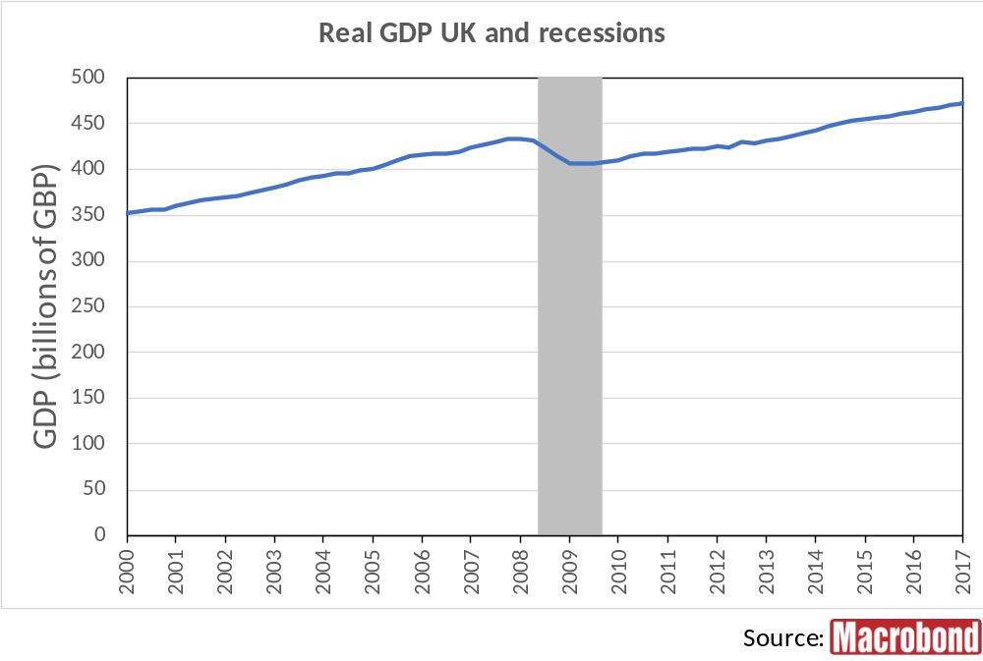
Notes:
Macrobond Series:
United Kingdom, Gross Domestic Product, At Market Prices, Constant Prices, SA, GBP
United Kingdom, Macrobond, Business Cycle Reference Dates

Slide 7
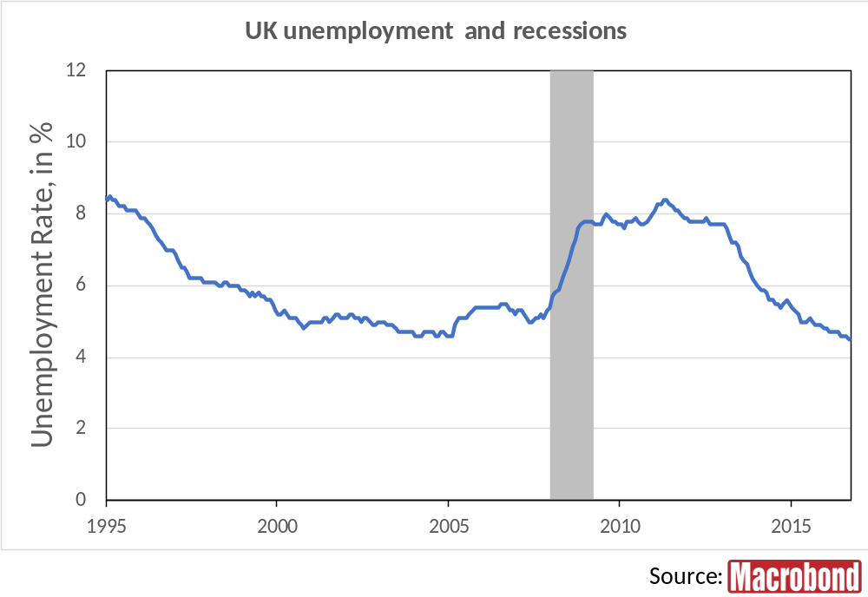
Notes:
Macrobond Series:
United Kingdom, Eurostat, Unemployment, Males & Females, All Ages, Total, Percentage of Active Population, SA
United Kingdom, Macrobond, Business Cycle Reference Dates

Slide 8
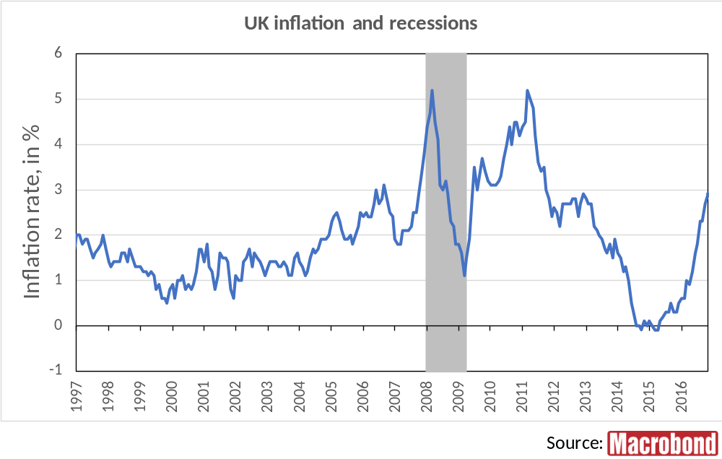
Notes:
Macrobond Series:
United Kingdom, Eurostat, HICP, All-Items HICP, Change Y/Y
United Kingdom, Macrobond, Business Cycle Reference Dates

Slide 9
France

Slide 10
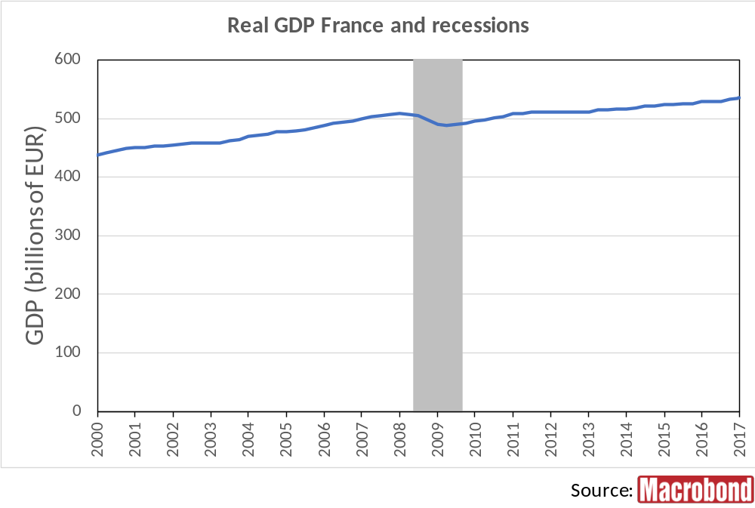
Notes:
Macrobond Series:
France, Gross Domestic Product, Total, At Previous Year Prices, Calendar Adjusted, Constant Prices, SA, Chained, EUR
France, Macrobond, Business Cycle Reference Dates

Slide 11
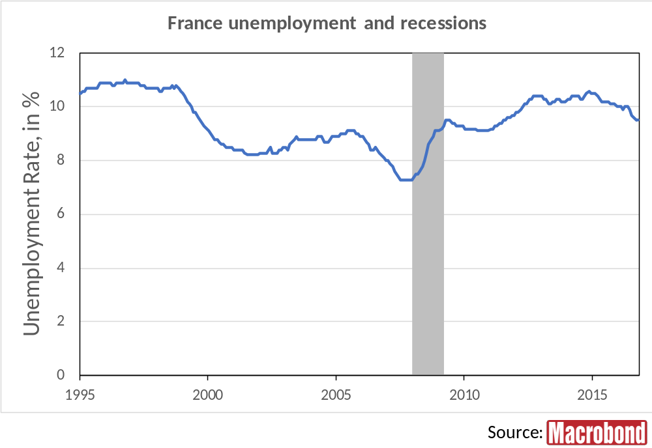
Notes:
Macrobond Series:
France, Eurostat, Unemployment, Males & Females, All Ages, Total, Percentage of Active Population, SA
France, Macrobond, Business Cycle Reference Dates

Slide 12
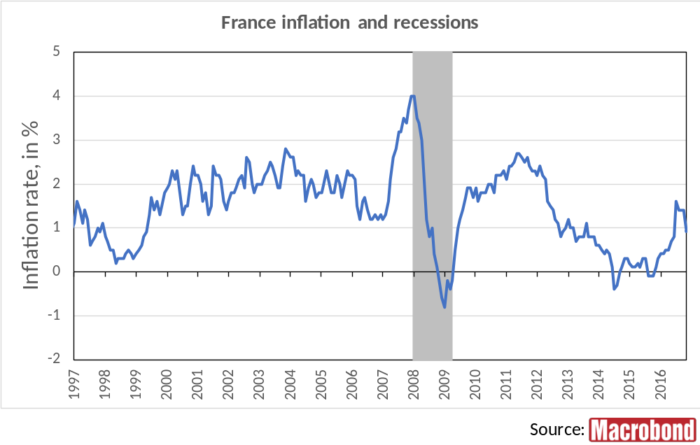
Notes:
Macrobond Series:
France, Eurostat, HICP, All-Items HICP, Change Y/Y
France, Macrobond, Business Cycle Reference Dates

Slide 13
Italy

Slide 14
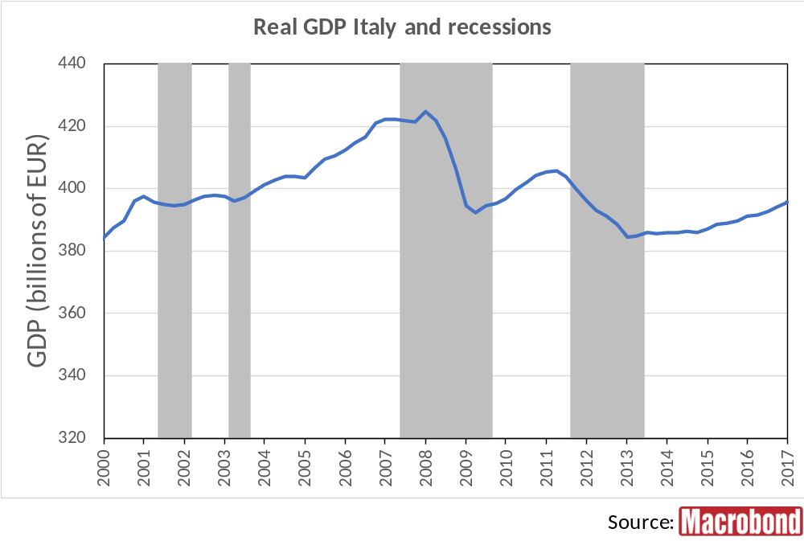
Notes:
Macrobond Series:
Italy, Gross Domestic Product, Total, Chained Volumes in Monetary Terms, Calendar Adjusted, Constant Prices, SA, Chained, Market Prices, EUR
Italy, Macrobond, Business Cycle Reference Dates

Slide 15
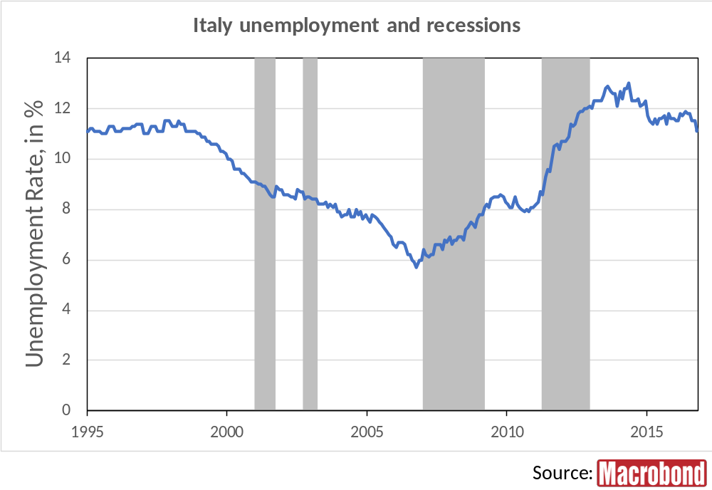
Notes:
Macrobond Series:
Italy, Eurostat, Unemployment, Males & Females, All Ages, Total, Percentage of Active Population, SA
Italy, Macrobond, Business Cycle Reference Dates

Slide 16
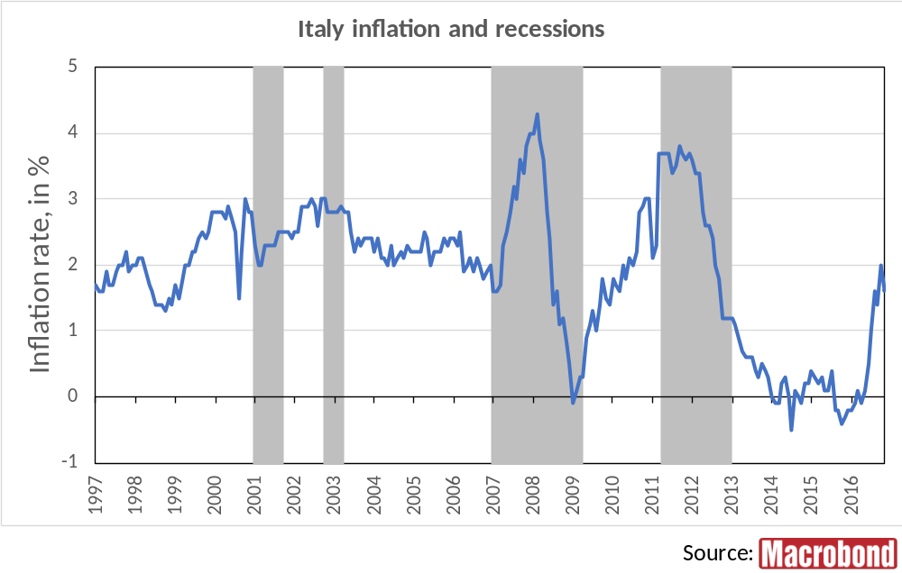
Notes:
Macrobond Series:
Italy, Eurostat, HICP, All-Items HICP, Change Y/Y
Italy, Macrobond, Business Cycle Reference Dates

Slide 17
Spain

Slide 18
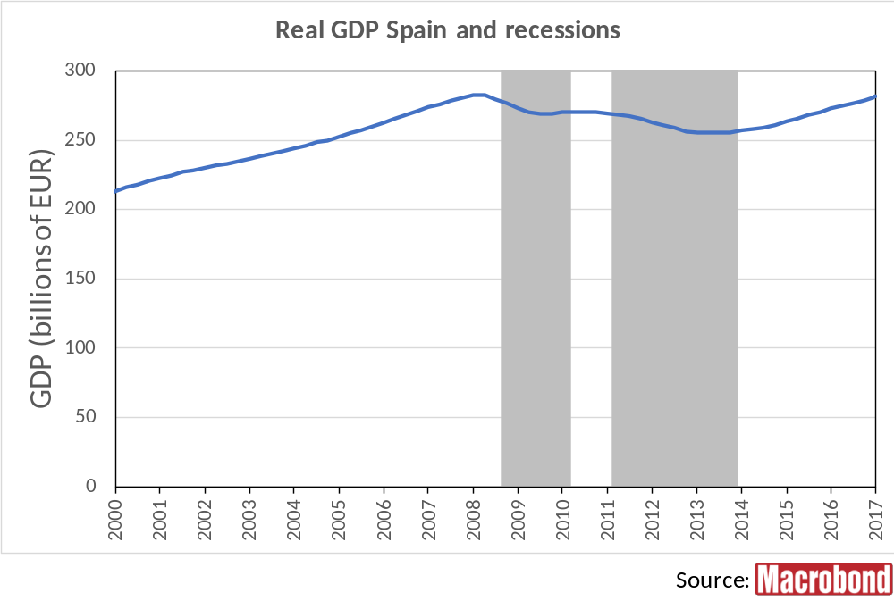
Notes:
Macrobond Series:
Spain, Eurostat, GDP Main Components (ESA 2010), Volumes, Gross Domestic Product, 2010 Reference Year, Calendar Adjusted, SA, Chained, Market Prices, EUR
Spain, Macrobond, Business Cycle Reference Dates

Slide 19
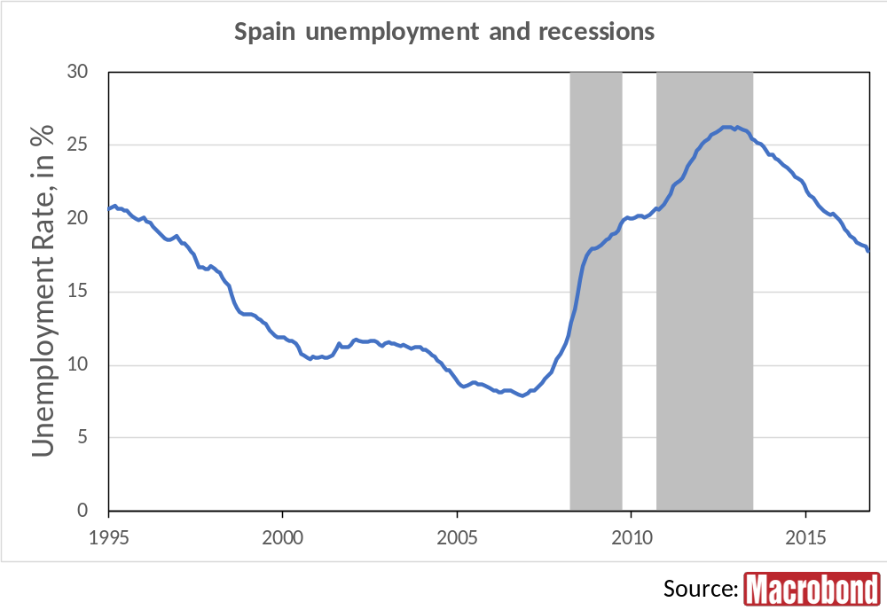
Notes:
Macrobond Series:
Spain, Eurostat, Unemployment, Males & Females, All Ages, Total, Percentage of Active Population, SA
Spain, Macrobond, Business Cycle Reference Dates

Slide 20
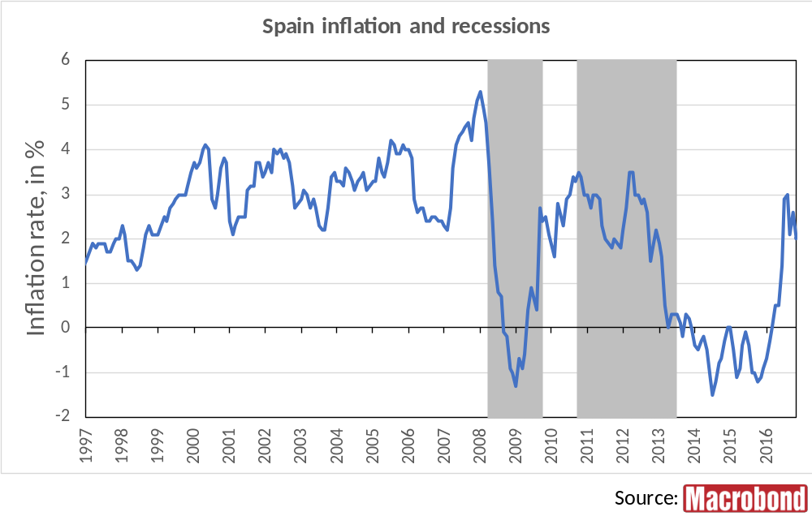
Notes:
Macrobond Series:
Spain, Eurostat, HICP, All-Items HICP, Change Y/Y
Spain, Macrobond, Business Cycle Reference Dates

Slide 21
Netherlands

Slide 22
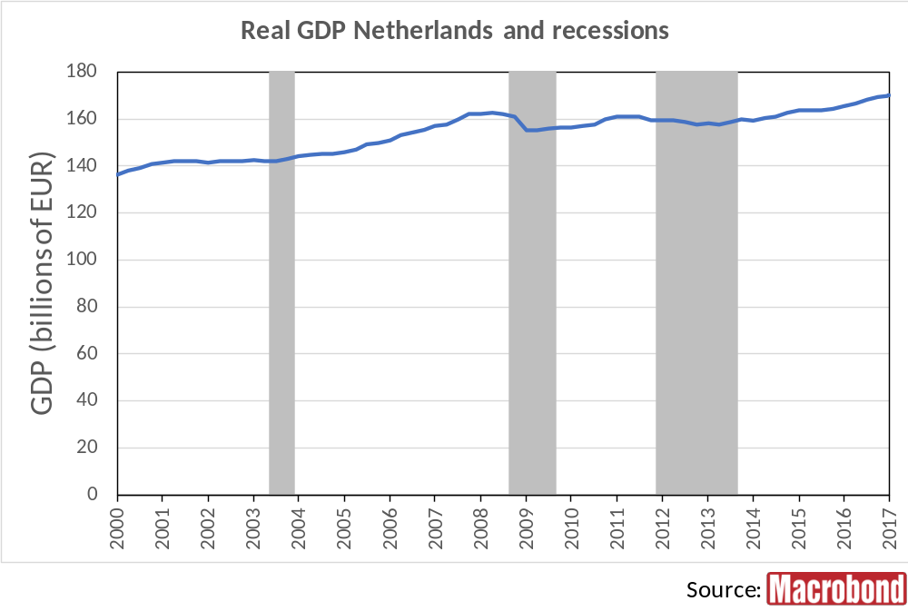
Notes:
Macrobond Series:
Netherlands, Gross Domestic Product, Total, Constant Prices, SA, EUR
Netherlands, Macrobond, Business Cycle Reference Dates

Slide 23
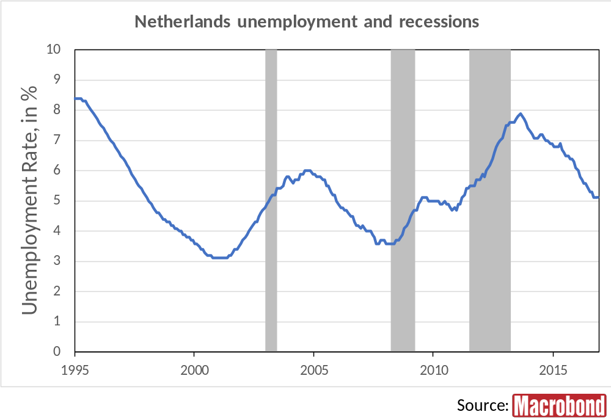
Notes:
Macrobond Series:
Netherlands, Eurostat, Unemployment, Males & Females, All Ages, Total, Percentage of Active Population, SA
Netherlands, Macrobond, Business Cycle Reference Dates

Slide 24
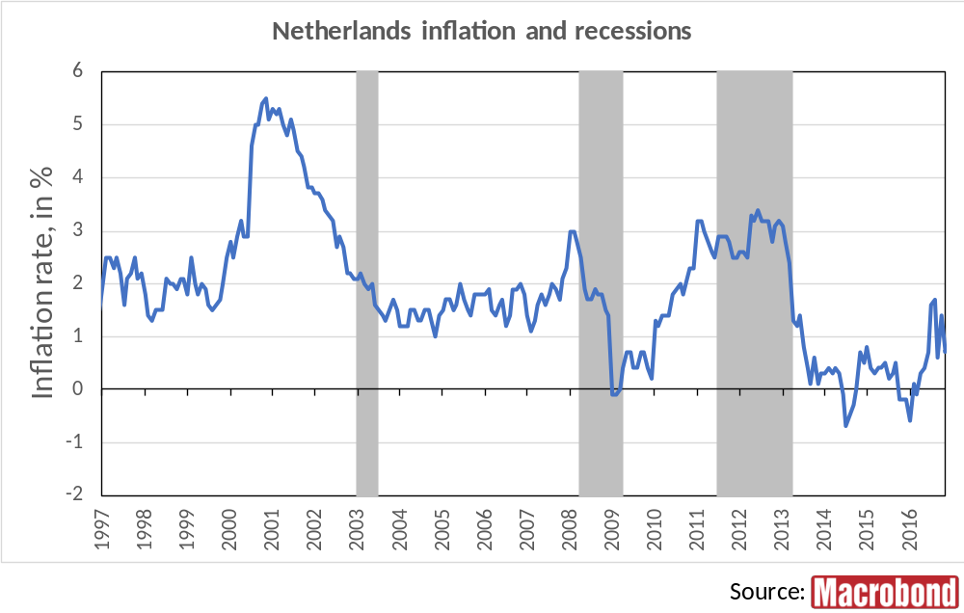
Notes:
Macrobond Series:
Netherlands, Eurostat, HICP, All-Items HICP, Change Y/Y
Netherlands, Macrobond, Business Cycle Reference Dates

Slide 25
Sweden

Slide 26
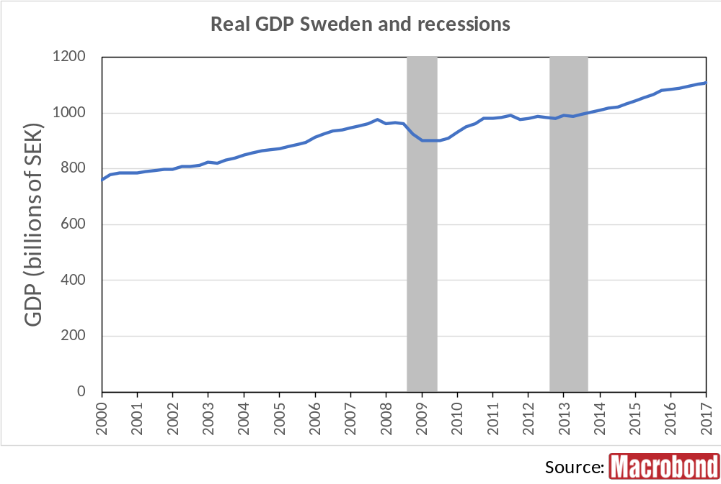
Notes:
Macrobond Series:
Sweden, Gross Domestic Product, Total, Constant Prices, SA, Market Prices, SEK
Sweden, Macrobond, Business Cycle Reference Dates

Slide 27
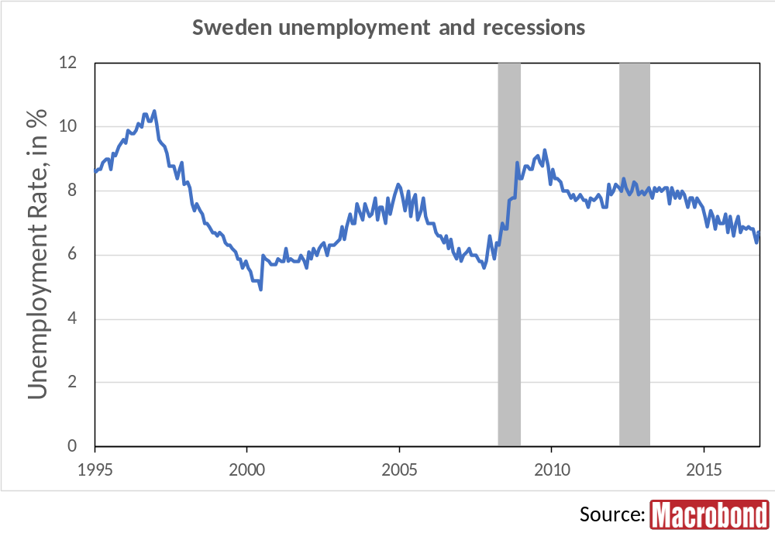
Notes:
Macrobond Series:
Sweden, Eurostat, Unemployment, Males & Females, All Ages, Total, Percentage of Active Population, SA
Sweden, Macrobond, Business Cycle Reference Dates

Slide 28
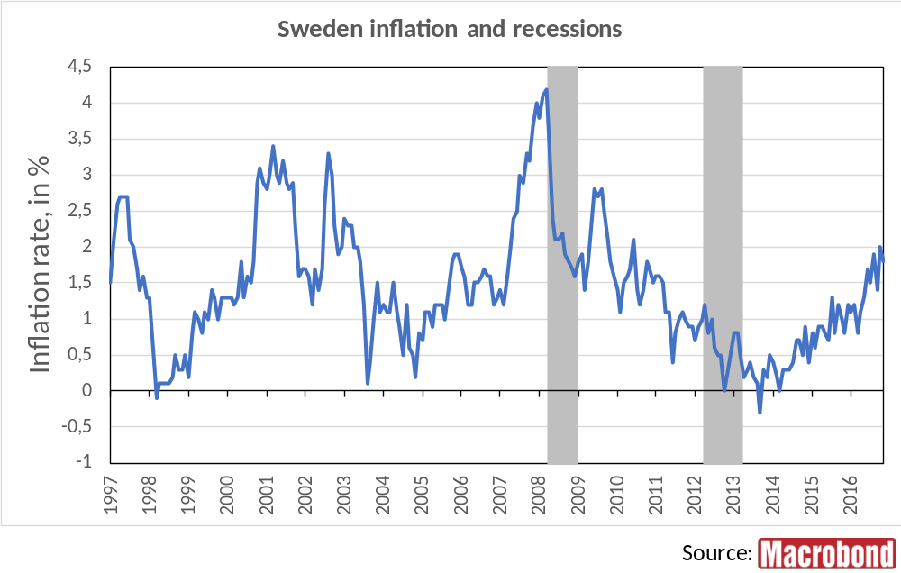
Notes:
Macrobond Series:
Sweden, Eurostat, HICP, All-Items HICP, Change Y/Y
Sweden, Macrobond, Business Cycle Reference Dates

Slide 29
Poland

Slide 30
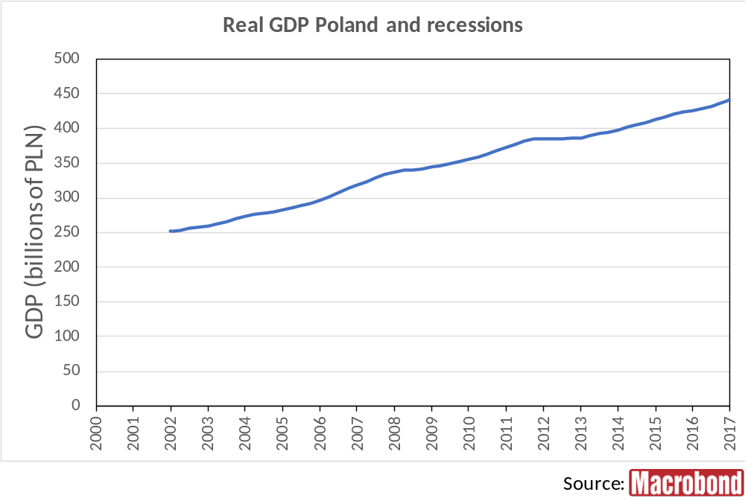
Notes:
Macrobond Series:
Poland, Gross Domestic Product, Total, Chain-Linked Volume, Calendar Adjusted, Constant Prices, SA, Market Prices, PLN
Poland, Macrobond, Business Cycle Reference Dates

Slide 31
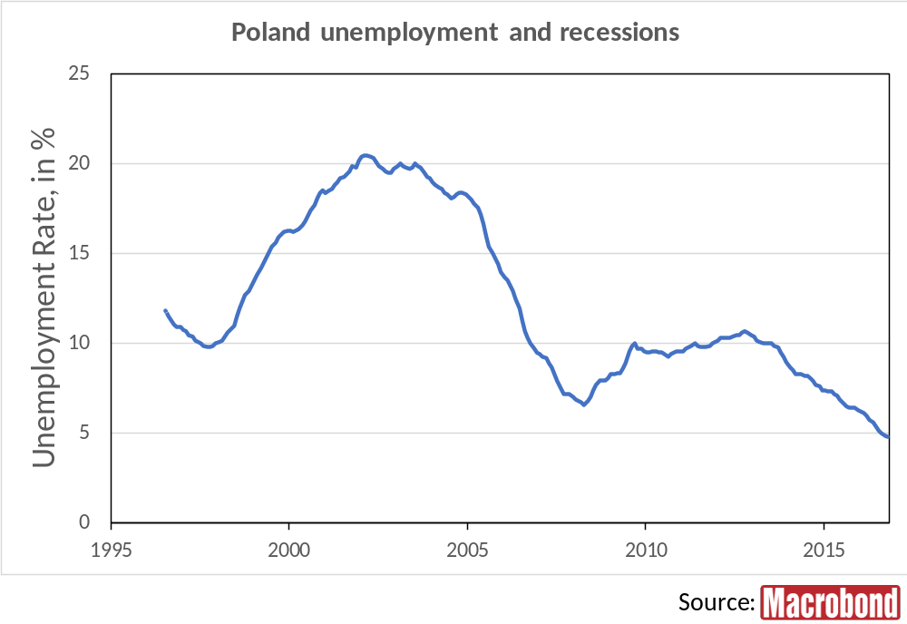
Notes:
Macrobond Series:
Poland, Eurostat, Unemployment, Males & Females, All Ages, Total, Percentage of Active Population, SA
Poland, Macrobond, Business Cycle Reference Dates

Slide 32
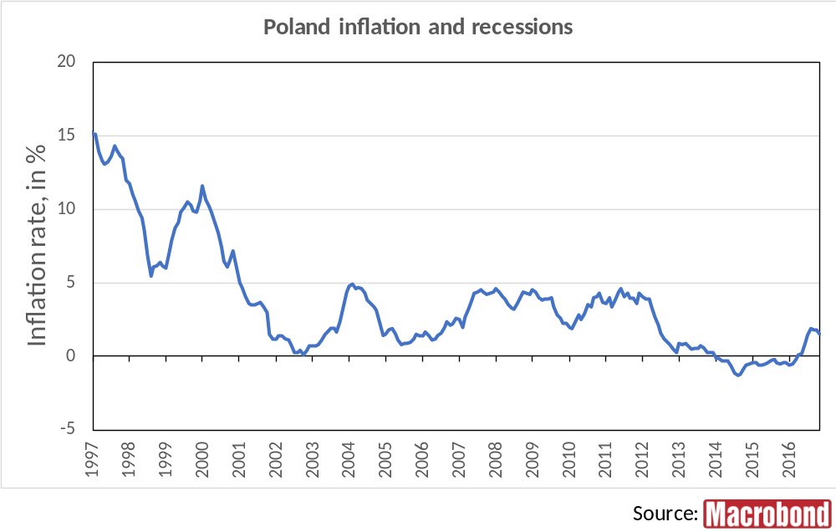
Notes:
Macrobond Series:
Poland, Eurostat, HICP, All-Items HICP, Change Y/Y
Poland, Macrobond, Business Cycle Reference Dates

Slide 33
Belgium

Slide 34
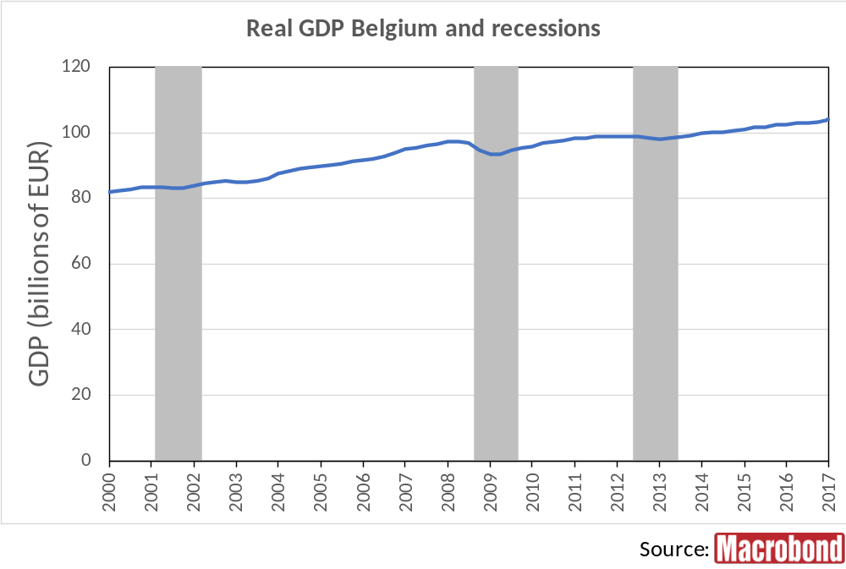
Notes:
Macrobond Series:
Belgium, Gross Domestic Product, Total, Calendar Adjusted, Constant Prices, SA, Chained, Market Prices, EUR
Belgium, Macrobond, Business Cycle Reference Dates

Slide 35
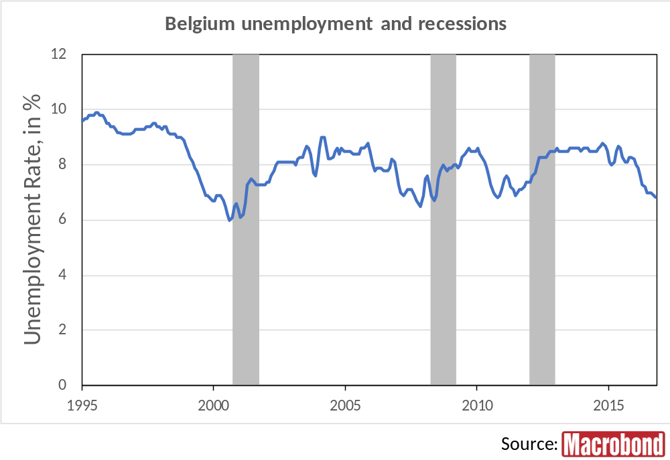
Notes:
Macrobond Series:
Belgium, Eurostat, Unemployment, Males & Females, All Ages, Total, Percentage of Active Population, SA
Belgium, Macrobond, Business Cycle Reference Dates

Slide 36
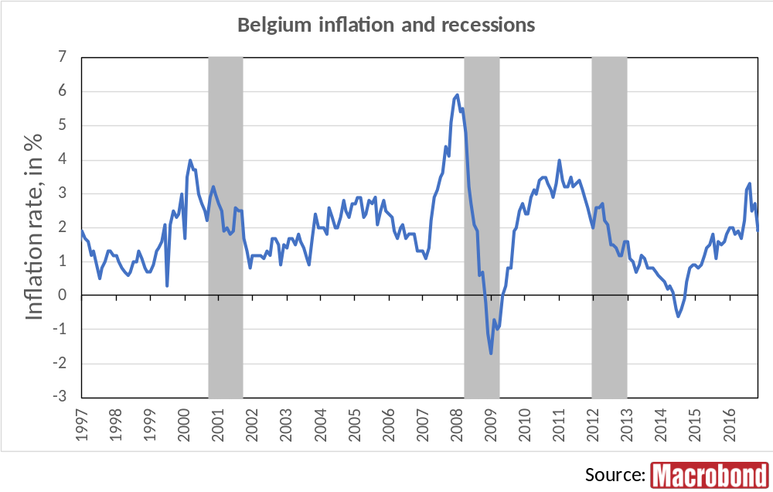
Notes:
Macrobond Series:
Belgium, Eurostat, HICP, All-Items HICP, Change Y/Y
Belgium, Macrobond, Business Cycle Reference Dates

Slide 37
Austria

Slide 38
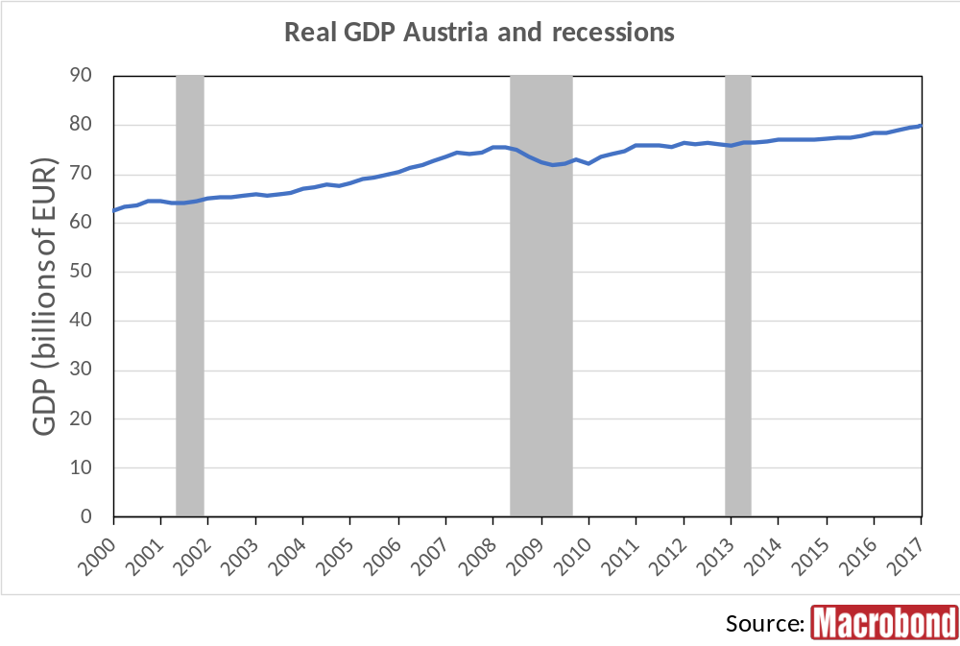
Notes:
Macrobond Series:
Austria, Gross Domestic Product, Total, Calendar Adjusted, Constant Prices, SA, Market Prices, EUR
Austria, Macrobond, Business Cycle Reference Dates

Slide 39
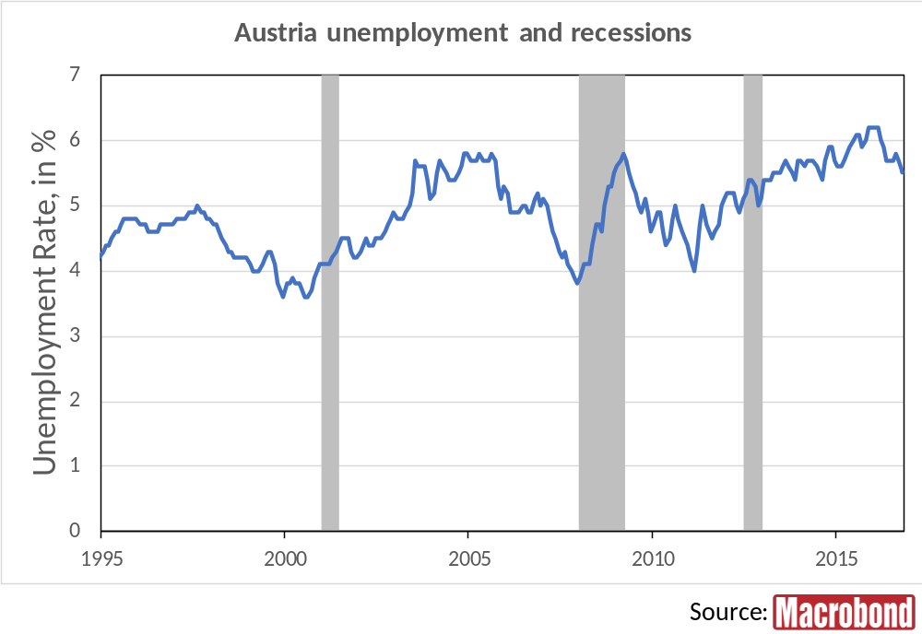
Notes:
Macrobond Series:
Austria, Eurostat, Unemployment, Males & Females, All Ages, Total, Percentage of Active Population, SA
Austria, Macrobond, Business Cycle Reference Dates

Slide 40
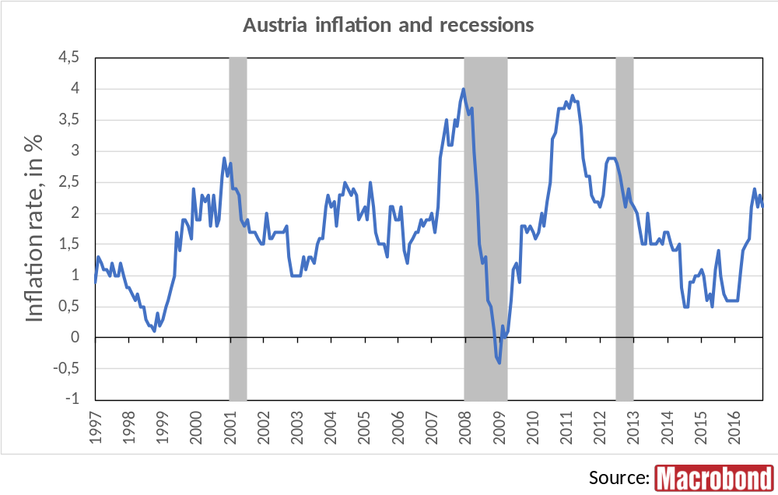
Notes:
Macrobond Series:
Austria, Eurostat, HICP, All-Items HICP, Change Y/Y
Austria, Macrobond, Business Cycle Reference Dates

Slide 41
Denmark

Slide 42
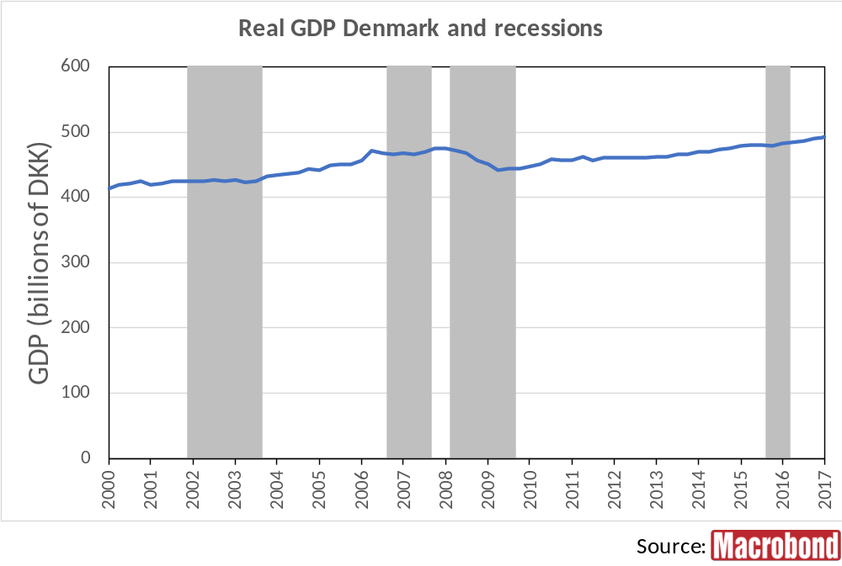
Notes:
Macrobond Series:
Denmark, Gross Domestic Product, Total, Total, Chained, Constant Prices, SA, DKK
Denmark, Macrobond, Business Cycle Reference Dates

Slide 43
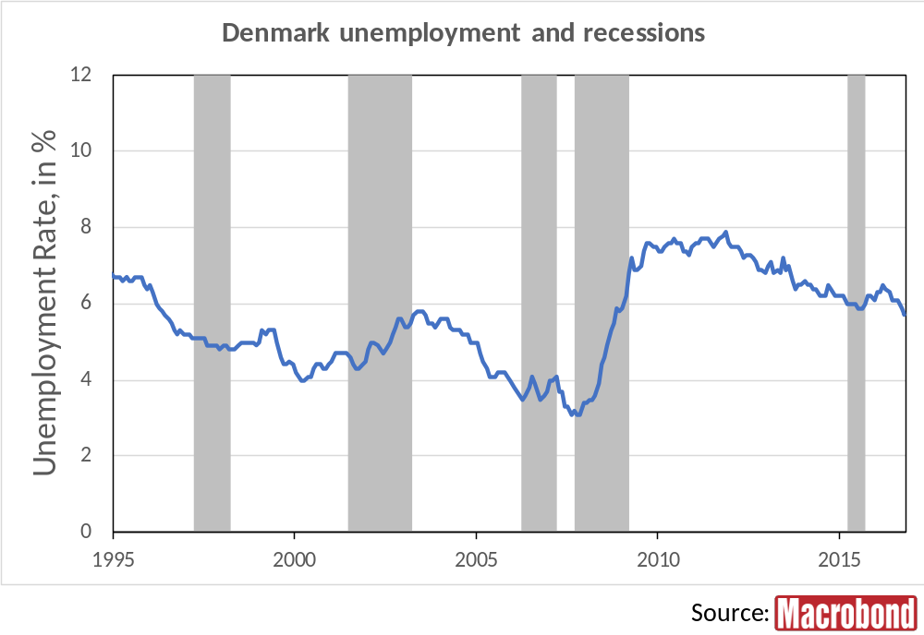
Notes:
Macrobond Series:
Denmark, Eurostat, Unemployment, Males & Females, All Ages, Total, Percentage of Active Population, SA
Denmark, Macrobond, Business Cycle Reference Dates

Slide 44
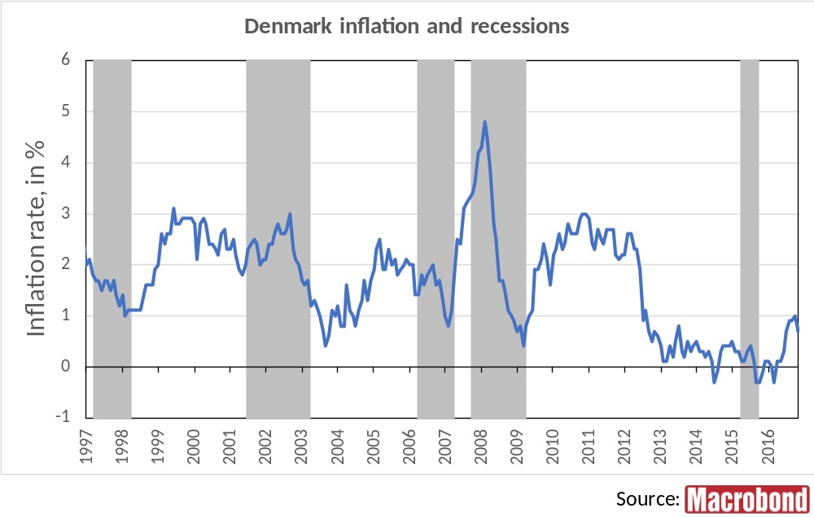
Notes:
Macrobond Series:
Denmark, Eurostat, HICP, All-Items HICP, Change Y/Y
Denmark, Macrobond, Business Cycle Reference Dates

Slide 45
Ireland

Slide 46
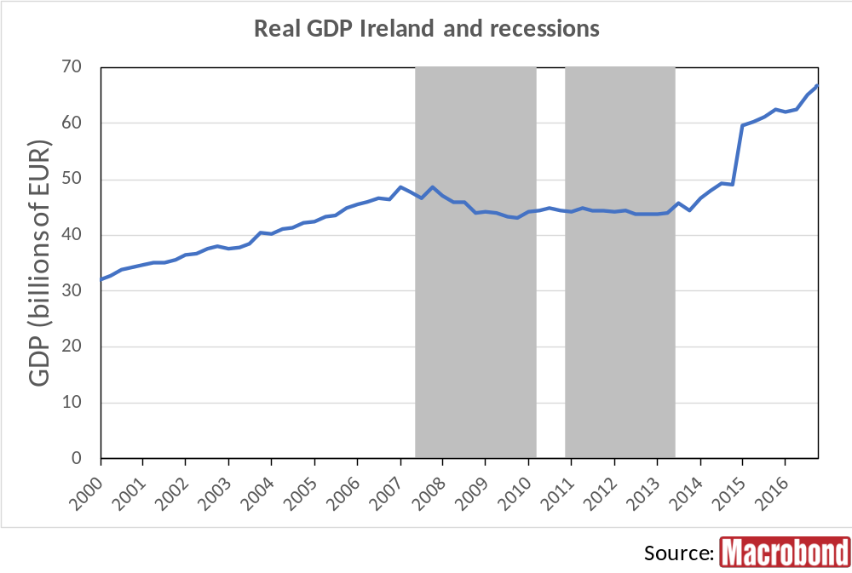
Notes:
Macrobond Series:
Ireland, Gross Domestic Product, Total, Constant Prices, SA, Chained, Market Prices, EUR
Ireland, Macrobond, Business Cycle Reference Dates

Slide 47
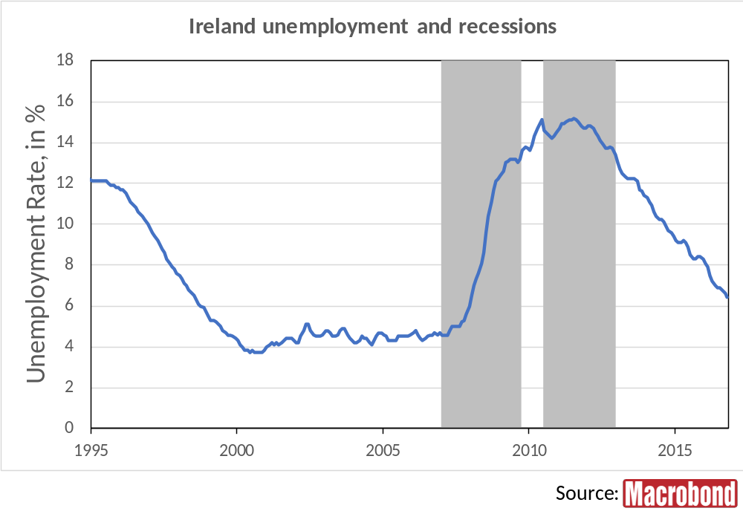
Notes:
Macrobond Series:
Ireland, Eurostat, Unemployment, Males & Females, All Ages, Total, Percentage of Active Population, SA
Ireland, Macrobond, Business Cycle Reference Dates

Slide 48
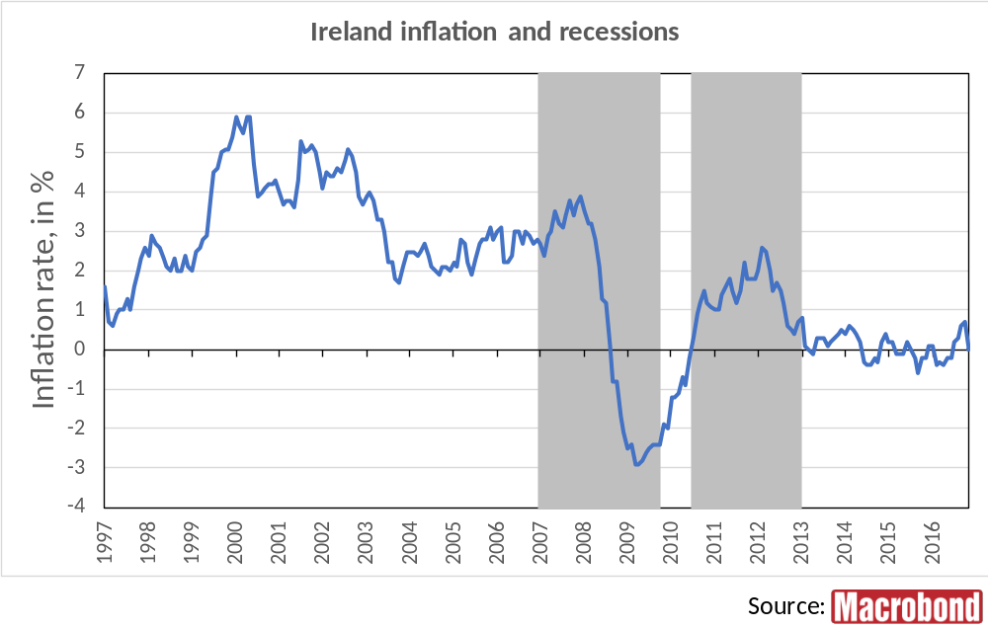
Notes:
Macrobond Series:
Ireland, Eurostat, HICP, All-Items HICP, Change Y/Y
Ireland, Macrobond, Business Cycle Reference Dates

Slide 49
Finland

Slide 50
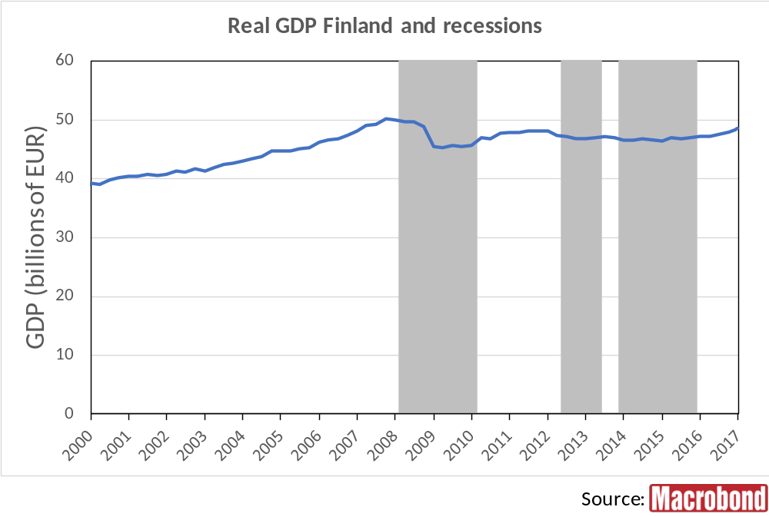
Notes:
Macrobond Series:
Finland, Gross Domestic Product, Total, Calendar Adjusted, Constant Prices, SA, EUR
Finland, Macrobond, Business Cycle Reference Dates

Slide 51
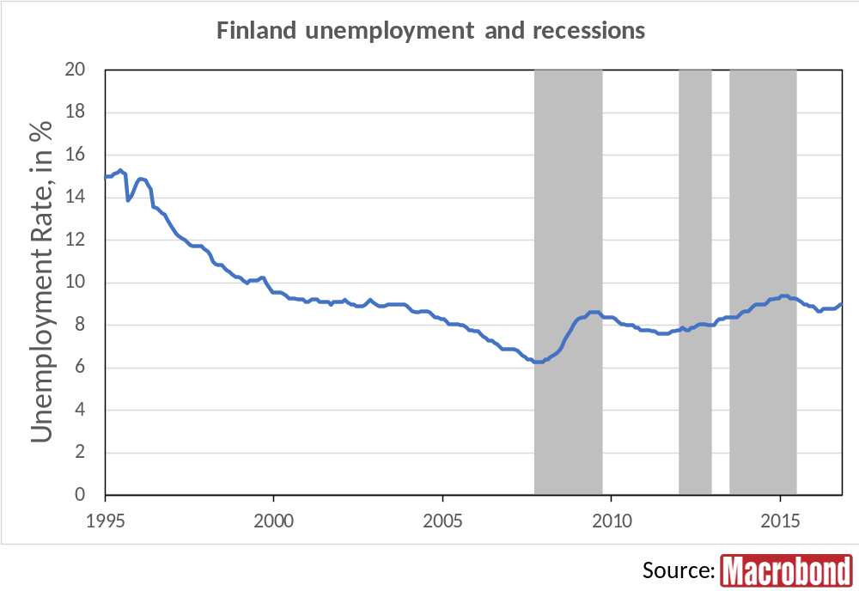
Notes:
Macrobond Series:
Finland, Eurostat, Unemployment, Males & Females, All Ages, Total, Percentage of Active Population, SA
Finland, Macrobond, Business Cycle Reference Dates

Slide 52
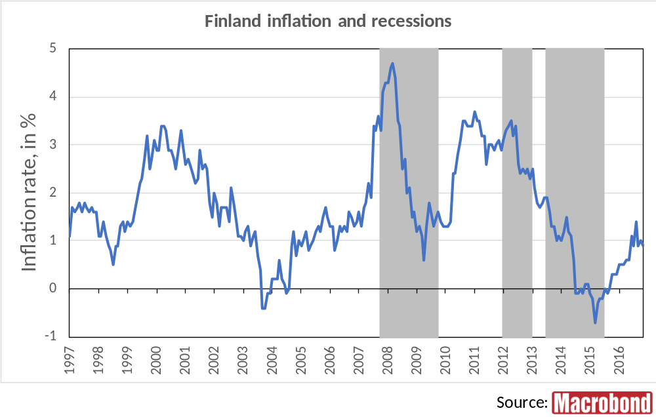
Notes:
Macrobond Series:
Finland, Eurostat, HICP, All-Items HICP, Change Y/Y
Finland, Macrobond, Business Cycle Reference Dates

Slide 53
Portugal

Slide 54
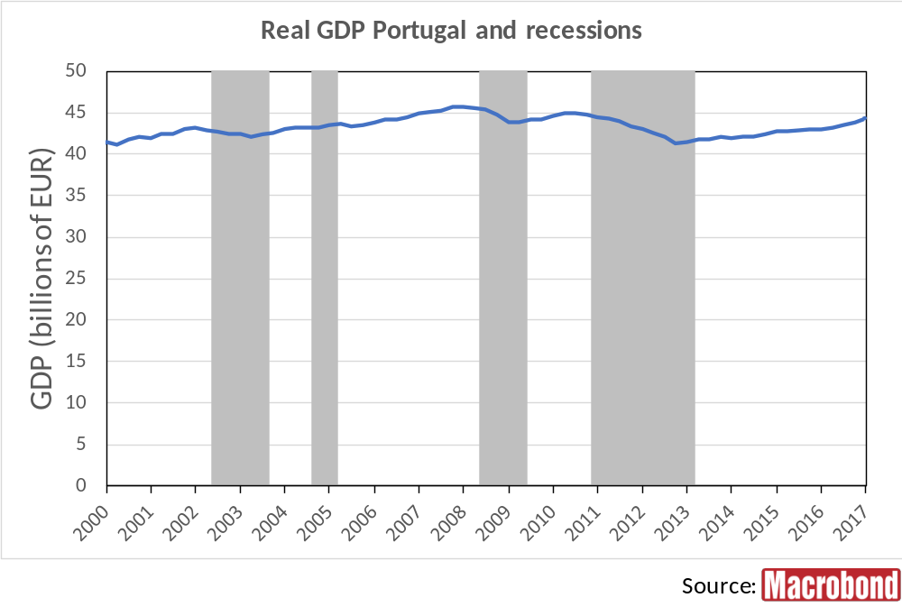
Notes:
Macrobond Series:
Portugal, Gross Domestic Product, Total, Chained, Constant Prices, SA, EUR
Portugal, Macrobond, Business Cycle Reference Dates

Slide 55
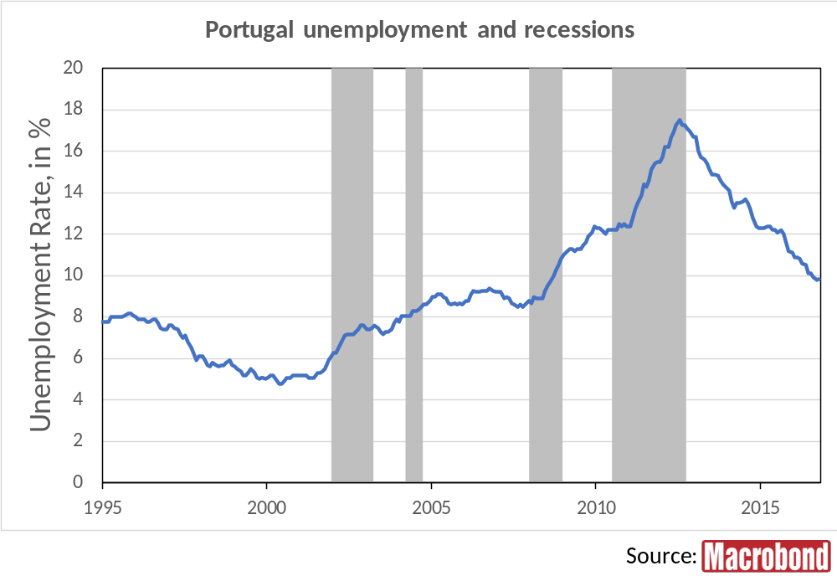
Notes:
Macrobond Series:
Portugal, Eurostat, Unemployment, Males & Females, All Ages, Total, Percentage of Active Population, SA
Portugal, Macrobond, Business Cycle Reference Dates

Slide 56
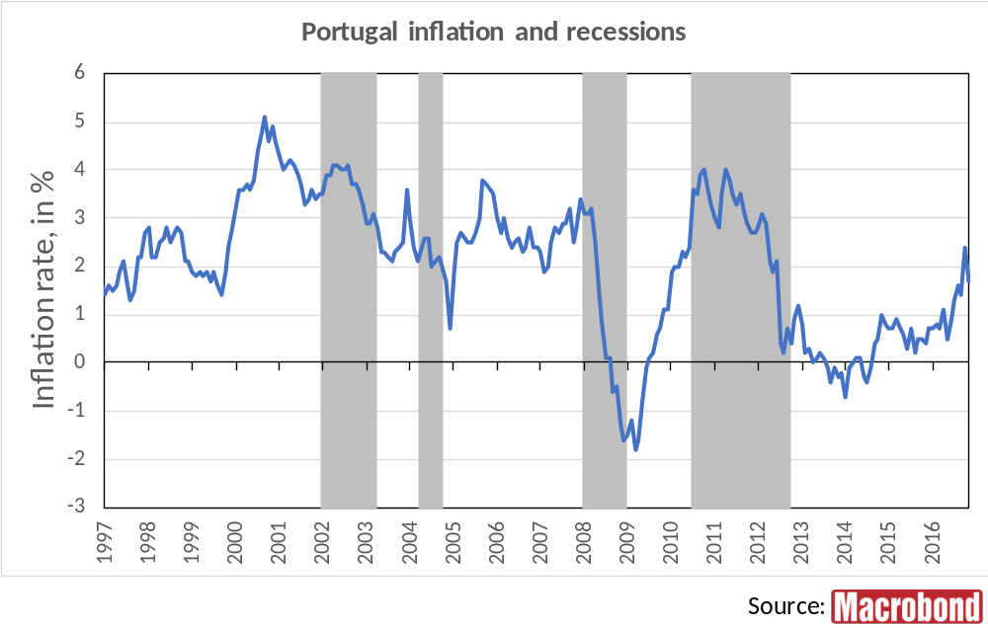
Notes:
Macrobond Series:
Portugal, Eurostat, HICP, All-Items HICP, Change Y/Y
Portugal, Macrobond, Business Cycle Reference Dates

Slide 57
Euro Area

Slide 58
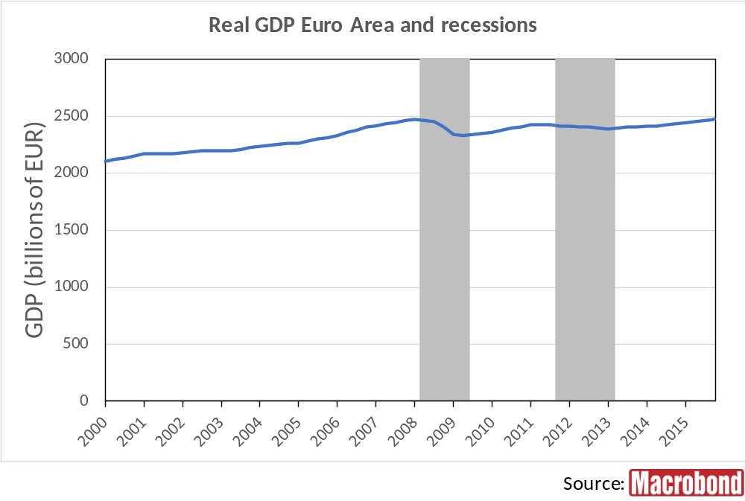
Notes:
Macrobond Series:
Euro Area 19, Eurostat, GDP Main Components (ESA 2010), Volumes, Gross Domestic Product, 2010 Reference Year, Calendar Adjusted, SA, Chained, Market Prices, bln EUR
Euro Area, Macrobond, Business Cycle Reference Dates

Slide 59
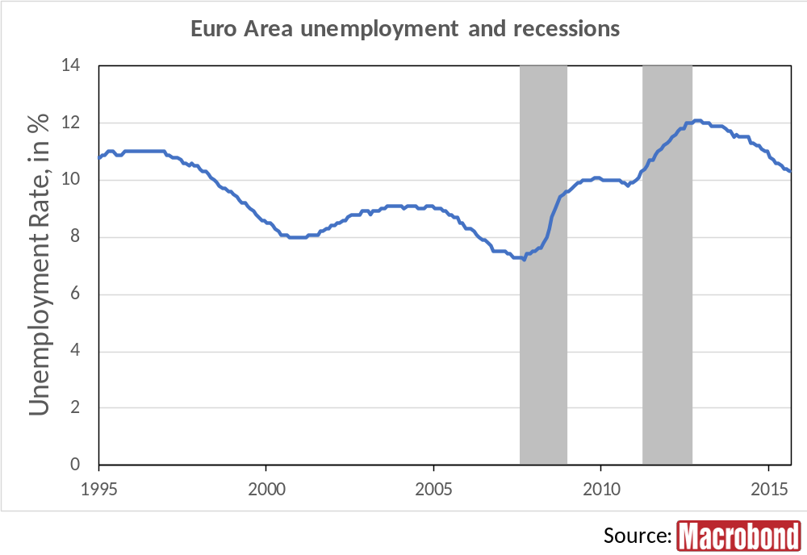
Notes:
Macrobond Series:
Euro Area, Unemployment, Total Population, Rate, SA
Euro Area, Macrobond, Business Cycle Reference Dates

Slide 60
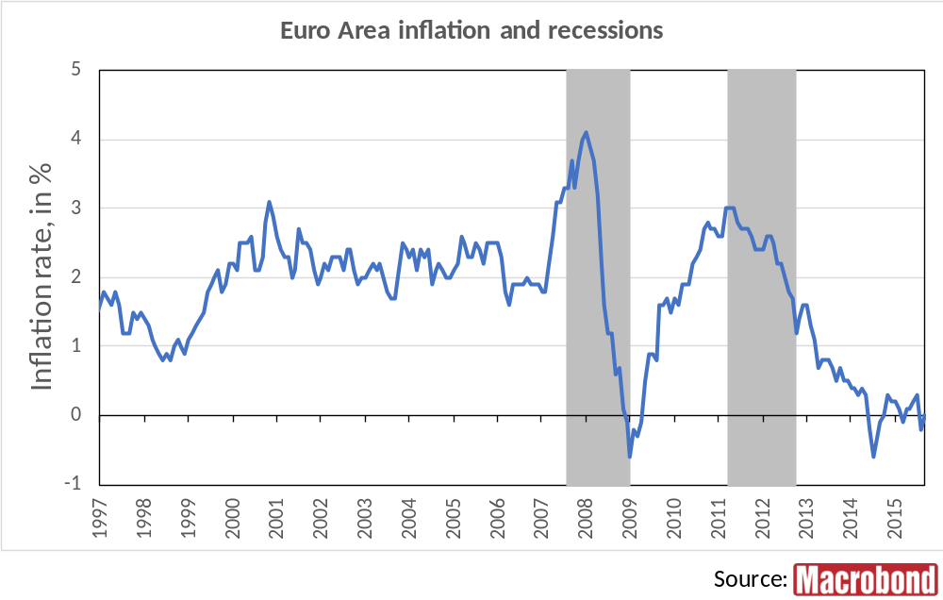
Notes:
Macrobond Series:
Euro Area 19, Eurostat, HICP, All-Items HICP, Change Y/Y
Euro Area, Macrobond, Business Cycle Reference Dates

