Slide 1
GH707 – Field Practicum
Public Health in East Africa
May 18 – June 29, 2016
in Tanzania
Depart (Boston): Monday, May 16
Arrive in Dar-es-Salaam: Tuesday, May 17
Course Start Date: Wednesday, May 18
Depart from Dar-es-Salaam: Wednesday, June 29

Slide 2
Overview
Since 2007, GH707 taught in Kenya, with School for Field Studies
Student-generated evidence shared with and used by MOH & Community stakeholders
2016 is inaugural year in Tanzania with Aga Khan University
6 week field experience in a low-resource, rural setting; Earn 6 credits; Satisfy practicum
Starts in Dar, travel to Iringa, live in Pommern

Slide 3
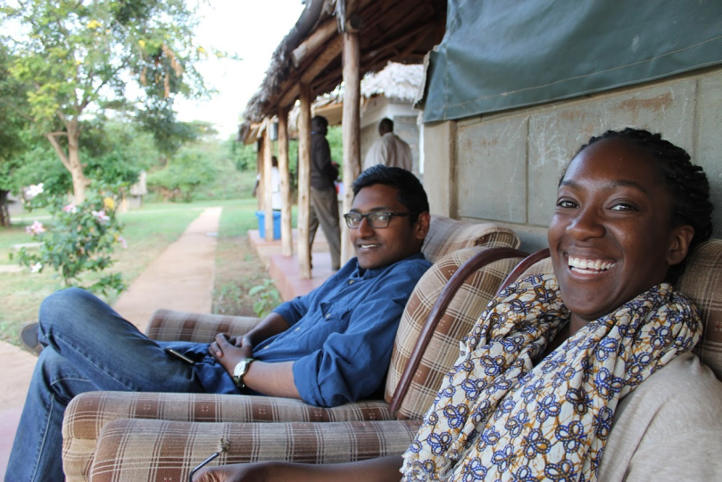
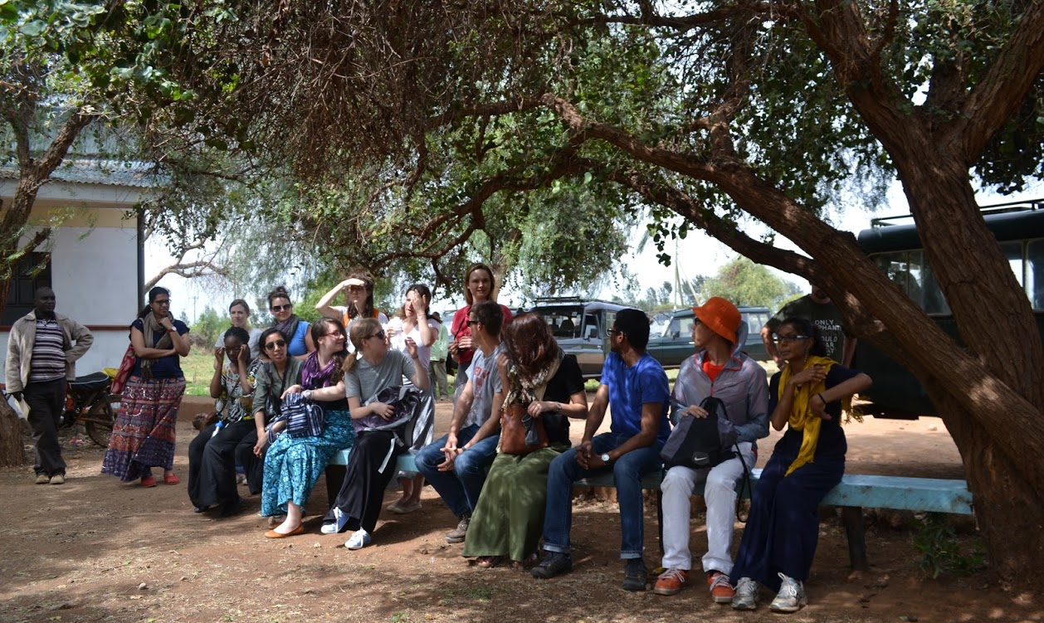
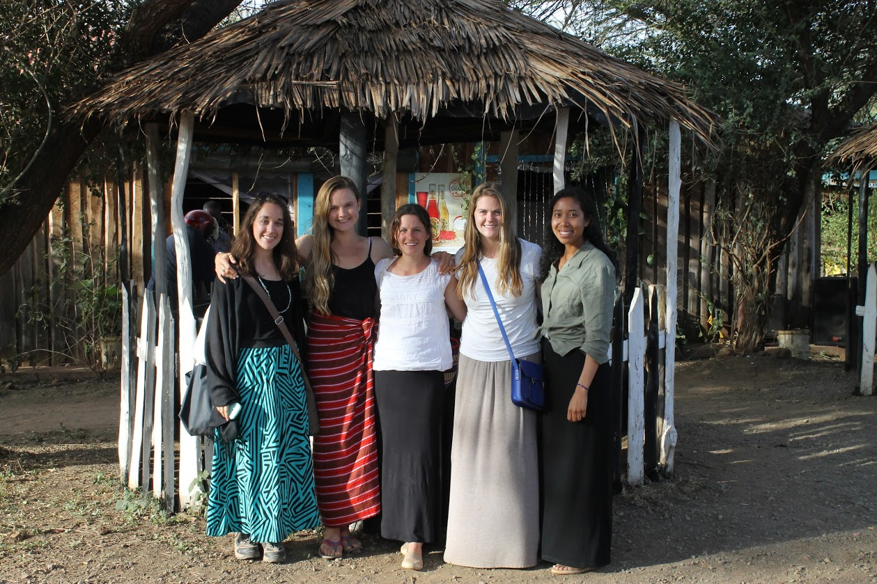
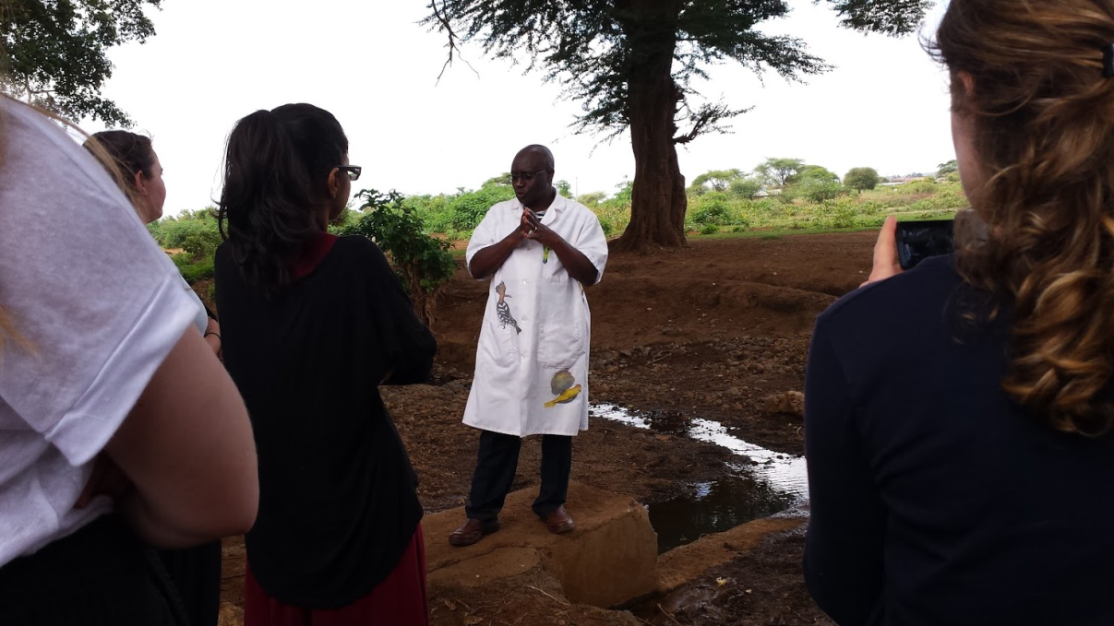
GH707 - 2015

Slide 4
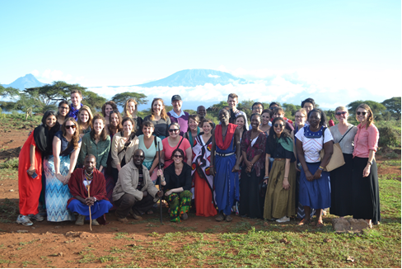

Slide 5
Our Partner: AKU - IED
Aga Khan University Institute for Educational Development East Africa (AKU-IED) runs post-graduate degrees in education for students from across East Africa. AKU has campuses in Dar es Salaam, Arusha, and Nairobi including IED, Aga Khan University Medical College (AKU-MC) and the Aga Khan University School of Nursing and Midwifery (AKU-SONAM).
Director of AKU-IED is Professor Joe Lugalla, a Tanzanian medical sociologist/anthropologist who taught at the University of New Hampshire for 20 years. He is helping the institute to expand its education focus to include health and development.
AKU-IED mission is to improve the quality of education throughout East Africa.

Slide 6
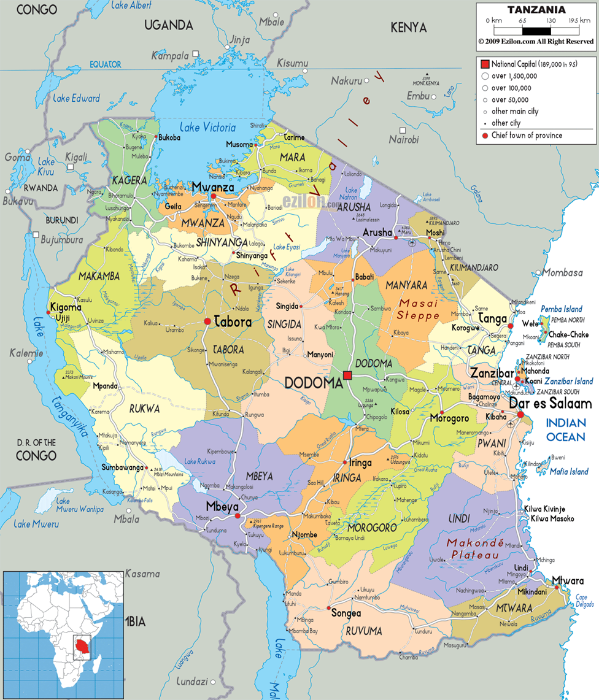
Tanzania = Tanganyika/mainland + Zanzibar
Tanganyika was colonized by the Germans 1880-1919 & British administration territory under UN from 1919-1960
Zanzibar archipelago controlled by Portugese, Sultanate of Oman, then as a British protectorate
Tanganyika (mainland) & Zanzibar became independent in 1964
Tanzania formed in 1967
President Julius Nyerere introduces Ujamaa (family ties) / African Socialism

Slide 7
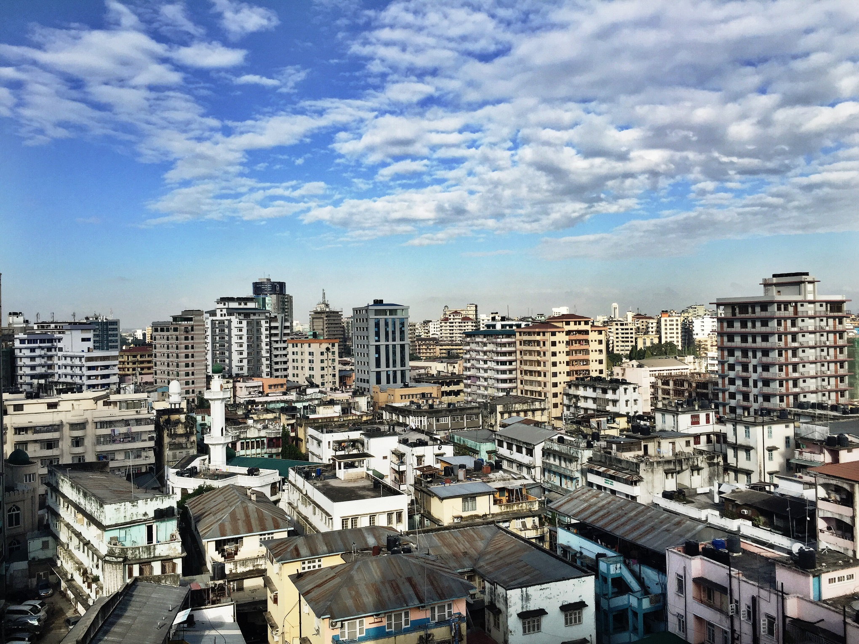
Dar es Salaam

Slide 8
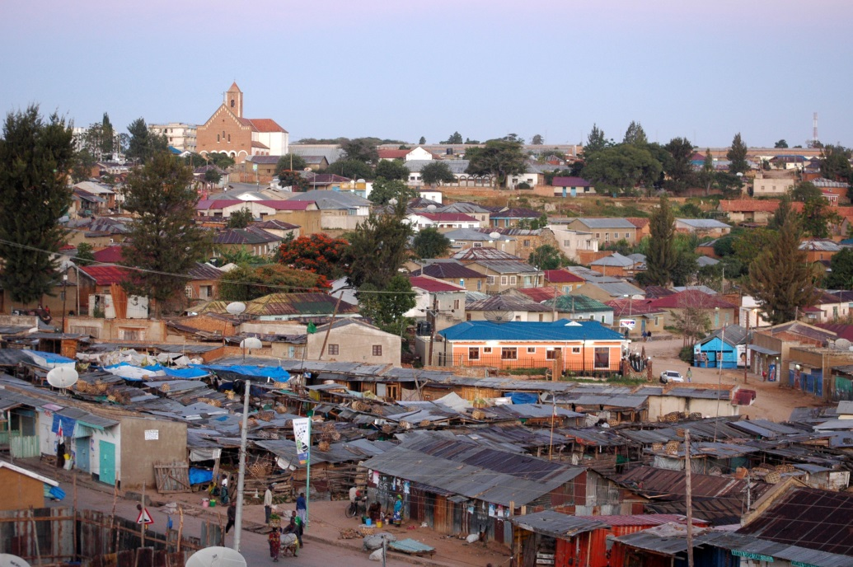
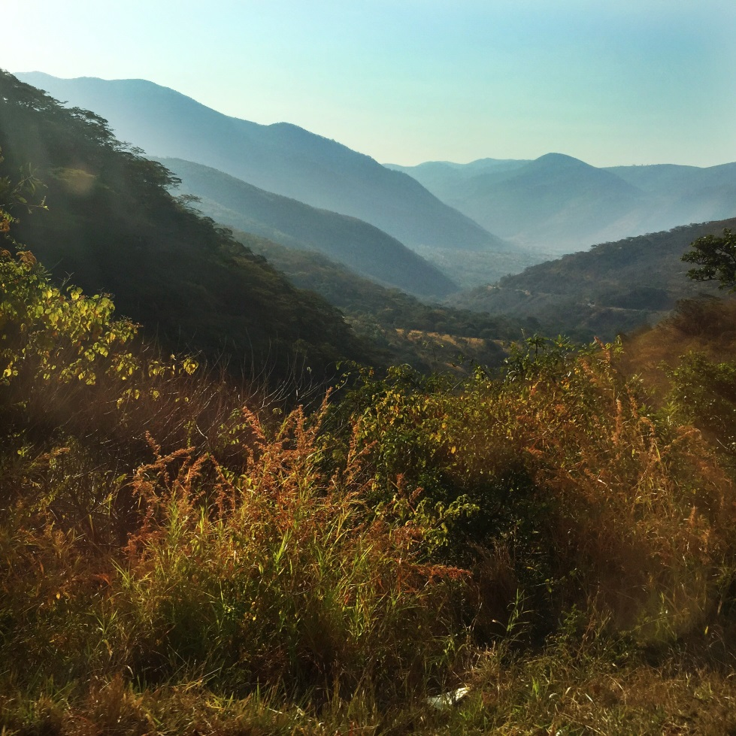
Iringa Region
Iringa Region, a mountainous area in the Southern Highlands of central Tanzania. The capital of the region is Iringa Town located approximately a 10 hour drive from Dar es Salaam. The road is well-paved and well-traveled and crosses …
Iringa
…through Mikumi National Park. Iringa is on the major transport route from the south to Dar es Salaam and an important center of agriculture and agro-business. It is also the gateway to Ruaha National Park, Tanzania’s second largest national park.

Slide 9
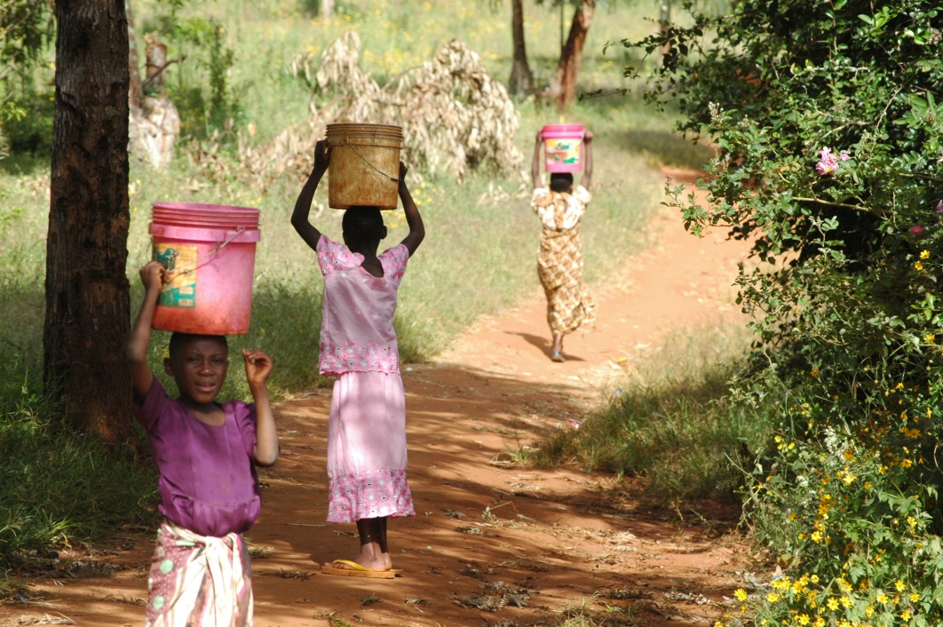
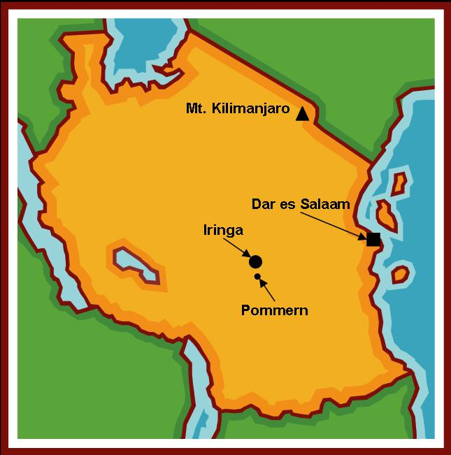
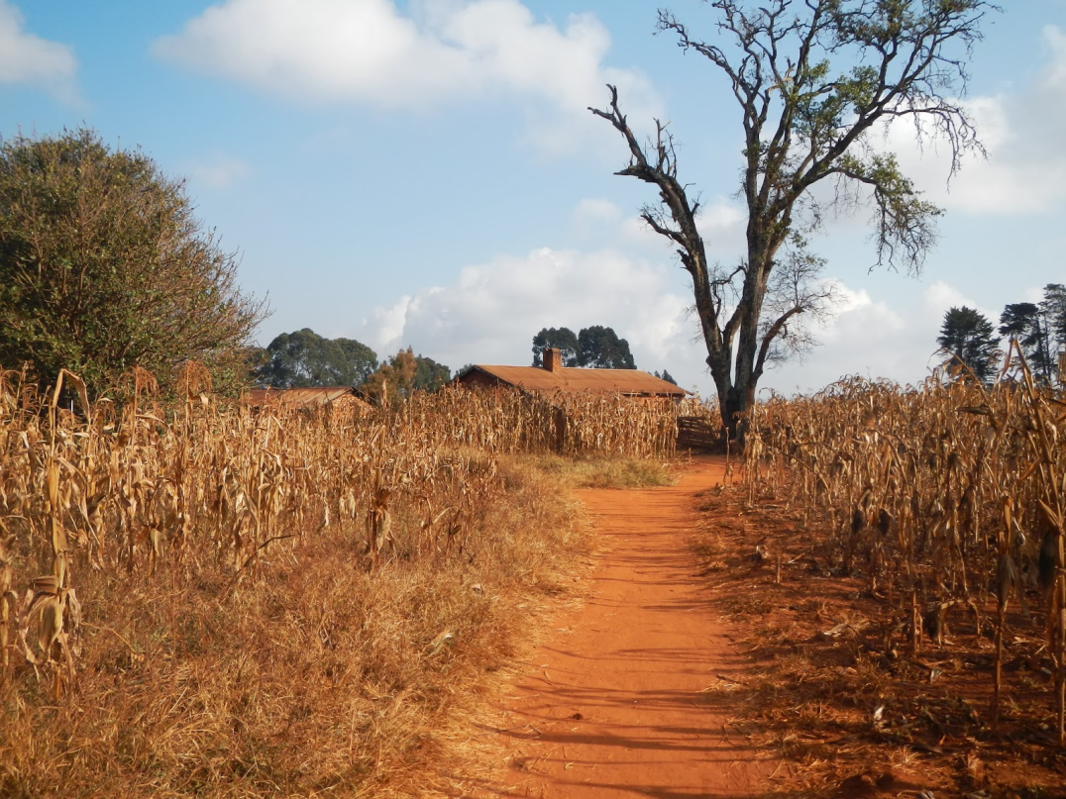
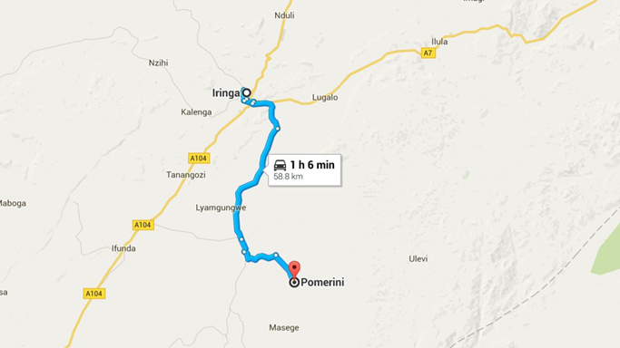
Pommern
Aka: Pommerin; Pommerini

Slide 10
Some Logistics
Arrive in Dar-es-Salaam on May 17 for a day or two of orientation activities
Daytime travel to Iringa (10 hours); spend night in Iringa Town
Travel from Iringa Town to village of Pommern (approximately 1 hour on an unpaved road)
Settle into Mission Guest House in the village center; 5-minute walk to School/classroom.
Small shops (dukas), dispensary, and churches close by

Slide 11
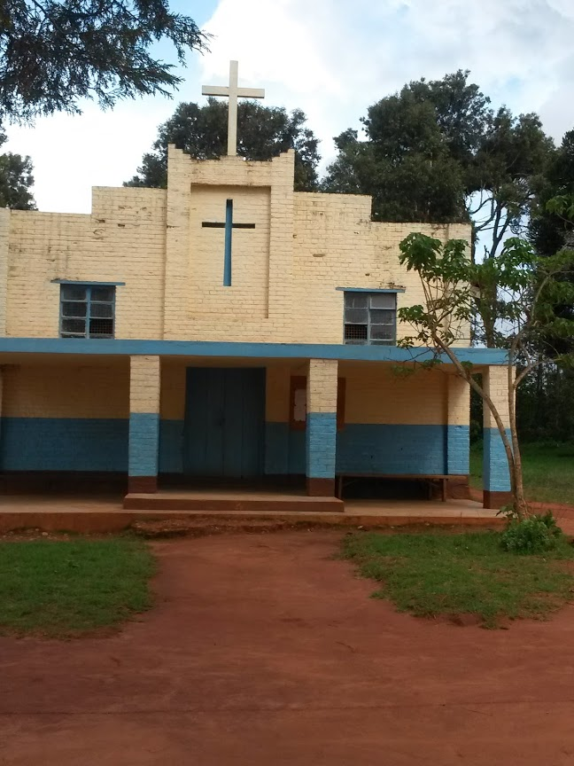
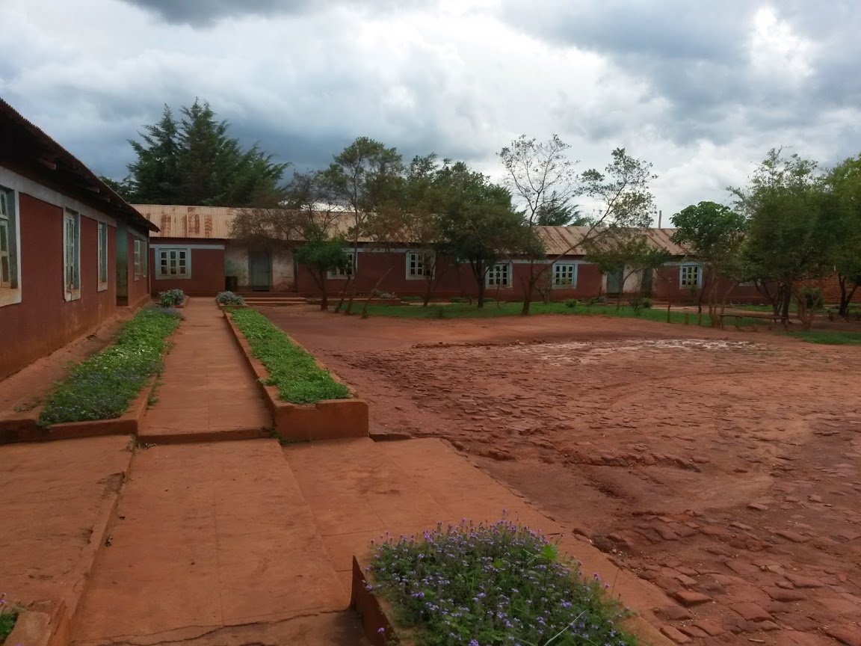
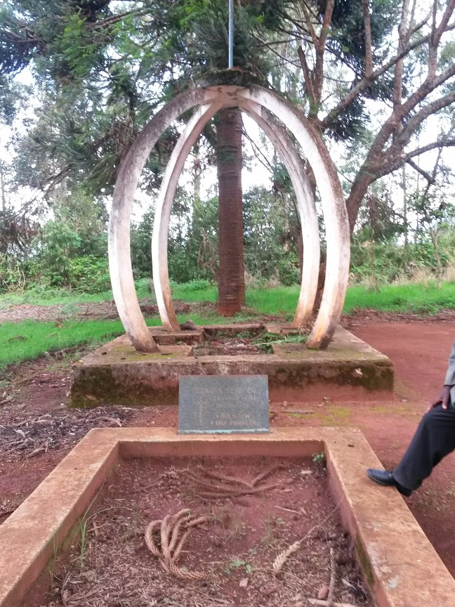
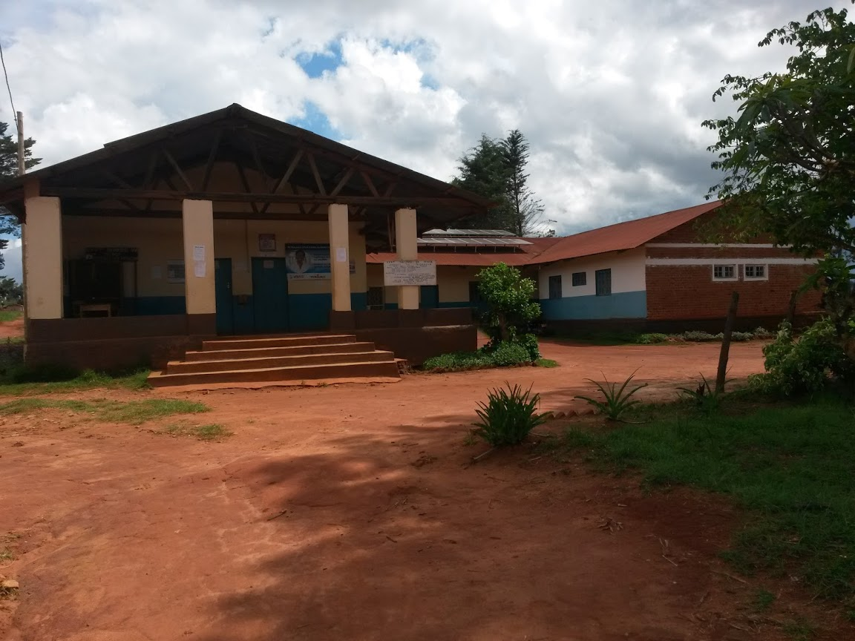
Some Places in Pommern

Slide 12
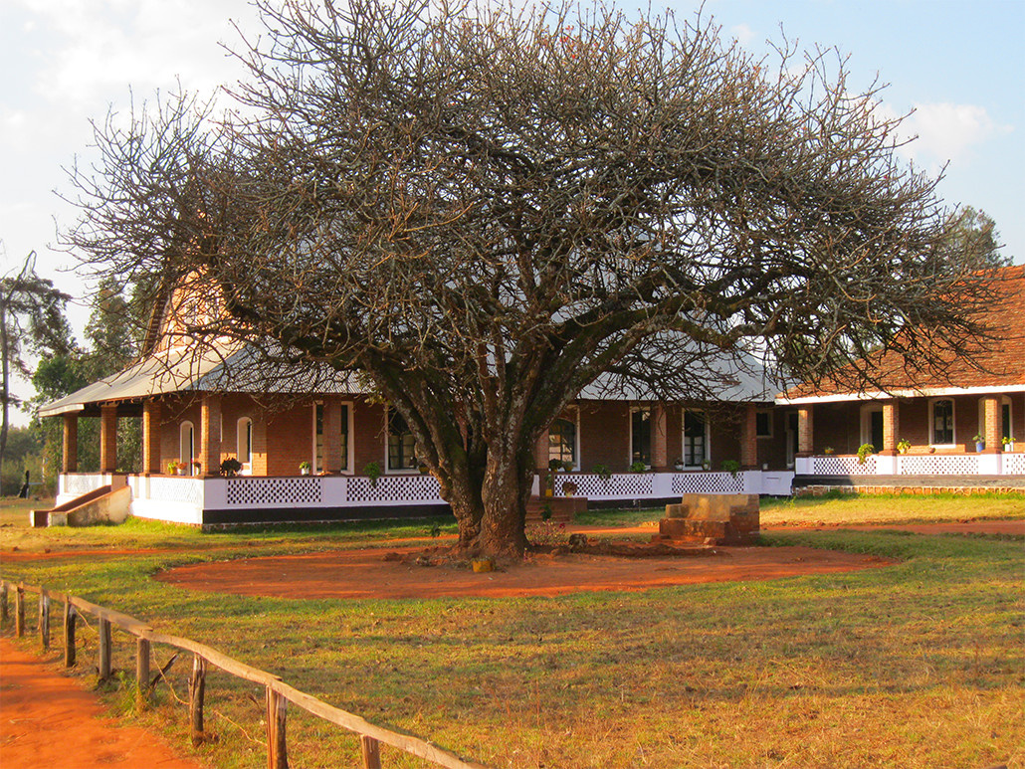
Mission Guest House

Slide 13
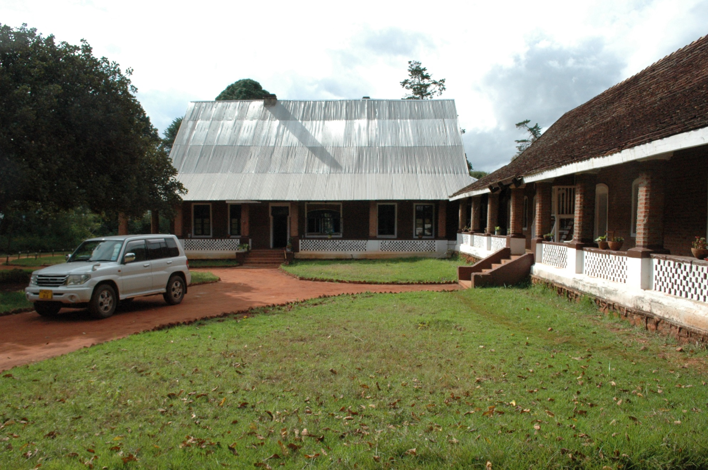
Mission Guest House

Slide 14
Mission Guest House
Dormitory-style (double to quadruple occupancy) lodging on frame and/or bunk beds with mosquito netting, sheets, pillows and blankets.
Three bathrooms with both American and Tanzanian style toilets and tepid-water showers are shared.
Two large common rooms, a wrap-around open-air veranda, and an attached kitchen.

Slide 15
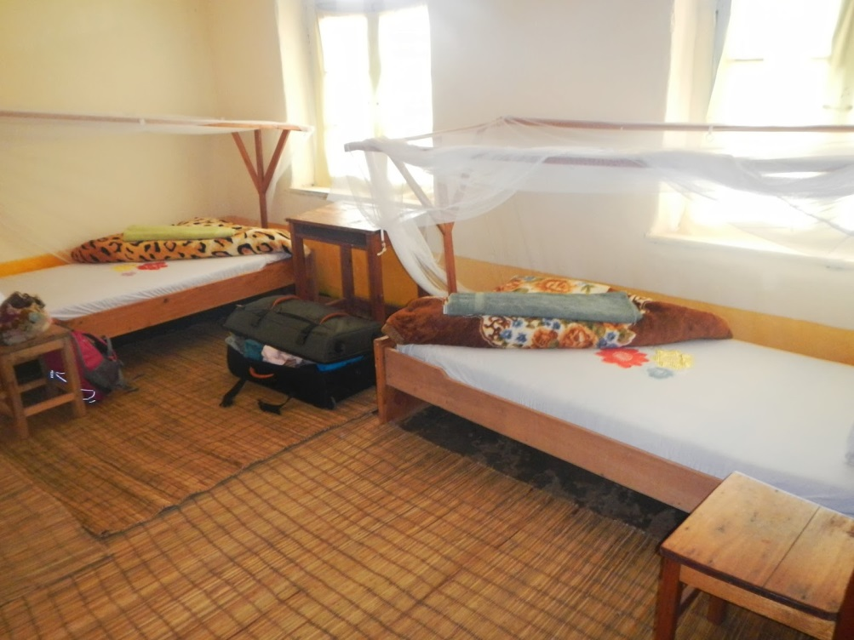
Rustic, Communal Living
  Shared living quarters
  Wash your own dishes
  Cook Crew
  RAP daily meetings (Reflections,
  Announcements, Presentations)
  Limited electricity & internet connectivity
  Limited warm showers
  (solar)
Limited downtime
  Busy and full schedule
Village Life
  Active Communities of Faith (Catholic & Lutheran)

Slide 16
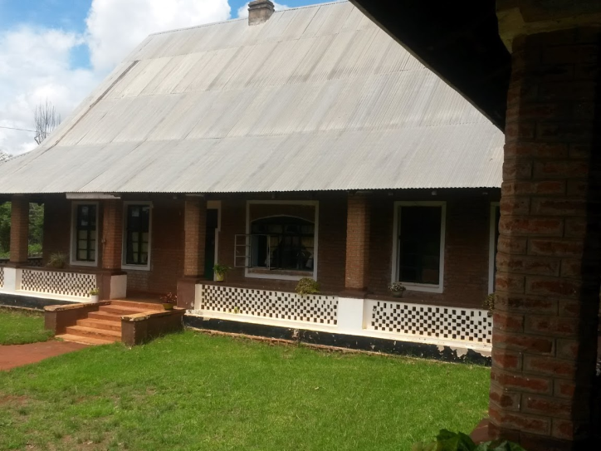
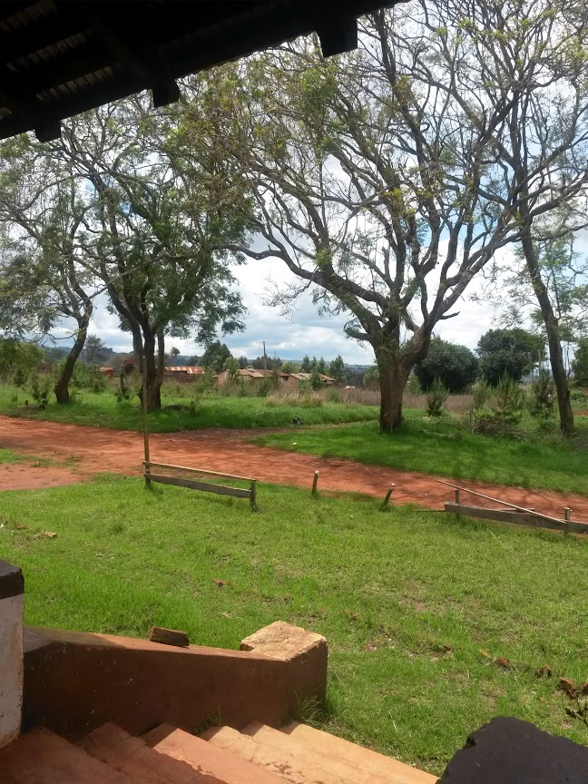
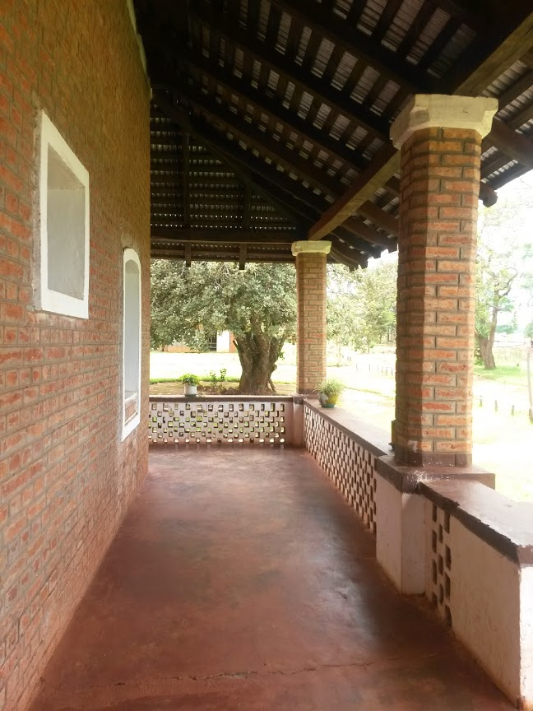
Mission Guest House Views

Slide 17
Living Challenges
Electricity is new to village
Poor internet and irregular cell phone connectivity
May & June will be winter! Frost at night, bring warm clothes and a sleeping bag
Health concerns: malaria, diarrhea, scorpions and spiders.

Slide 18
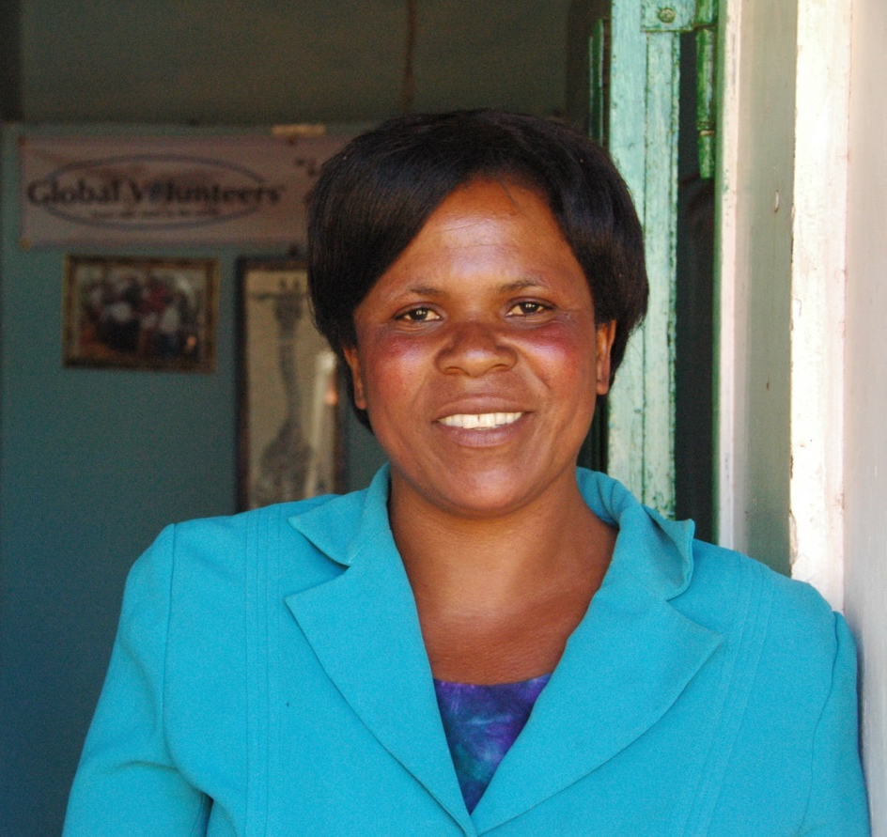
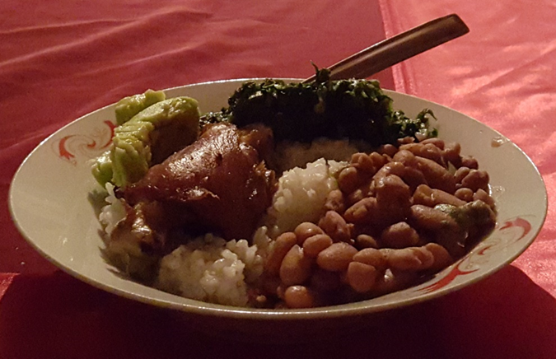
Mama Tony Cooks
Meals are based on rice, pasta, potatoes and beans. Added to that are vegetables, eggs, chicken and savory sauces. Seasonal fruit
Bottled and filtered water is provided. Vegetarian diets can generally be accommodated.

Slide 19
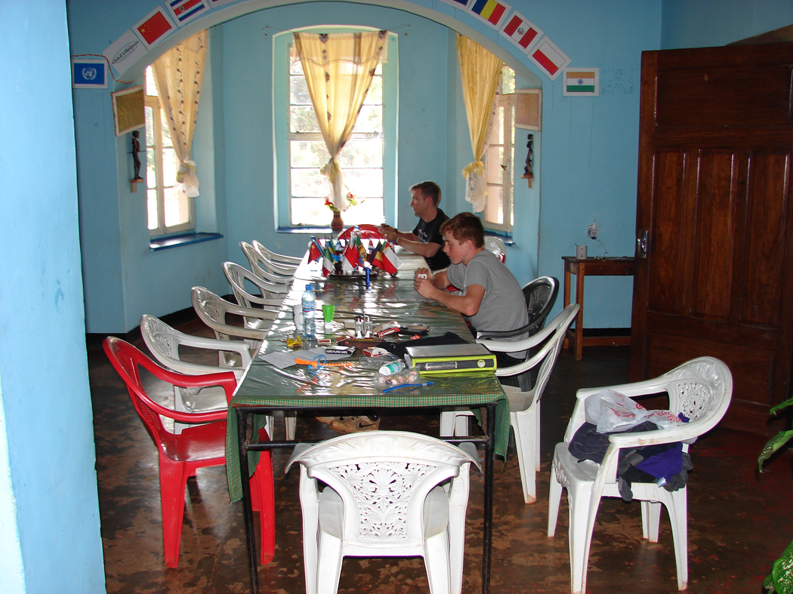

Slide 20
Local Context
Lutheran missionaries based in Pommern since late 19th century
Mission house built around 1900
Hub for Global Volunteers and ongoing faith-based volunteerism and development
Dispensary & HIV clinic
Catholic church and local missionaries also have a strong presence and have contributed to local development
Private secondary school, public primary school, new school for disabled students

Slide 21
Iringa Region & Pommern Village
Primary tribal groups are Hehe and Bene
Hehe Chief Mkwawa led a rebellion against the Germans 1894-98. Died in 1898 and his head was sent to museum in Germany. It is now in a museum in Iringa.
Vestiges of German presence remain, particularly in the strong role of the Lutheran church
Pommern village is named after a region of Germany (Pomerania)
Pommern, TZ is located in Kilolo District

Slide 22
Local Health Challenges
Poverty
HIV Prevalence in Iringa 9.1% and 14.8% Njombe. National prevalence is 5.1%.
Malaria
Diarrheal disease
Road to Iringa is unpaved

Slide 23
GH707 Course - Elements
Learn about people & public health programs
Community service
Design data collection tools & sampling plan
Collect qualitative & quantitative data
Compile and analyze the data
Present results to stakeholders & write report

Slide 24
GH707 Potential Topics
Each year, course selects topics of focus
In 2015, topics included:
  Community Health Workers
  Essential Primary Health Care Services
  Health Care Utilization & Satisfaction
  Community Participation in Primary Health Care
  Health Management Information System

Slide 25
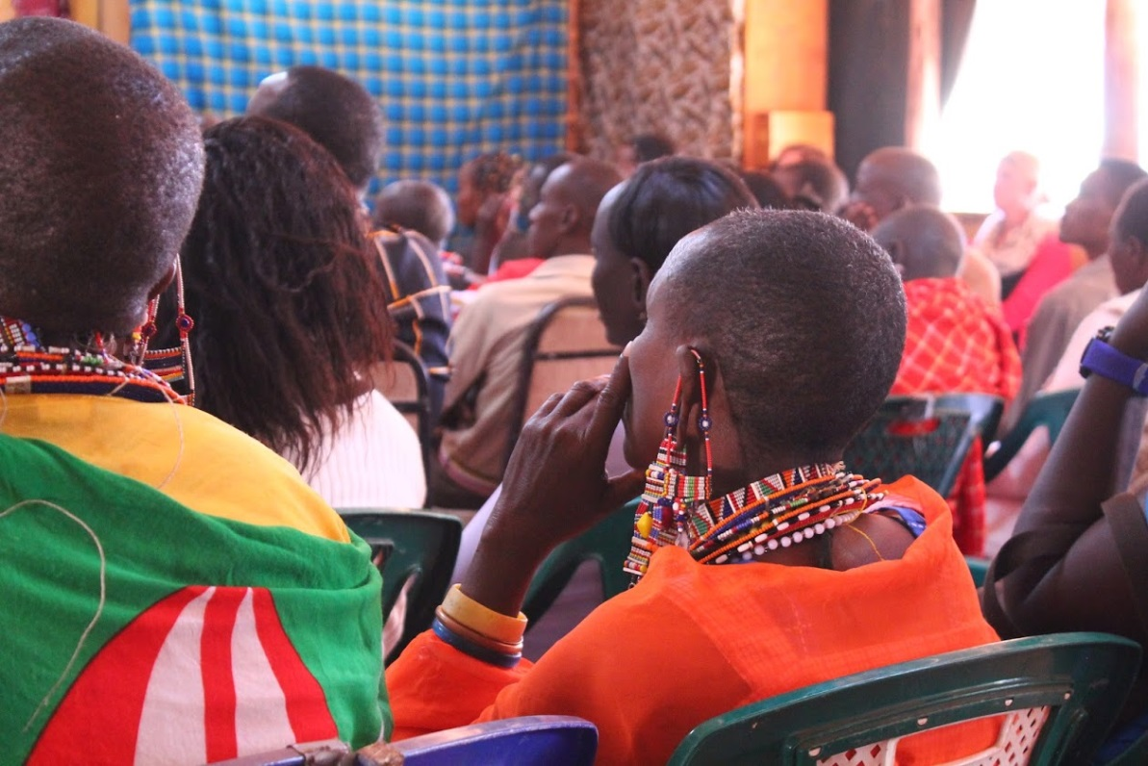
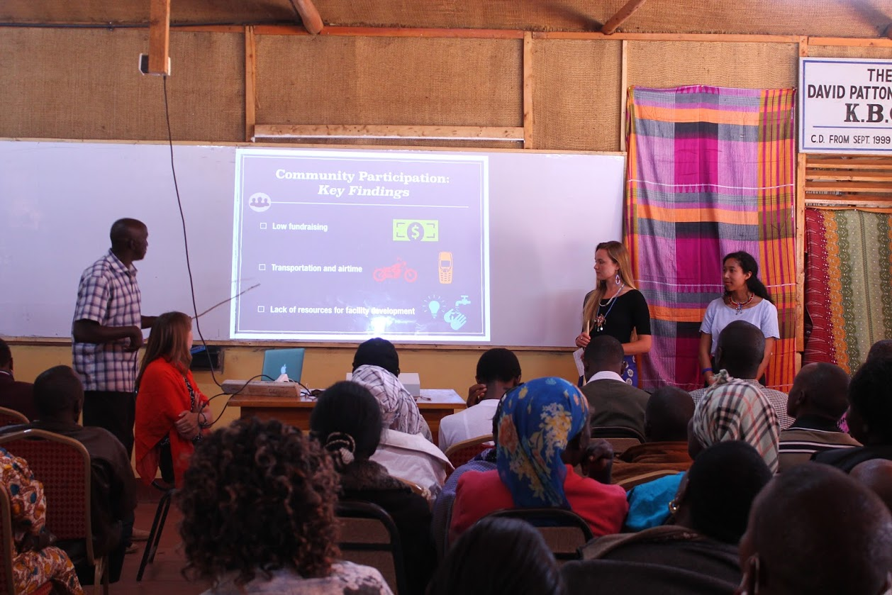
Presenting Back

Slide 26
Pre-Departure Orientations
Dates & Tentative Topics
April 8: Living and Working – What to expect, What to pack, and What to Leave Home
April 15: Karibu Pommerni – Village of Pommern & introduction to Kiswahili
April 22: Field activities the program will be undertaking
April 29: Talk about culture, history of TZ including colonialism and socialism, being a Westerner/American in a rural village, privilege and humility

Slide 27
Tuition & Expenses:
$ 8,892 - tuition for 6 credits; Summer I
$1500 - room & board;
$130 - required travel insurance fee
$100 - visa fee (US Passport)
Variable-travel clinic visit; vaccines/prophylaxis
(antimalarial, Hepatitis A & Typhoid shots, Anti-Diarrheal, Insect repellant)
$1700+/- for Airfare
Miscellaneous
Open to BUSPH MPH students

Slide 28
Applying & Santander Award
Biographical & Essay Questions, plus
  Acknowledgement/Waiver of Risks
  Unofficial transcript
  Scan of your passport
  Submit via online form (accessible via GHBlast)
Applications Rolling –
accepted until Feb 28, 2016
Santander Award - $3,250 for 24 candidates

Slide 29

Questions?

